Slide 1
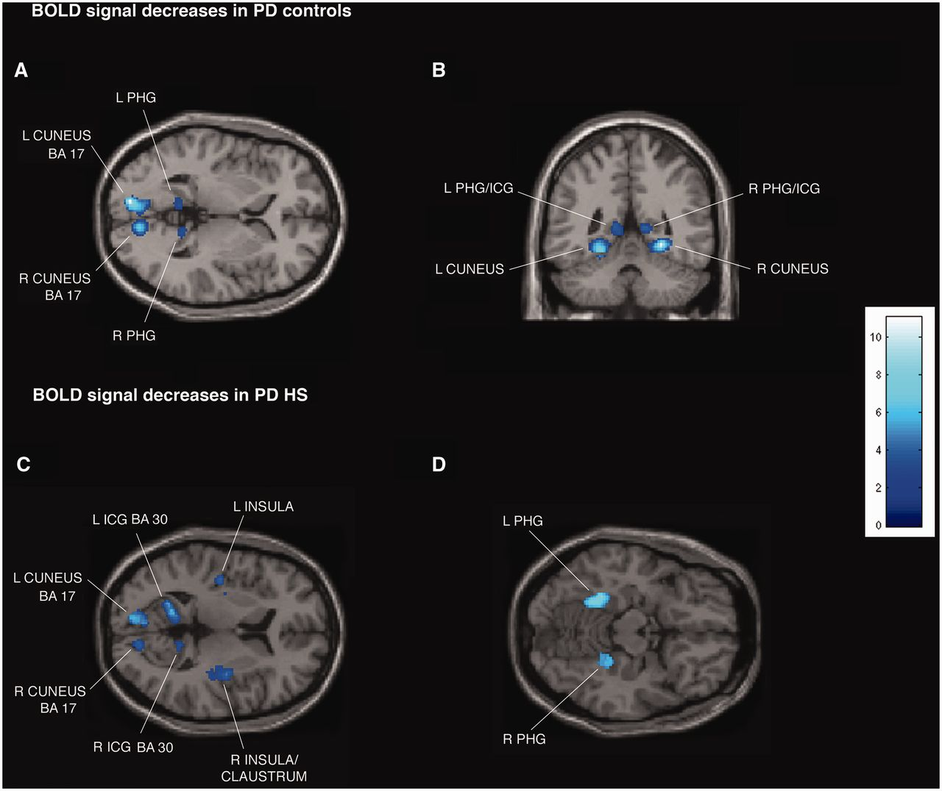
Figure 2 Transverse and coronal sections of statistical parametric maps showing significant BOLD signal decreases ...
Notes:
Figure 2 Transverse and coronal sections of statistical parametric maps showing significant BOLD signal decreases (dark and light blue areas) associated with exposure to common sexual imagery in 12 Parkinson’s disease (PD) control patients (A and B) and in 12 patients with Parkinson’s disease with hypersexuality (HS) (C and D) during the OFF medication state. BOLD signal decreases are illustrated in (A and B) left and right parahippocampal gyrus (PHG), isthmus of cingulate gyrus (ICG) and cuneus (x = −9, y = −47, z = 2), (C) left and right parahippocampal gyrus, cuneus, isthmus of cingulate gyrus, insula and right claustrum (x = −42, y = 14, z = 8), and (D) left and right parahippocampal gyrus (x = 22, y = 38, z = −14). In the ON medication state, in the group of 12 patients with Parkinson’s disease with hypersexuality, no BOLD signal decreases are detected. The colour bar indicates z-values.
Unless provided in the caption above, the following copyright applies to the content of this slide: © The Author (2013). Published by Oxford University Press on behalf of the Guarantors of Brain. All rights reserved. For Permissions, please email: journals.permissions@oup.com

