Slide 1
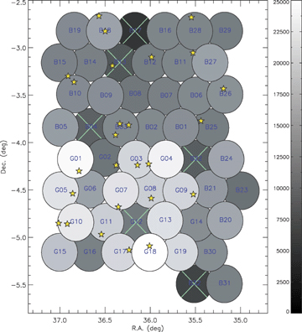
Figure 1 Sky distribution of the C1 clusters. The colour scale indicates the on-axis exposure time of each pointing in ...
Notes:
Figure 1 Sky distribution of the C1 clusters. The colour scale indicates the on-axis exposure time of each pointing in seconds (after particle flare filtering). Pointings marked by a cross are strongly affected by flares and will be re-observed during AO5.
Unless provided in the caption above, the following copyright applies to the content of this slide: © 2007 The Authors. Journal compilation © 2007 RASThis article is published and distributed under the terms of the Oxford University Press, Standard Journals Publication Model (https://academic.oup.com/journals/pages/open_access/funder_policies/chorus/standard_publication_model)

Slide 2
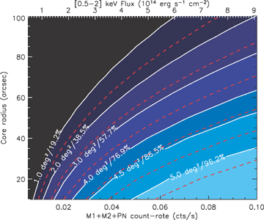
Figure 2 The survey coverage is displayed in a two-dimensional parameter space: the sky coverage is a function of both ...
Notes:
Figure 2 The survey coverage is displayed in a two-dimensional parameter space: the sky coverage is a function of both cluster flux and extent. The dashed lines are the result of extensive 10-ks simulations. The slightly shifted white lines are the analytical corrections accounting for exposure variations across the surveyed area, hence indicating the effective selection function of the current data set. The sample completeness corresponding to each line is indicated in terms of both the sky coverage and the percentage of detected sources. Extent values correspond to the core radius of a β-model with β= 2/3. The count rate to flux conversion assumes a 2-keV spectrum at z= 0.
Unless provided in the caption above, the following copyright applies to the content of this slide: © 2007 The Authors. Journal compilation © 2007 RASThis article is published and distributed under the terms of the Oxford University Press, Standard Journals Publication Model (https://academic.oup.com/journals/pages/open_access/funder_policies/chorus/standard_publication_model)

Slide 3
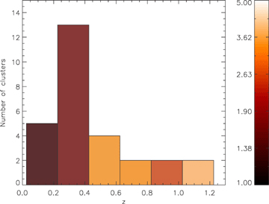
Figure 3 Redshift distribution of the C1 sample. The colour scale indicates the cluster mean temperature for each bin ...
Notes:
Figure 3 Redshift distribution of the C1 sample. The colour scale indicates the cluster mean temperature for each bin (unweighed mean of the individual cluster temperatures in keV) .
Unless provided in the caption above, the following copyright applies to the content of this slide: © 2007 The Authors. Journal compilation © 2007 RASThis article is published and distributed under the terms of the Oxford University Press, Standard Journals Publication Model (https://academic.oup.com/journals/pages/open_access/funder_policies/chorus/standard_publication_model)

Slide 4
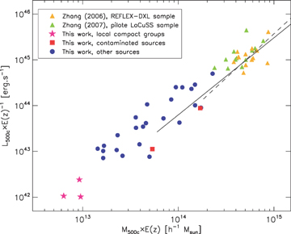
Figure 4 The mass–luminosity relation for the sample clusters. Because of the large redshift range spanned by the ...
Notes:
Figure 4 The mass–luminosity relation for the sample clusters. Because of the large redshift range spanned by the data, the mass and luminosity parameters are scaled assuming self-similar evolution [factor E(z), see Section 4.3]. For comparison, the massive cluster samples from Zhang et al. (2006) and Zhang et al. (2007) are also shown. The dashed and solid lines also show the mean M500–LX relation inferred from the M500–T and LX–T measured in Arnaud et al. (2005) and Arnaud & Evrard (1999), respectively, for T > 3.5 keV and T > 2 keV.
Unless provided in the caption above, the following copyright applies to the content of this slide: © 2007 The Authors. Journal compilation © 2007 RASThis article is published and distributed under the terms of the Oxford University Press, Standard Journals Publication Model (https://academic.oup.com/journals/pages/open_access/funder_policies/chorus/standard_publication_model)

Slide 5
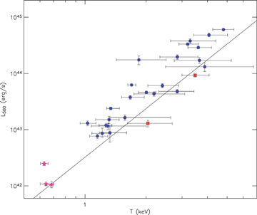
Figure 5 The L₅₀₀–T relation. Same symbols as in Fig. 4. The sources that are used for the analysis of the ...
Notes:
Figure 5 The L500–T relation. Same symbols as in Fig. 4. The sources that are used for the analysis of the LX–T evolution (circles) have redshifts in the range [0.14–1.05] and fall on average above the local LX–T relation of Arnaud & Evrard (1999) (shown by the solid line).
Unless provided in the caption above, the following copyright applies to the content of this slide: © 2007 The Authors. Journal compilation © 2007 RASThis article is published and distributed under the terms of the Oxford University Press, Standard Journals Publication Model (https://academic.oup.com/journals/pages/open_access/funder_policies/chorus/standard_publication_model)

Slide 6
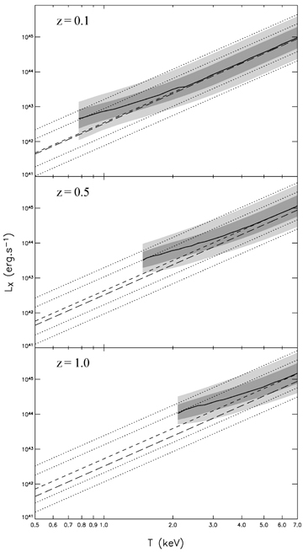
Figure 6 Comparison of the modelled L_{X}–T distribution with and without selection effects for several ...
Notes:
Figure 6 Comparison of the modelled LX–T distribution with and without selection effects for several redshifts, assuming self-similar evolution. The light and dark-shaded regions show, for each temperature, the luminosity interval than contains, respectively, 95.5 and 68.3 per cent of the expected detections. The solid line gives the maximum of the luminosity PDF for each temperature; it is cut at the temperature for which the detection probability (integrated over LX) falls to 5 per cent. For comparison, the local Arnaud & Evrard (1999) relation, evolved according to the self-similar model, is indicated by the short-dashed line, and the 1 and 2σ bounds arising from our scatter model are shown by the dotted lines. The long-dashed line is the local relation.
Unless provided in the caption above, the following copyright applies to the content of this slide: © 2007 The Authors. Journal compilation © 2007 RASThis article is published and distributed under the terms of the Oxford University Press, Standard Journals Publication Model (https://academic.oup.com/journals/pages/open_access/funder_policies/chorus/standard_publication_model)

Slide 7
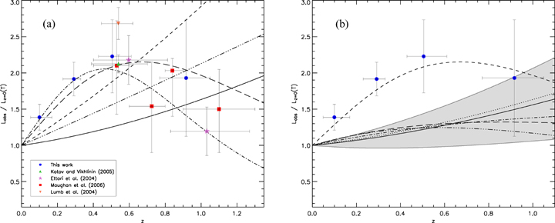
Figure 7 Evolution of the L_{X}–T relation. (a): Raw analysis. The data points from several studies are ...
Notes:
Figure 7 Evolution of the LX–T relation. (a): Raw analysis. The data points from several studies are plotted (stacked into redshift bins for clarity). Whenever possible, we converted luminosity estimates from the other samples to L500 using the information provided by the authors. The following differences remain: the luminosities of the Lumb et al. (2004) clusters are estimated within the virial radius; the data points of Maughan et al. (2006) also include the clusters from Vikhlinin et al. (2002) and have luminosities estimated within R200. Overlaid are several enhancement factor fits from our baseline analysis: the (1 +z) power law and ad hoc two-parameter fits to our data alone (respectively short- and long-dashed lines), and the (1 +z) power law and ad hoc two-parameter fits (respectively, dot–dashed and three-dot–dashed lines) fitted to the C1 clusters combined with the samples of Kotov & Vikhlinin (2005) and Ettori et al. (2004). For comparison, the self-similar prediction is indicated by the solid line. (b): Taking into account selection effects. The filled circles and short-dashed line recall the location of our raw data points and best-fitting model from the preliminary analysis. The corrected enhancement factor fit for the two-parameter model is shown as the long-dashed line. The final one-parameter fit and its 1σ confidence interval are displayed by the solid line and the shaded region. Expectations from several intracluster gas models are plotted for comparison: the self-similar predictions (dotted line) and two models by Voit (2005) including non-gravitational physics (dot–dashed and three-dot–dashed lines).
Unless provided in the caption above, the following copyright applies to the content of this slide: © 2007 The Authors. Journal compilation © 2007 RASThis article is published and distributed under the terms of the Oxford University Press, Standard Journals Publication Model (https://academic.oup.com/journals/pages/open_access/funder_policies/chorus/standard_publication_model)

Slide 8
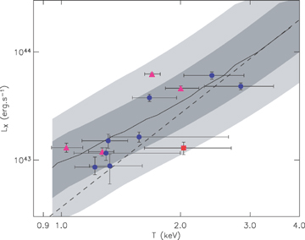
Figure 8 Similar to figure 6 for z= 0.3, with the 0.2 < z < 0.4, C1 clusters overlaid. Again, the dashed line is the ...
Notes:
Figure 8 Similar to figure 6 for z= 0.3, with the 0.2 < z < 0.4, C1 clusters overlaid. Again, the dashed line is the evolved model of Arnaud & Evrard (1999). The triangles indicate the D1 clusters presented by Pierre et al. (2006). The only cluster (XLSSC-018, square) that falls well below the Arnaud & Evrard (1999)LX–T relation, and at the limit of our 2σ contour, is likely to be contaminated by an AGN (see Appendix B).
Unless provided in the caption above, the following copyright applies to the content of this slide: © 2007 The Authors. Journal compilation © 2007 RASThis article is published and distributed under the terms of the Oxford University Press, Standard Journals Publication Model (https://academic.oup.com/journals/pages/open_access/funder_policies/chorus/standard_publication_model)

Slide 9
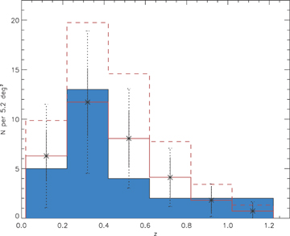
Figure 9 Redshift distribution of the C1 sample. The filled histogram shows the redshift distribution of our sample, ...
Notes:
Figure 9 Redshift distribution of the C1 sample. The filled histogram shows the redshift distribution of our sample, while the solid line shows the expectations of our cosmological model (WMAP3: σ8= 0.74 and self-similar evolution for the LX–T relation). Expected fluctuations around the mean model density due to shot noise and (shot noise + cosmic variance) are, respectively, displayed with the solid and dotted error bars. The dashed line shows the expectations for a model with WMAP first-year cosmological parameters (σ8= 0.85) and a non-evolving LX–T relation; combining the latter σ8 value with self-similar evolution would produce a normalization even higher, by about 35 per cent.
Unless provided in the caption above, the following copyright applies to the content of this slide: © 2007 The Authors. Journal compilation © 2007 RASThis article is published and distributed under the terms of the Oxford University Press, Standard Journals Publication Model (https://academic.oup.com/journals/pages/open_access/funder_policies/chorus/standard_publication_model)

Slide 10
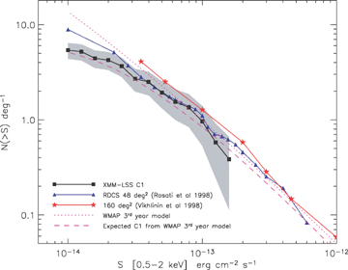
Figure 10 The C1 log(N)–log(S). The squares show the observed C1 number counts and the shaded region indicates the 1σ ...
Notes:
Figure 10 The C1 log(N)–log(S). The squares show the observed C1 number counts and the shaded region indicates the 1σ error region. Overlaid are the predictions from our model: the dashed line for C1 clusters, and the dotted line for the whole cluster population (i.e. all clusters above a given flux). Since only a fraction of cluster fluxes are detected in any survey, there is an important caveat in this comparison: our model delivers total cluster fluxes (i.e integrated to infinity) while our measurements are performed within 0.5 Mpc (which includes approximately two-third of the total flux for a cluster with Rc= 180 kpc and β= 2/3). Previously, Vikhlinin et al. (1998) claimed to measure total fluxes in an unbiased manner, while Rosati et al. (1998) estimated that they had recovered at least 80–90 per cent of the total flux.
Unless provided in the caption above, the following copyright applies to the content of this slide: © 2007 The Authors. Journal compilation © 2007 RASThis article is published and distributed under the terms of the Oxford University Press, Standard Journals Publication Model (https://academic.oup.com/journals/pages/open_access/funder_policies/chorus/standard_publication_model)

Slide 11
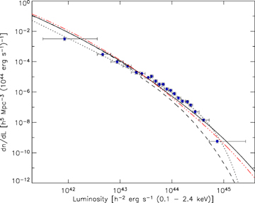
Figure 11 The local luminosity function predicted by our model, compared with the REFLEX data points (Böhringer et al. ...
Notes:
Figure 11 The local luminosity function predicted by our model, compared with the REFLEX data points (Böhringer et al. 2002). The dotted line is the best fit to the REFLEX data from the original paper. The dashed line is the expectation from our model assuming no scatter in the M–LX relation. The solid line shows our model (including scatter) yielding a much better agreement. The three-dot–dashed line is the prediction of our model for a redshift of 0.8.
Unless provided in the caption above, the following copyright applies to the content of this slide: © 2007 The Authors. Journal compilation © 2007 RASThis article is published and distributed under the terms of the Oxford University Press, Standard Journals Publication Model (https://academic.oup.com/journals/pages/open_access/funder_policies/chorus/standard_publication_model)

Slide 12
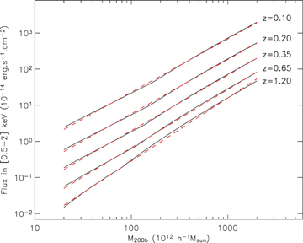
Figure 12 Calibration of the [0.5–2] keV band total flux versus M_{200b} relation. The exact correlations ...
Notes:
Figure 12 Calibration of the [0.5–2] keV band total flux versus M200b relation. The exact correlations derived from our model are shown for several redshifts with plain lines. The overplotted dashed lines show the recovered values using the fit presented in Table 4.
Unless provided in the caption above, the following copyright applies to the content of this slide: © 2007 The Authors. Journal compilation © 2007 RASThis article is published and distributed under the terms of the Oxford University Press, Standard Journals Publication Model (https://academic.oup.com/journals/pages/open_access/funder_policies/chorus/standard_publication_model)

Slide 13
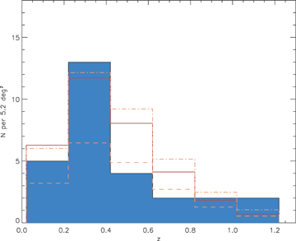
Figure 13 Impact of the steepening of the M–T relation in the group regime on the modelling of the cluster number ...
Notes:
Figure 13 Impact of the steepening of the M–T relation in the group regime on the modelling of the cluster number density. The full line corresponds to our fiducial model (broken power law, Section 5.1), giving 6.2 clusters per square degree. If we assume the Vikhlinin et al (2006) result (single slope of 1.5, dashed line), the cluster density drops to 3.6 deg−2. The relation of Arnaud et al. (2005), motivated by a possible steepening of the mass function below 3.5 keV (single slope of 1.7, dash–dotted line), seems to be closer to our observations and yields a cluster density of 6.9 deg−2.
Unless provided in the caption above, the following copyright applies to the content of this slide: © 2007 The Authors. Journal compilation © 2007 RASThis article is published and distributed under the terms of the Oxford University Press, Standard Journals Publication Model (https://academic.oup.com/journals/pages/open_access/funder_policies/chorus/standard_publication_model)

Slide 14
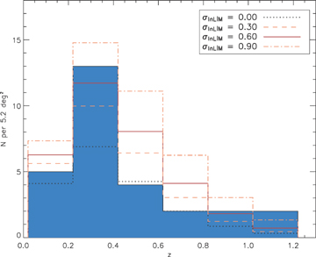
Figure 14 Impact of scatter in the M–L_{X} relation on the predicted C1 redshift distribution. For given ...
Notes:
Figure 14 Impact of scatter in the M–LX relation on the predicted C1 redshift distribution. For given scatter values, the predicted total number of clusters per square degree are: 3.6 (no scatter), 5.1 (0.3) and 8.4 (0.9); our model gives 6.2 (0.6).
Unless provided in the caption above, the following copyright applies to the content of this slide: © 2007 The Authors. Journal compilation © 2007 RASThis article is published and distributed under the terms of the Oxford University Press, Standard Journals Publication Model (https://academic.oup.com/journals/pages/open_access/funder_policies/chorus/standard_publication_model)

Slide 15
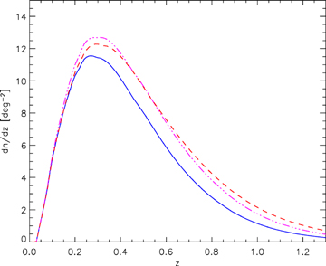
Figure 15 Dark energy versus scaling laws for our modelled cluster reshift distribution. The solid line shows the ...
Notes:
Figure 15 Dark energy versus scaling laws for our modelled cluster reshift distribution. The solid line shows the prediction for the Spergel et al. (2006) cosmology and self-similar evolution of the scaling laws. Assuming instead F(z) =E(z) × (1 +z)0.34 for the LX–T evolution, which is our 1σ higher bound from Section 4.3, yields the dot–dashed line. As a comparison, the dashed line shows the distribution obtained by keeping self-similar evolution but changing the dark energy equation of state from −1 to −0.6.
Unless provided in the caption above, the following copyright applies to the content of this slide: © 2007 The Authors. Journal compilation © 2007 RASThis article is published and distributed under the terms of the Oxford University Press, Standard Journals Publication Model (https://academic.oup.com/journals/pages/open_access/funder_policies/chorus/standard_publication_model)

Slide 16
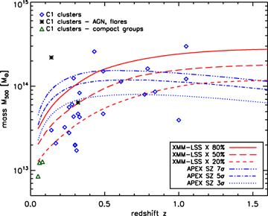
Figure 16 Comparison of the XMM-LSS and APEX–SZ sensitivity in terms of limiting mass. The red lines show various ...
Notes:
Figure 16 Comparison of the XMM-LSS and APEX–SZ sensitivity in terms of limiting mass. The red lines show various probability detection thresholds for the C1 clusters. The blue lines are the predictions for the 10-μK APEX survey (see the text). The X-ray and SZ curves make use of the best-fitting model to our current data set (Section 5.1).
Unless provided in the caption above, the following copyright applies to the content of this slide: © 2007 The Authors. Journal compilation © 2007 RASThis article is published and distributed under the terms of the Oxford University Press, Standard Journals Publication Model (https://academic.oup.com/journals/pages/open_access/funder_policies/chorus/standard_publication_model)

Slide 17
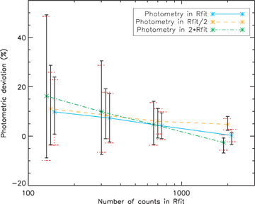
Figure A1 Photometric accuracy of our spatial fitting procedure using simulations. The data points show the mean ...
Notes:
Figure A1 Photometric accuracy of our spatial fitting procedure using simulations. The data points show the mean deviation from the true value in our simulation as a function of available signal (number of counts within spectral fitting radius Rfit), and the extrapolation factor (flux measurement within Rfit, Rfit/2 and 2Rfit). The solid error bars with short hats show the dispersion among measured values, while the dotted error bars with large hats give the mean value of the 1σ bounds estimated by the procedure.
Unless provided in the caption above, the following copyright applies to the content of this slide: © 2007 The Authors. Journal compilation © 2007 RASThis article is published and distributed under the terms of the Oxford University Press, Standard Journals Publication Model (https://academic.oup.com/journals/pages/open_access/funder_policies/chorus/standard_publication_model)

Slide 18
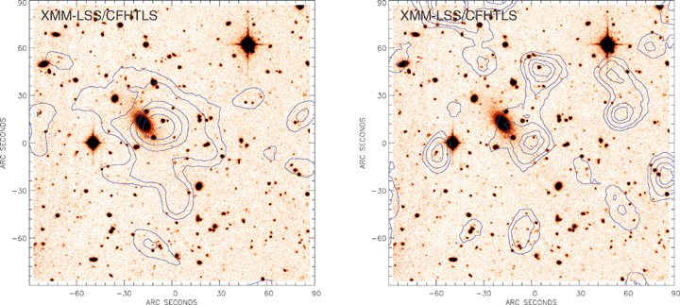
Figure B1 Gaussian-smoothed X-ray emission from the source XLSSC-018 at z= 0.32 in bands [0.5–2] keV and [2–10] keV. ...
Notes:
Figure B1 Gaussian-smoothed X-ray emission from the source XLSSC-018 at z= 0.32 in bands [0.5–2] keV and [2–10] keV. The emission in the soft band seems slightly offset from the cluster cD galaxy. In the hard band, the offset becomes much larger.
Unless provided in the caption above, the following copyright applies to the content of this slide: © 2007 The Authors. Journal compilation © 2007 RASThis article is published and distributed under the terms of the Oxford University Press, Standard Journals Publication Model (https://academic.oup.com/journals/pages/open_access/funder_policies/chorus/standard_publication_model)

