Slide 1
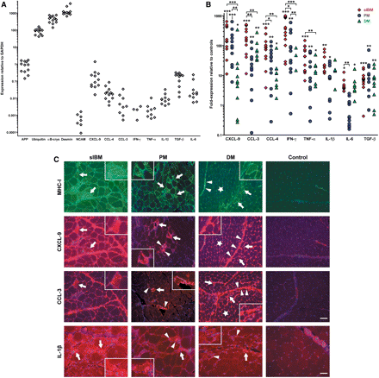
Fig. 1 Quantification and localization of pro-inflammatory markers in sIBM compared to PM, DM and non-myopathic ...
Notes:
Fig. 1 Quantification and localization of pro-inflammatory markers in sIBM compared to PM, DM and non-myopathic control muscle. (A) GAPDH-normalized mRNA expression of pro-inflammatory and degeneration-associated markers amplified by quantitative (real-time) PCR from skeletal muscle tissue of non-myopathic control patients (n = 12). Each dot represents one patient with arbitrary units multiplied by 1000. (B) GAPDH-normalized mRNA expression of pro-inflammatory markers amplified by quantitative PCR from skeletal muscle tissue of sIBM patients (n = 12, red spades), PM (n = 12, blue circles) and DM (n = 11, green triangles). Data are expressed as fold-expression in relation to values from (A) in non-myopathic control muscle. Each dot represents one patient. Statistics were performed as detailed in the Methods section using *P < 0.05, **P < 0.01, ***P < 0.001 as significant values. Undetectable values are not plotted on the logarithmic scale of the y-axis. (C) Fluorescent double-labelling (MHC-I and CXCL-9) and single-labelling (CCL-3, IL-1β) immunohistochemistry in representative muscle biopsy specimens of sIBM versus PM, DM and non-myopathic muscle, using antibodies for MHC-I (top row), CXCL-9 (second row), CCL-3 (third row) or IL-1β (bottom row) with Alexa-594 (red) or Alexa-488 (green)-labelled secondary antibodies and DAPI-counterstain (blue). Arrows in sIBM denote myofibres that display overexpression of IL-1β or co-expression of MHC-I, CXCL-9 and CCL-3. In PM, arrows indicate myofibres that are localized in areas of inflammation and show an enhanced staining signal of MHC-I, CXCL-9, CCL-3 or IL-1β; arrowheads point to mononuclear cells that express CXCL-9, CCL-3 or IL-1β. In DM, arrows indicate muscle fibres that are located in the perifascicular area and display an enhanced staining signal of MHC-I, CXCL-9, CCL-3 or IL-1β; stars indicate upregulation of MHC-I, CXCL-9 and CCL-3 in capillaries; arrowheads denote connective tissue positive for MHC-I, CXCL-9 or CCL-3 as well as mononuclear cells positive for IL-1β. Photos taken by a CCD-camera using a conventional fluorescent microscope with a 10× objective. Scale bars represent 100 µm in rows 1–3 and 50 µm in the last row.
Unless provided in the caption above, the following copyright applies to the content of this slide: Published by Oxford University Press on behalf of the Guarantors of Brain (2008).The online version of this article has been published under an open access model. users are entitled to use, reproduce, disseminate, or display the open access version of this article for non-commerical purposes provided that: the original authorship is properly and fully attributed; the Journal and the Guarantors of Brain are attributed as the original place of publication with the correction citation details given; if an article is subsequently reproduced or disseminated not in its entirety but only in part or as a derivative work this must be clearly indicated. For commercial re-use, please contact journals.permissions@oxfordjournals.org.

Slide 2
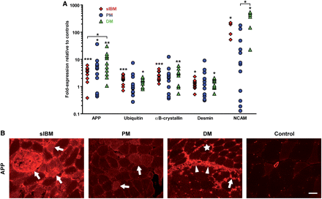
Fig. 2 Quantification and localization of degeneration-associated markers in sIBM compared to PM, DM and ...
Notes:
Fig. 2 Quantification and localization of degeneration-associated markers in sIBM compared to PM, DM and non-myopathic control muscle. (A) By quantitative (real-time) PCR from muscle tissue, an overexpression of the mRNA of the degenerative markers APP, desmin, NCAM, ubiquitin and αB-crystallin was observed in sIBM, PM and DM compared to non-myopathic controls. Symbols, analysis, statistics and plotting same as in Fig. 1B. (B) Fluorescent immunohistochemistry in representative muscle biopsy specimens of sIBM versus PM, DM and non-myopathic muscle, using an antibody for APP and an Alexa-594 (red)-labelled secondary antibody. Arrows point to muscle fibres that display overexpression of APP in sIBM, PM or DM (perifascicularly). Arrowheads denote an enhanced staining signal for APP in connective tissue in DM. The star indicates an upregulated expression of APP in capillaries of DM muscle. Photos taken by a CCD-camera using a conventional fluorescent microscope with a 20× objective. Scale bar represents 50 µm.
Unless provided in the caption above, the following copyright applies to the content of this slide: Published by Oxford University Press on behalf of the Guarantors of Brain (2008).The online version of this article has been published under an open access model. users are entitled to use, reproduce, disseminate, or display the open access version of this article for non-commerical purposes provided that: the original authorship is properly and fully attributed; the Journal and the Guarantors of Brain are attributed as the original place of publication with the correction citation details given; if an article is subsequently reproduced or disseminated not in its entirety but only in part or as a derivative work this must be clearly indicated. For commercial re-use, please contact journals.permissions@oxfordjournals.org.

Slide 3
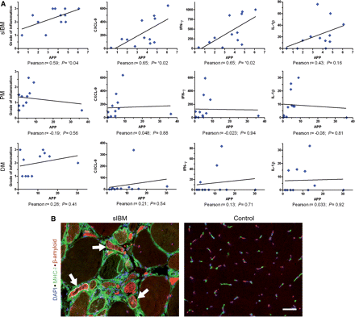
Fig. 3 Correlation of the mRNA- and protein-expression (same mRNA-data as shown in Figs 1 and 2) of ...
Notes:
Fig. 3 Correlation of the mRNA- and protein-expression (same mRNA-data as shown in Figs 1 and 2) of β-amyloid-associated and inflammatory markers in the muscle of sIBM, PM and DM patients. (A) Correlation of the mRNA-expression of APP with the grade of cellular infiltration as assessed by H&E staining (first column), the mRNA-expression of CXCL-9 (second column), IFN-γ (third column) as well as with IL-1β (last column). One dot per patient. Due to similar values, two patients in the PM group are plotted with a high degree of overlap. (B) Immunohistochemical double labelling for β-amyloid (Alexa-594; red) and MHC-I (Alexa-488; green) reveals a frequent co-localization (arrows) of these markers in myofibres in a representative muscle biopsy specimen of a patient with sIBM. Nuclear counterstain with DAPI. Images taken by a CCD-camera using a conventional fluorescent microscope with a 20× objective. Scale bar represents 50 µm.
Unless provided in the caption above, the following copyright applies to the content of this slide: Published by Oxford University Press on behalf of the Guarantors of Brain (2008).The online version of this article has been published under an open access model. users are entitled to use, reproduce, disseminate, or display the open access version of this article for non-commerical purposes provided that: the original authorship is properly and fully attributed; the Journal and the Guarantors of Brain are attributed as the original place of publication with the correction citation details given; if an article is subsequently reproduced or disseminated not in its entirety but only in part or as a derivative work this must be clearly indicated. For commercial re-use, please contact journals.permissions@oxfordjournals.org.

Slide 4
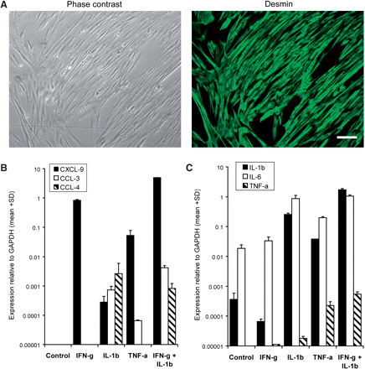
Fig. 4 In vitro analysis of expression of pro-inflammatory mediators in primary cultures of differentiated human ...
Notes:
Fig. 4 In vitro analysis of expression of pro-inflammatory mediators in primary cultures of differentiated human myotubes. (A) Purity of primary myotube cultures was assessed by immunohistochemical staining of the muscle cell marker desmin (Alexa-488; green) with a typical purity of 95% as revealed by comparison to phase contrast photos of the same culture well. Scale bar represents 100 µm. (B and C) mRNA-expression relative to GAPDH of chemokines (B) and cytokines (C) as assessed by quantitative (real-time) PCR in myotubes exposed 24 h to IFN-γ (300 U/ml), TNF-α (5 ng/ml) or IL-1β (10 ng/ml)—alone or in combinations. Data are given as mean + SD of two wells per condition from one representative experiment of four with similar results.
Unless provided in the caption above, the following copyright applies to the content of this slide: Published by Oxford University Press on behalf of the Guarantors of Brain (2008).The online version of this article has been published under an open access model. users are entitled to use, reproduce, disseminate, or display the open access version of this article for non-commerical purposes provided that: the original authorship is properly and fully attributed; the Journal and the Guarantors of Brain are attributed as the original place of publication with the correction citation details given; if an article is subsequently reproduced or disseminated not in its entirety but only in part or as a derivative work this must be clearly indicated. For commercial re-use, please contact journals.permissions@oxfordjournals.org.

Slide 5
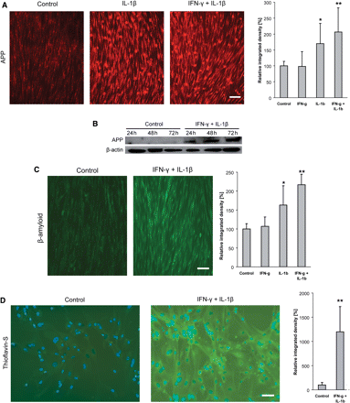
Fig. 5 Overexpression of APP and accumulation of β-amyloid in human primary skeletal myotube cultures exposed to ...
Notes:
Fig. 5 Overexpression of APP and accumulation of β-amyloid in human primary skeletal myotube cultures exposed to IL-1β (10 ng/ml) and/or IFN-γ (300 U/ml) for 24–72 h. (A) A 24 h exposure to IL-1β, alone or in combination with IFN-γ, induced enhanced staining for APP (Alexa-594, red). Grey-scale analysis of the same experiment demonstrates a significant increase of the staining intensity upon IL-1β, and even more in combination with IFN-γ. (B) Immunoblot analysis of APP demonstrates an increased level of protein expression upon 24–72 h of exposure to IL-1β in combination with IFN-γ. Protein loading in each lane is confirmed by detection of β-actin. (C) Staining for β-amyloid reveals an enhanced intracellular accumulation upon 48 h of exposure to IL-1β, particularly in combination with IFN-γ (Alexa-488, green). Grey-scale analysis of the same experiment demonstrates a significant increase of the staining intensity upon IL-1β, and even more in combination with IFN-γ. (D) After 48 h of exposure to IL-1β and IFN-γ, intracellular aggregation of β-amyloid is evidenced by thioflavin-S, which is statistically significant as revealed by grey-scale analysis of the same experiment. Photos taken by a CCD-camera using a conventional fluorescent microscope with a 10× (A and C) or 20× (D) objective. All photomicrographs for the analyses in this Figure have been acquired with the same settings of camera and microscope; all data are representative of at least three experiments with similar results. Scale bars represent 100 µm in A, C and 60 µm in D.
Unless provided in the caption above, the following copyright applies to the content of this slide: Published by Oxford University Press on behalf of the Guarantors of Brain (2008).The online version of this article has been published under an open access model. users are entitled to use, reproduce, disseminate, or display the open access version of this article for non-commerical purposes provided that: the original authorship is properly and fully attributed; the Journal and the Guarantors of Brain are attributed as the original place of publication with the correction citation details given; if an article is subsequently reproduced or disseminated not in its entirety but only in part or as a derivative work this must be clearly indicated. For commercial re-use, please contact journals.permissions@oxfordjournals.org.

Slide 6
Fig. 6 Fluorescent immunohistochemical double labelling for β-amyloid and IL-1β. Representative muscle biopsy ...
Notes:
Fig. 6 Fluorescent immunohistochemical double labelling for β-amyloid and IL-1β. Representative muscle biopsy specimen of a patient with sIBM stained with anti-β-amyloid (Alexa-488, green; left) and anti-IL-1β (Alexa-594, red; middle). A degenerating muscle fibre in the centre is double positive (arrows; yellow in merged image, right). Photos taken by a CCD camera using a conventional fluorescent microscope with a 40× objective. Scale bar represents 40 µm.
Unless provided in the caption above, the following copyright applies to the content of this slide: Published by Oxford University Press on behalf of the Guarantors of Brain (2008).The online version of this article has been published under an open access model. users are entitled to use, reproduce, disseminate, or display the open access version of this article for non-commerical purposes provided that: the original authorship is properly and fully attributed; the Journal and the Guarantors of Brain are attributed as the original place of publication with the correction citation details given; if an article is subsequently reproduced or disseminated not in its entirety but only in part or as a derivative work this must be clearly indicated. For commercial re-use, please contact journals.permissions@oxfordjournals.org.

