Slide 1
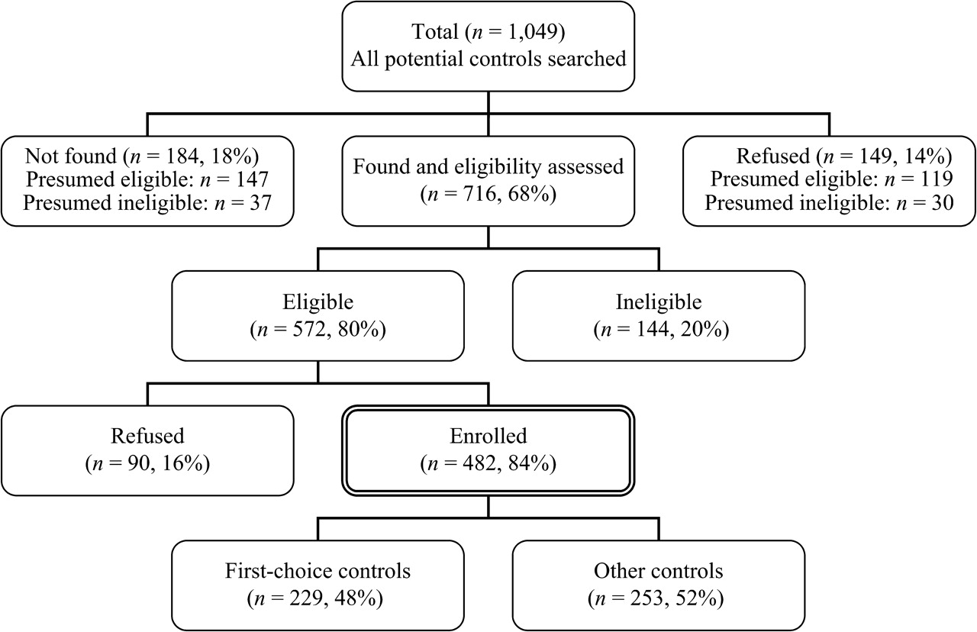
FIGURE 1. Selection of controls for the Northern California Childhood Leukemia Study in the period of August 19, 1995, ...
Notes:
FIGURE 1. Selection of controls for the Northern California Childhood Leukemia Study in the period of August 19, 1995, to November 30, 2002. “Presumed eligible” and “presumed ineligible” determined by assuming the same percentage of eligible as that in potential controls who were located and whose eligibilities were assessed.
Unless provided in the caption above, the following copyright applies to the content of this slide: American Journal of Epidemiology Copyright © 2006 by the Johns Hopkins Bloomberg School of Public Health All rights reserved; printed in U.S.A.

