Slide 1
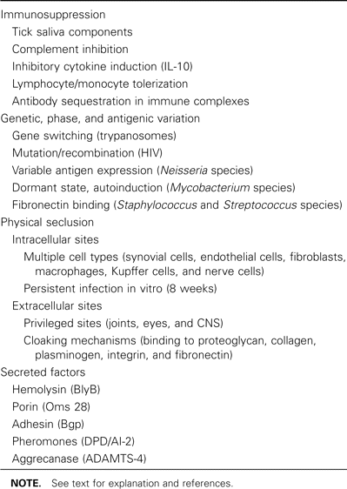
Table 1 “Stealth” pathology of Borrelia burgdorferi.
Notes:
Table 1 “Stealth” pathology of Borrelia burgdorferi.
Unless provided in the caption above, the following copyright applies to the content of this slide: © 2007 by the Infectious Diseases Society of America

Slide 2
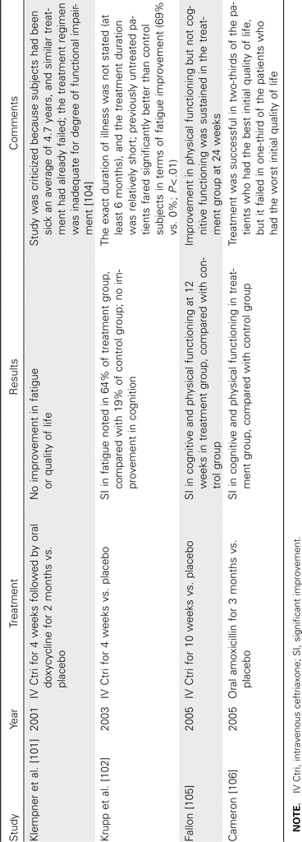
Table 2 Results of placebo-controlled trials of antibiotic treatment in chronic Lyme disease.
Notes:
Table 2 Results of placebo-controlled trials of antibiotic treatment in chronic Lyme disease.
Unless provided in the caption above, the following copyright applies to the content of this slide: © 2007 by the Infectious Diseases Society of America

Slide 3
Table 3 Precedents for prolonged antibiotic therapy.
Notes:
Table 3 Precedents for prolonged antibiotic therapy.
Unless provided in the caption above, the following copyright applies to the content of this slide: © 2007 by the Infectious Diseases Society of America

