Slide 1
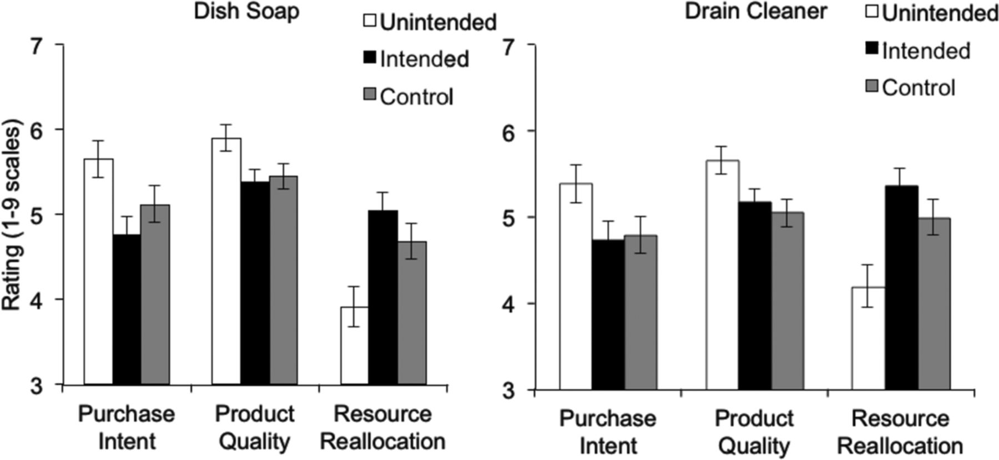
Figure 1. Mean Ratings of Purchase Intent, Product Quality, and Resource Allocation (Experiment 1)
Notes:
Figure 1. Mean Ratings of Purchase Intent, Product Quality, and Resource Allocation (Experiment 1)
Unless provided in the caption above, the following copyright applies to the content of this slide: © 2014 by JOURNAL OF CONSUMER RESEARCH, Inc.

Slide 2
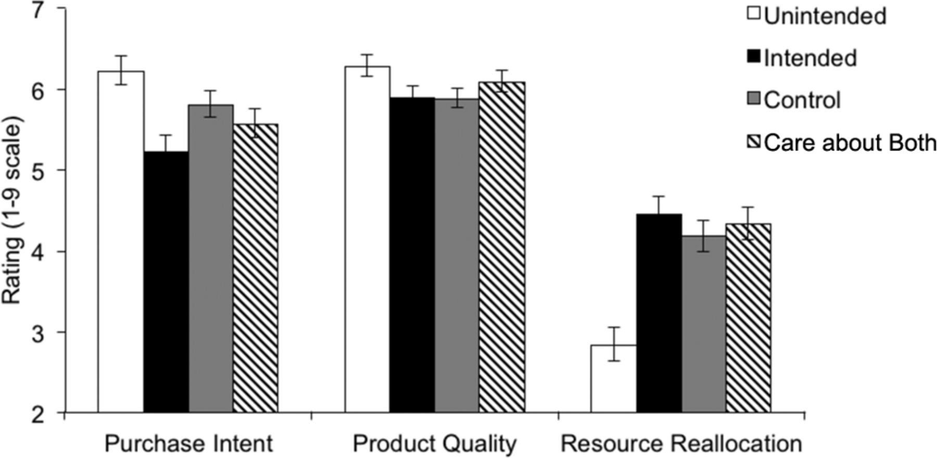
Figure 2. Mean Ratings of Purchase Intent, Product Quality, and Resource Allocation (Experiment 2A)
Notes:
Figure 2. Mean Ratings of Purchase Intent, Product Quality, and Resource Allocation (Experiment 2A)
Unless provided in the caption above, the following copyright applies to the content of this slide: © 2014 by JOURNAL OF CONSUMER RESEARCH, Inc.

Slide 3
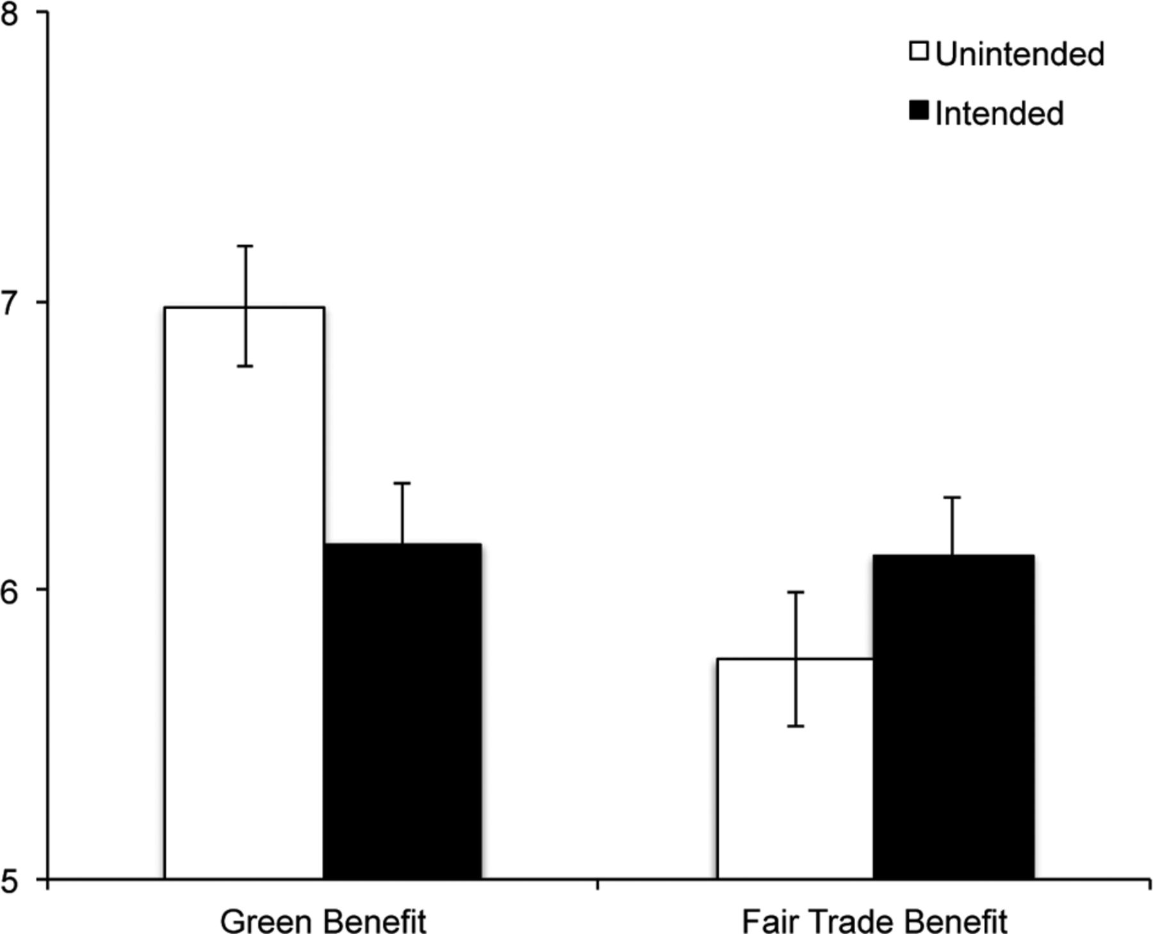
Figure 3. Mean Ratings of Purchase Intent in Experiment 3
Notes:
Figure 3. Mean Ratings of Purchase Intent in Experiment 3
Unless provided in the caption above, the following copyright applies to the content of this slide: © 2014 by JOURNAL OF CONSUMER RESEARCH, Inc.

Slide 4
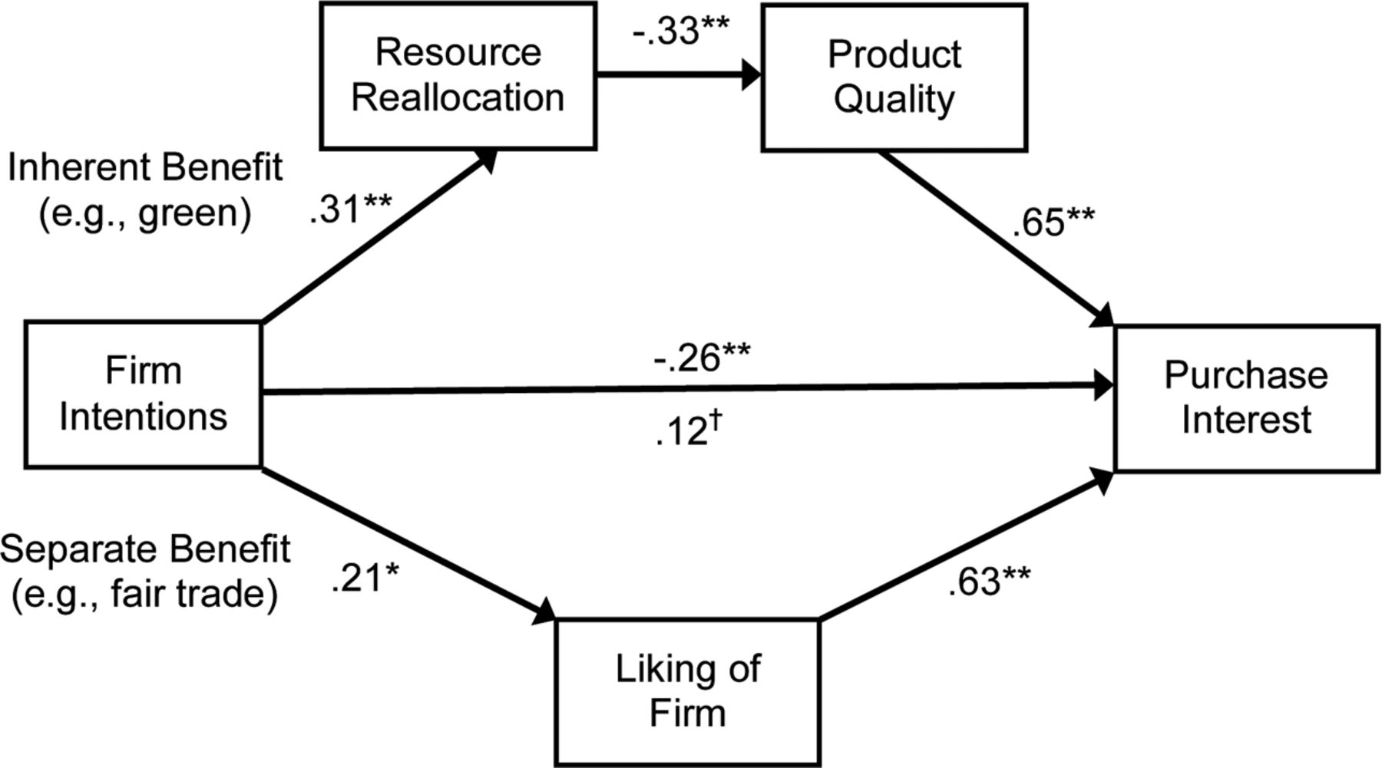
Figure 4. Moderated Mediation Analyses (Experiment 3) Note.—†p = .10, *p < .01, **p < .001.
Notes:
Figure 4. Moderated Mediation Analyses (Experiment 3) Note.—†p = .10, *p < .01, **p < .001.
Unless provided in the caption above, the following copyright applies to the content of this slide: © 2014 by JOURNAL OF CONSUMER RESEARCH, Inc.

Slide 5
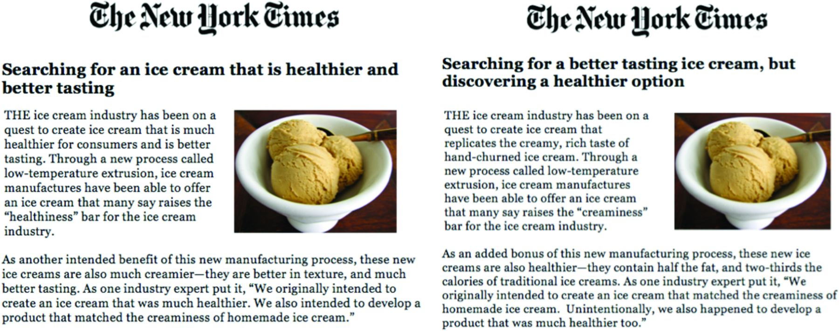
Figure E1. Experiment 4 Stimuli: Intended Condition (left) and Unintended Condition (right)
Notes:
Figure E1. Experiment 4 Stimuli: Intended Condition (left) and Unintended Condition (right)
Unless provided in the caption above, the following copyright applies to the content of this slide: © 2014 by JOURNAL OF CONSUMER RESEARCH, Inc.

