Slide 1
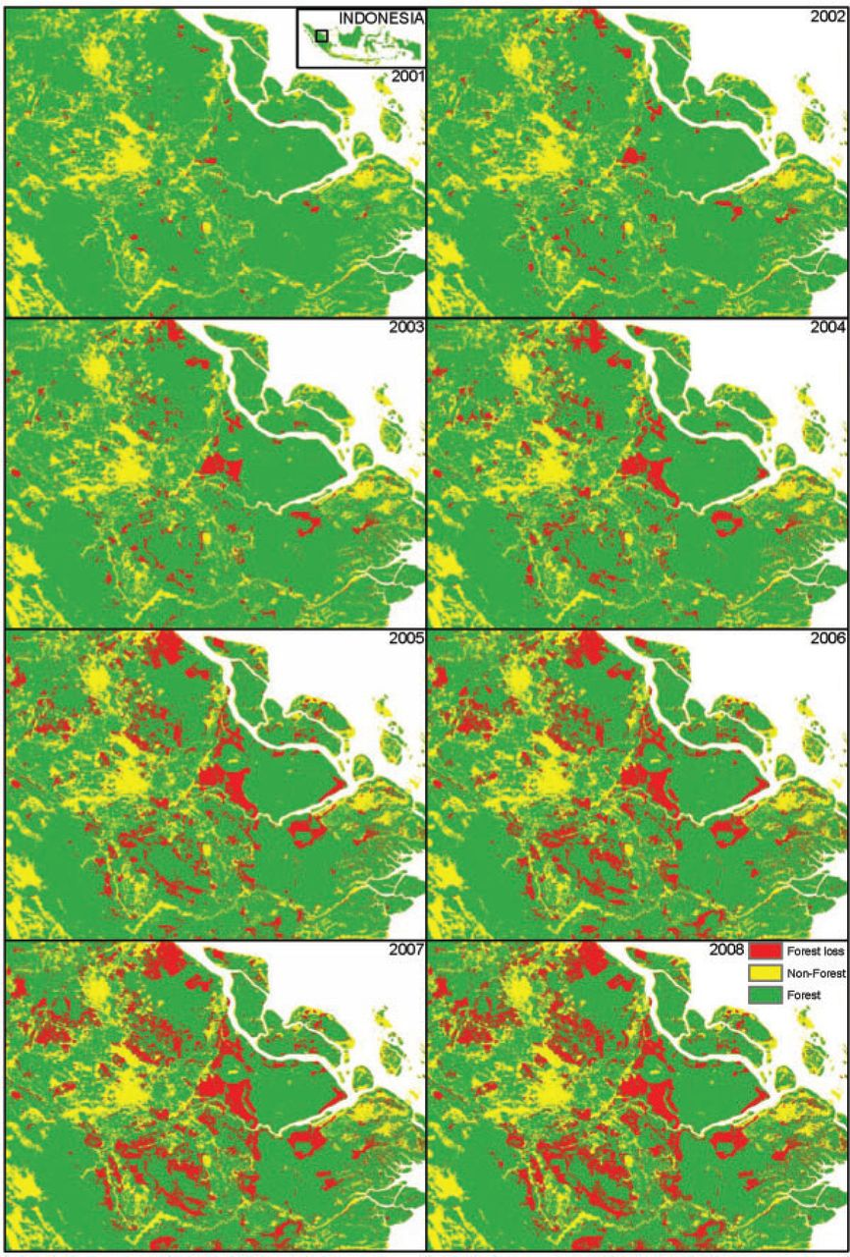
Figure I Forest Cover Change in the Province of Riau, 2001–2008
Notes:
Figure I Forest Cover Change in the Province of Riau, 2001–2008
Unless provided in the caption above, the following copyright applies to the content of this slide: © The Author(s) 2012. Published by Oxford University Press, on behalf of President and Fellows of Harvard College. All rights reserved. For Permissions, please email: journals.permissions@oup.com

Slide 2
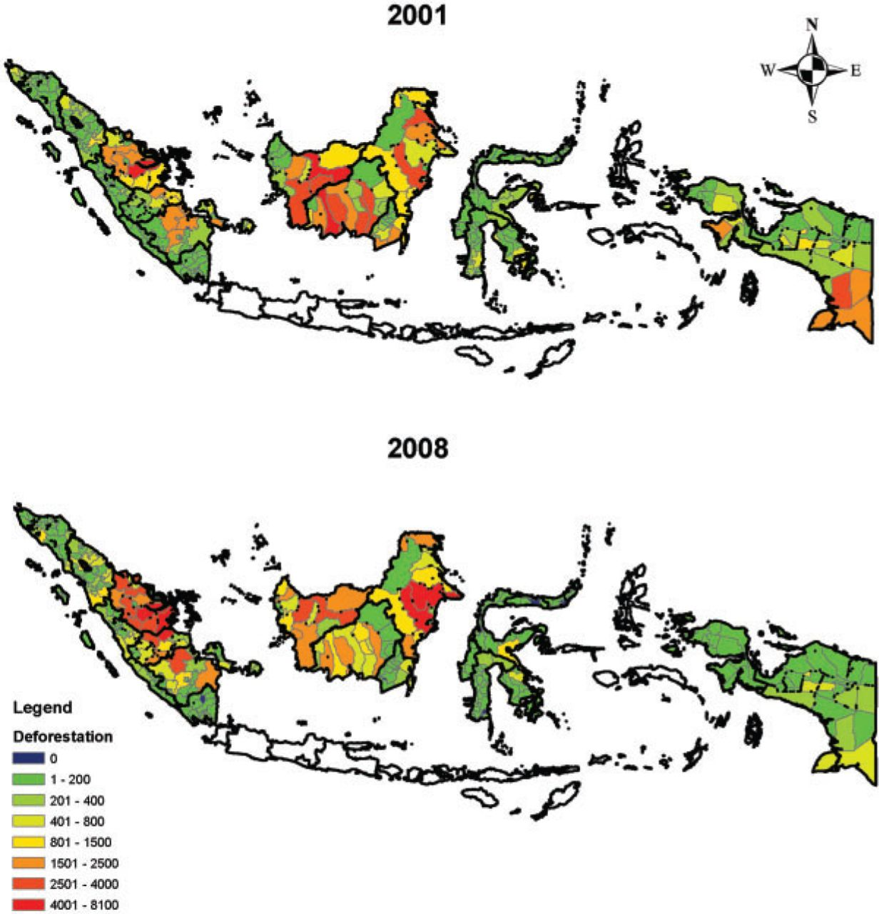
Figure II District-Level Logging in Indonesia Using the 2008 District Boundaries, 2001 and 2008
Notes:
Figure II District-Level Logging in Indonesia Using the 2008 District Boundaries, 2001 and 2008
Unless provided in the caption above, the following copyright applies to the content of this slide: © The Author(s) 2012. Published by Oxford University Press, on behalf of President and Fellows of Harvard College. All rights reserved. For Permissions, please email: journals.permissions@oup.com

Slide 3
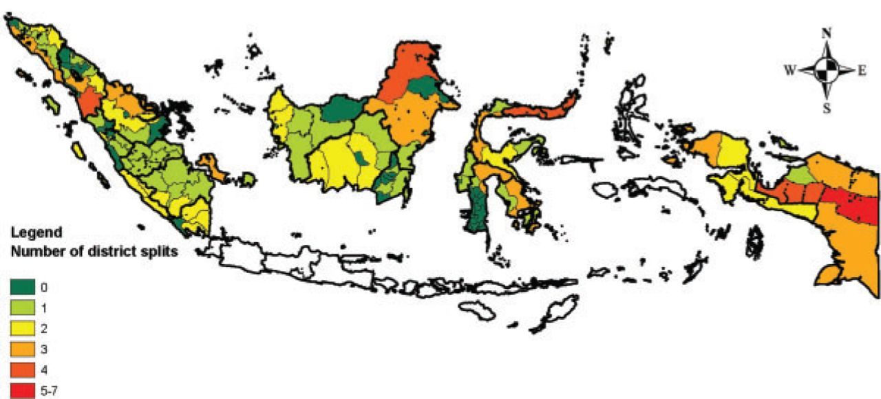
Figure III Total Number of District Splits Using the 1990 District Boundaries
Notes:
Figure III Total Number of District Splits Using the 1990 District Boundaries
Unless provided in the caption above, the following copyright applies to the content of this slide: © The Author(s) 2012. Published by Oxford University Press, on behalf of President and Fellows of Harvard College. All rights reserved. For Permissions, please email: journals.permissions@oup.com

Slide 4
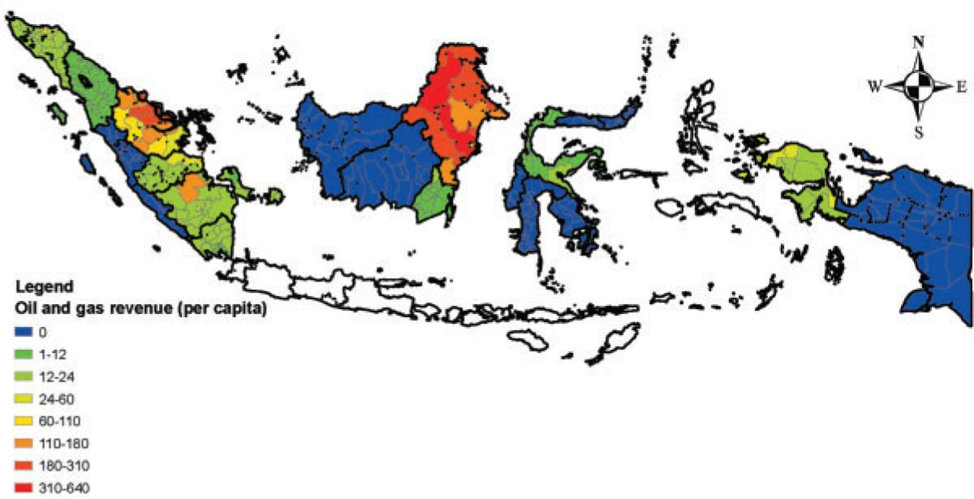
Figure IV Oil and Gas Revenue per Capita Using the 2008 District Boundaries, 2008
Notes:
Figure IV Oil and Gas Revenue per Capita Using the 2008 District Boundaries, 2008
Unless provided in the caption above, the following copyright applies to the content of this slide: © The Author(s) 2012. Published by Oxford University Press, on behalf of President and Fellows of Harvard College. All rights reserved. For Permissions, please email: journals.permissions@oup.com

