Slide 1
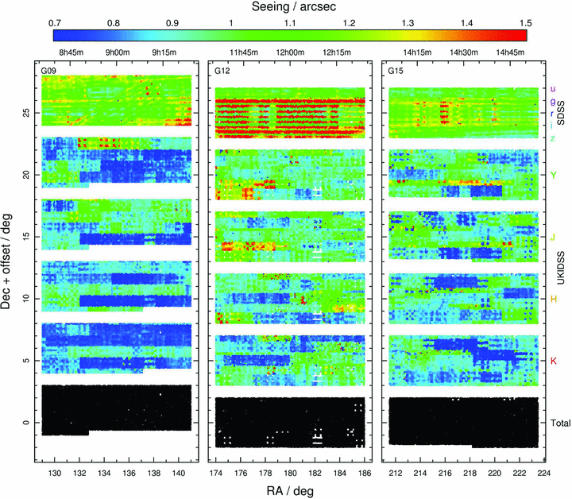
Figure 1 Coverage in each bandpass across the three GAMA regions is shown, where white space indicates a lack of ...
Notes:
Figure 1 Coverage in each bandpass across the three GAMA regions is shown, where white space indicates a lack of coverage at that position. Different bandpasses are offset in declination for plotting purposes, with the bottom row (black data points) positioned at the correct GAMA coordinates. The five SDSS bands (ugriz) were taken simultaneously and therefore are represented together, whilst the four UKIDSS bands (YJHK) are shown separately. The data points are coloured according to the local value of the PSF FWHM at that position, giving an indication of the variation in seeing (SDSS data are taken from the r band). See Section 3.4 for further details on the derivation of the PSFs. The bottom row represents a common coverage area, containing galaxies that have been observed across all nine bands (92.8 per cent of the total). A common coverage sample is derived from this area, and used for all subsequent figures.
Unless provided in the caption above, the following copyright applies to the content of this slide: © 2012 The Authors Monthly Notices of the Royal Astronomical Society © 2012 RAS

Slide 2
Figure 4 A series of set-up images centred on G00196053. (a) A science image cutout of 1201 × 1201 pixels (∼400 × ...
Notes:
Figure 4 A series of set-up images centred on G00196053. (a) A science image cutout of 1201 × 1201 pixels (∼400 × 400 arcsec2) in the r band, with the primary galaxy centred at 601 × 601. The image is scaled logarithmically from −1σsky to 40σsky, where σsky is the typical rms of the sky in the r band. (b) A weight map cutout of 1201 × 1201 pixels (∼400 × 400 arcsec2) in the r band, with the primary galaxy located in an overlap region at the white cross-hairs. Darker shades indicate larger values, therefore, a greater number of overlapping frames. (c) The additional local background sky removed from this cutout. The z-axis range shown is ±0.5 counts. For this galaxy, a background mesh size of 128 × 128 pixels (white square) was chosen in addition to the coarse 256 × 256 background mesh already applied in creating the GAMA mosaics.
Unless provided in the caption above, the following copyright applies to the content of this slide: © 2012 The Authors Monthly Notices of the Royal Astronomical Society © 2012 RAS

Slide 3
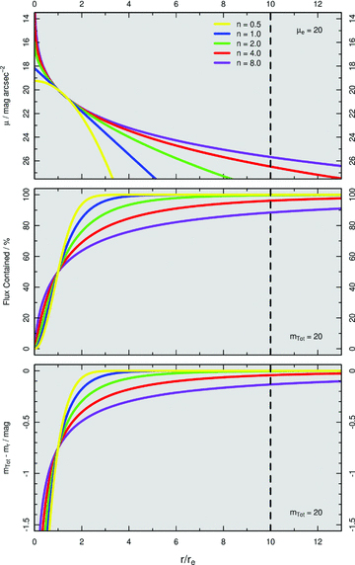
Figure 2 The Sérsic profile (equation 1) describes how a galaxy light profile varies as a function of radius, shown ...
Notes:
Figure 2 The Sérsic profile (equation 1) describes how a galaxy light profile varies as a function of radius, shown here for five distinct values of Sérsic index n. Top: surface brightness at a given radius. Middle: flux contained within a given radius. Bottom: the magnitude offset between the total magnitude of the galaxy and the Sérsic magnitude at a given radius.
Unless provided in the caption above, the following copyright applies to the content of this slide: © 2012 The Authors Monthly Notices of the Royal Astronomical Society © 2012 RAS

Slide 4
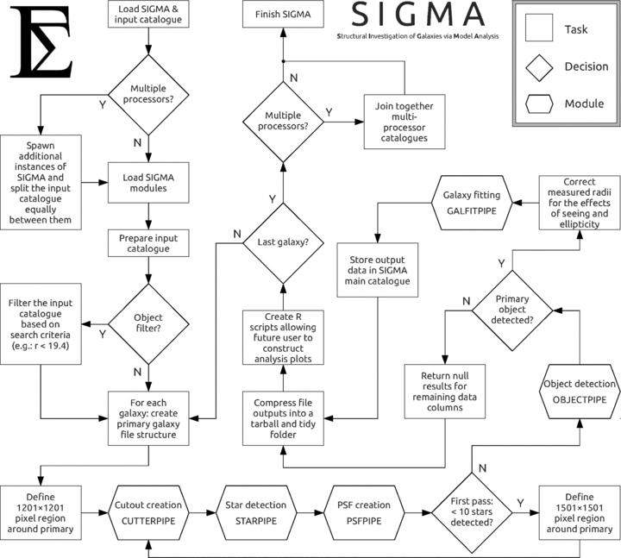
Figure 3 A flowchart describing sigma’s operation. Required inputs are imaging data in the form of GAMA mosaics ...
Notes:
Figure 3 A flowchart describing sigma’s operation. Required inputs are imaging data in the form of GAMA mosaics (including weight maps), and an input catalogue with a list of galaxy coordinates.
Unless provided in the caption above, the following copyright applies to the content of this slide: © 2012 The Authors Monthly Notices of the Royal Astronomical Society © 2012 RAS

Slide 5
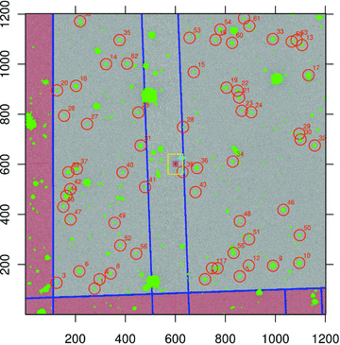
Figure 7 Final detail analysis plot for G00196053. Green shaded areas represent all detected objects, with stars ...
Notes:
Figure 7 Final detail analysis plot for G00196053. Green shaded areas represent all detected objects, with stars chosen as part of the PSF star sample circled in orange. The galfit fitting area is outlined in yellow, and the weight map frame edges in blue. Secondary objects which will be modelled as nearby neighbours in the fitting process are represented in turquoise. Note how no sample stars are taken from frames which did not contribute directly to the flux of the primary galaxy (areas represented with red shading). Consequently, no stars are taken for PSF analysis from the red shaded areas. The image is scaled logarithmically from −1σsky to 40σsky, where σsky is the typical rms of the sky in the r band.
Unless provided in the caption above, the following copyright applies to the content of this slide: © 2012 The Authors Monthly Notices of the Royal Astronomical Society © 2012 RAS

Slide 6
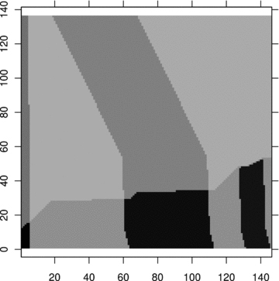
Figure 5 A simplified version of the weight map shown in Fig. 4(b). A single cutout from a GAMA mosaic may contain ...
Notes:
Figure 5 A simplified version of the weight map shown in Fig. 4(b). A single cutout from a GAMA mosaic may contain data from several frames observed on different nights in different seeing conditions. The weight map allows us to determine which frames contributed flux to the primary galaxy and which did not, thereby allowing a PSF to be constructed representing the seeing for that galaxy. Simplification of the weight map removes superfluous information contained within the original cutout weight map, reducing the number of pixels to analyse typically by a factor of ∼150, and significantly speeding up starpipe.
Unless provided in the caption above, the following copyright applies to the content of this slide: © 2012 The Authors Monthly Notices of the Royal Astronomical Society © 2012 RAS

Slide 7
Figure 6 psfex generates an empirical PSF (b) from a host sample of representative stars (a). This figure shows 63 ...
Notes:
Figure 6 psfex generates an empirical PSF (b) from a host sample of representative stars (a). This figure shows 63 sample star cutouts of 25 × 25 pixels each chosen from around GAMA object G00196053, whose real sky positions may be noted in Fig. 7 (orange circles). Panel (c) represents the residual of each star sample with a scaled form of the PSF subtracted from each. (a) and (c) are scaled logarithmically from −1σsky to 40σsky, where σsky is the typical rms of the sky in the r band.
Unless provided in the caption above, the following copyright applies to the content of this slide: © 2012 The Authors Monthly Notices of the Royal Astronomical Society © 2012 RAS

Slide 8
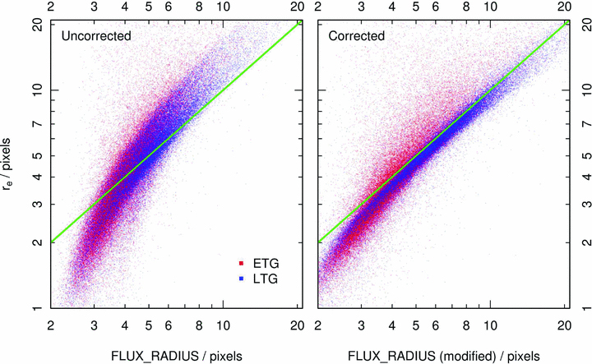
Figure B1 A comparison between source extractor half-light radii (FLUX_RADIUS) and modelled galfit half-light radii ...
Notes:
Figure B1 A comparison between source extractor half-light radii (FLUX_RADIUS) and modelled galfit half-light radii (re) in the r band, with data points coloured according to their predicted morphological type as described in Section 5.2. Left: uncorrected half-light radii from source extractor are a poor initial condition for modelling an object in galfit, as source extractor radii are circularized and make no attempt to correct for the effect of seeing. Right: using equation (5) to correct for ellipticity and the PSF produces a much better starting value for galfit, hence reducing the chance of finding local minima during the minimization phase. The green line represents a 1:1 ratio, for reference.
Unless provided in the caption above, the following copyright applies to the content of this slide: © 2012 The Authors Monthly Notices of the Royal Astronomical Society © 2012 RAS

Slide 9
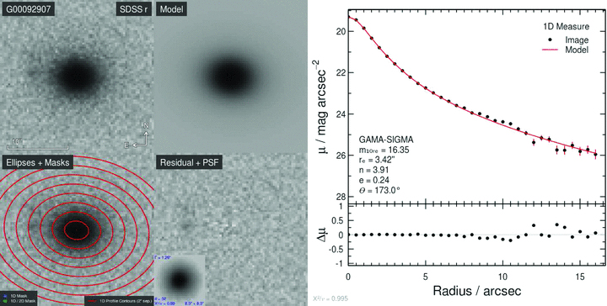
Figure 8 An example model output for GAMA galaxy G00092907. The original SDSS r-band image is shown in the top left. ...
Notes:
Figure 8 An example model output for GAMA galaxy G00092907. The original SDSS r-band image is shown in the top left. The 2D model of this galaxy and its residual (image − model) are also shown as indicated. Inset into the residual is a postage stamp of the PSF constructed for this galaxy. Blue captions within the PSF postage stamp indicate (anticlockwise from top left) the FWHM of the PSF; the number of stars used in creating the PSF; the χ2/ν for the PSF model fit and the size of the PSF postage stamp (8.5 × 8.5 arcsec2). The 1D profile for this galaxy, calculated by taking the average counts along ellipses centred on the primary galaxy and displayed against the semimajor axis, was created using the iraf package ellipse. Example ellipses from ellipse have been added to the image in the bottom left to guide the eye, spaced evenly at intervals of 2 arcsec along the semimajor axis. Note that inset into the 1D profile is relevant output Sérsic modelling parameters for this galaxy, and the overall χ2/ν for the Sérsic model is shown in grey at the bottom of the figure. The 1D profile is a 1D measure of 2D data. Any flux from secondary objects (neighbouring galaxies and stars) lying outside the 1D mask and overlapping with the primary galaxy will be counted as belonging to the primary galaxy by ellipse. The 1D profile therefore should chiefly be used as a guide as to the true light distributions of both the 2D image and 2D model. For plotting, the image data are divided by some scaling constant (150 counts in the r band) and scaled using the arctan function with cut levels at −(π/4) and (π/2).
Unless provided in the caption above, the following copyright applies to the content of this slide: © 2012 The Authors Monthly Notices of the Royal Astronomical Society © 2012 RAS

Slide 10
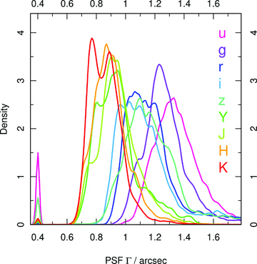
Figure 10 Recovered FWHM PSF values from the sigma common coverage sample.
Notes:
Figure 10 Recovered FWHM PSF values from the sigma common coverage sample.
Unless provided in the caption above, the following copyright applies to the content of this slide: © 2012 The Authors Monthly Notices of the Royal Astronomical Society © 2012 RAS

Slide 11
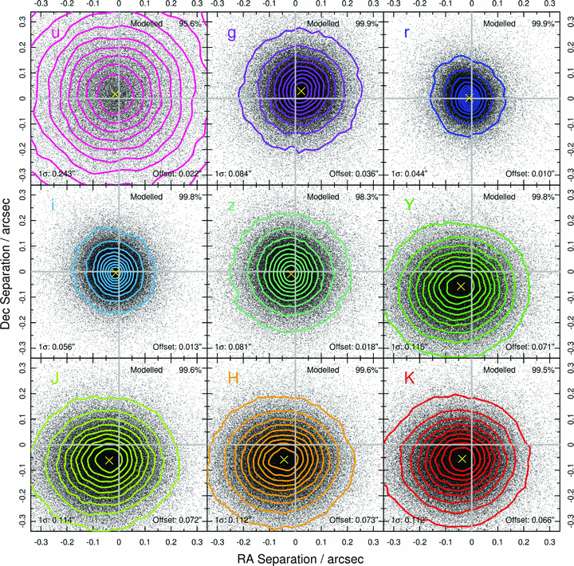
Figure 9 Astrometric offsets in RA and Dec. between the input SDSS positions and the modelled sigma positions for all ...
Notes:
Figure 9 Astrometric offsets in RA and Dec. between the input SDSS positions and the modelled sigma positions for all nine bands. Contours range from the 10th to the 90th percentile in steps of 10 per cent with the peak density of each distribution represented by a yellow cross. Each subplot is exactly 2 × 2 pixels in dimension. The global systematic offsets in the NIR UKIDSS data (YJHK), typically ∼0.07 arcsec (∼0.2 pixels), are caused by minor variations in the WCS definitions between SDSS and UKIDSS. sigma accounts for this during the modelling phase.
Unless provided in the caption above, the following copyright applies to the content of this slide: © 2012 The Authors Monthly Notices of the Royal Astronomical Society © 2012 RAS

Slide 12
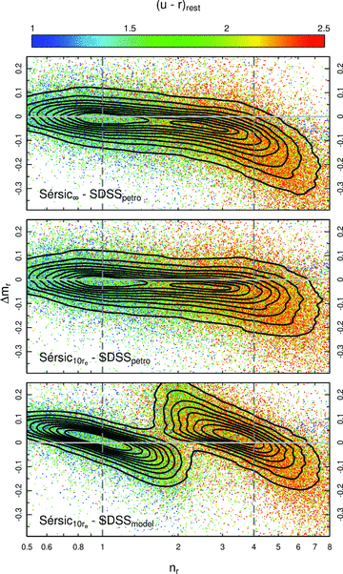
Figure 17 A series of plots displaying offsets between various magnitude systems as a function of r-band Sérsic index, ...
Notes:
Figure 17 A series of plots displaying offsets between various magnitude systems as a function of r-band Sérsic index, with the data points coloured according to their u−r rest colour, as shown. Contours range from the 10th percentile to the 90th percentile in 10 per cent steps. Top: the Sérsic profile integrated out to infinity minus the SDSS Petrosian magnitude. Middle: the Sérsic profile truncated at 10re minus the SDSS Petrosian magnitude. These figures show how Sérsic profiling is able to recover flux in the wings of galaxies that would otherwise be missed by traditional aperture-based methods, such as Petrosian apertures. Bottom: the Sérsic profile truncated at 10re minus the SDSS model magnitude. SDSS force fit either an exponential (n= 1) or de Vaucouleurs (n= 4) profile fit to attain their model magnitudes. This figure shows how model magnitudes provide an inaccurate measure of flux for a galaxy whose Sérsic index differs significantly from either n= 1 or n= 4. Vertical dashed grey lines at exponential (n= 1) and de Vaucouleurs (n= 4) Sérsic indices are added for reference.
Unless provided in the caption above, the following copyright applies to the content of this slide: © 2012 The Authors Monthly Notices of the Royal Astronomical Society © 2012 RAS

Slide 13
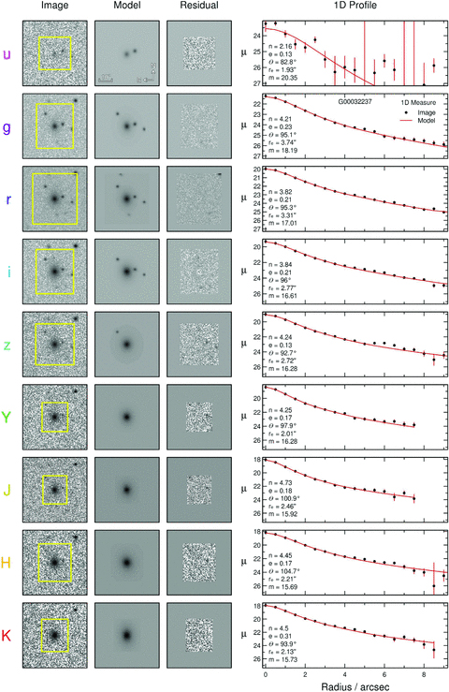
Figure 13 Model fits for G00032237 across all nine bands. Each column represents (from left to right) the original ...
Notes:
Figure 13 Model fits for G00032237 across all nine bands. Each column represents (from left to right) the original input image, the model fit to the input image, the residual image (input − model) and the 1D surface brightness profile along the semimajor axis (averaged along the annulus). The fitting region (the region within which 2D modelling takes place) is represented by a yellow box. Recovered 2D intrinsic (i.e. prior to PSF convolution) Sérsic parameters are listed inset into the 1D profile plot. The images are scaled logarithmically from −1σsky to nσsky, where σsky is the typical rms of the sky in that band, and n is some scaling constant (generally, n∼ 40).
Unless provided in the caption above, the following copyright applies to the content of this slide: © 2012 The Authors Monthly Notices of the Royal Astronomical Society © 2012 RAS

Slide 14
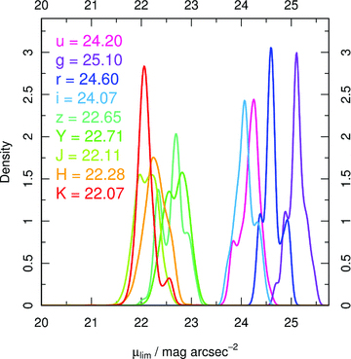
Figure 11 Apparent surface brightness limits for all galaxies within the sigma common coverage sample, with median ...
Notes:
Figure 11 Apparent surface brightness limits for all galaxies within the sigma common coverage sample, with median surface brightness values for each band inset.
Unless provided in the caption above, the following copyright applies to the content of this slide: © 2012 The Authors Monthly Notices of the Royal Astronomical Society © 2012 RAS

Slide 15
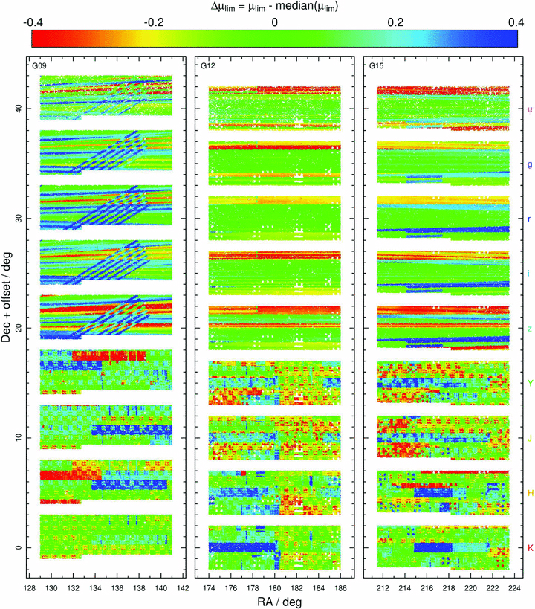
Figure 12 Apparent surface brightness limits for all galaxies within the sigma common coverage sample as a function of ...
Notes:
Figure 12 Apparent surface brightness limits for all galaxies within the sigma common coverage sample as a function of their position on the sky in RA and Dec. The three GAMA regions are displayed, as indicated, with each band labelled along the right-hand side of the figure. Bands are offset in declination in order to differentiate them from one another. The K band is situated at the correct GAMA coordinates. Surface brightnesses are shown as offsets from the median surface brightness for that band, the values of which are found in Fig. 11. Blue data points represent the deepest limits and red the shallowest.
Unless provided in the caption above, the following copyright applies to the content of this slide: © 2012 The Authors Monthly Notices of the Royal Astronomical Society © 2012 RAS

Slide 16
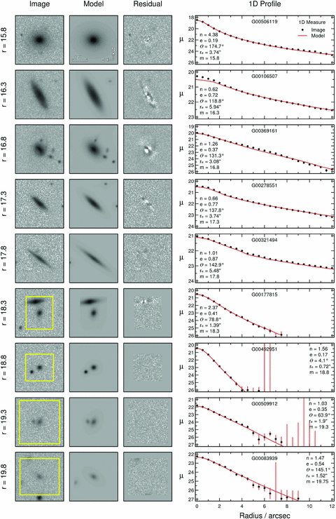
Figure 14 Model fits for nine galaxies in the r band separated in magnitude space by approximately Δm_{r}= 0.5 ...
Notes:
Figure 14 Model fits for nine galaxies in the r band separated in magnitude space by approximately Δmr= 0.5 in the range 15.8 < mr < 19.8. Each column represents (from left to right) the original input image, the model fit to the input image, the residual image (input − model) and the 1D surface brightness profile along the semimajor axis (averaged along the annulus). If the fitting region (the region within which 2D modelling takes place) lies within the image thumbnail above, it is represented by a yellow box. If no yellow box is visible, the fitting region is larger than the thumbnail. Recovered 2D intrinsic (i.e. prior to PSF convolution) Sérsic parameters are listed inset into the 1D profile plot. The images are scaled logarithmically from −1σsky to 40σsky, where σsky is the typical rms of the sky in the r band.
Unless provided in the caption above, the following copyright applies to the content of this slide: © 2012 The Authors Monthly Notices of the Royal Astronomical Society © 2012 RAS

Slide 17
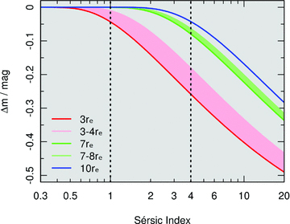
Figure 16 Magnitude offset between the Sérsic profile integrated out to infinity and that truncated at a given multiple ...
Notes:
Figure 16 Magnitude offset between the Sérsic profile integrated out to infinity and that truncated at a given multiple of the effective radius. SDSS model magnitudes [forcing either exponential (n= 1) or de Vaucouleurs (n= 4) profile fits; dotted vertical lines] employ smooth tapering truncation radii, represented by the shaded red and green areas. sigma Sérsic magnitudes within GAMA adopt a sharp 10re truncation radius; blue line.
Unless provided in the caption above, the following copyright applies to the content of this slide: © 2012 The Authors Monthly Notices of the Royal Astronomical Society © 2012 RAS

Slide 18
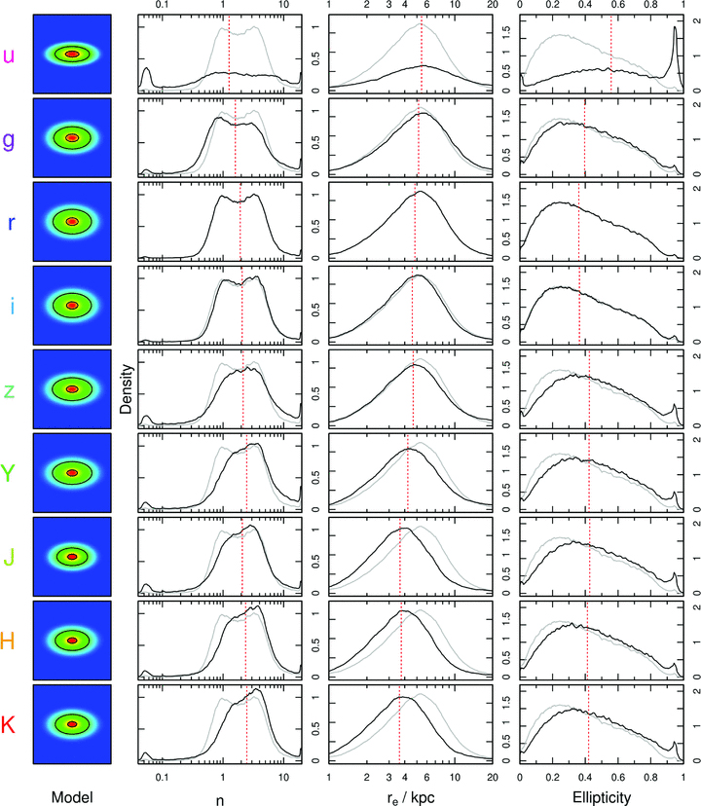
Figure 15 Global results from the sigma common coverage sample for all nine bands. Each column represents (from left to ...
Notes:
Figure 15 Global results from the sigma common coverage sample for all nine bands. Each column represents (from left to right) the average model galaxy based on median values for Sérsic index, half-light radius and ellipticity and the distributions for all recovered Sérsic indices, half-light radii (converted into kpc) and ellipticities. The y-axis for each distribution shows the probability density function convolved with a rectangular top-hat kernel with standard deviations of 0.05, 0.05 and 0.02 for index, size and ellipticity, respectively. Median values for each distribution are represented by a red dashed line and are used in creating the average model galaxy in the left-hand column. The r-band distributions are shown in grey for reference.
Unless provided in the caption above, the following copyright applies to the content of this slide: © 2012 The Authors Monthly Notices of the Royal Astronomical Society © 2012 RAS

Slide 19
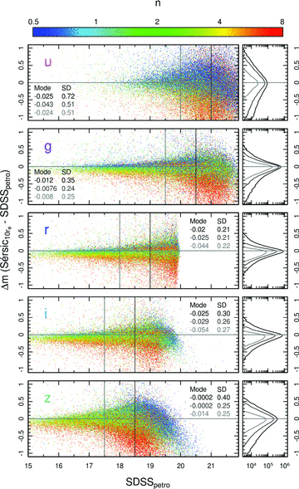
Figure 18 Comparison between Sérsic magnitudes truncated at 10r_{e} and SDSS Petrosian magnitudes for the five ...
Notes:
Figure 18 Comparison between Sérsic magnitudes truncated at 10re and SDSS Petrosian magnitudes for the five SDSS bandpasses as a function of SDSS Petrosian magnitude, with the data points coloured according to their Sérsic index in that band (left-hand column). Vertical lines define subsets at magnitudes brighter than those values, with corresponding statistics for mode and standard deviation inset into the figure. Density plots (right-hand column) show the relative density of objects in Δm space for each of the aforementioned subsets.
Unless provided in the caption above, the following copyright applies to the content of this slide: © 2012 The Authors Monthly Notices of the Royal Astronomical Society © 2012 RAS

Slide 20
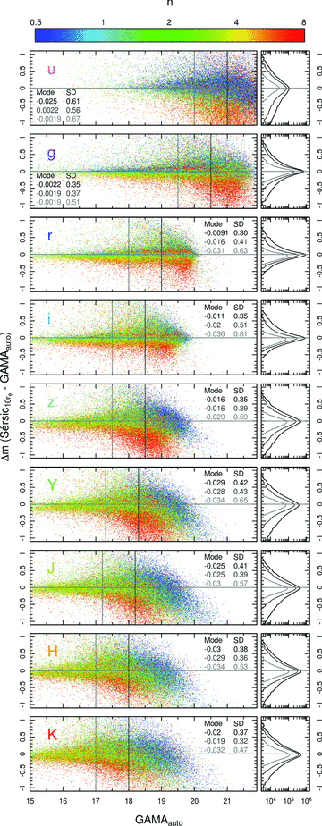
Figure 19 Comparison between Sérsic magnitudes truncated at 10r_{e} and GAMA AUTO magnitudes for all ...
Notes:
Figure 19 Comparison between Sérsic magnitudes truncated at 10re and GAMA AUTO magnitudes for all wavelengths as a function of GAMA AUTO magnitude, with the data points coloured according to their Sérsic index in that band (left-hand column). Vertical lines define subsets at magnitudes brighter than those values, with corresponding statistics for mode and standard deviation inset into the figure. Density plots (right-hand column) show the relative density of objects in Δm space for each of the aforementioned subsets.
Unless provided in the caption above, the following copyright applies to the content of this slide: © 2012 The Authors Monthly Notices of the Royal Astronomical Society © 2012 RAS

Slide 21
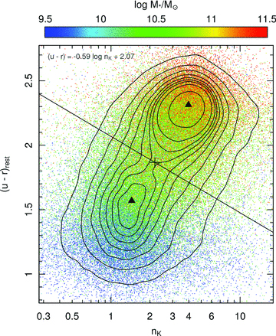
Figure 20 K-band Sérsic index versus u−r rest-frame colour, with the data points coloured according to their galaxy ...
Notes:
Figure 20 K-band Sérsic index versus u−r rest-frame colour, with the data points coloured according to their galaxy stellar mass estimates, as shown. Contours range from the 10th to the 90th percentile in steps of 10 per cent. The two highest peaks in object density, corresponding to two distinct galaxy populations (late- and early type for low- and high index, respectively), are represented by filled black triangles. The diagonal line lies perpendicular to the line connecting these two peaks, and bisects it at the point of lowest object density along the connecting line, marked on the figure with a plus sign. This dividing line defines two subsamples, which for the most massive galaxies, relate to disc-dominated systems below the line (LTGs) and spheroid-dominated systems above (ETGs), the equation of which is inset into the figure.
Unless provided in the caption above, the following copyright applies to the content of this slide: © 2012 The Authors Monthly Notices of the Royal Astronomical Society © 2012 RAS

Slide 22
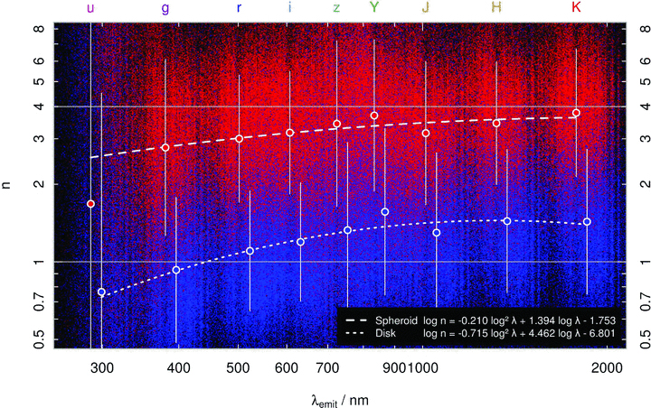
Figure 21 Recovered Sérsic index shown as a function of rest-frame wavelength in log–log space, coloured according to ...
Notes:
Figure 21 Recovered Sérsic index shown as a function of rest-frame wavelength in log–log space, coloured according to the population definitions described in Section 5.2. Blue data points correspond to disc-dominated galaxies whereas red data points correspond to spheroid-dominated galaxies. Large red and blue circles show the 3σ-clipped mean Sérsic indices for each respective population in each band, positioned at the median-redshift rest-frame wavelength for that population. Polynomial fits to these mean Sérsic indices are shown for both populations, the equations of which are inset into the figure. Owing to its lower quality imaging data, we exclude the u-band data in the calculation of these lines. Vertical lines show the 1σ spread in the data. For reference, grey horizontal lines at n= 1 and 4, equating to exponential and de Vaucouleurs profiles, respectively, are added.
Unless provided in the caption above, the following copyright applies to the content of this slide: © 2012 The Authors Monthly Notices of the Royal Astronomical Society © 2012 RAS

Slide 23
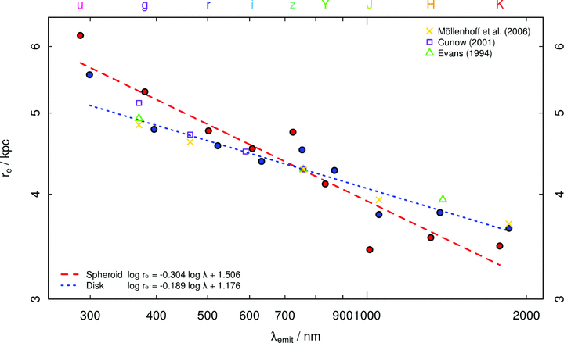
Figure 22 Recovered half-light radii in kpc as a function of rest-frame wavelength. Red and blue circles show the ...
Notes:
Figure 22 Recovered half-light radii in kpc as a function of rest-frame wavelength. Red and blue circles show the 3σ-clipped mean half-light radii for spheroid-dominated and disc-dominated galaxies, respectively, in each band, positioned at the median-redshift rest-frame wavelength for that population. Linear fits to these mean half-light radii are shown for both populations, the equations of which are inset into the figure. Owing to its lower quality imaging data, we exclude the u-band data in the calculation of these lines. Overlaid are data from several authors who predict an increase in the measured half-light radii in late-type systems due to the effects of dust. Further details are available in the text.
Unless provided in the caption above, the following copyright applies to the content of this slide: © 2012 The Authors Monthly Notices of the Royal Astronomical Society © 2012 RAS

Slide 24
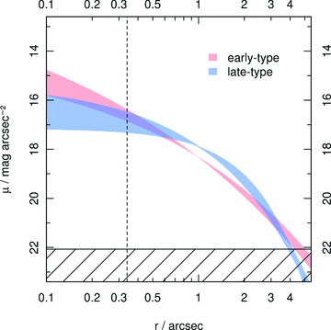
Figure 23 Surface brightness variation from u through to K for the early-type spheroid-dominated and late-type ...
Notes:
Figure 23 Surface brightness variation from u through to K for the early-type spheroid-dominated and late-type disc-dominated populations. We generate Sérsic indices and half-light radii in wavelength steps from u→K for each population using the trends as described in equations (10), (11), (14) and (15). Using these values, surface brightness profiles (without PSF convolution) may be constructed for each wavelength bin. The shaded regions shown here represent the maximal area swept out by these light profiles along the transition from u through K, and represent how much of an effect the reported changes in Sérsic index and half-light radius have on the overall light profiles. The hatched region indicates the brightest limit at which light profiles may be trusted (μlim,K= 22.07 mag arcsec−2), and the vertical dashed line represents 1 pixel in distance from the centre. Profiles are produced assuming a constant total magnitude of mtot= 15 for both the spheroid and disc populations.
Unless provided in the caption above, the following copyright applies to the content of this slide: © 2012 The Authors Monthly Notices of the Royal Astronomical Society © 2012 RAS

Slide 25
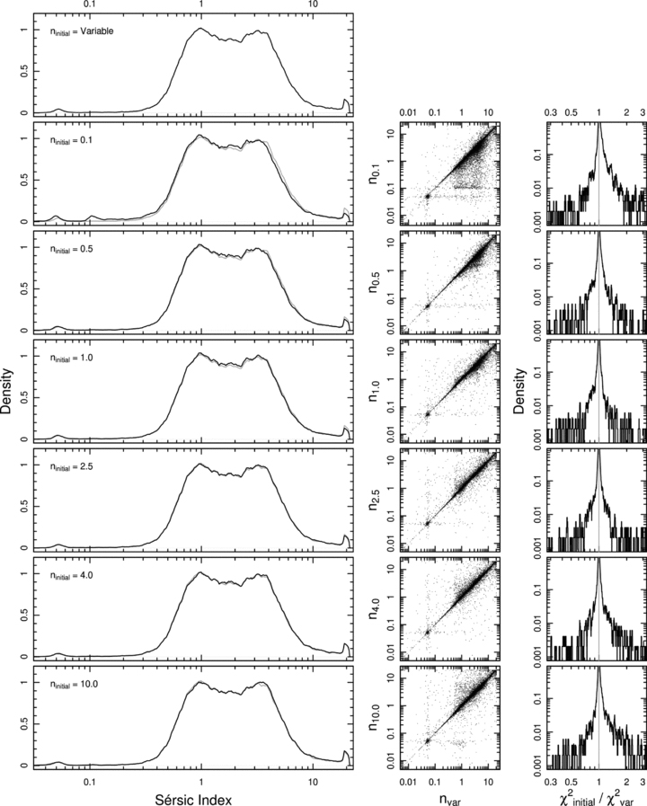
Figure B2 A plot comparing final modelled Sérsic indices for a sample of 49 395 galaxies in the r band given different ...
Notes:
Figure B2 A plot comparing final modelled Sérsic indices for a sample of 49 395 galaxies in the r band given different initial Sérsic indices, as shown. From top to bottom, the initial Sérsic indices fed into galfit are variable (see equation B1), 0.1, 0.5, 1.0, 2.5, 4.0 and 10.0. Underlying the fixed initial Sérsic index distributions is the distribution for the variable Sérsic index coloured in grey, for reference.
Unless provided in the caption above, the following copyright applies to the content of this slide: © 2012 The Authors Monthly Notices of the Royal Astronomical Society © 2012 RAS

