Slide 1
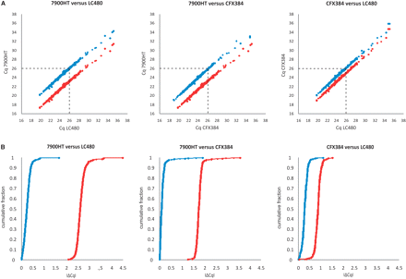
Figure 1. (a) Correlation plots of the Cq values from 366 samples for a representative target gene (ARHGEF7) measured ...
Notes:
Figure 1. (a) Correlation plots of the Cq values from 366 samples for a representative target gene (ARHGEF7) measured on two different qPCR platforms before (red) and after (blue) Cq level IRC using a five-point serial dilution series of external standards run in parallel with the patient samples. (b) Cumulative distribution plots of the difference in Cq for a representative target gene (ARHGEF7) and 366 samples measured on two different qPCR platforms before (red) and after (blue) Cq level IRC. Each dot represents a patient sample. The vertical (a) and horizontal (b) distance between two correlation scatterplots (a) or distribution plots (b) designates the platform dependent difference in Cq value between both platforms.
Unless provided in the caption above, the following copyright applies to the content of this slide: © The Author(s) 2009. Published by Oxford University Press.This is an Open Access article distributed under the terms of the Creative Commons Attribution Non-Commercial License (http://creativecommons.org/licenses/by-nc/2.5/uk/) which permits unrestricted non-commercial use, distribution, and reproduction in any medium, provided the original work is properly cited.

Slide 2
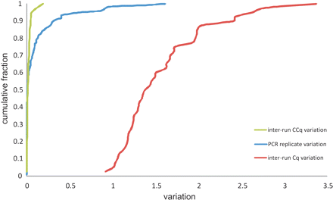
Figure 2. Cumulative distribution plots depicting the intra-run variation between the PCR replicates for the standard ...
Notes:
Figure 2. Cumulative distribution plots depicting the intra-run variation between the PCR replicates for the standard samples as well as the inter-run variation between IRC samples before and after IRC. Results are based on data from all tested genes (ARHGEF7, HIVEP2, HPRT1, MRPL3, NRCAM, SDHA, TNFRSF25 and UBC) on three different qPCR platforms (Cq, quantification cycle value; CCq, calibrated Cq value).
Unless provided in the caption above, the following copyright applies to the content of this slide: © The Author(s) 2009. Published by Oxford University Press.This is an Open Access article distributed under the terms of the Creative Commons Attribution Non-Commercial License (http://creativecommons.org/licenses/by-nc/2.5/uk/) which permits unrestricted non-commercial use, distribution, and reproduction in any medium, provided the original work is properly cited.

Slide 3
Figure 3. Correlation scatterplots between the CNRQ of 366 samples for a representative target gene (ARHGEF7) measured ...
Notes:
Figure 3. Correlation scatterplots between the CNRQ of 366 samples for a representative target gene (ARHGEF7) measured on two different qPCR platforms indicate almost perfect concordance, validating NRQ level IRC.
Unless provided in the caption above, the following copyright applies to the content of this slide: © The Author(s) 2009. Published by Oxford University Press.This is an Open Access article distributed under the terms of the Creative Commons Attribution Non-Commercial License (http://creativecommons.org/licenses/by-nc/2.5/uk/) which permits unrestricted non-commercial use, distribution, and reproduction in any medium, provided the original work is properly cited.

