Slide 1
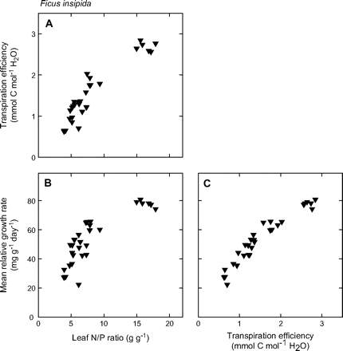
Fig. 1. Transpiration efficiency (A) and mean relative growth rate (B) plotted against leaf N/P mass ratio, and mean ...
Notes:
Fig. 1. Transpiration efficiency (A) and mean relative growth rate (B) plotted against leaf N/P mass ratio, and mean relative growth rate plotted against transpiration efficiency (C) for Ficus insipida plants subject to varying soil fertility.
Unless provided in the caption above, the following copyright applies to the content of this slide: © 2007 The Author(s).This is an Open Access article distributed under the terms of the Creative Commons Attribution Non-Commercial License (http://creativecommons.org/licenses/by-nc/2.0/uk/) which permits unrestricted non-commercial use, distribution, and reproduction in any medium, provided the original work is properly cited.This paper is available online free of all access charges (see http://jxb.oxfordjournals.org/open_access.html for further details)

Slide 2
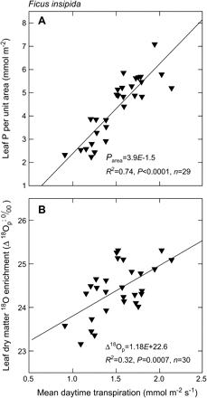
Fig. 2. Leaf P per unit area (A) and leaf dry matter ¹⁸O enrichment (B) plotted against mean daytime ...
Notes:
Fig. 2. Leaf P per unit area (A) and leaf dry matter 18O enrichment (B) plotted against mean daytime transpiration rate for Ficus insipida plants. Transpiration was determined gravimetrically for whole plants on 1–3 November 2005; plant leaf area was determined after harvest on 4 November 2005.
Unless provided in the caption above, the following copyright applies to the content of this slide: © 2007 The Author(s).This is an Open Access article distributed under the terms of the Creative Commons Attribution Non-Commercial License (http://creativecommons.org/licenses/by-nc/2.0/uk/) which permits unrestricted non-commercial use, distribution, and reproduction in any medium, provided the original work is properly cited.This paper is available online free of all access charges (see http://jxb.oxfordjournals.org/open_access.html for further details)

Slide 3
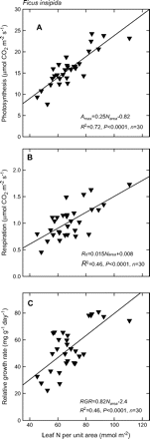
Fig. 3. Light-saturated photosynthesis (A), leaf dark respiration (B), and mean relative growth rate (C) plotted ...
Notes:
Fig. 3. Light-saturated photosynthesis (A), leaf dark respiration (B), and mean relative growth rate (C) plotted against leaf N per unit area for plants of Ficus insipida subject to varying soil fertility. Leaf photosynthesis was measured during morning and midday on 20 October 2005; mean photon flux density was ∼1200 μmol m−2 s−1. Leaf dark respiration was measured on 3 November 2005; mean leaf temperature was ∼26 °C. Gas-exchange measurements were made on the youngest fully-expanded leaf for each plant.
Unless provided in the caption above, the following copyright applies to the content of this slide: © 2007 The Author(s).This is an Open Access article distributed under the terms of the Creative Commons Attribution Non-Commercial License (http://creativecommons.org/licenses/by-nc/2.0/uk/) which permits unrestricted non-commercial use, distribution, and reproduction in any medium, provided the original work is properly cited.This paper is available online free of all access charges (see http://jxb.oxfordjournals.org/open_access.html for further details)

Slide 4
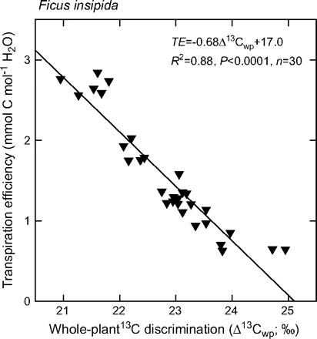
Fig. 4. Transpiration efficiency (TE) plotted as a function of whole-plant C isotope discrimination ...
Notes:
Fig. 4. Transpiration efficiency (TE) plotted as a function of whole-plant C isotope discrimination (Δ13Cwp) for Ficus insipida plants subject to varying soil fertility. The Δ13Cwp was calculated from measurements of δ13C and C mass in leaves, stems, and roots. The δ13C of ambient air was assumed to be –8‰.
Unless provided in the caption above, the following copyright applies to the content of this slide: © 2007 The Author(s).This is an Open Access article distributed under the terms of the Creative Commons Attribution Non-Commercial License (http://creativecommons.org/licenses/by-nc/2.0/uk/) which permits unrestricted non-commercial use, distribution, and reproduction in any medium, provided the original work is properly cited.This paper is available online free of all access charges (see http://jxb.oxfordjournals.org/open_access.html for further details)

Slide 5
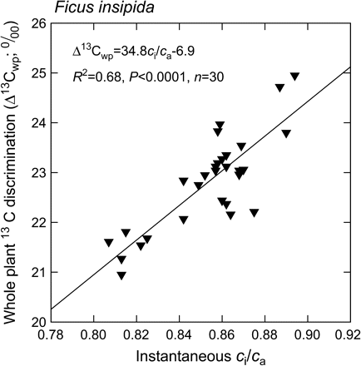
Fig. 5. Whole-plant C isotope discrimination (Δ¹³C_{wp}) plotted as a function of the ratio of ...
Notes:
Fig. 5. Whole-plant C isotope discrimination (Δ13Cwp) plotted as a function of the ratio of intercellular to ambient CO2 mole fractions (ci/ca) for plants of Ficus insipida subject to varying soil fertility. The ci/ca was calculated from instantaneous leaf gas exchange measurements made during the morning and at midday on 20 October 2005. The Δ13Cwp was calculated from measurements of δ13C and C mass in leaves, stems, and roots. The δ13C of ambient air was assumed to be –8‰.
Unless provided in the caption above, the following copyright applies to the content of this slide: © 2007 The Author(s).This is an Open Access article distributed under the terms of the Creative Commons Attribution Non-Commercial License (http://creativecommons.org/licenses/by-nc/2.0/uk/) which permits unrestricted non-commercial use, distribution, and reproduction in any medium, provided the original work is properly cited.This paper is available online free of all access charges (see http://jxb.oxfordjournals.org/open_access.html for further details)

Slide 6
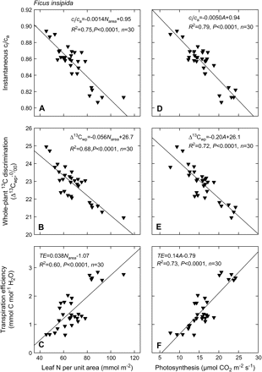
Fig. 6. Ratio of intercellular to ambient CO₂ mole fractions, c_{i}/c_{a}, determined from ...
Notes:
Fig. 6. Ratio of intercellular to ambient CO2 mole fractions, ci/ca, determined from instantaneous gas-exchange measurements (A), whole-plant C isotope discrimination, Δ13Cwp (B), and transpiration efficiency, TE (C) plotted against leaf N per unit area. Similarly, ci/ca (D), Δ13Cwp (E), and TE (F) plotted against light-saturated net photosynthetic rate of the youngest fully-expanded leaf.
Unless provided in the caption above, the following copyright applies to the content of this slide: © 2007 The Author(s).This is an Open Access article distributed under the terms of the Creative Commons Attribution Non-Commercial License (http://creativecommons.org/licenses/by-nc/2.0/uk/) which permits unrestricted non-commercial use, distribution, and reproduction in any medium, provided the original work is properly cited.This paper is available online free of all access charges (see http://jxb.oxfordjournals.org/open_access.html for further details)

