Slide 1
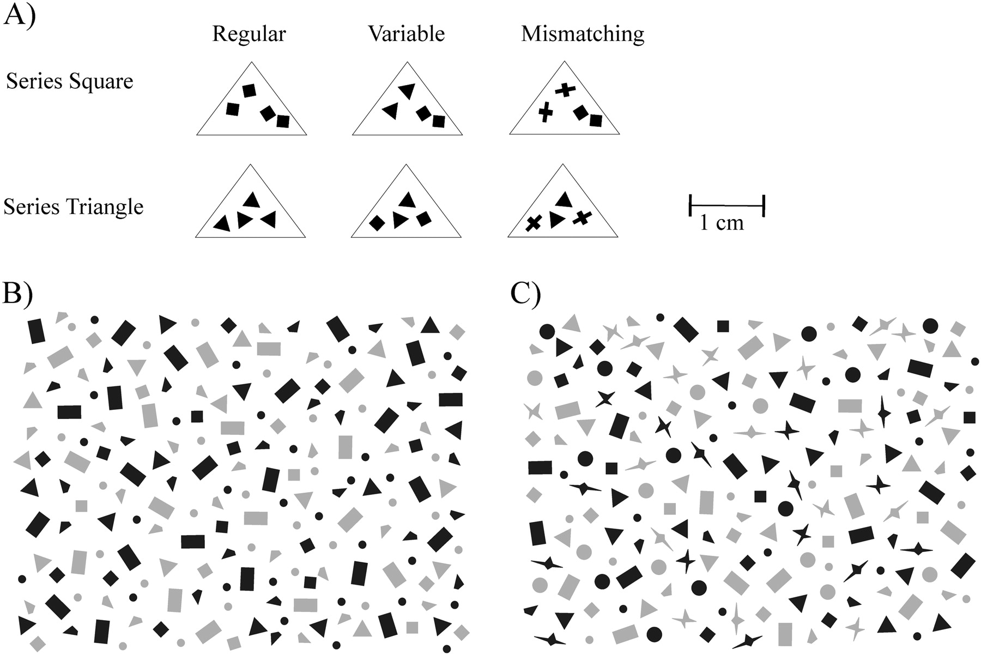
Figure 1 (A) Examples of prey items from the 2 prey series (Square and Triangle) of the 3 prey categories: repeated (4 ...
Notes:
Figure 1 (A) Examples of prey items from the 2 prey series (Square and Triangle) of the 3 prey categories: repeated (4 identical, background-matching elements), variable (4 background-matching elements of 2 different shapes), and mismatching (2 background-matching and 2 background-mismatching elements). (B) The simple and (C) the complex background. The borderlines around the prey items are included for illustratory reasons only.
Unless provided in the caption above, the following copyright applies to the content of this slide: © The Author 2011. Published by Oxford University Press on behalf of the International Society for Behavioral Ecology. All rights reserved. For permissions, please e-mail: journals.permissions@oup.com

Slide 2
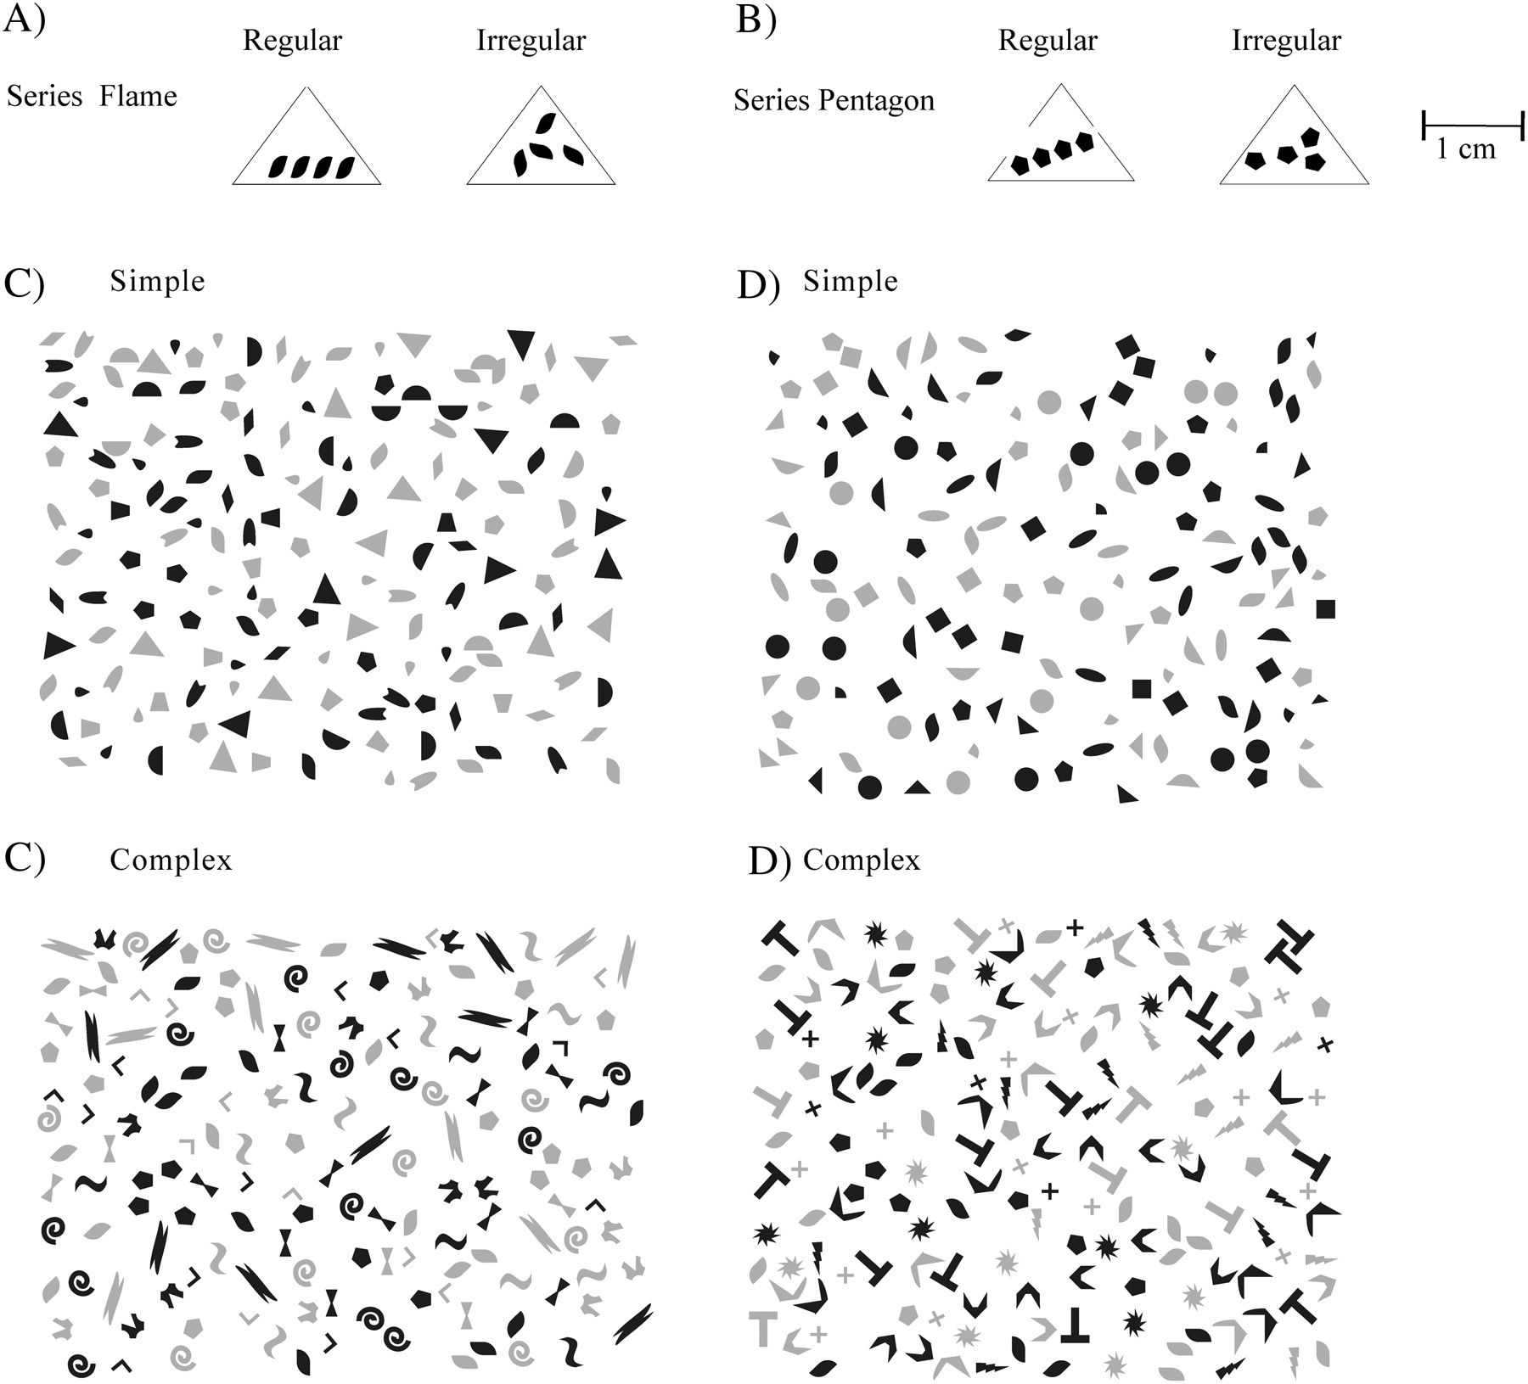
Figure 2 Examples of prey items of the 2 prey series (A) Flame and (B) Pentagon of the 2 prey categories: spatially ...
Notes:
Figure 2 Examples of prey items of the 2 prey series (A) Flame and (B) Pentagon of the 2 prey categories: spatially regular (4 identical pattern elements placed spatially regular) and spatially irregular (4 identical pattern elements placed randomly). The simple and the complex background pair that (C) prey series Flame and (D) prey series Pentagon were displayed on in experiment 2. The borderlines around the prey items are included for illustratory reasons only.
Unless provided in the caption above, the following copyright applies to the content of this slide: © The Author 2011. Published by Oxford University Press on behalf of the International Society for Behavioral Ecology. All rights reserved. For permissions, please e-mail: journals.permissions@oup.com

Slide 3
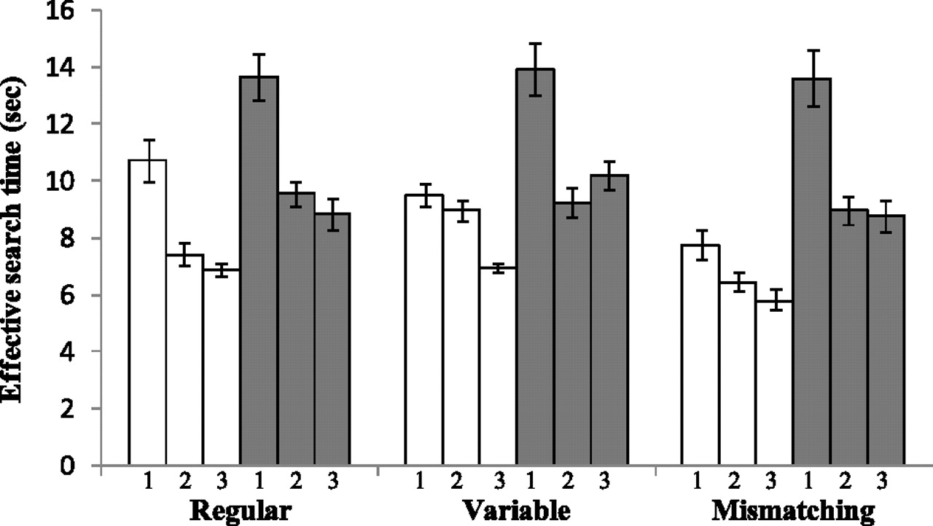
Figure 3 The effective search times (mean ± back-transformed standard error) for the 3 prey categories regular ...
Notes:
Figure 3 The effective search times (mean ± back-transformed standard error) for the 3 prey categories regular background-matching pattern (Regular); variable background-matching pattern (Variable); and variable mismatching pattern (Mismatching) on the 2 backgrounds. White bars show the search times on the simple background and gray bars show the search times on the complex background. Each combination of a prey category and a background was presented 3 times, and the presentation order is denoted within a combination by the number underneath each bar.
Unless provided in the caption above, the following copyright applies to the content of this slide: © The Author 2011. Published by Oxford University Press on behalf of the International Society for Behavioral Ecology. All rights reserved. For permissions, please e-mail: journals.permissions@oup.com

Slide 4
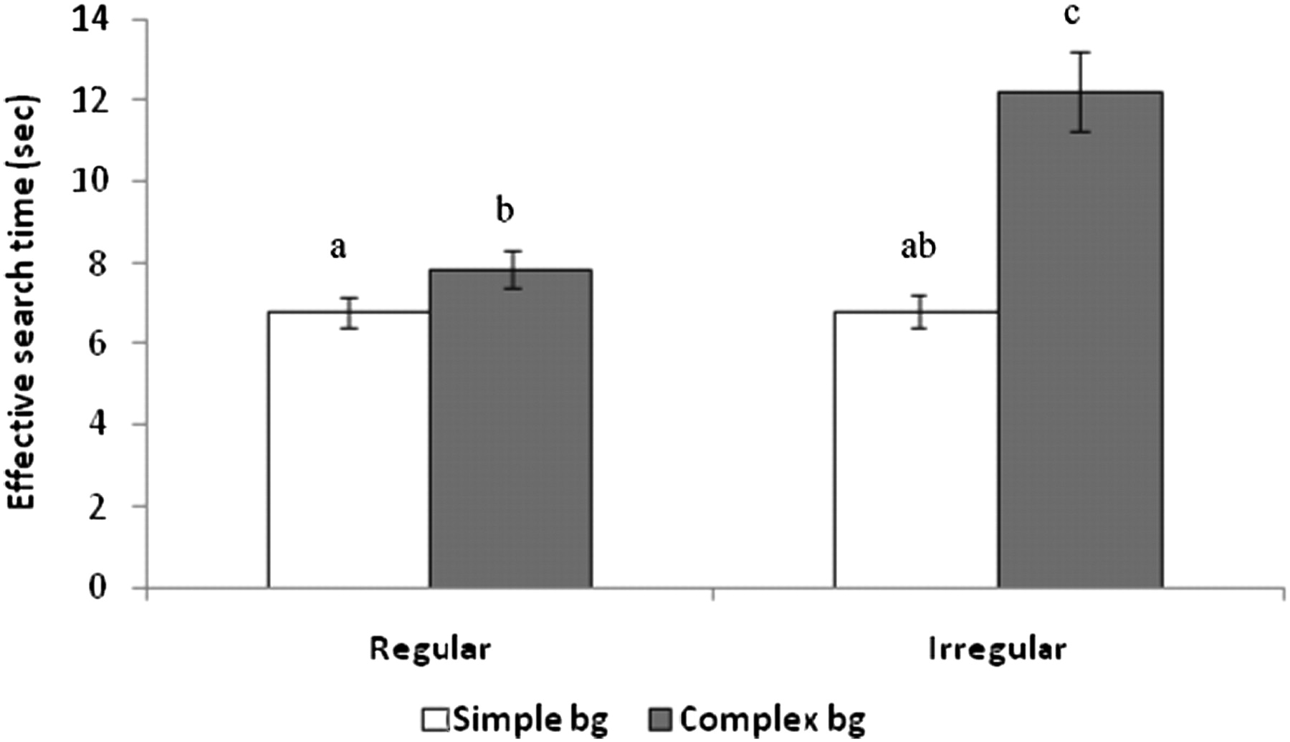
Figure 4 The effective search time (seconds) for the spatially regular and the spatially irregular prey category on ...
Notes:
Figure 4 The effective search time (seconds) for the spatially regular and the spatially irregular prey category on the simple background (white bars) and the complex background (gray bars). The letters above the bars denote the results of the post hoc comparisons so that bars with different letters differ significantly from each other. Whiskers are back-transformed standard errors.
Unless provided in the caption above, the following copyright applies to the content of this slide: © The Author 2011. Published by Oxford University Press on behalf of the International Society for Behavioral Ecology. All rights reserved. For permissions, please e-mail: journals.permissions@oup.com

