Slide 1
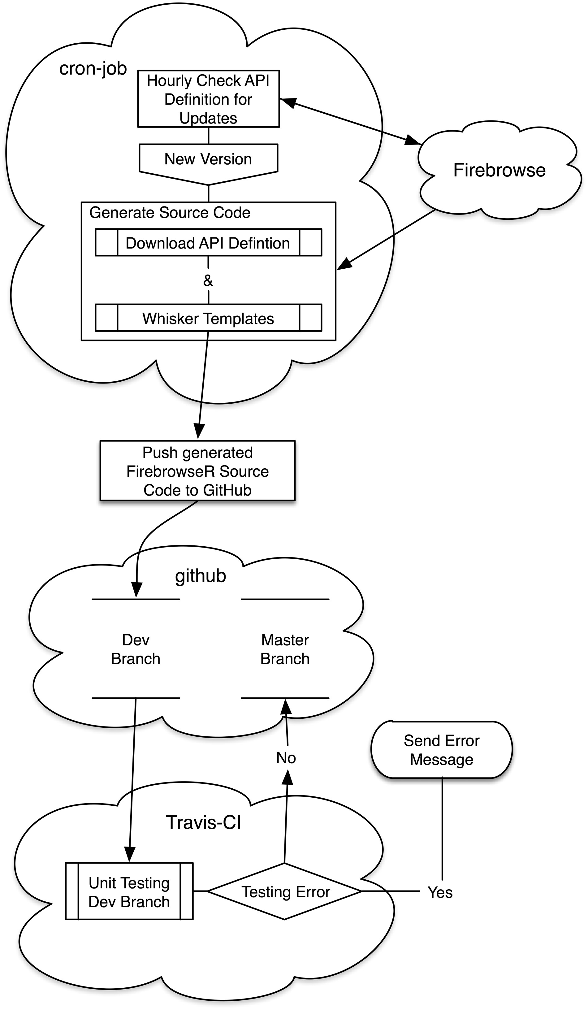
Figure 1. The complete system is composed of three web platforms. On cron-job.org the current API version is checked ...
Notes:
Figure 1. The complete system is composed of three web platforms. On cron-job.org the current API version is checked hourly and compared to the last one generated. If a new version is available, its definition is downloaded and the R source code is generated using whisker templates. The newly generated source code is then pushed to a developer branch on the second component, github.com. The third component, travisci.com, now applies pre-defined unit tests to the generated source on github’s developer branch. If no errors occur, the new R code is pushed into the repositories master branch. Otherwise the developer is notified via mail.
Unless provided in the caption above, the following copyright applies to the content of this slide: © The Author(s) 2016. Published by Oxford University Press.This is an Open Access article distributed under the terms of the Creative Commons Attribution License (http://creativecommons.org/licenses/by/4.0/), which permits unrestricted reuse, distribution, and reproduction in any medium, provided the original work is properly cited.

Slide 2
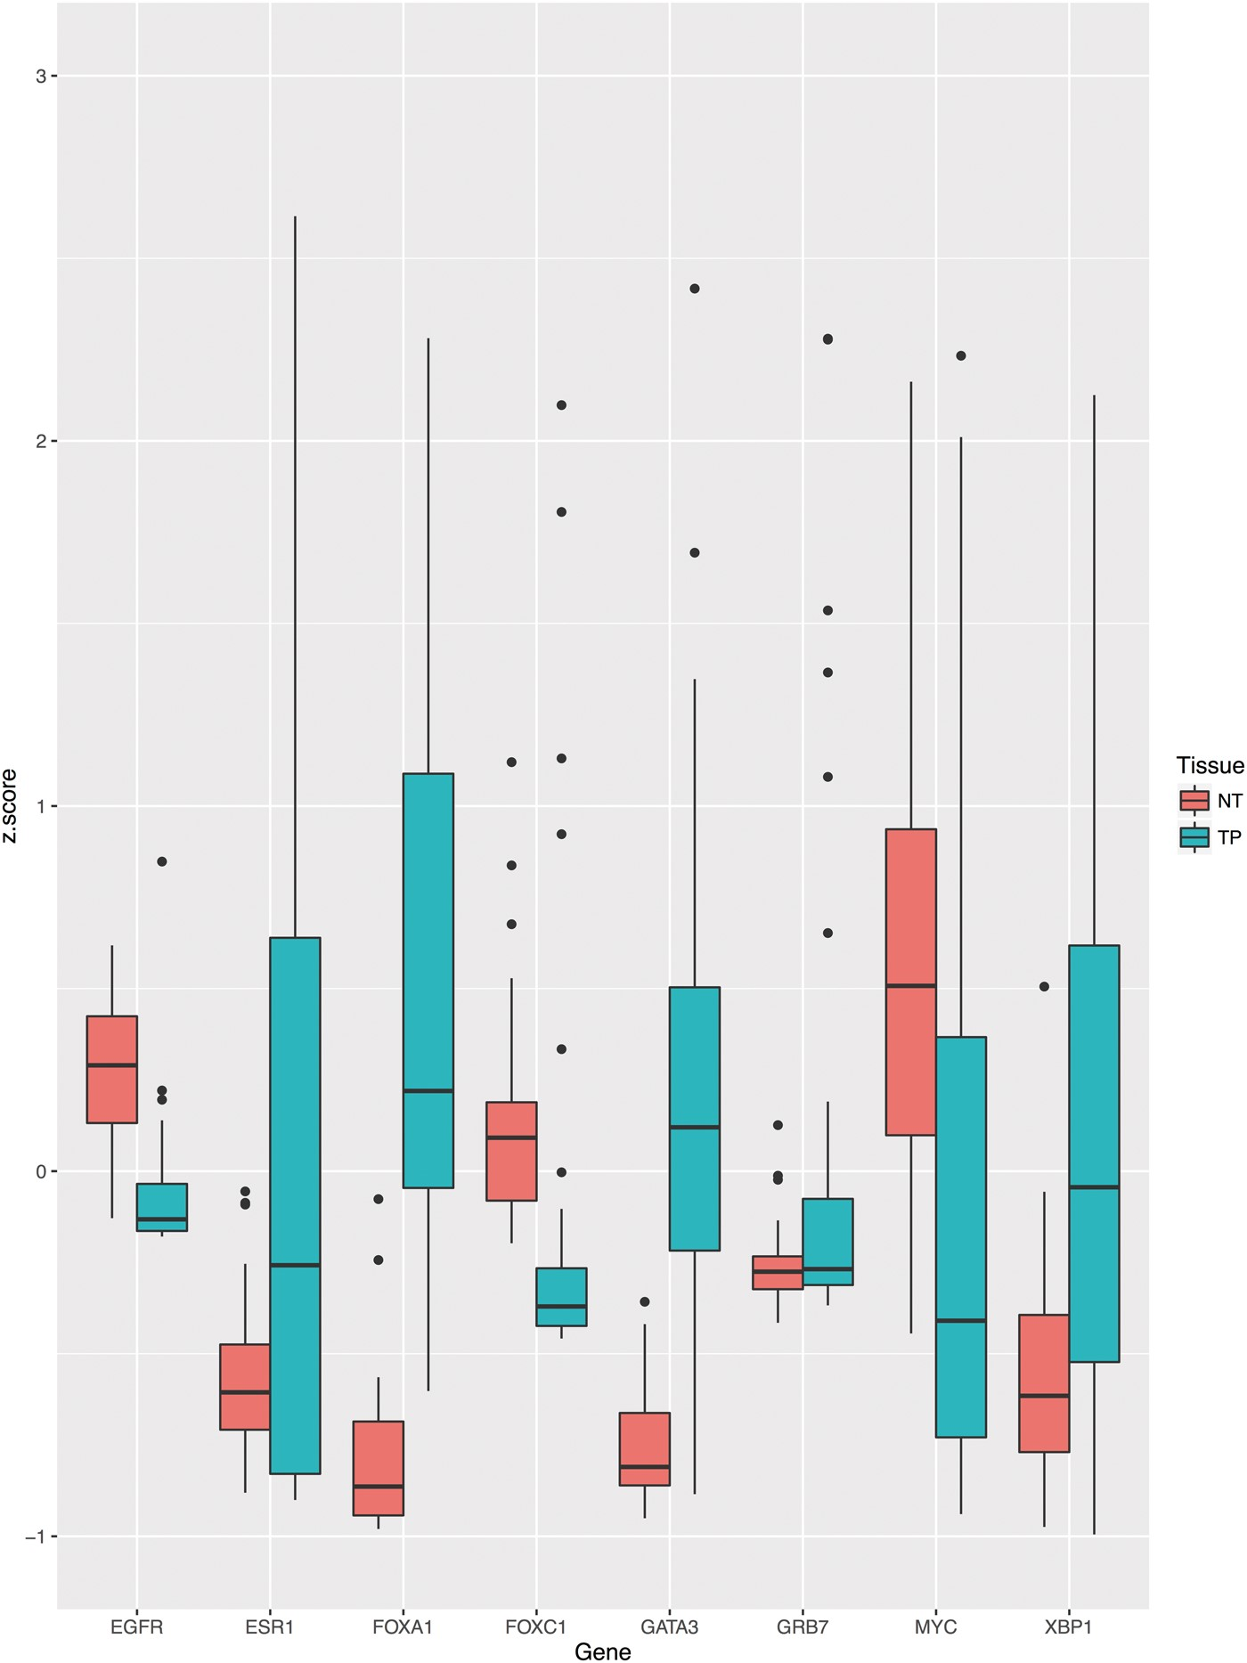
Figure 2. Boxplot indicating the expressions levels for tumor and adjacent normal tissue of deceased breast cancer ...
Notes:
Figure 2. Boxplot indicating the expressions levels for tumor and adjacent normal tissue of deceased breast cancer patients. To provide clear example, well-known onco genes have been used to display potential differential expression.
Unless provided in the caption above, the following copyright applies to the content of this slide: © The Author(s) 2016. Published by Oxford University Press.This is an Open Access article distributed under the terms of the Creative Commons Attribution License (http://creativecommons.org/licenses/by/4.0/), which permits unrestricted reuse, distribution, and reproduction in any medium, provided the original work is properly cited.

