Slide 1
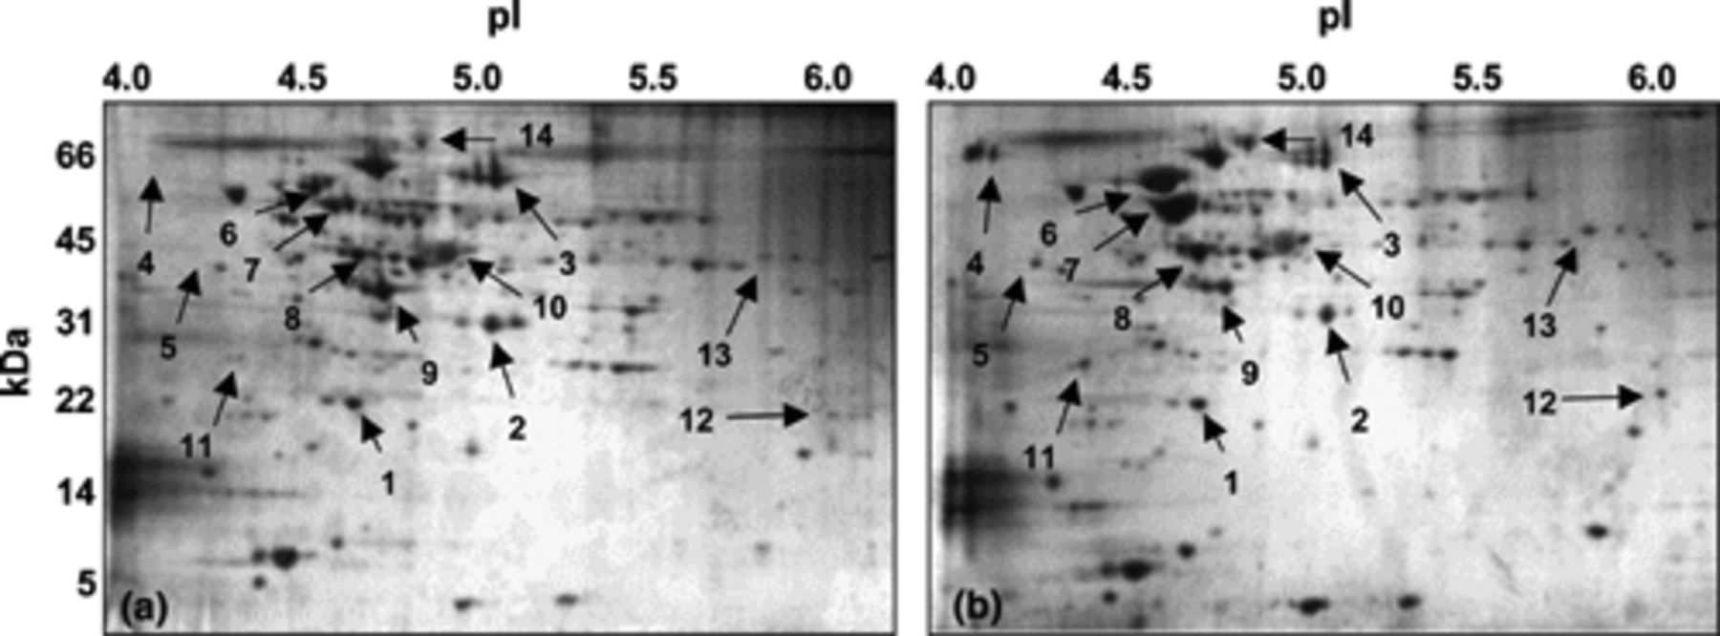
1 Silver-stained 2D-gels of cellular proteins extracted from non-stressed (a) and heat-shock treated (b) B. ...
Notes:
1 Silver-stained 2D-gels of cellular proteins extracted from non-stressed (a) and heat-shock treated (b) B. longum 3A cells. The numbered spots represent proteins, which were identified by MALDI-TOF/(TOF) analyses (Table 1). The horizontal and vertical axes represent pH (pI) range and molecular weight (kDa), respectively. 2D-gels were calibrated with the Bio-Rad 2D SDS–PAGE standards.
Unless provided in the caption above, the following copyright applies to the content of this slide: © 2005 Federation of European Microbiological Societies

Slide 2
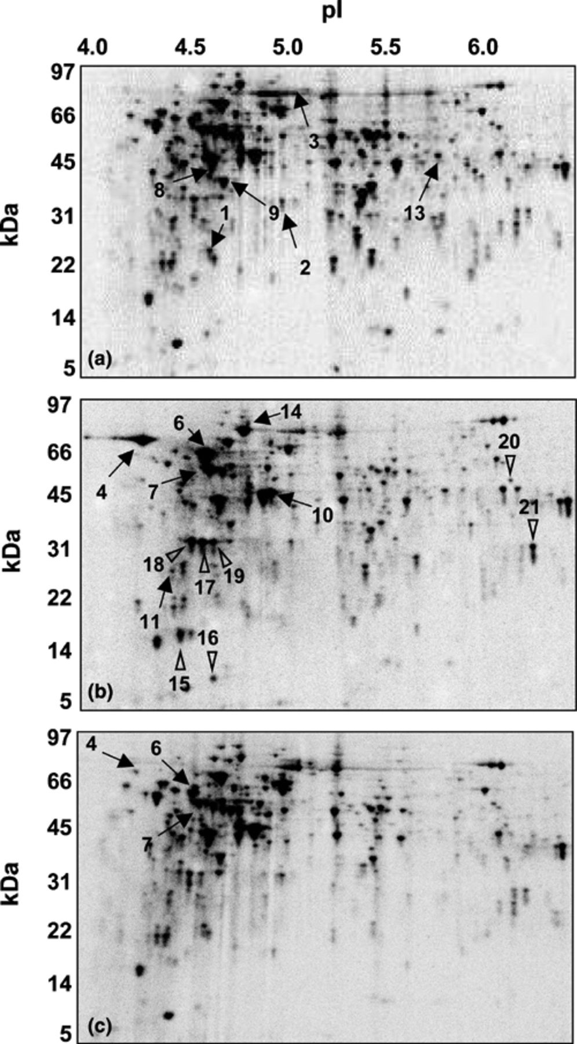
2 Assessment of protein synthesis of B.longum 3A by [³⁵S]methionine labelling in SDM followed by ...
Notes:
2 Assessment of protein synthesis of B.longum 3A by [35S]methionine labelling in SDM followed by 2D-PAGE. (a) 2D-image of proteins extracted from cells pulse-chase labelled (a) at 37°C and (b) 47°C, or (c) from cells pulse-chase labelled at 37°C in the presence of 0.1% bile salt. The spot numbers 1–13 (a) represent proteins exhibiting constant expression level (Table 2). The spot numbers 4–21 (b) and 4–7 (c) represent proteins displaying increased synthesis (Table 2). Proteins marked with arrows were identified by MALDI-TOF/(TOF) analyses. Triangles refer to upregulated proteins that were not identified by MALDI-TOF(TOF). Horizontal and vertical axes represent pH (pI) range and molecular weight (kDa), respectively. 2D-gels were calibrated with the Bio-Rad 2D SDS–PAGE standards.
Unless provided in the caption above, the following copyright applies to the content of this slide: © 2005 Federation of European Microbiological Societies

Slide 3
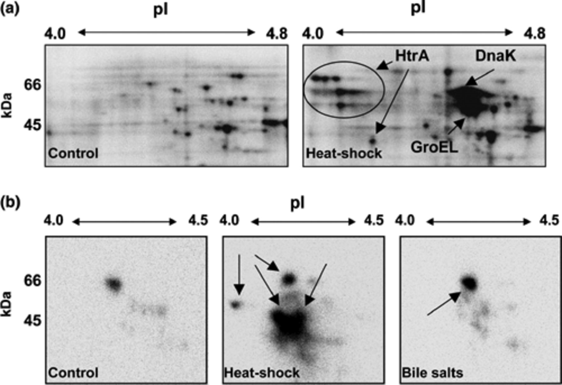
3 Expression of HtrA in response to heat and bile salts stress. (a) Portions of 2D-gels representing proteins ...
Notes:
3 Expression of HtrA in response to heat and bile salts stress. (a) Portions of 2D-gels representing proteins of B. longum 3A in the pH range of 4.0–4.8. Cells were subjected to pulse-chase labelling for 30 min at 37 or 47°C. (b) Immunoblotting of 2D-gels with HtrA specific antibodies. Protein samples (200 μg) used for immunoblots were extracted from B. longum before and 30 min after exposing the cells to heat- or bile salt stress. Detection system based on chemiluminescence was used to visualize the cross-reacting proteins. DnaK, GroEL and HtrA are marked with arrows. Circled proteins refer to probable isoforms of HtrA. Horizontal and vertical axes represent pH (pI) range and the molecular weight (kDa), respectively. 2D-gels were calibrated with the Bio-Rad 2D SDS–PAGE standard.
Unless provided in the caption above, the following copyright applies to the content of this slide: © 2005 Federation of European Microbiological Societies

