Slide 1
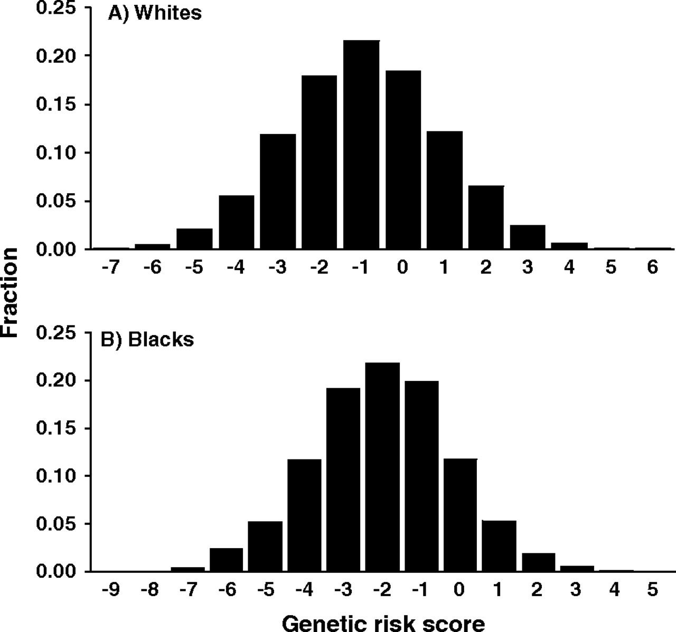
FIGURE 1. Distribution of the genetic risk score for predicting coronary heart disease in Whites (A) and Blacks (B), ...
Notes:
FIGURE 1. Distribution of the genetic risk score for predicting coronary heart disease in Whites (A) and Blacks (B), the Atherosclerosis Risk in Communities study, United States, 1986–2001.
Unless provided in the caption above, the following copyright applies to the content of this slide: American Journal of Epidemiology Copyright © 2007 by the Johns Hopkins Bloomberg School of Public Health All rights reserved; printed in U.S.A.

Slide 2
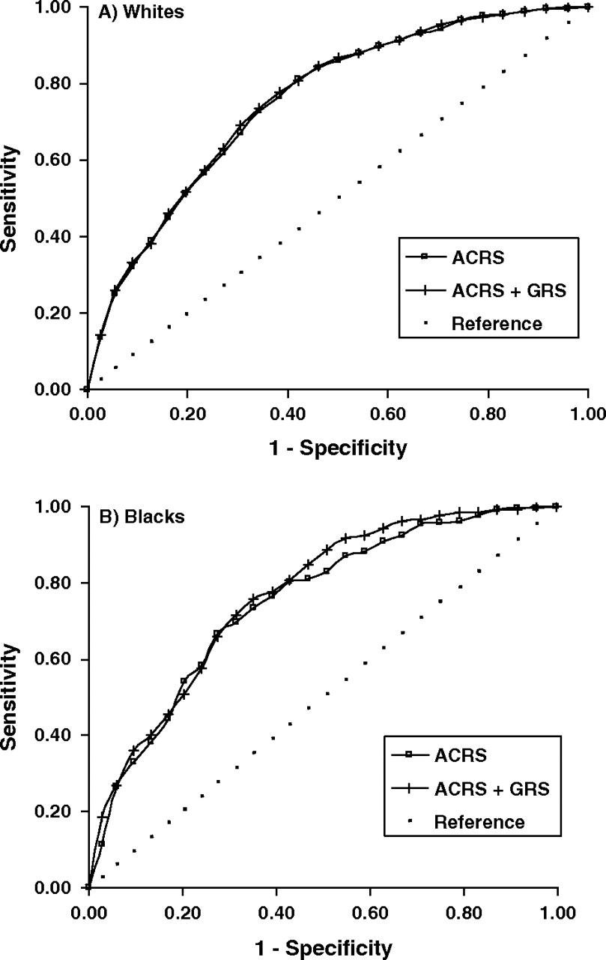
FIGURE 2. Receiver operating characteristic curves using the Atherosclerosis Risk in Communities study cardiovascular ...
Notes:
FIGURE 2. Receiver operating characteristic curves using the Atherosclerosis Risk in Communities study cardiovascular risk score (ACRS) alone and incorporating the genetic risk score (GRS) for Whites (A) and Blacks (B), United States, 1986–2001.
Unless provided in the caption above, the following copyright applies to the content of this slide: American Journal of Epidemiology Copyright © 2007 by the Johns Hopkins Bloomberg School of Public Health All rights reserved; printed in U.S.A.

