Slide 1
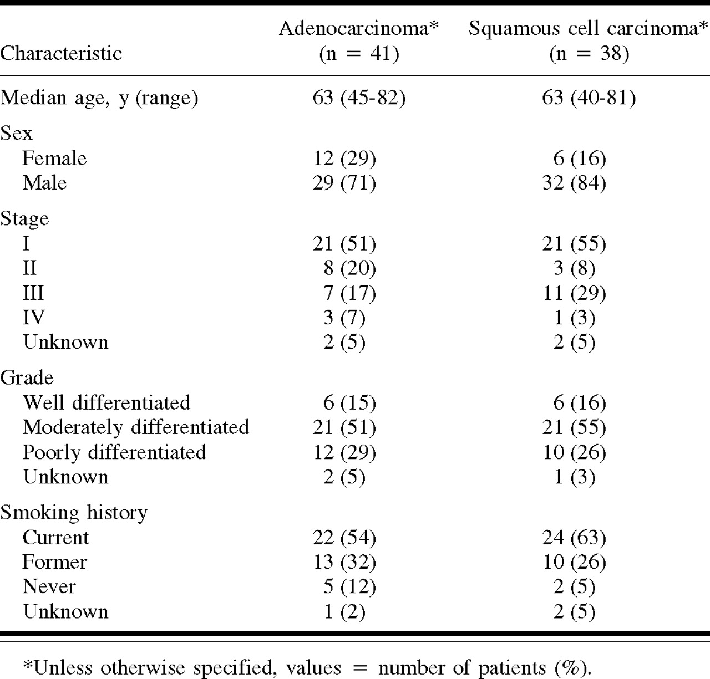
Table 1. Table 1. Clinical data of specimens from non-small-cell lung cancers
Notes:
Table 1. Table 1. Clinical data of specimens from non-small-cell lung cancers
Unless provided in the caption above, the following copyright applies to the content of this slide:

Slide 2
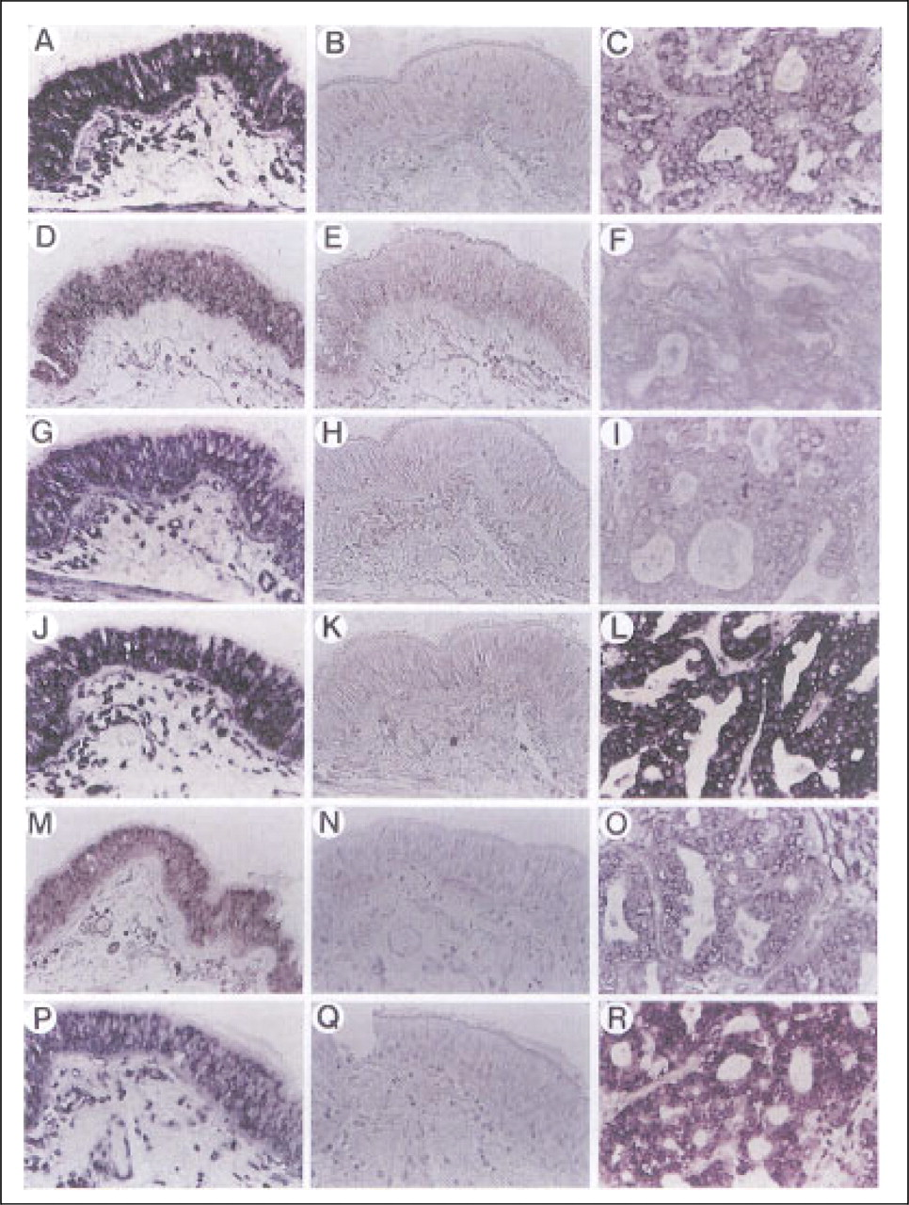
Fig. 1. Fig. 1. Localization of nuclear retinoic acid receptor (RAR) and retinoid X receptor (RXR) messenger RNAs in ...
Notes:
Fig. 1. Fig. 1. Localization of nuclear retinoic acid receptor (RAR) and retinoid X receptor (RXR) messenger RNAs in sections of surgical specimens from normal bronchus and lung adenocarcinoma by in situ hybridization. Consecutive sections of formalin-fixed, paraffin-embedded normal human lung tissue were hybridized with RARβ antisense (A) or sense (B); RARγ antisense (D) or sense (E): RARα antisense (G) or sense (H); RXRα antisense (J) or sense (K); RXRβ antisense (M) or sense (N); and RXRγ antisense (P) or sense (Q). Consecutive sections of lung adenocarcinoma were hybridized with antisense riboprobes for RARα (C); RARβ (F); RARγ (I); RXRα (L); RXRβ (O); or RXRγ (R).
Unless provided in the caption above, the following copyright applies to the content of this slide:

Slide 3
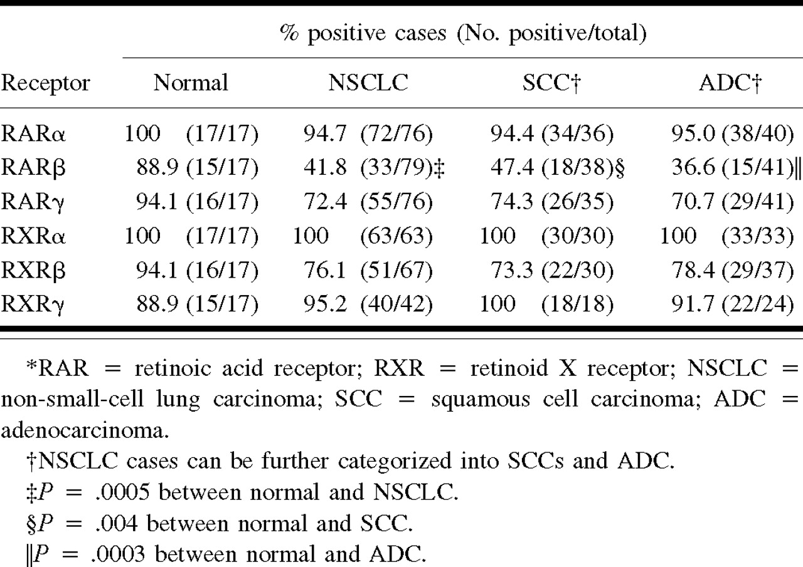
Table 2. Table 2. Expression of RAR and RXR messenger RNAs in normal bronchial epithelia and NSCLC*
Notes:
Table 2. Table 2. Expression of RAR and RXR messenger RNAs in normal bronchial epithelia and NSCLC*
Unless provided in the caption above, the following copyright applies to the content of this slide:

Slide 4
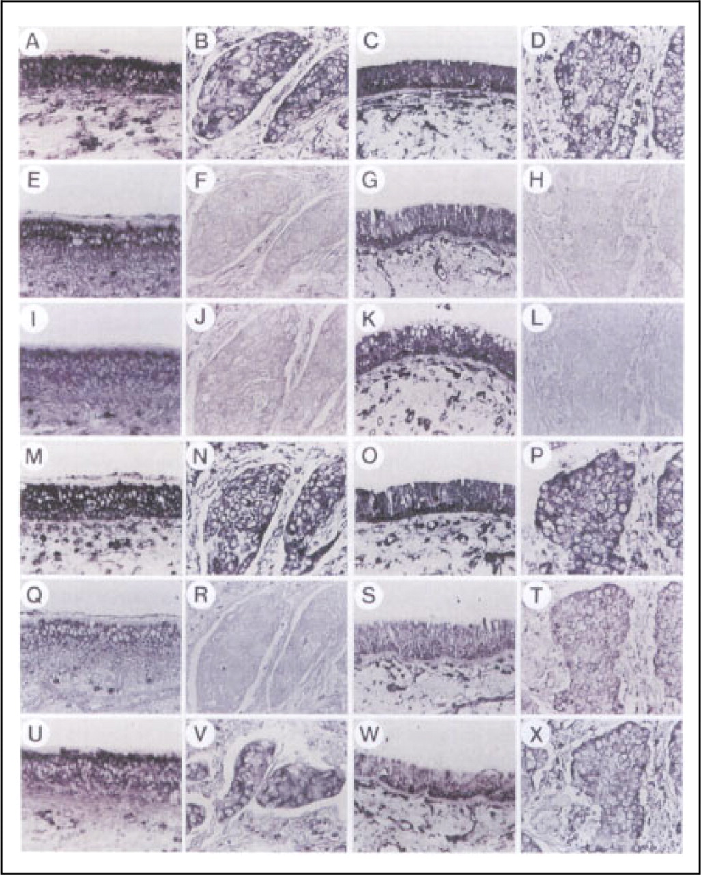
Fig. 2. Fig. 2. Localization of nuclear retinoic acid receptor (RAR) and retinoid X receptor (RXR) messenger RNAs in ...
Notes:
Fig. 2. Fig. 2. Localization of nuclear retinoic acid receptor (RAR) and retinoid X receptor (RXR) messenger RNAs in matched pairs of either adjacent normal or distant normal bronchial tissue and their corresponding squamous cell carcinomas (SCCs) by in situ hybridization. Consecutive sections of for-malin-fixed, paraffin-embedded adjacent normal lung tissue (A, E, I, M, Q, and U) and the corresponding SCCs (B, F, J, N, R, and V) and distant lung tissue (C, G,K,O, S, and W) or the corresponding SCCs (D, H, L, P, T, and X) were hybridized with antisense probes for RAR (A, B, C, and D); RAR (E, F, G, and H); RAR (I, J, K, and L); RXR (M, N, O, and P); RXR (Q, R, S, T); or RXR (U, V, W, and X).
Unless provided in the caption above, the following copyright applies to the content of this slide:

Slide 5
Table 3. Table 3. Comparison of expression of RAR and RXR messenger RNAs in matched pairs of distant and adjacent ...
Notes:
Table 3. Table 3. Comparison of expression of RAR and RXR messenger RNAs in matched pairs of distant and adjacent normal bronchial epithelia and the corresponding NSCLC*
Unless provided in the caption above, the following copyright applies to the content of this slide:

