Slide 1
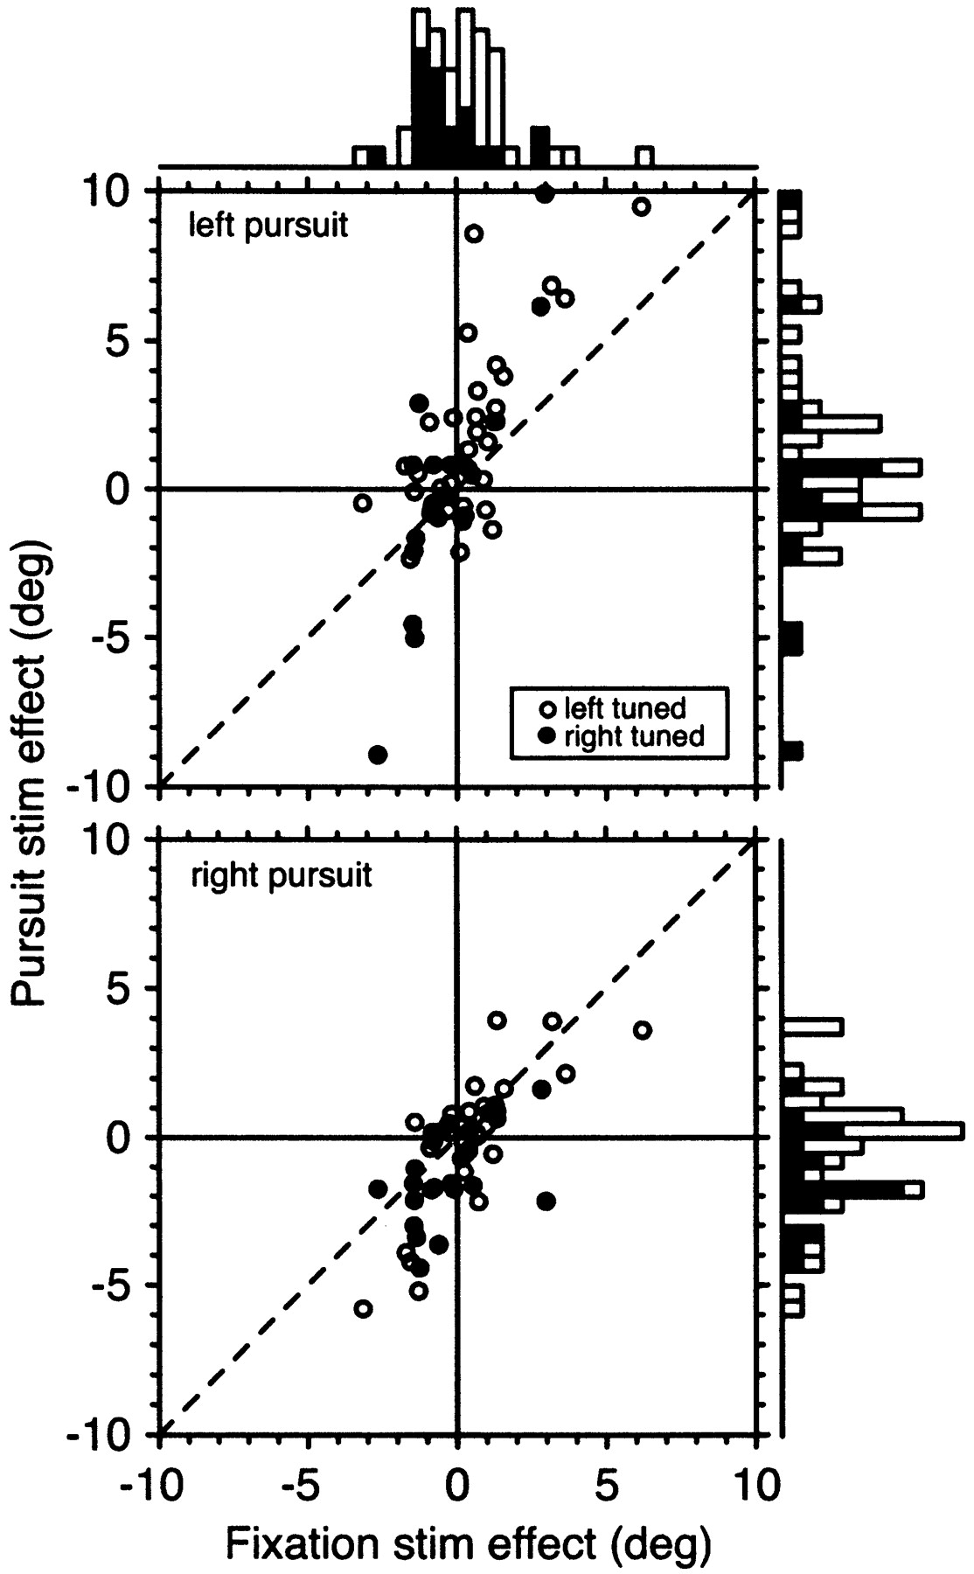
Figure 13. The interaction between smooth pursuit condition and the effects of MST microstimulation. In each panel, we ...
Notes:
Figure 13. The interaction between smooth pursuit condition and the effects of MST microstimulation. In each panel, we plot the effect without pursuit (x-axis) against the effect in the same experiment on the interleaved trials with pursuit. Solid symbols denote experiments performed in right-tuned sites; open symbols show those with left-tuned sites. The dashed line indicates equal effect under both conditions. The correlation coefficients under both conditions were significant (left pursuit, 0.75; right pursuit, 0.71) and the slopes in both relationships were significantly greater than one (regression assuming equal variance on x and y: left pursuit, 2.55; right pursuit, 1.45).
Unless provided in the caption above, the following copyright applies to the content of this slide: © Oxford University Press

Slide 2
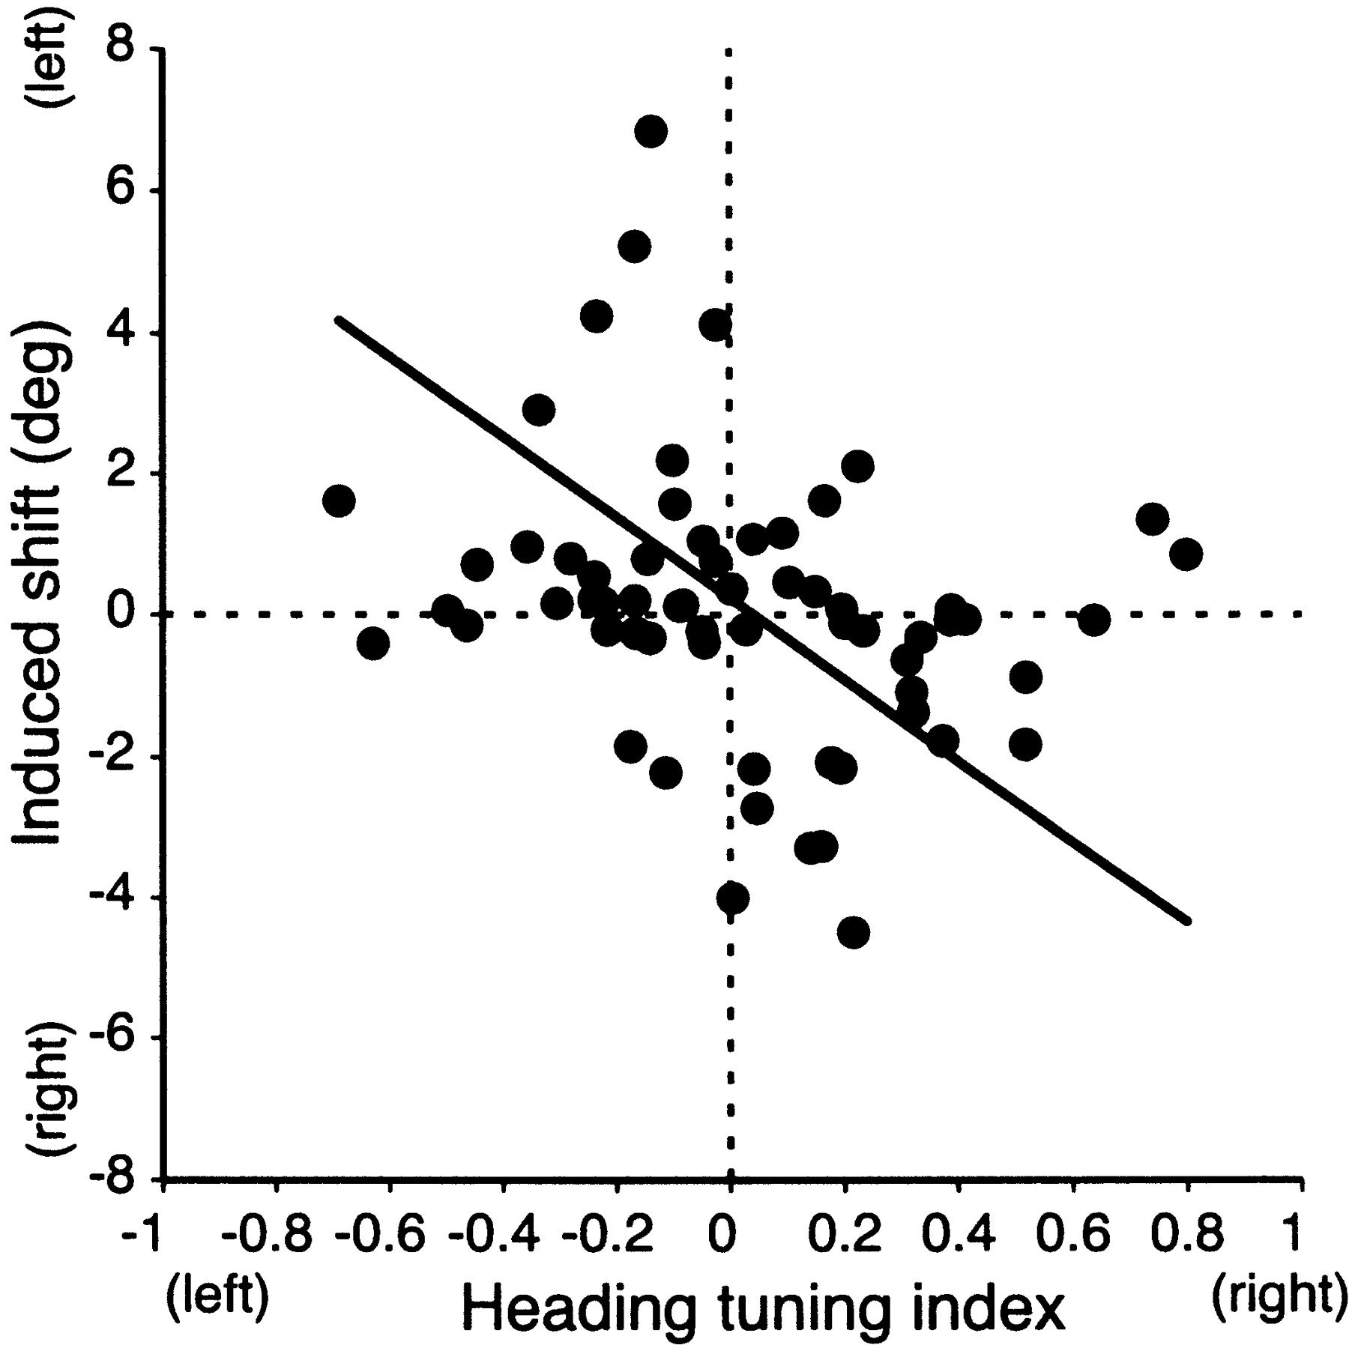
Figure 12. The relationship between site tuning and magnitude of stimulation effect. The heading tuning index is a ...
Notes:
Figure 12. The relationship between site tuning and magnitude of stimulation effect. The heading tuning index is a contrast index expressing the difference between the average responses to left and right headings. The solid line shows the results of linear regression analysis. This indicates that stimulation of more selective sites usually produced bigger perceptual effects. The correlation was significant with either parametric or non-parametric testing. Four cells were omitted from this analysis because quantitative tuning data were not obtained.
Unless provided in the caption above, the following copyright applies to the content of this slide: © Oxford University Press

Slide 3
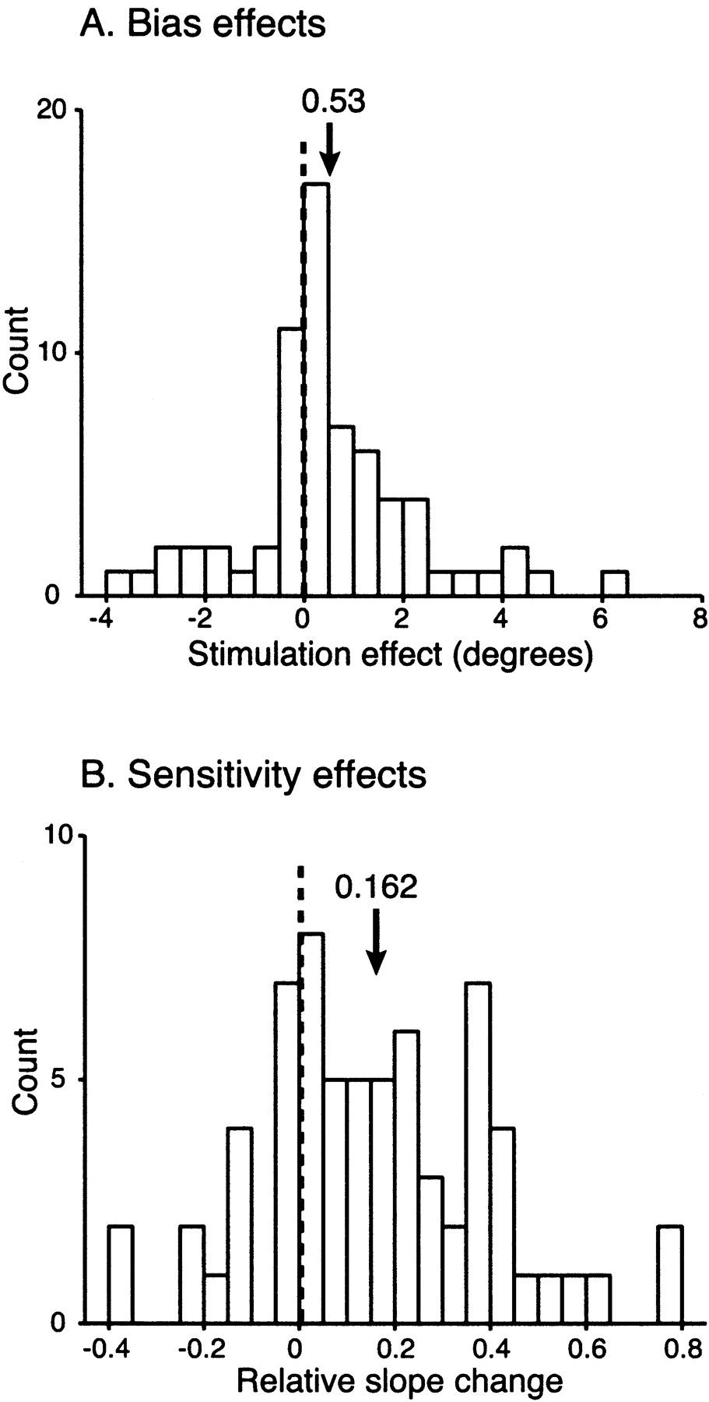
Figure 11. Summary of microstimulation effects including all trials. We plot changes in bias (A) and threshold (B) as in ...
Notes:
Figure 11. Summary of microstimulation effects including all trials. We plot changes in bias (A) and threshold (B) as in Figure 8, but now including all trials. Each single site produced a single main effect of microstimulation, equivalent to the average change of the function across all pursuit conditions. Conventions are as in Figure 8.
Unless provided in the caption above, the following copyright applies to the content of this slide: © Oxford University Press

Slide 4
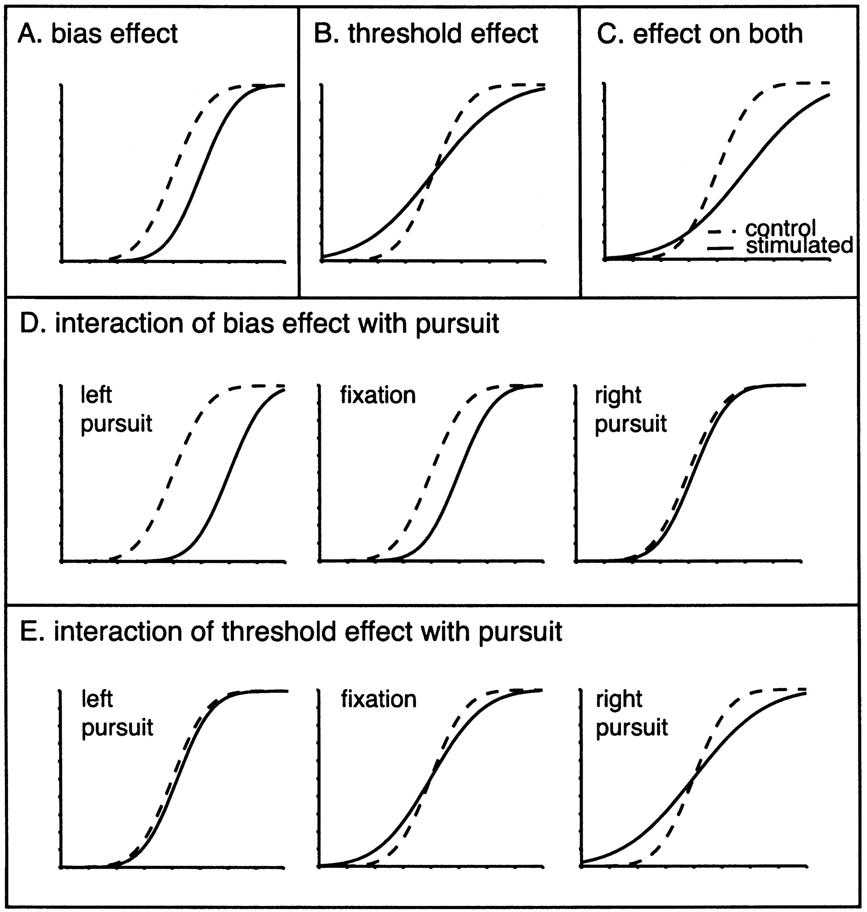
Figure 10. Schematic illustrating different microstimulation effects. In all panels, the dashed line illustrates the ...
Notes:
Figure 10. Schematic illustrating different microstimulation effects. In all panels, the dashed line illustrates the control, unstimulated psychometric function, and the solid line illustrates the function with microstimulation. (A) A single experiment with an effect only on bias, which was an increase in left choices. (B) A case where microstimulation had no effect on bias, but did have an effect on sensitivity. (C) A case with effects on both bias and sensitivity. (D) Interaction of induced bias effects with pursuit. The magnitude of the function shift is different for the different pursuit conditions, but the sensitivity is unaffected throughout. (E) Interaction of induced sensitivity effects with pursuit. In this case, the effect of microstimulation is on the sensitivity to heading (as in B) and this sensitivity effect varies with pursuit.
Unless provided in the caption above, the following copyright applies to the content of this slide: © Oxford University Press

Slide 5
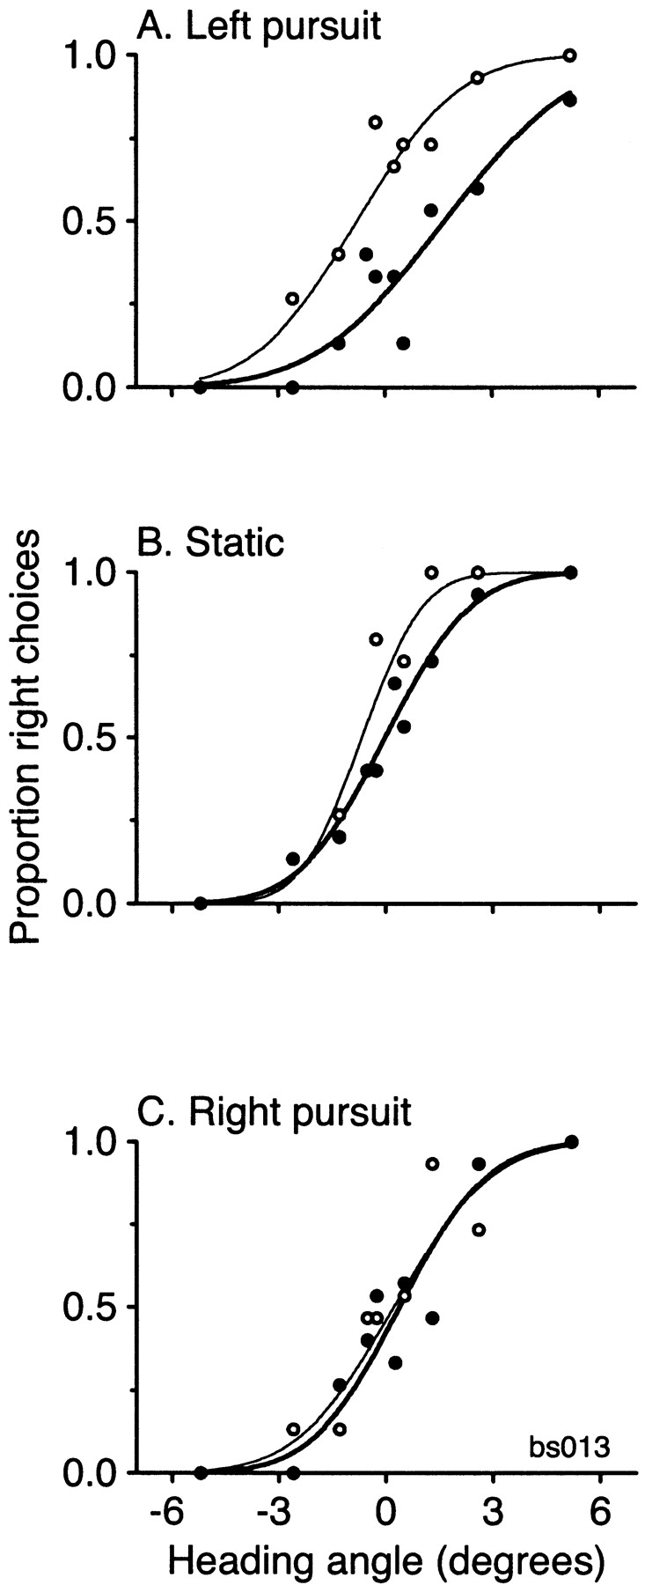
Figure 9. Example of microstimulation in the presence of smooth pursuit. We now separately plot the animal's choices ...
Notes:
Figure 9. Example of microstimulation in the presence of smooth pursuit. We now separately plot the animal's choices and fit functions for each of the three pursuit conditions. Conventions are as in Figure 7. The neurons at this site preferred left headings.
Unless provided in the caption above, the following copyright applies to the content of this slide: © Oxford University Press

Slide 6
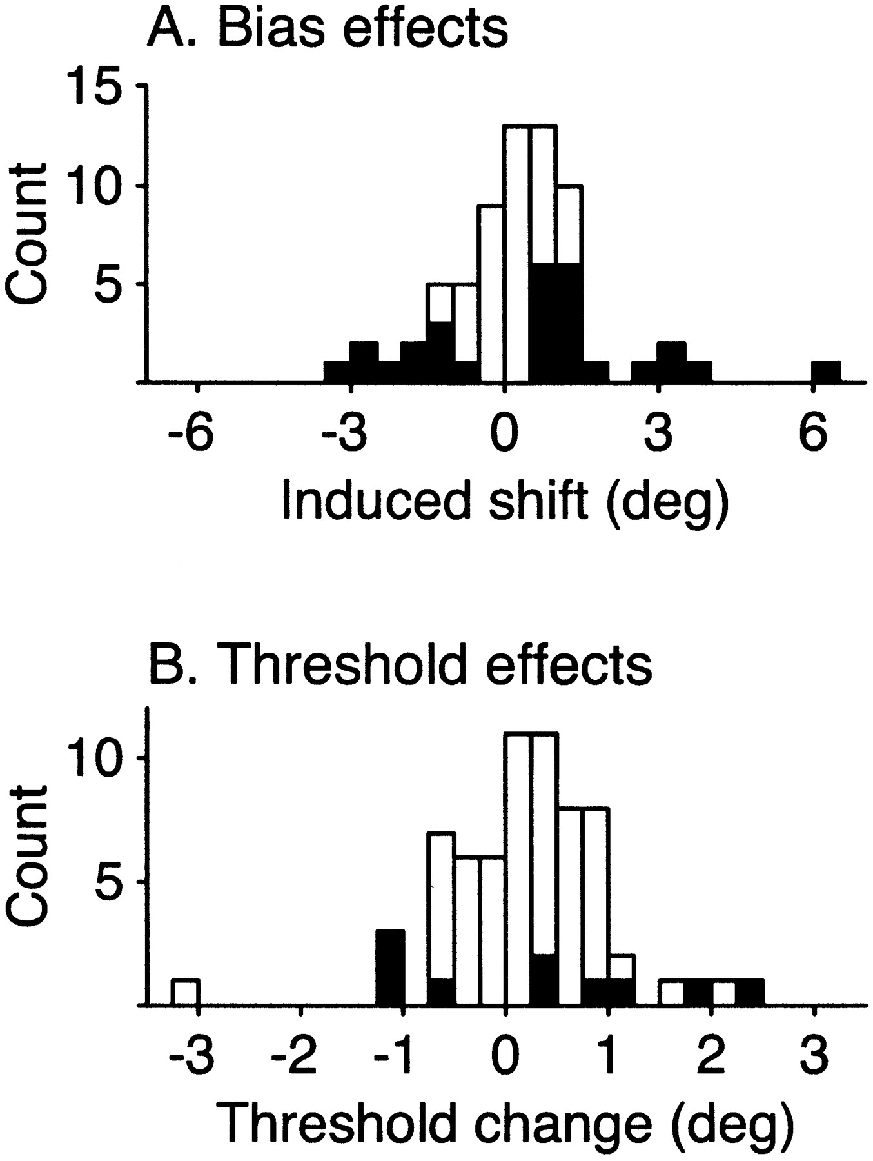
Figure 8. Effects of MST microstimulation in the absence of smooth pursuit. For each experiment, we calculate the ...
Notes:
Figure 8. Effects of MST microstimulation in the absence of smooth pursuit. For each experiment, we calculate the difference in the means (A) and sigmas (B) between the stimulation and control data. For the analysis of bias, the sign of the resulting difference was assigned relative to the preference of the neurons at the stimulation site.
Unless provided in the caption above, the following copyright applies to the content of this slide: © Oxford University Press

Slide 7
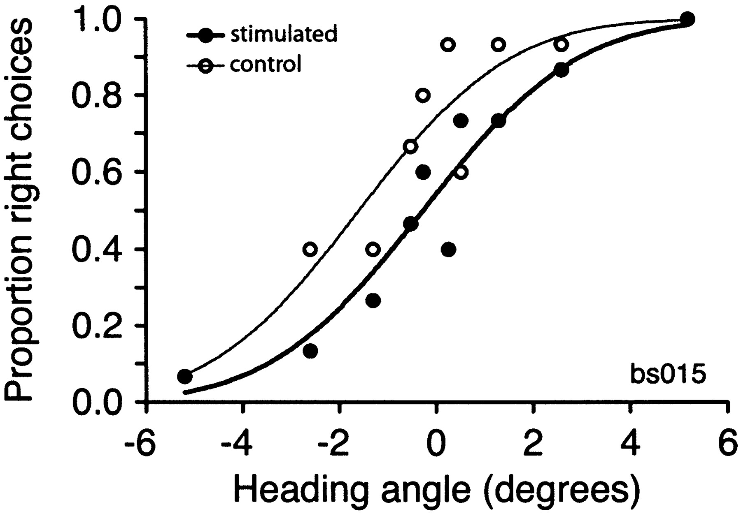
Figure 7. Example of a typical MST microstimulation experiment. The filled symbols and bold-line curve show performance ...
Notes:
Figure 7. Example of a typical MST microstimulation experiment. The filled symbols and bold-line curve show performance with microstimulation; open symbols and fine lines depict the interleaved control trials. The site in this case preferred left headings, and microstimulation produced significant decreases in rightwards choices. The best-fit curves were allowed to be fully independent, so that each curve could have its own mean and slope. Nonetheless, the stimulation data are close to a horizontally shifted replica of the control data. Fit parameters for this case were: stimulated, μ = –1.58, σ = 2.47; control, μ = –0.26, σ = 2.53.
Unless provided in the caption above, the following copyright applies to the content of this slide: © Oxford University Press

Slide 8
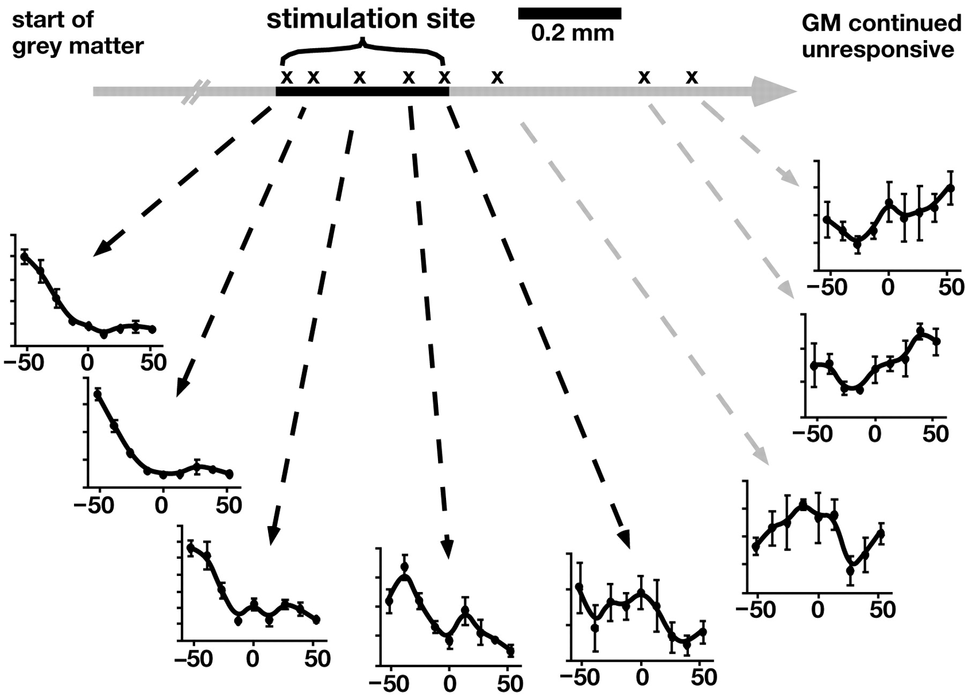
Figure 6. Map of a typical microstimulation site in MST. The Xs mark multiunit recording locations and the ...
Notes:
Figure 6. Map of a typical microstimulation site in MST. The Xs mark multiunit recording locations and the corresponding tuning functions show multiunit responses to a range of headings at each site. Vertical scale on each is arbitrary, since the spike threshold could not be set precisely relative to the amplitude of neuronal signals. The bold line on the track record denotes the region in which the tuning was sufficiently clear to pass our criterion and be included in the site.
Unless provided in the caption above, the following copyright applies to the content of this slide: © Oxford University Press

Slide 9
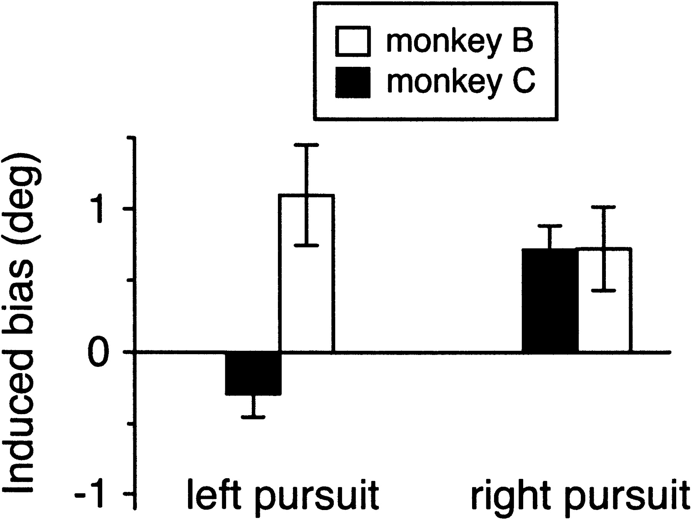
Figure 5. The relationship between pursuit and average induced bias. The induced bias expresses the horizontal shift of ...
Notes:
Figure 5. The relationship between pursuit and average induced bias. The induced bias expresses the horizontal shift of the psychometric function under pursuit, compared to that measured under fixation. Both monkeys were largely able to compensate for the distortions in the optic flow produced by pursuit. If uncompensated, the induced bias from the change in retinal optic flow would be ~20°.
Unless provided in the caption above, the following copyright applies to the content of this slide: © Oxford University Press

Slide 10
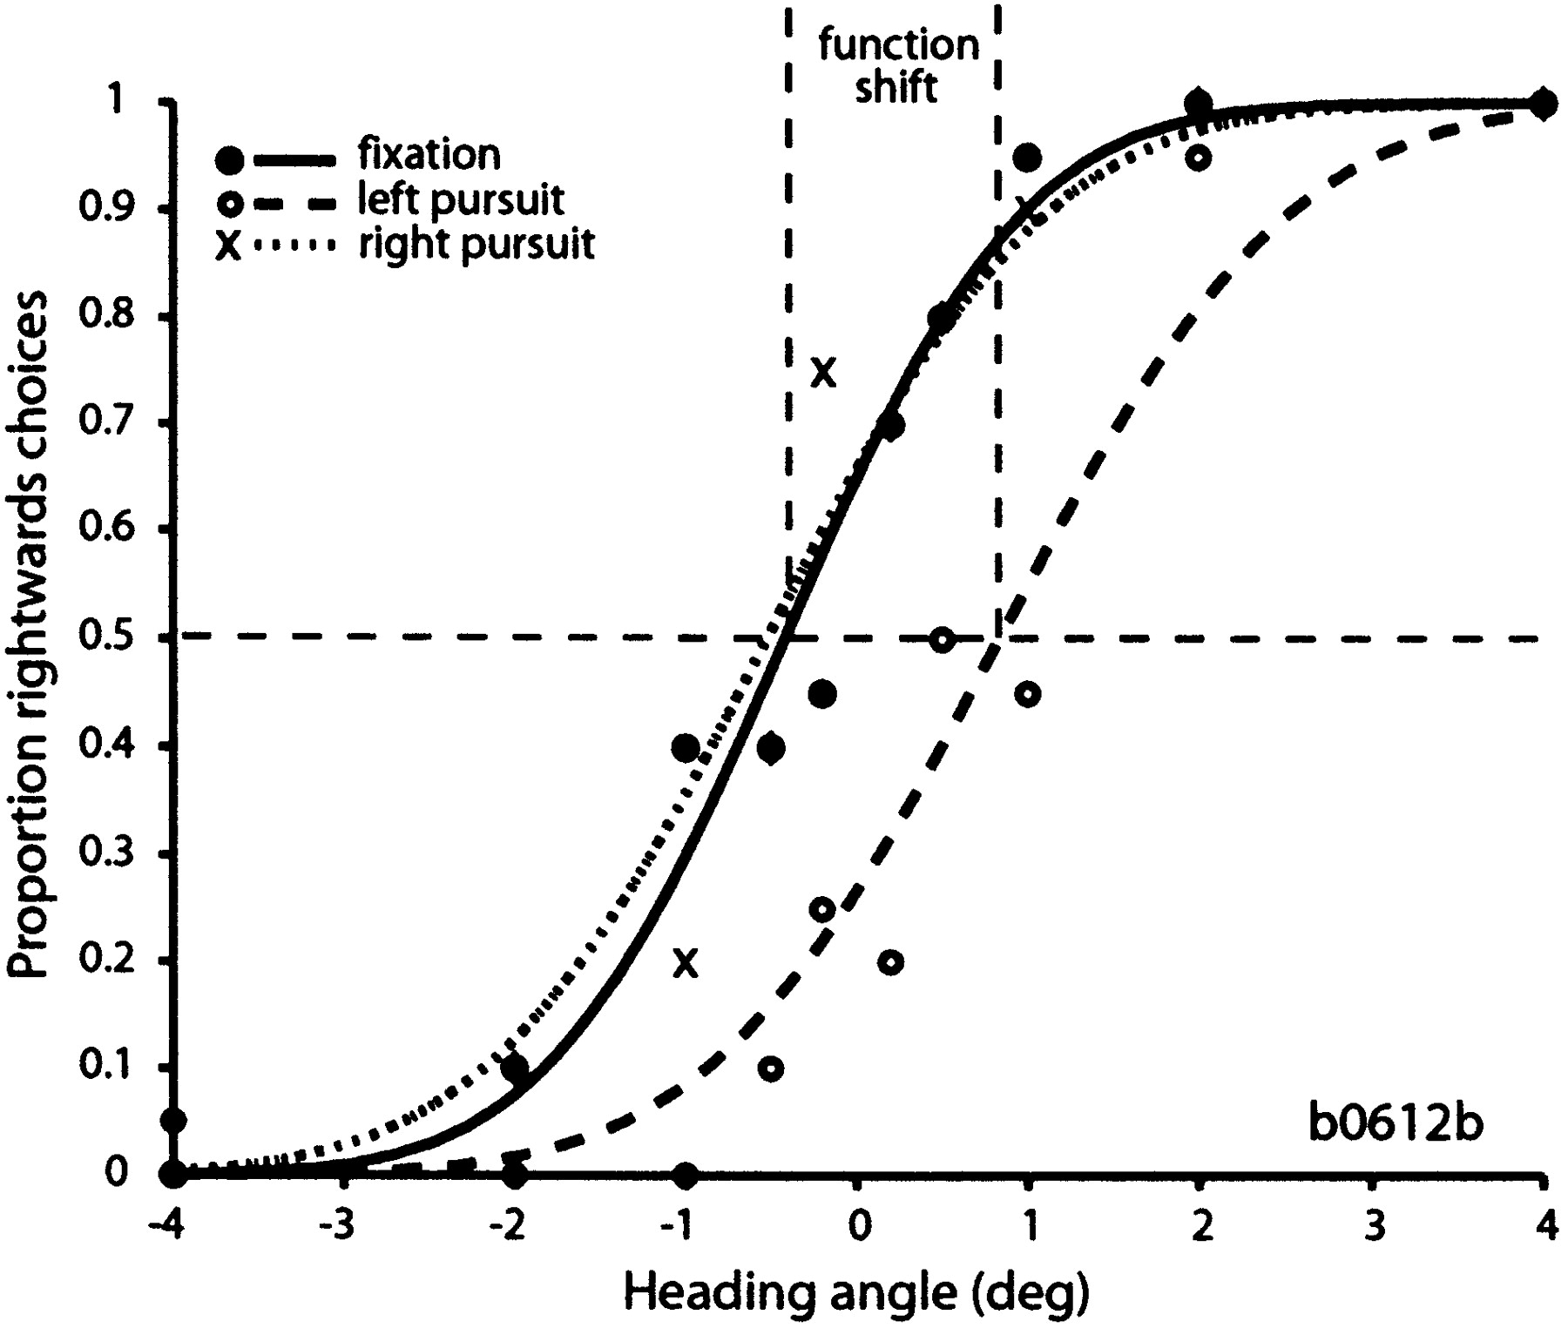
Figure 4. A single experiment in which pursuit influenced heading perception. Data resulting from the three pursuit ...
Notes:
Figure 4. A single experiment in which pursuit influenced heading perception. Data resulting from the three pursuit conditions are illustrated by the three different symbols: solid circles denote fixation, open circles show left pursuit and open diamonds show right pursuit. The three independently fit probit functions are illustrated. To describe the induced bias in such experiments, we measured the horizontal distance between the reference curve (fixation) and each of the others. This shift is graphically depicted by the horizontal distance between the vertical dashed lines, which intersect each curve where it crosses the 50% point (horizontal dashed line). Fit parameters for these functions were as follows: static, μ = –0.42, σ = 1.09; left pursuit, μ = 0.83, σ = 1.33; right pursuit, μ = –0.53, σ = 1.29.
Unless provided in the caption above, the following copyright applies to the content of this slide: © Oxford University Press

Slide 11
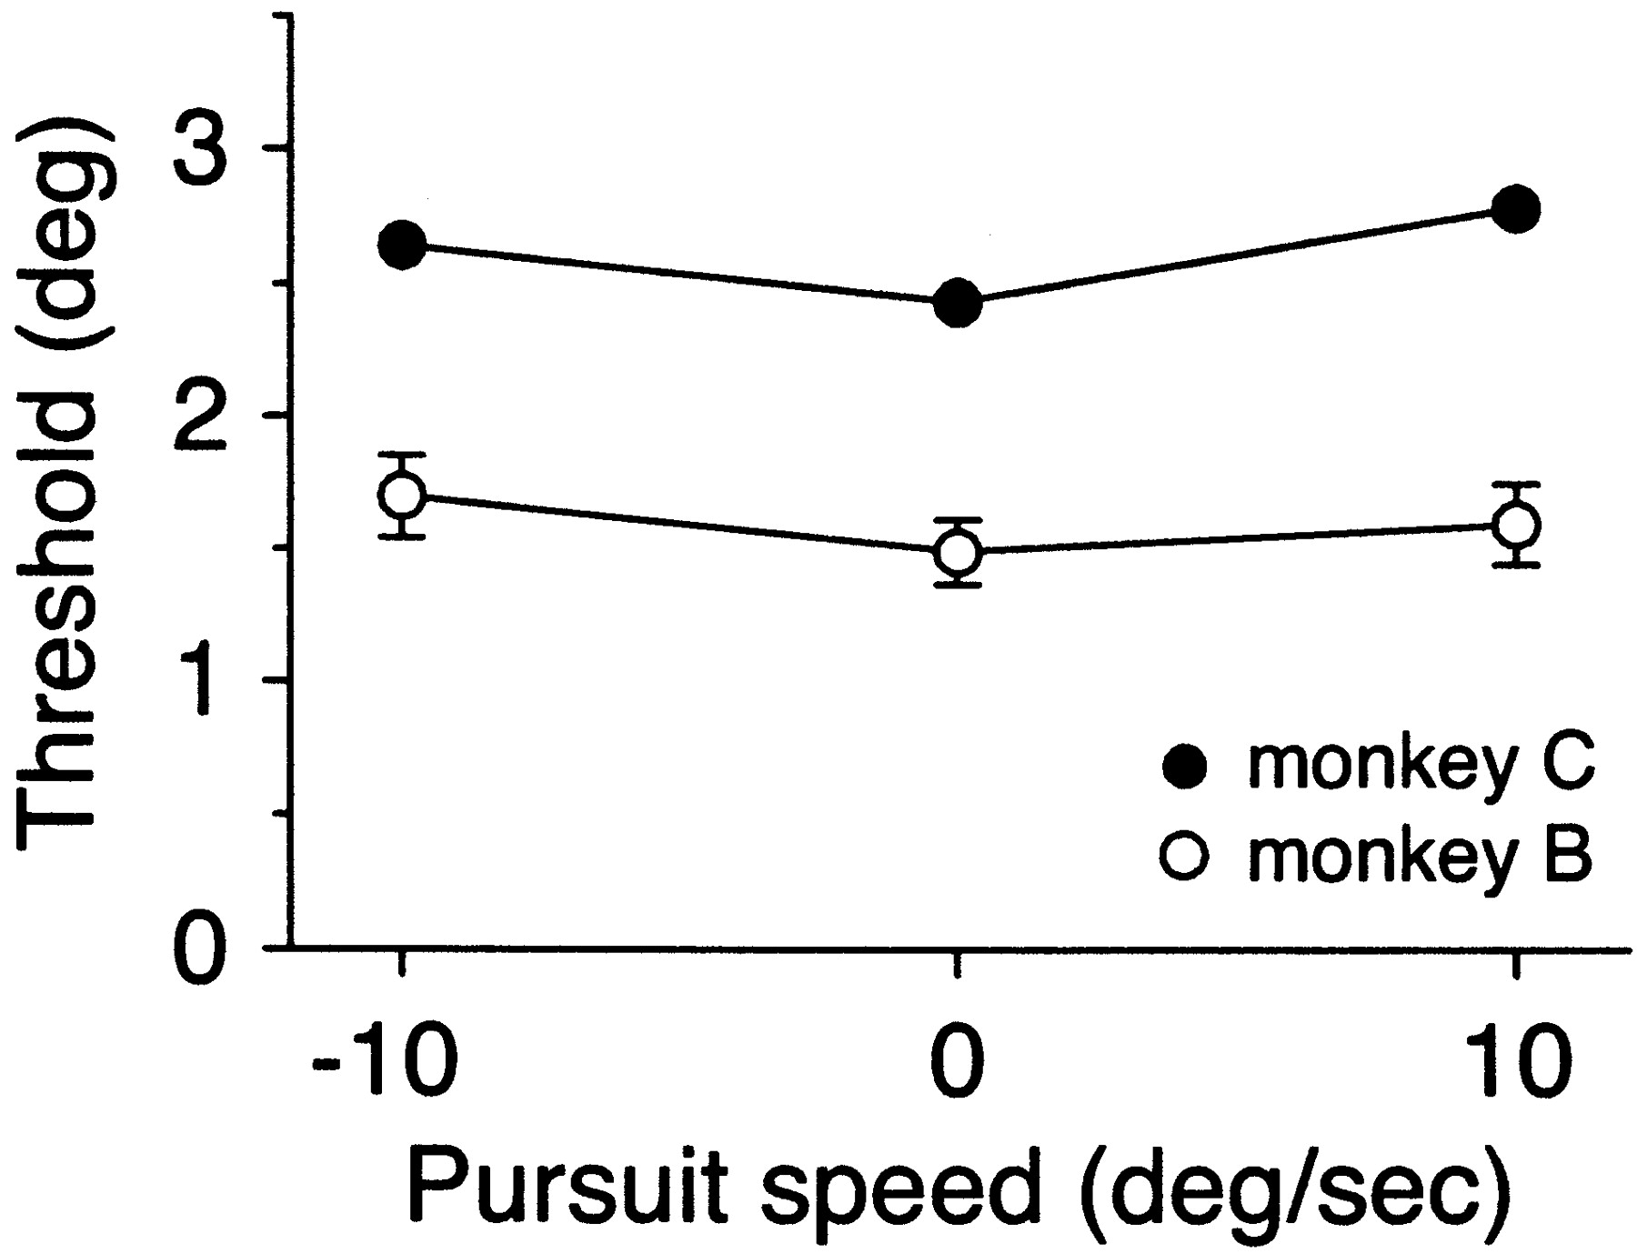
Figure 3. Dependence of threshold (sigma) on pursuit for each monkey. While the monkey was trained on a range of ...
Notes:
Figure 3. Dependence of threshold (sigma) on pursuit for each monkey. While the monkey was trained on a range of pursuit speeds, most experiments were carried out using a pursuit speed of 10°/s. This speed slightly reduced the sensitivity to heading for both monkeys, but this difference was modest. Where error bars are not visible, they are within the dimensions of the plot symbol.
Unless provided in the caption above, the following copyright applies to the content of this slide: © Oxford University Press

Slide 12
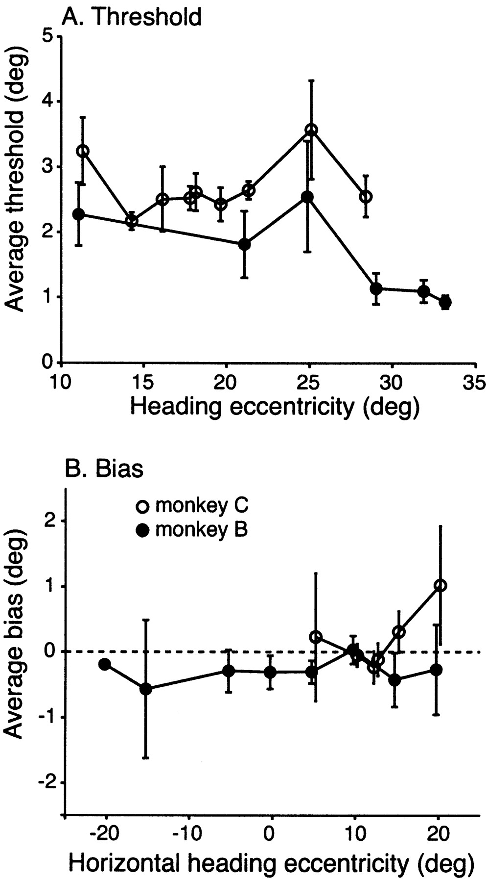
Figure 2. Dependence of heading threshold and bias on heading eccentricity. Heading eccentricity is defined as the ...
Notes:
Figure 2. Dependence of heading threshold and bias on heading eccentricity. Heading eccentricity is defined as the distance between the fixation point (or center of pursuit sweep if pursuit is included on the trial) and the center of headings, which was directly ahead of the monkey, in the center of the screen. Sensitivity is estimated by the sigma parameter from the best-fit probit function. For both panels, data were taken from the trials in which the fixation point remained stationary. (A) Thresholds did not depend on eccentricity. The weak and inconsistent trends seen in each monkey's data were probably the result of unequal training in different locations and were not statistically significant. (B) Bias, estimated from the mean of the best-fit probit function, did not systematically depend on the horizontal heading eccentricity. Monkey C (open circles) was only trained for fixation points to the left of the center of headings.
Unless provided in the caption above, the following copyright applies to the content of this slide: © Oxford University Press

Slide 13
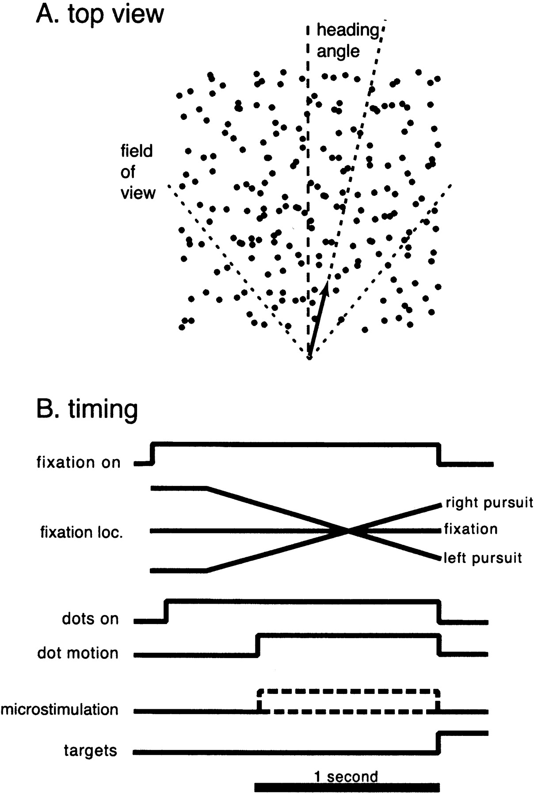
Figure 1. Stimulus schematic and task timing. (A) Top view of the simulated geometry of the task. The arrow shows the ...
Notes:
Figure 1. Stimulus schematic and task timing. (A) Top view of the simulated geometry of the task. The arrow shows the trajectory with respect to the stationary dot fields, which represents a cube in three-dimensional space. The vertical dashed line shows straight ahead and the angled dashed line illustrates the heading angle for the particular trajectory. For reasons of graphical clarity, the illustrated angle is larger than most that were used. The dotted lines indicate the limits of the field of view on the projection on the monitor. (B) Timing of events in the task. For the fixation location lines, upward on the page indicates right locations. The two dashed lines for the microstimulation portrayal indicate the two types of trial that are possible—some trials lack microstimulation.
Unless provided in the caption above, the following copyright applies to the content of this slide: © Oxford University Press

