Slide 1
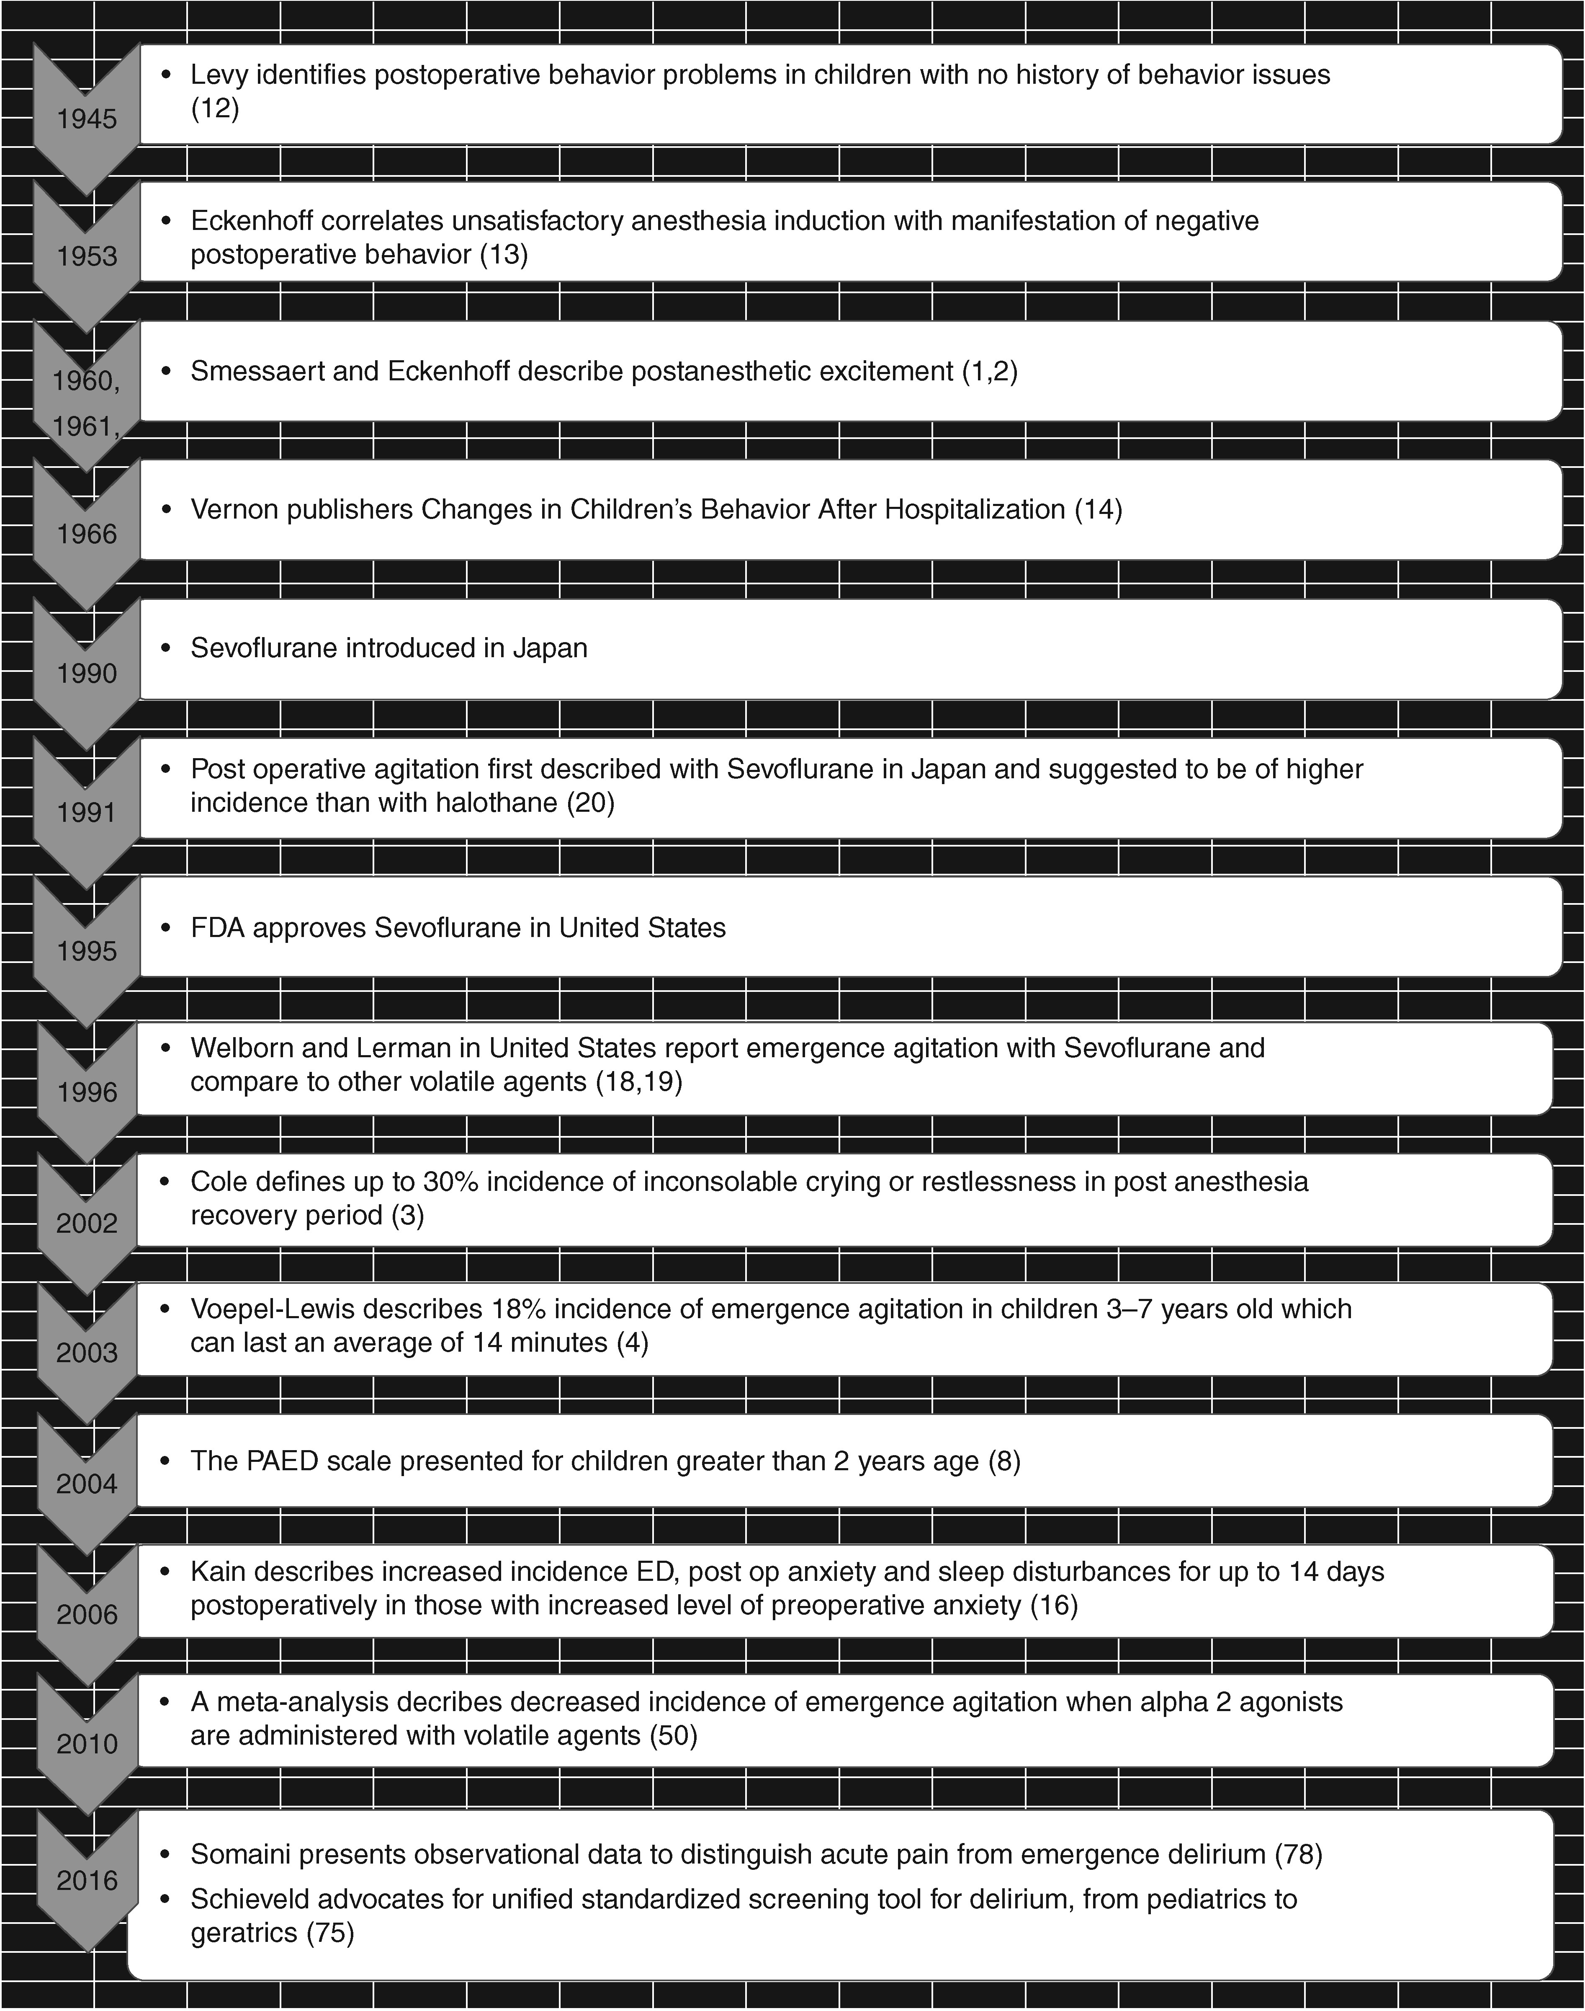
Fig 1 Historical time line of noteworthy events for emergency agitation and delirium.
Notes:
Fig 1 Historical time line of noteworthy events for emergency agitation and delirium.
Unless provided in the caption above, the following copyright applies to the content of this slide: © The Author 2017. Published by Oxford University Press on behalf of the British Journal of Anaesthesia. All rights reserved. For Permissions, please email: journals.permissions@oup.com

Slide 2
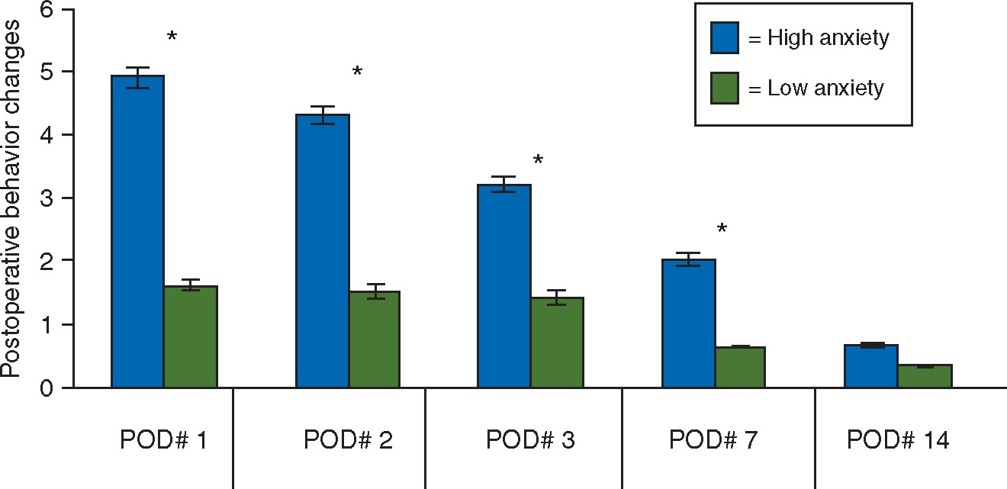
Fig 2 The number of new-onset maladaptive behaviours throughout a 2 week postoperative period as exhibited by ...
Notes:
Fig 2 The number of new-onset maladaptive behaviours throughout a 2 week postoperative period as exhibited by groups of children with high and low preoperative anxiety. *Statistical significance; P<0.05, reproduced with permission.36
Unless provided in the caption above, the following copyright applies to the content of this slide: © The Author 2017. Published by Oxford University Press on behalf of the British Journal of Anaesthesia. All rights reserved. For Permissions, please email: journals.permissions@oup.com

