Slide 1
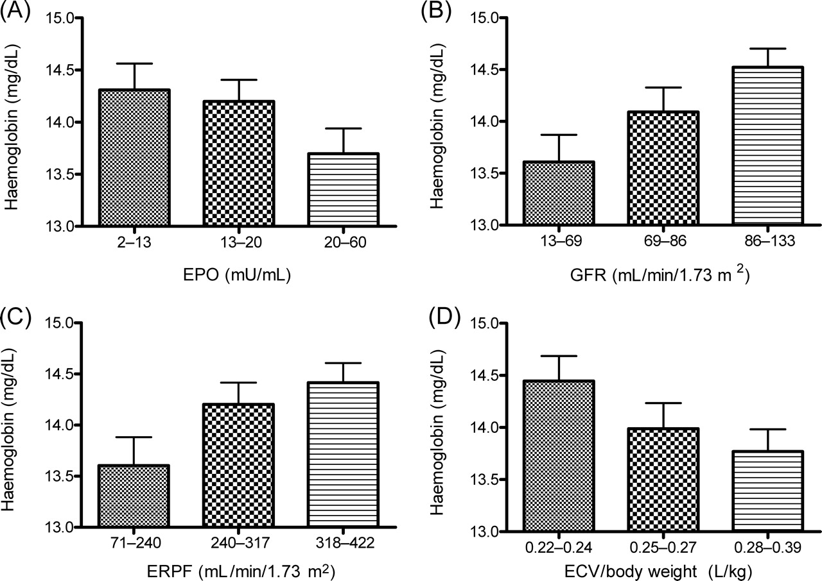
Figure 1 Relation between haemoglobin levels and EPO, GFR, ERPF, and ECV.
Notes:
Figure 1 Relation between haemoglobin levels and EPO, GFR, ERPF, and ECV.
Unless provided in the caption above, the following copyright applies to the content of this slide: © The European Society of Cardiology 2006. All rights reserved. For Permissions, please e-mail: journals.permissions@oxfordjournals.org

