Slide 1
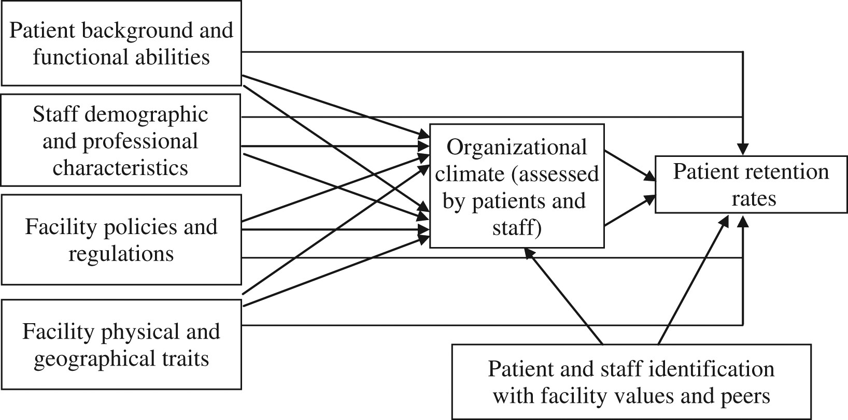
Figure 1: Hypothesized Research Model
Notes:
Figure 1: Hypothesized Research Model
Unless provided in the caption above, the following copyright applies to the content of this slide: © 2017 National Association of Social Workers

Slide 2
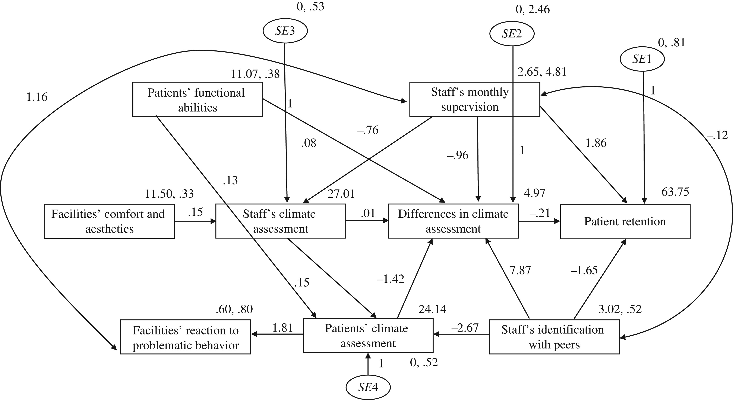
Figure 2: Results of a Paths Analysis for the Prediction of Patient Retention
Notes:
Figure 2: Results of a Paths Analysis for the Prediction of Patient Retention
Unless provided in the caption above, the following copyright applies to the content of this slide: © 2017 National Association of Social Workers

