Slide 1
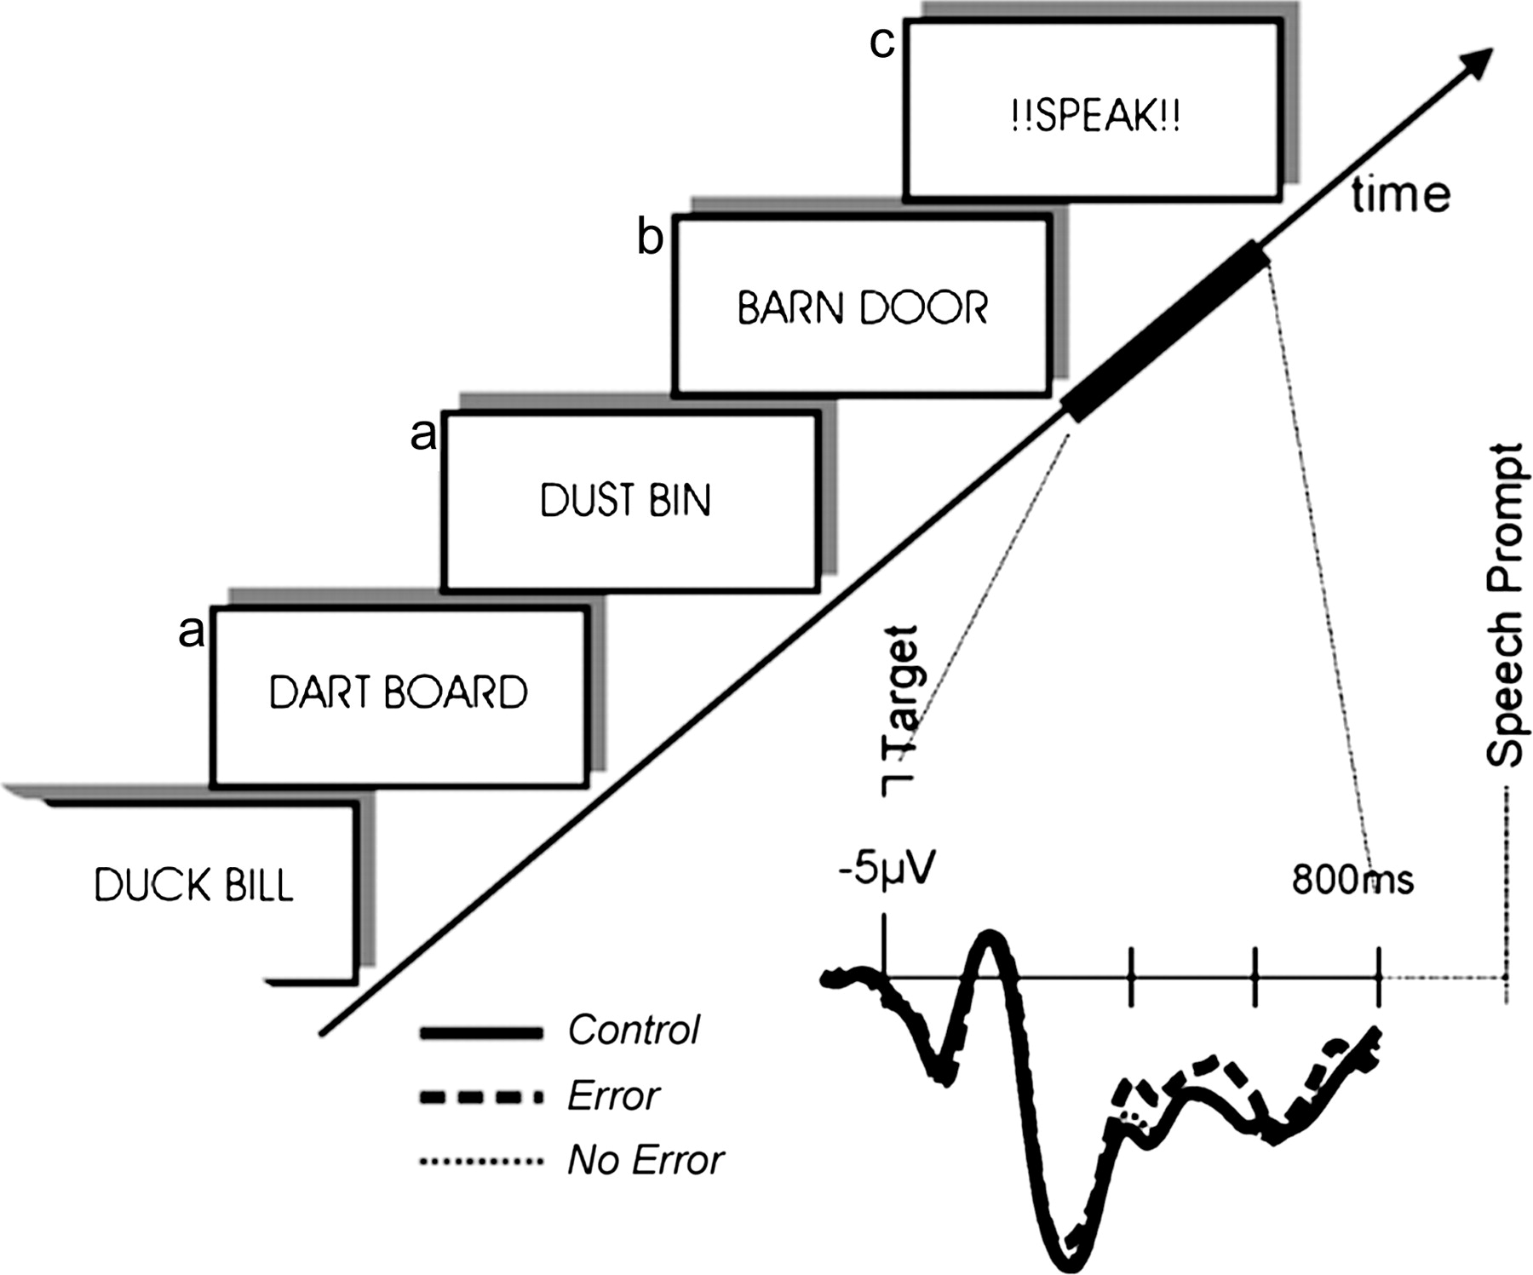
Figure 1. The experiment entailed the presentation of word pairs that had to be read silently for a subsequent memory ...
Notes:
Figure 1. The experiment entailed the presentation of word pairs that had to be read silently for a subsequent memory task. In critical trials, a number of inductor pairs (a) that shared the initial phonemes of the 2 words were followed by a target pair (b), for which the order of initial phonemes was reversed. After the target pair, a prompt (c) required the subjects to overtly vocalize the immediately preceding word pair. In control trials, there was no relation between the initial phonemes of inductor and target pairs. This allowed the recording of brain potentials without contamination by speech artifacts in the time interval between the target pair and prompt (thicker portion of time arrow). On the right, group average brain potentials are shown for critical pairs with errors, without errors, and control trials for a central midline electrode site (Cz). Only error trials are associated with a more negative ERP between 350 and 600 ms.
Unless provided in the caption above, the following copyright applies to the content of this slide: © The Author 2006. Published by Oxford University Press. All rights reserved. For permissions, please e-mail: journals.permissions@oxfordjournals.org

Slide 2
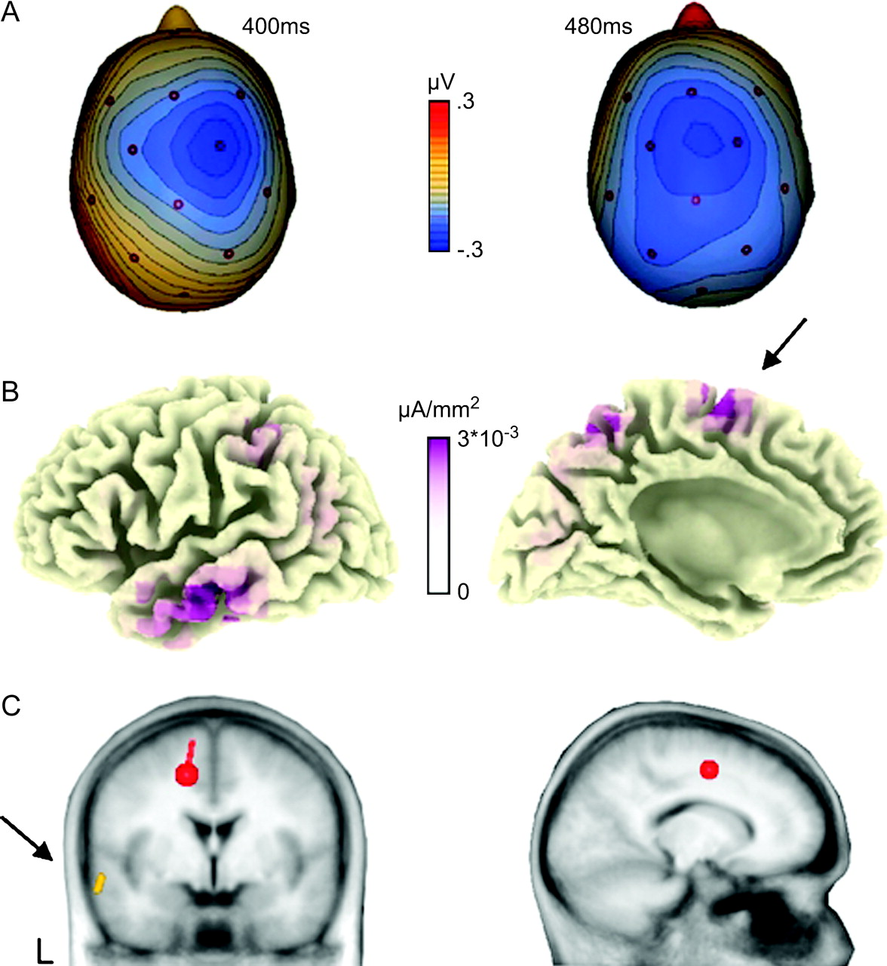
Figure 2. (A) Spline interpolated isovoltage maps of the (error minus correct) difference waves showing a clear medial ...
Notes:
Figure 2. (A) Spline interpolated isovoltage maps of the (error minus correct) difference waves showing a clear medial frontocentral maximum. (B) Distributed source model for the difference potential (Pascual-Marqui and others 1994; Pizzagalli and others 2002) projected onto a 3-dimensional standard brain at 400 ms. A medial source (arrow) and a left anterior temporal source were seen throughout the 400 to 600-ms period. (C) Multiple dipole solution obtained with the BESA algorithm (Scherg and others 1999). Again, a medial frontal source located in the left SMA and a left anterior temporal source (arrow) were found.
Unless provided in the caption above, the following copyright applies to the content of this slide: © The Author 2006. Published by Oxford University Press. All rights reserved. For permissions, please e-mail: journals.permissions@oxfordjournals.org

Slide 3
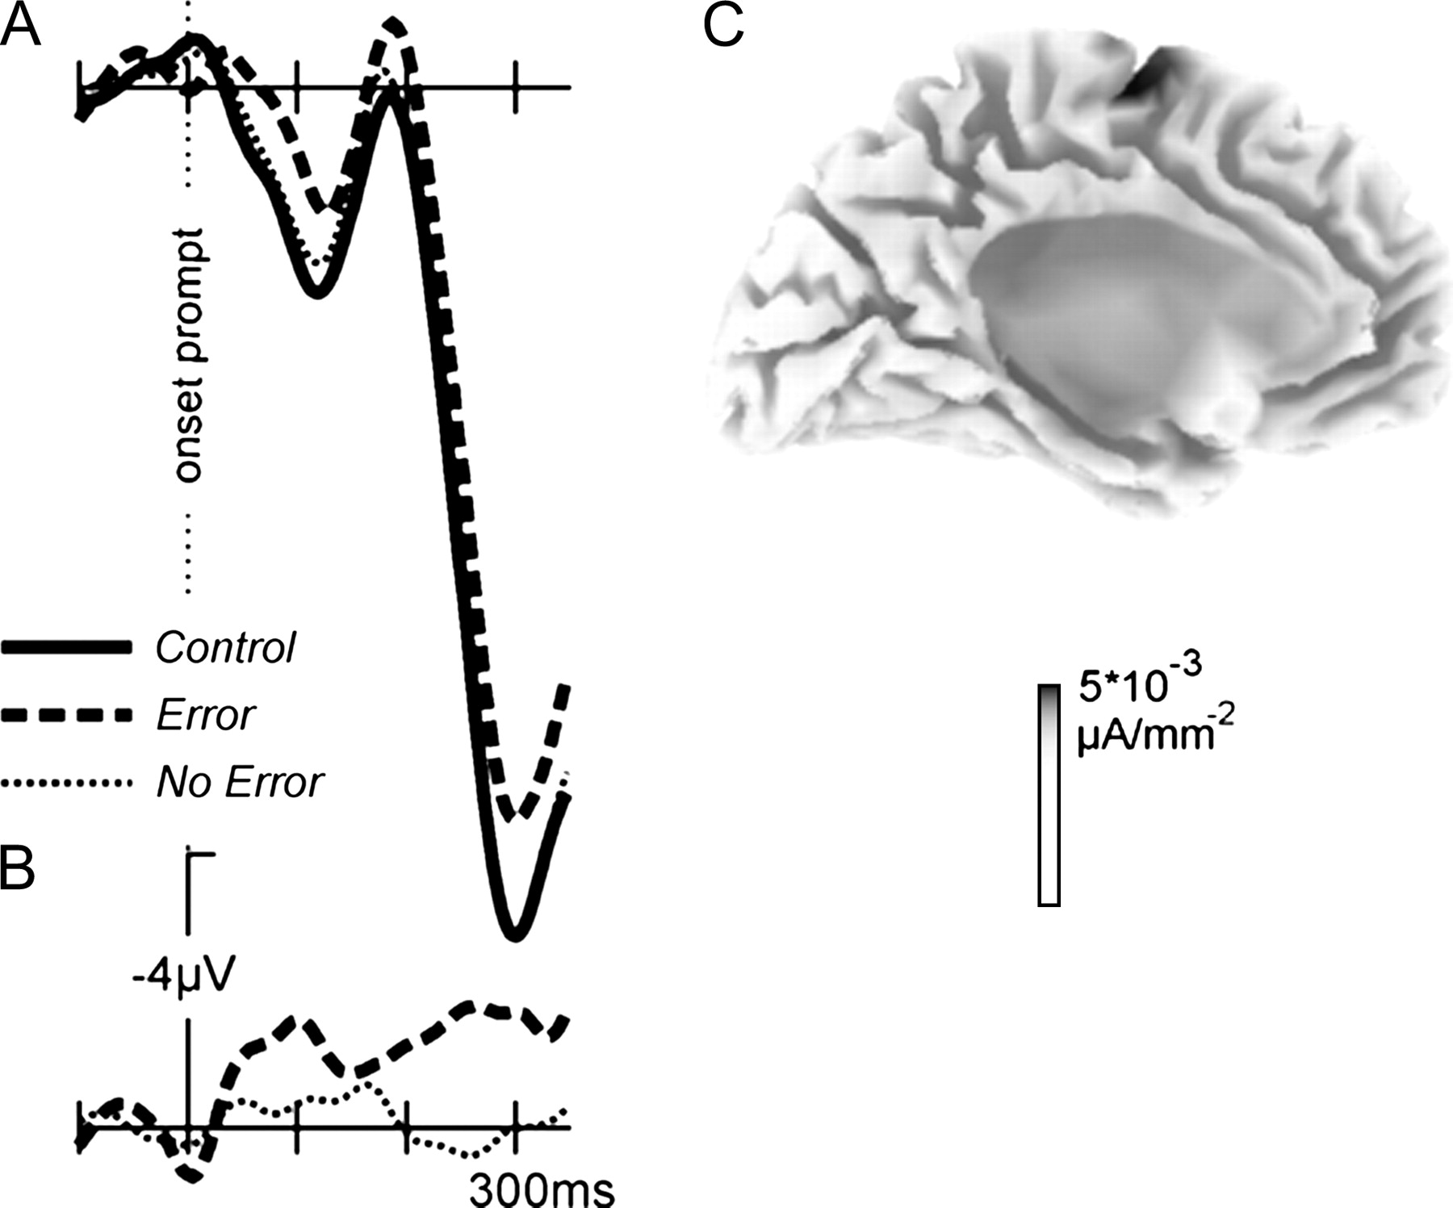
Figure 3. (A) Brain potentials time locked to the vocalization prompt for a central electrode (Cz). Error trials were ...
Notes:
Figure 3. (A) Brain potentials time locked to the vocalization prompt for a central electrode (Cz). Error trials were associated with more negativity that the control trials and the critical trials without errors. (B) Difference potentials obtained by subtracting the activity in the control trials from the activity of the other 2 trial types. Only the error trials are associated with a negative potential. (C) Source solution (Pascual-Marqui and others 1994; Pizzagalli and others 2002) for the error minus correct difference wave at 250 ms. A mesial frontal source implicating the SMA is found.
Unless provided in the caption above, the following copyright applies to the content of this slide: © The Author 2006. Published by Oxford University Press. All rights reserved. For permissions, please e-mail: journals.permissions@oxfordjournals.org

