Slide 1
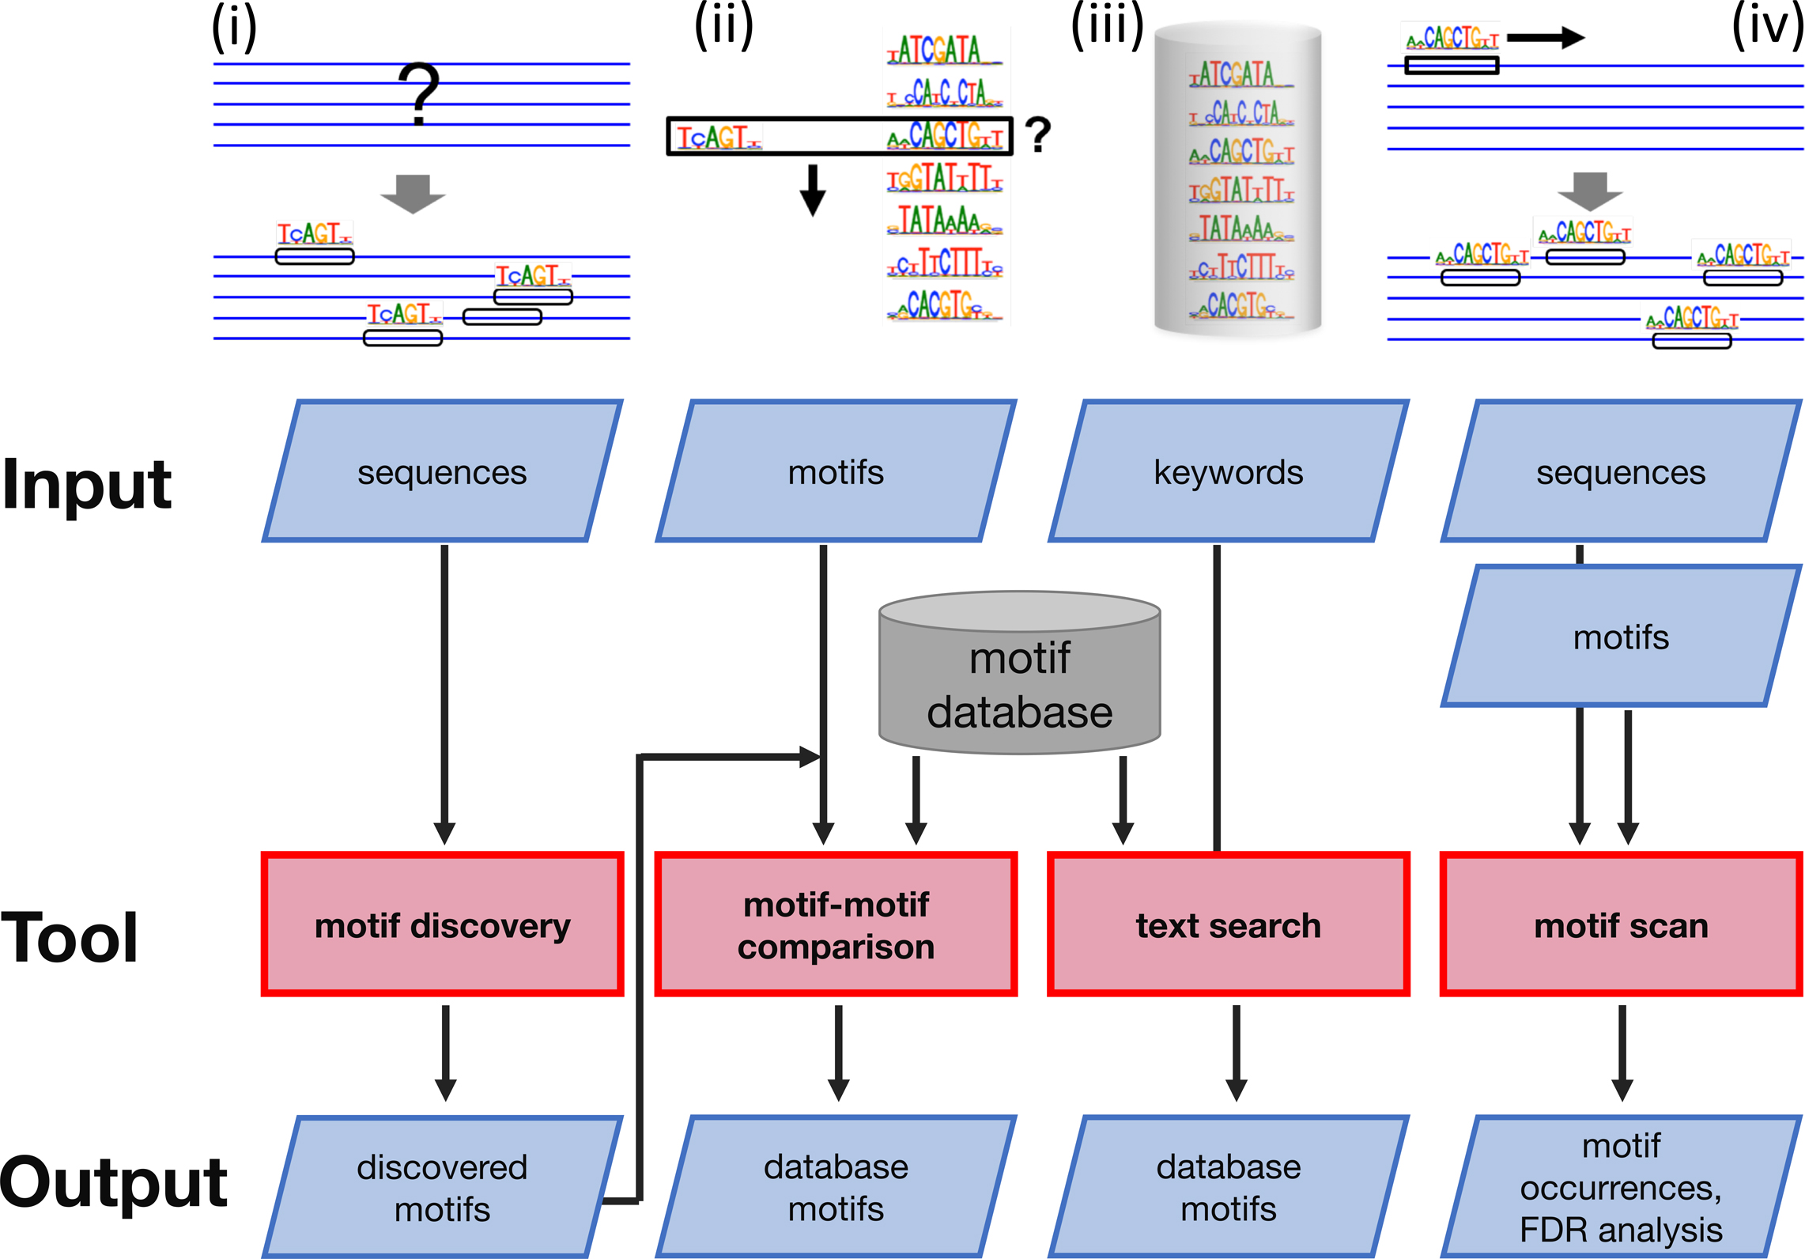
Figure 1. Tools offered by the BaMM server: (i) de-novo discovery of motifs enriched in a nucleotide sequence set. ...
Notes:
Figure 1. Tools offered by the BaMM server: (i) de-novo discovery of motifs enriched in a nucleotide sequence set. Motifs are represented by higher order BaMMs, which capture correlations between nucleotides. (ii) Searching with an input BaMM or PWM motif for similar motifs in our database of over 1000 fourth-order BaMM motifs. (iii) Browsing and keyword searching in our motif database. (iv) Scanning a set of nucleotide sequences with BaMM or PWM motifs to find motif occurrences.
Unless provided in the caption above, the following copyright applies to the content of this slide: © The Author(s) 2018. Published by Oxford University Press on behalf of Nucleic Acids Research.This is an Open Access article distributed under the terms of the Creative Commons Attribution Non-Commercial License (http://creativecommons.org/licenses/by-nc/4.0/), which permits non-commercial re-use, distribution, and reproduction in any medium, provided the original work is properly cited. For commercial re-use, please contact journals.permissions@oup.com

Slide 2
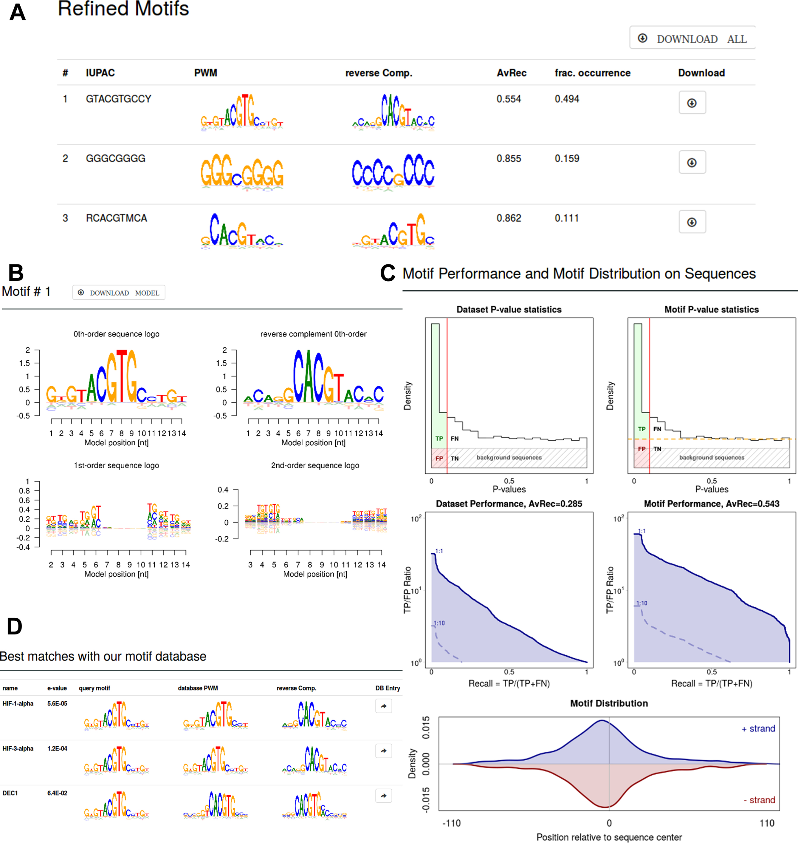
Figure 2. Selected results from a de-novo motif discovery run. (A) Summary table of discovered motifs. (B) Sequence ...
Notes:
Figure 2. Selected results from a de-novo motif discovery run. (A) Summary table of discovered motifs. (B) Sequence logos of order 0, 1 and 2 for one discovered motif. (C) Motif quality analysis and positional distribution. In the dataset-centered analysis (left) all input sequences are defined as positives. In the motif-centered analysis (right), only input sequences carrying a motif occurrence are positives. Their fraction is estimated using fdrtool (orange broken line on the upper right). The quality of motifs is quantified by average recall (AvRec), the blue area under the TP-to-FP-versus-recall curves. The curves for positive-to-negative ratios in the dataset of 1:1, 1:10 and 1:100 are plotted. Recall = TP/(TP + FN), where TP = true positives, FP = false positives, FN = false negatives. Positional distribution of the motif occurrences relative to the center of the sequences is shown on the bottom. (D) List of database motifs similar to discovered motif.
Unless provided in the caption above, the following copyright applies to the content of this slide: © The Author(s) 2018. Published by Oxford University Press on behalf of Nucleic Acids Research.This is an Open Access article distributed under the terms of the Creative Commons Attribution Non-Commercial License (http://creativecommons.org/licenses/by-nc/4.0/), which permits non-commercial re-use, distribution, and reproduction in any medium, provided the original work is properly cited. For commercial re-use, please contact journals.permissions@oup.com

