Slide 1
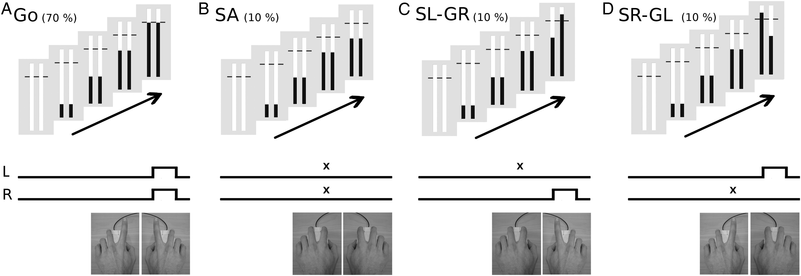
Figure 1. On every trial, participants prepared to simultaneously extend their left (L) and right (R) index fingers ...
Notes:
Figure 1. On every trial, participants prepared to simultaneously extend their left (L) and right (R) index fingers such that 2 continuously moving indicators were interrupted at a target, 800 ms from onset. (A) Go—on most trials, participants were required to respond as accurately as possible. (B) SA—when both indicators stopped automatically (x), the successful response was to prevent any movement. (C and D) SL-GR and SR-GL—when only one indicator stopped automatically, the successful response was to prevent movement of the corresponding hand, while still responding with the other at the target.
Unless provided in the caption above, the following copyright applies to the content of this slide: © The Author 2014. Published by Oxford University Press. All rights reserved. For Permissions, please e-mail: journals.permissions@oup.com

Slide 2
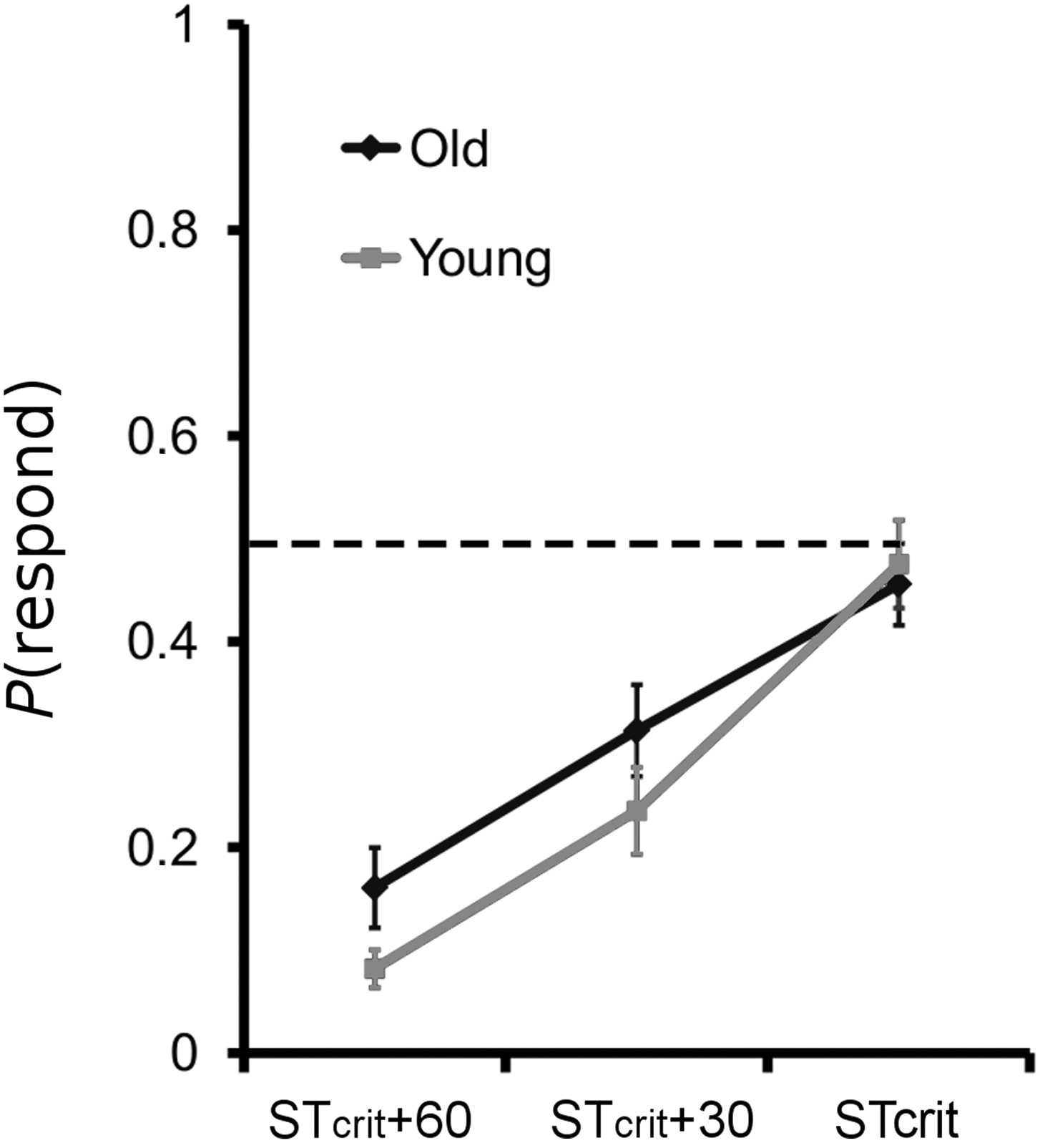
Figure 2. Modulation of stop-task difficulty in the scanner. The closer the stop cue is to the Go response, the greater ...
Notes:
Figure 2. Modulation of stop-task difficulty in the scanner. The closer the stop cue is to the Go response, the greater the probability of responding on a stop trial, confirming our parametric modulation of stop-signal inhibition difficulty during scanning.
Unless provided in the caption above, the following copyright applies to the content of this slide: © The Author 2014. Published by Oxford University Press. All rights reserved. For Permissions, please e-mail: journals.permissions@oup.com

Slide 3
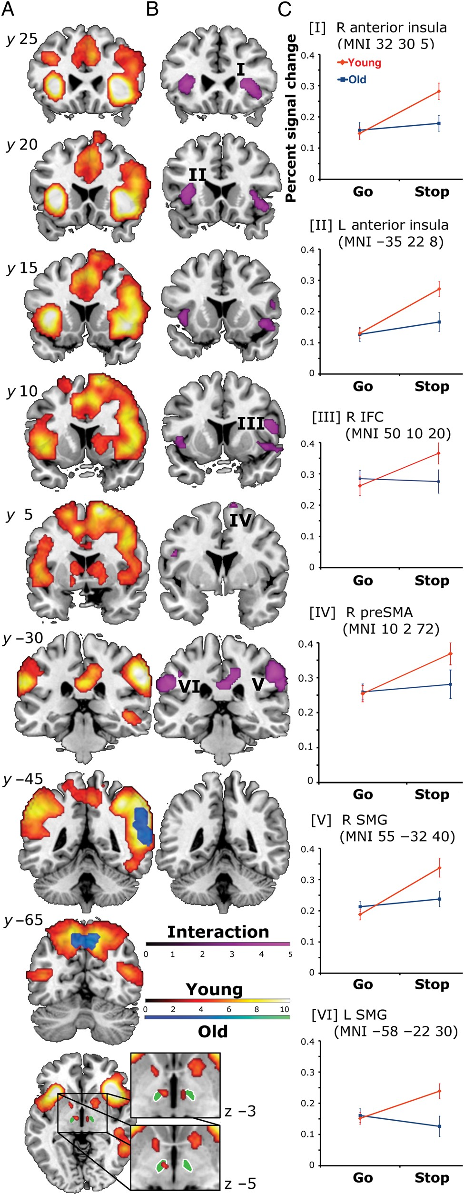
Figure 3. Active regions for the main contrast StopInhibit > Go, corrected for multiple comparisons (FWE P < 0.05) at ...
Notes:
Figure 3. Active regions for the main contrast StopInhibit > Go, corrected for multiple comparisons (FWE P GoYoung) > (StopInhibit > GoOld) are shown in the violet color scale. A significant interaction was present in bilateral anterior insula and supramarginal gyrus. The interaction was also significant in right IFC and preSMA at both the voxel and cluster level (FWE P < 0.05) after small volume correction. The reverse interaction did not reveal any significant results. (C) Percent signal change for Go and StopInhibit in each group at the local maxima shown in B. The roman numerals adjacent to the clusters in B correspond to the plots in C.
Unless provided in the caption above, the following copyright applies to the content of this slide: © The Author 2014. Published by Oxford University Press. All rights reserved. For Permissions, please e-mail: journals.permissions@oup.com

Slide 4
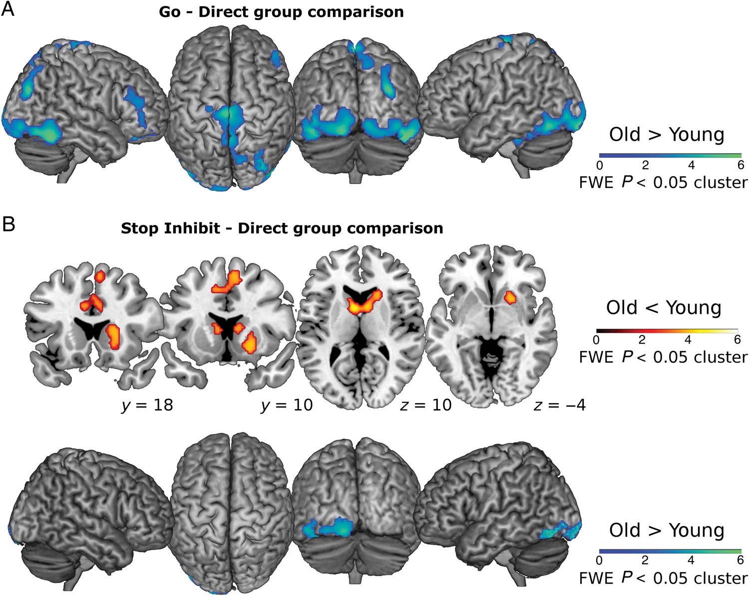
Figure 4. Direct group comparison of activation on Go trials (A) and StopInhibit trials (B). Results are corrected for ...
Notes:
Figure 4. Direct group comparison of activation on Go trials (A) and StopInhibit trials (B). Results are corrected for multiple comparisons (FWE P < 0.05) at the cluster level.
Unless provided in the caption above, the following copyright applies to the content of this slide: © The Author 2014. Published by Oxford University Press. All rights reserved. For Permissions, please e-mail: journals.permissions@oup.com

Slide 5
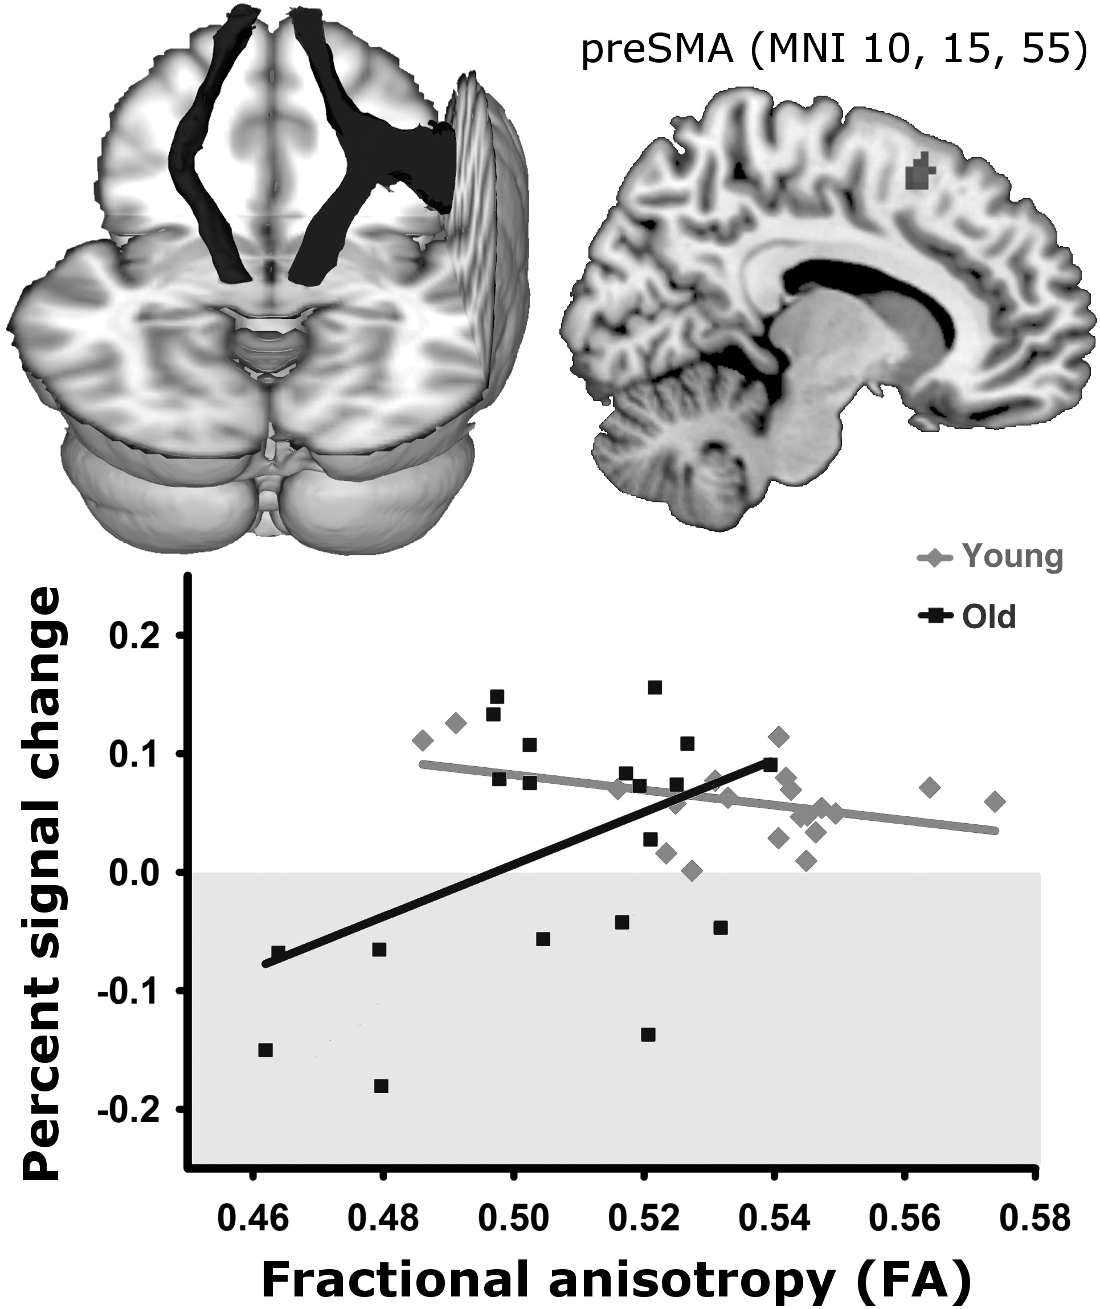
Figure 5. StopInhibit > Go activation regressed against mean FA from a combined rIFC–preSMA–STN tract mask (top left). ...
Notes:
Figure 5. StopInhibit > Go activation regressed against mean FA from a combined rIFC–preSMA–STN tract mask (top left). Older adults with less white matter deterioration were better able to activate preSMA (top right), and this same cluster remained for the group comparison. Percent signal change is plotted against FA below. Negative percent signal change (light gray shaded region) indicates that, for some old participants, activation was greater for Go than StopInhibit.
Unless provided in the caption above, the following copyright applies to the content of this slide: © The Author 2014. Published by Oxford University Press. All rights reserved. For Permissions, please e-mail: journals.permissions@oup.com

