Slide 1
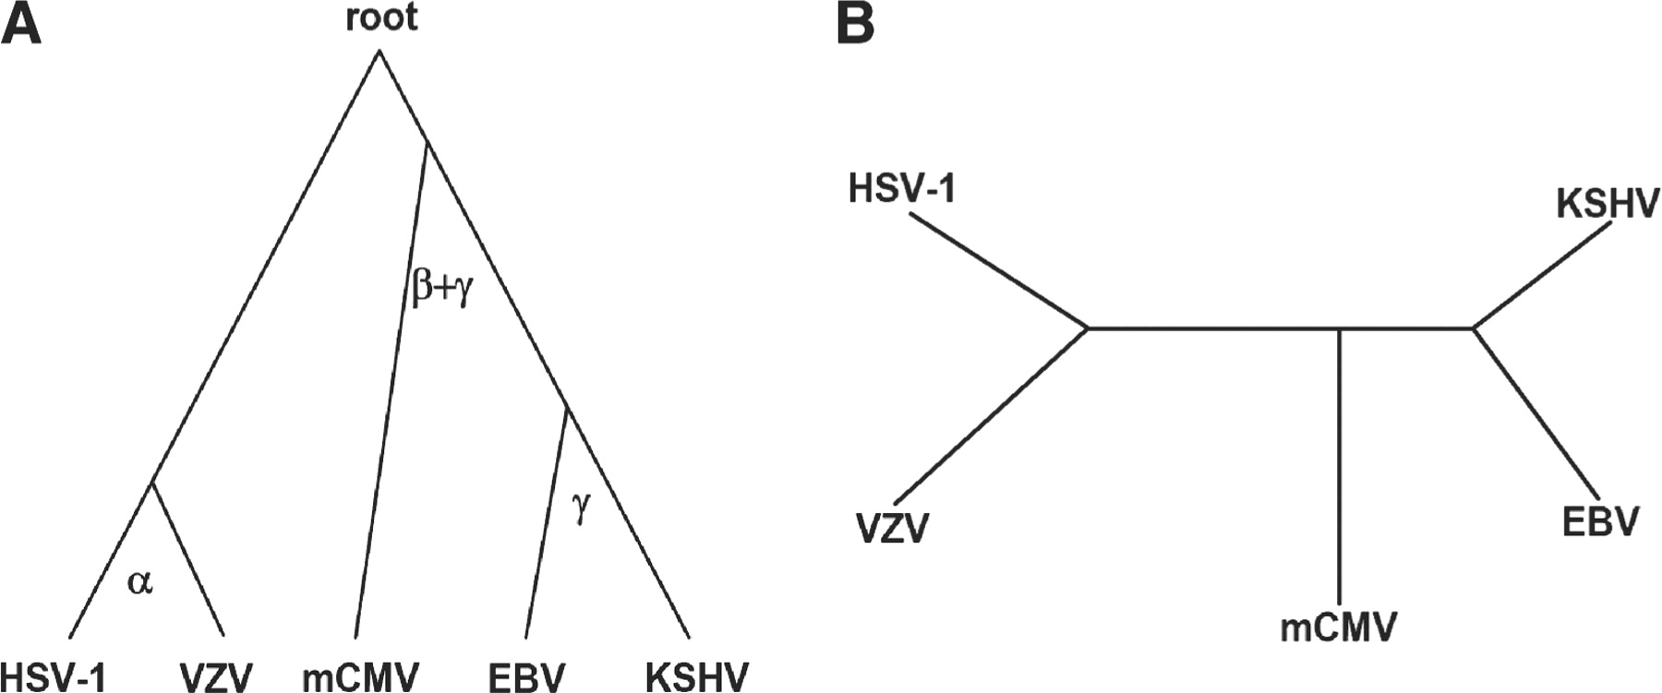
Fig. 1. Phylogeny of the five analyzed herpesviruses. (A) The gold standard tree (McGeoch and Gatherer, 2005; McGeoch ...
Notes:
Fig. 1. Phylogeny of the five analyzed herpesviruses. (A) The gold standard tree (McGeoch and Gatherer, 2005; McGeoch et al., 2006; (B) unrooted phylogenetic tree reconstructed from edge correctness scores of topological alignments produced by MI-GRAAL.
Unless provided in the caption above, the following copyright applies to the content of this slide: © The Author 2011. Published by Oxford University Press. All rights reserved. For Permissions, please email: journals.permissions@oup.com

