Slide 1
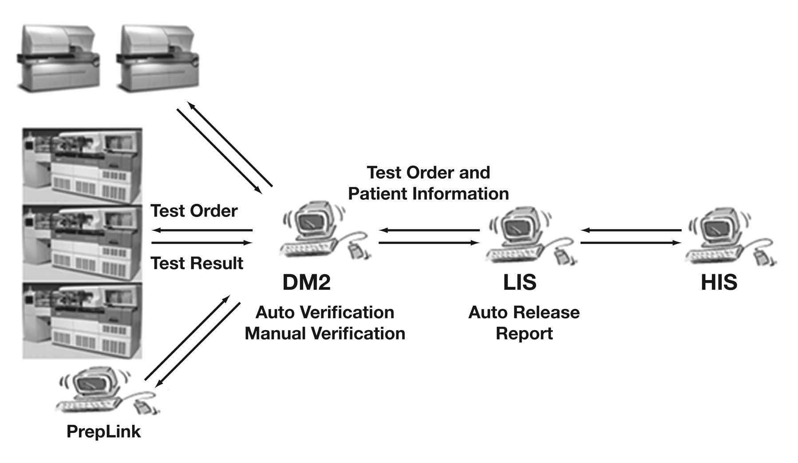
Figure 1 DM2 as the core center of the AV system.
Notes:
Figure 1 DM2 as the core center of the AV system.
Unless provided in the caption above, the following copyright applies to the content of this slide: © American Society of Clinical Pathologists

Slide 2
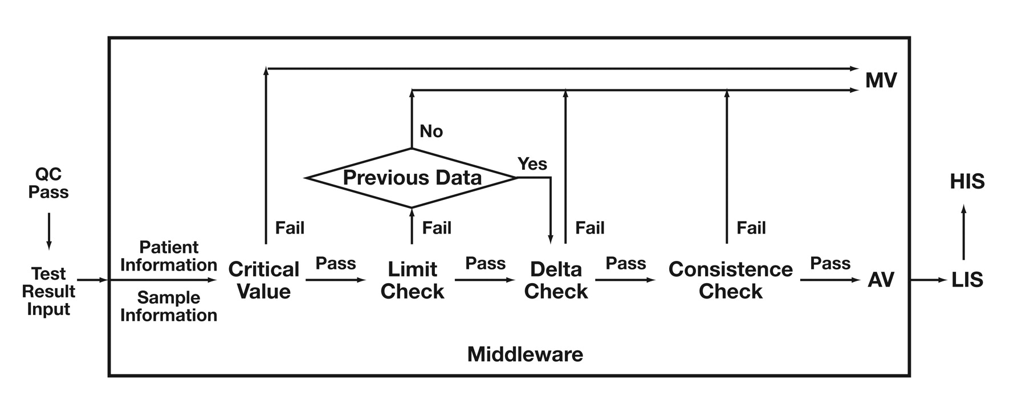
Figure 2 Algorithm design of AV.
Notes:
Figure 2 Algorithm design of AV.
Unless provided in the caption above, the following copyright applies to the content of this slide: © American Society of Clinical Pathologists

Slide 3
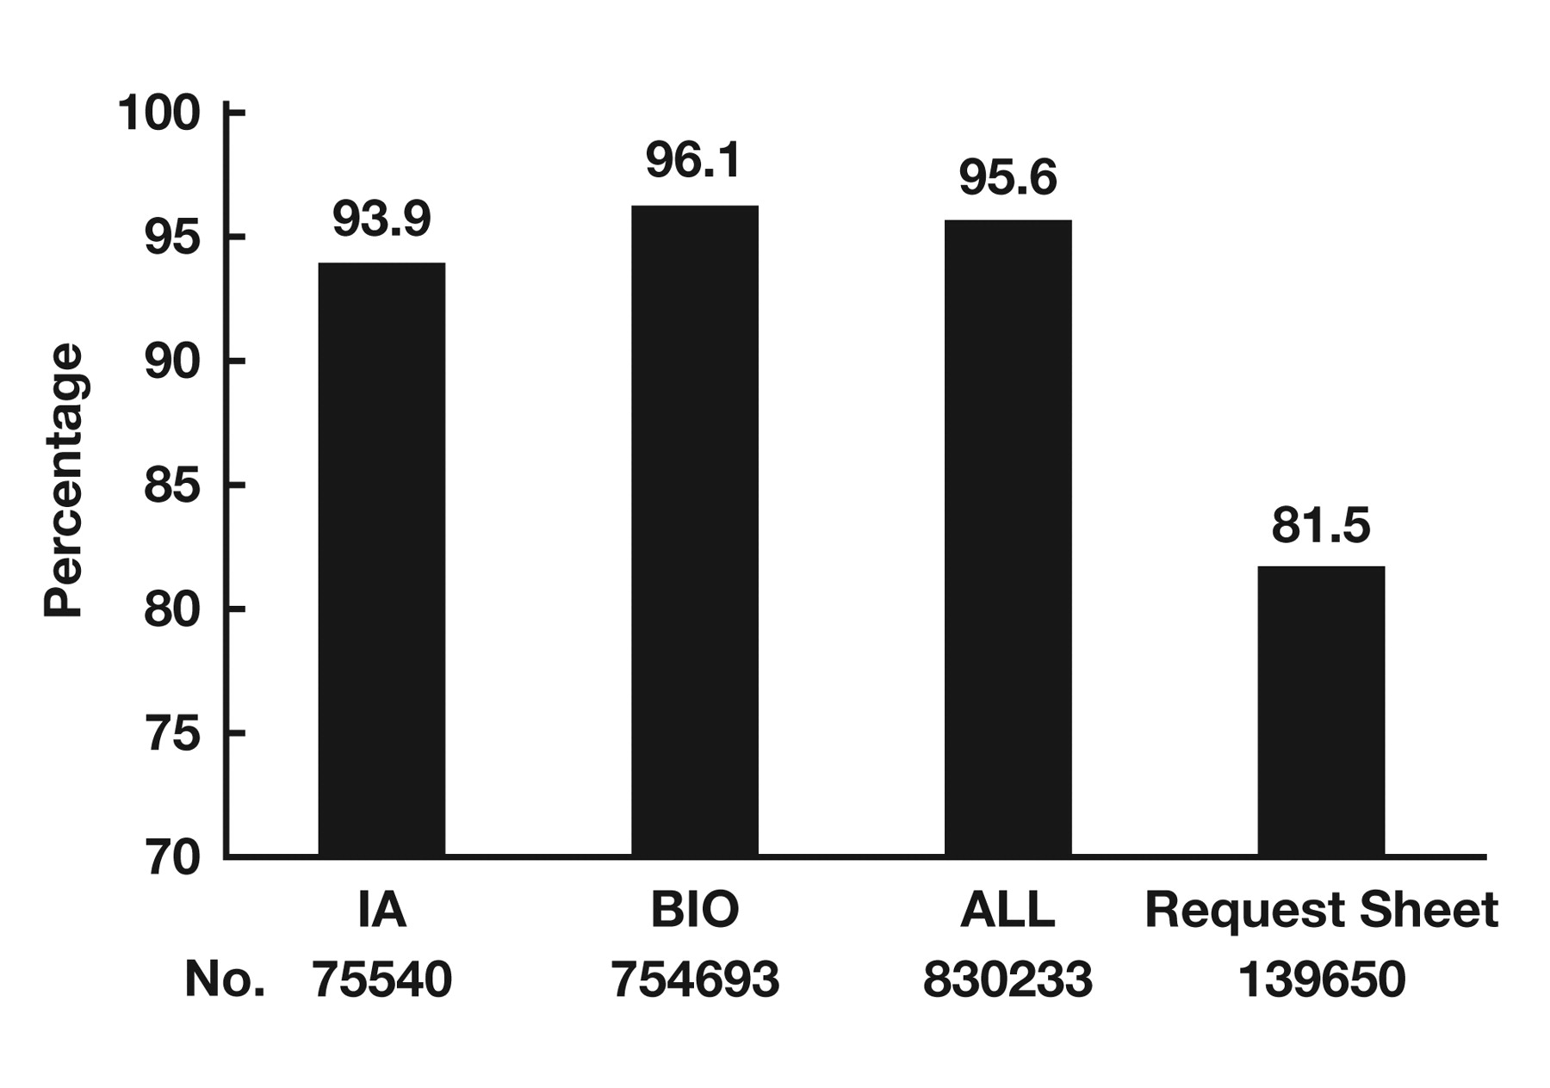
Figure 3 Autoverification passing rate of IA items, BIO related test items, and all (IA + BIO) test items. About 81.5% ...
Notes:
Figure 3 Autoverification passing rate of IA items, BIO related test items, and all (IA + BIO) test items. About 81.5% of patient reports could be auto-released without manual intervention.
Unless provided in the caption above, the following copyright applies to the content of this slide: © American Society of Clinical Pathologists

Slide 4
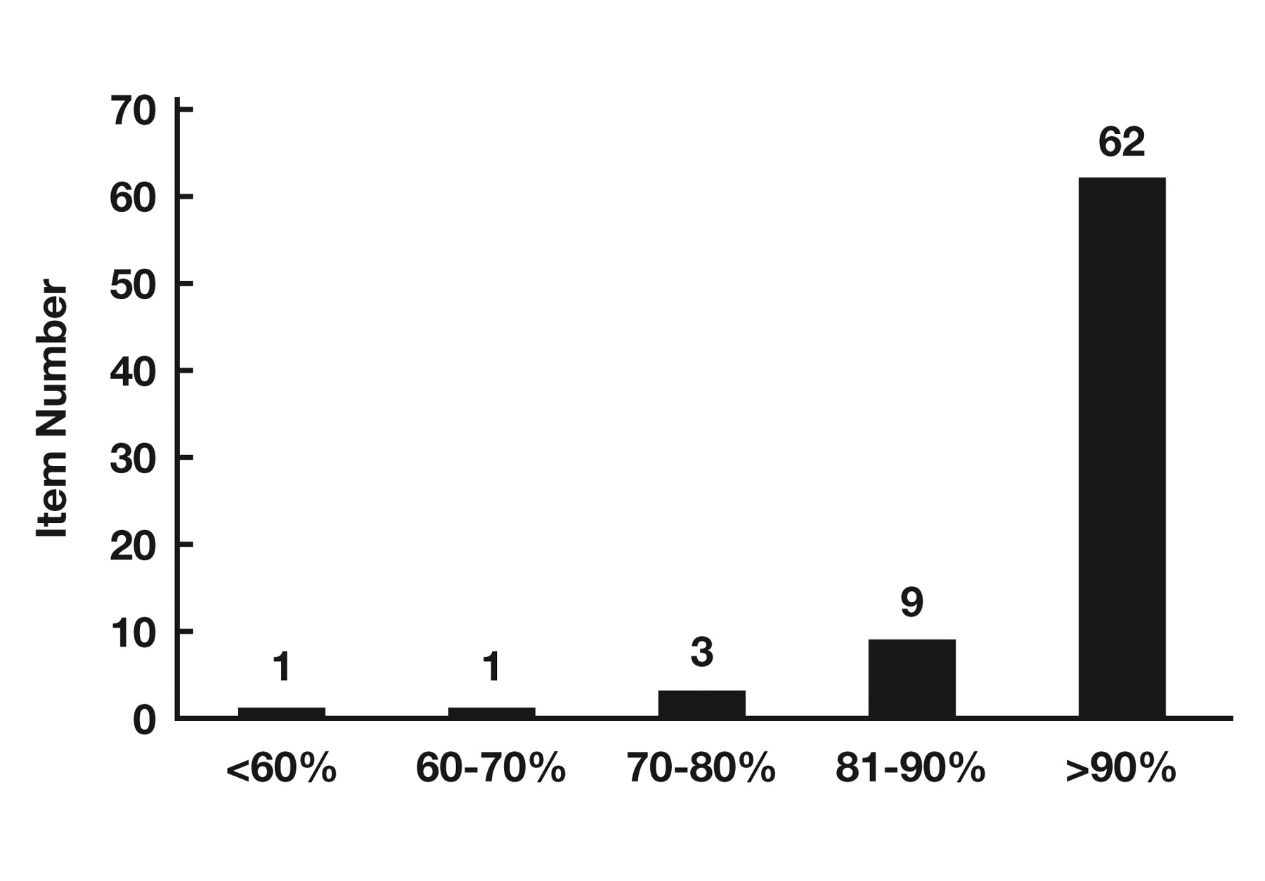
Figure 4 Distribution of the AV passing rate for 76 test items.
Notes:
Figure 4 Distribution of the AV passing rate for 76 test items.
Unless provided in the caption above, the following copyright applies to the content of this slide: © American Society of Clinical Pathologists

