Slide 1
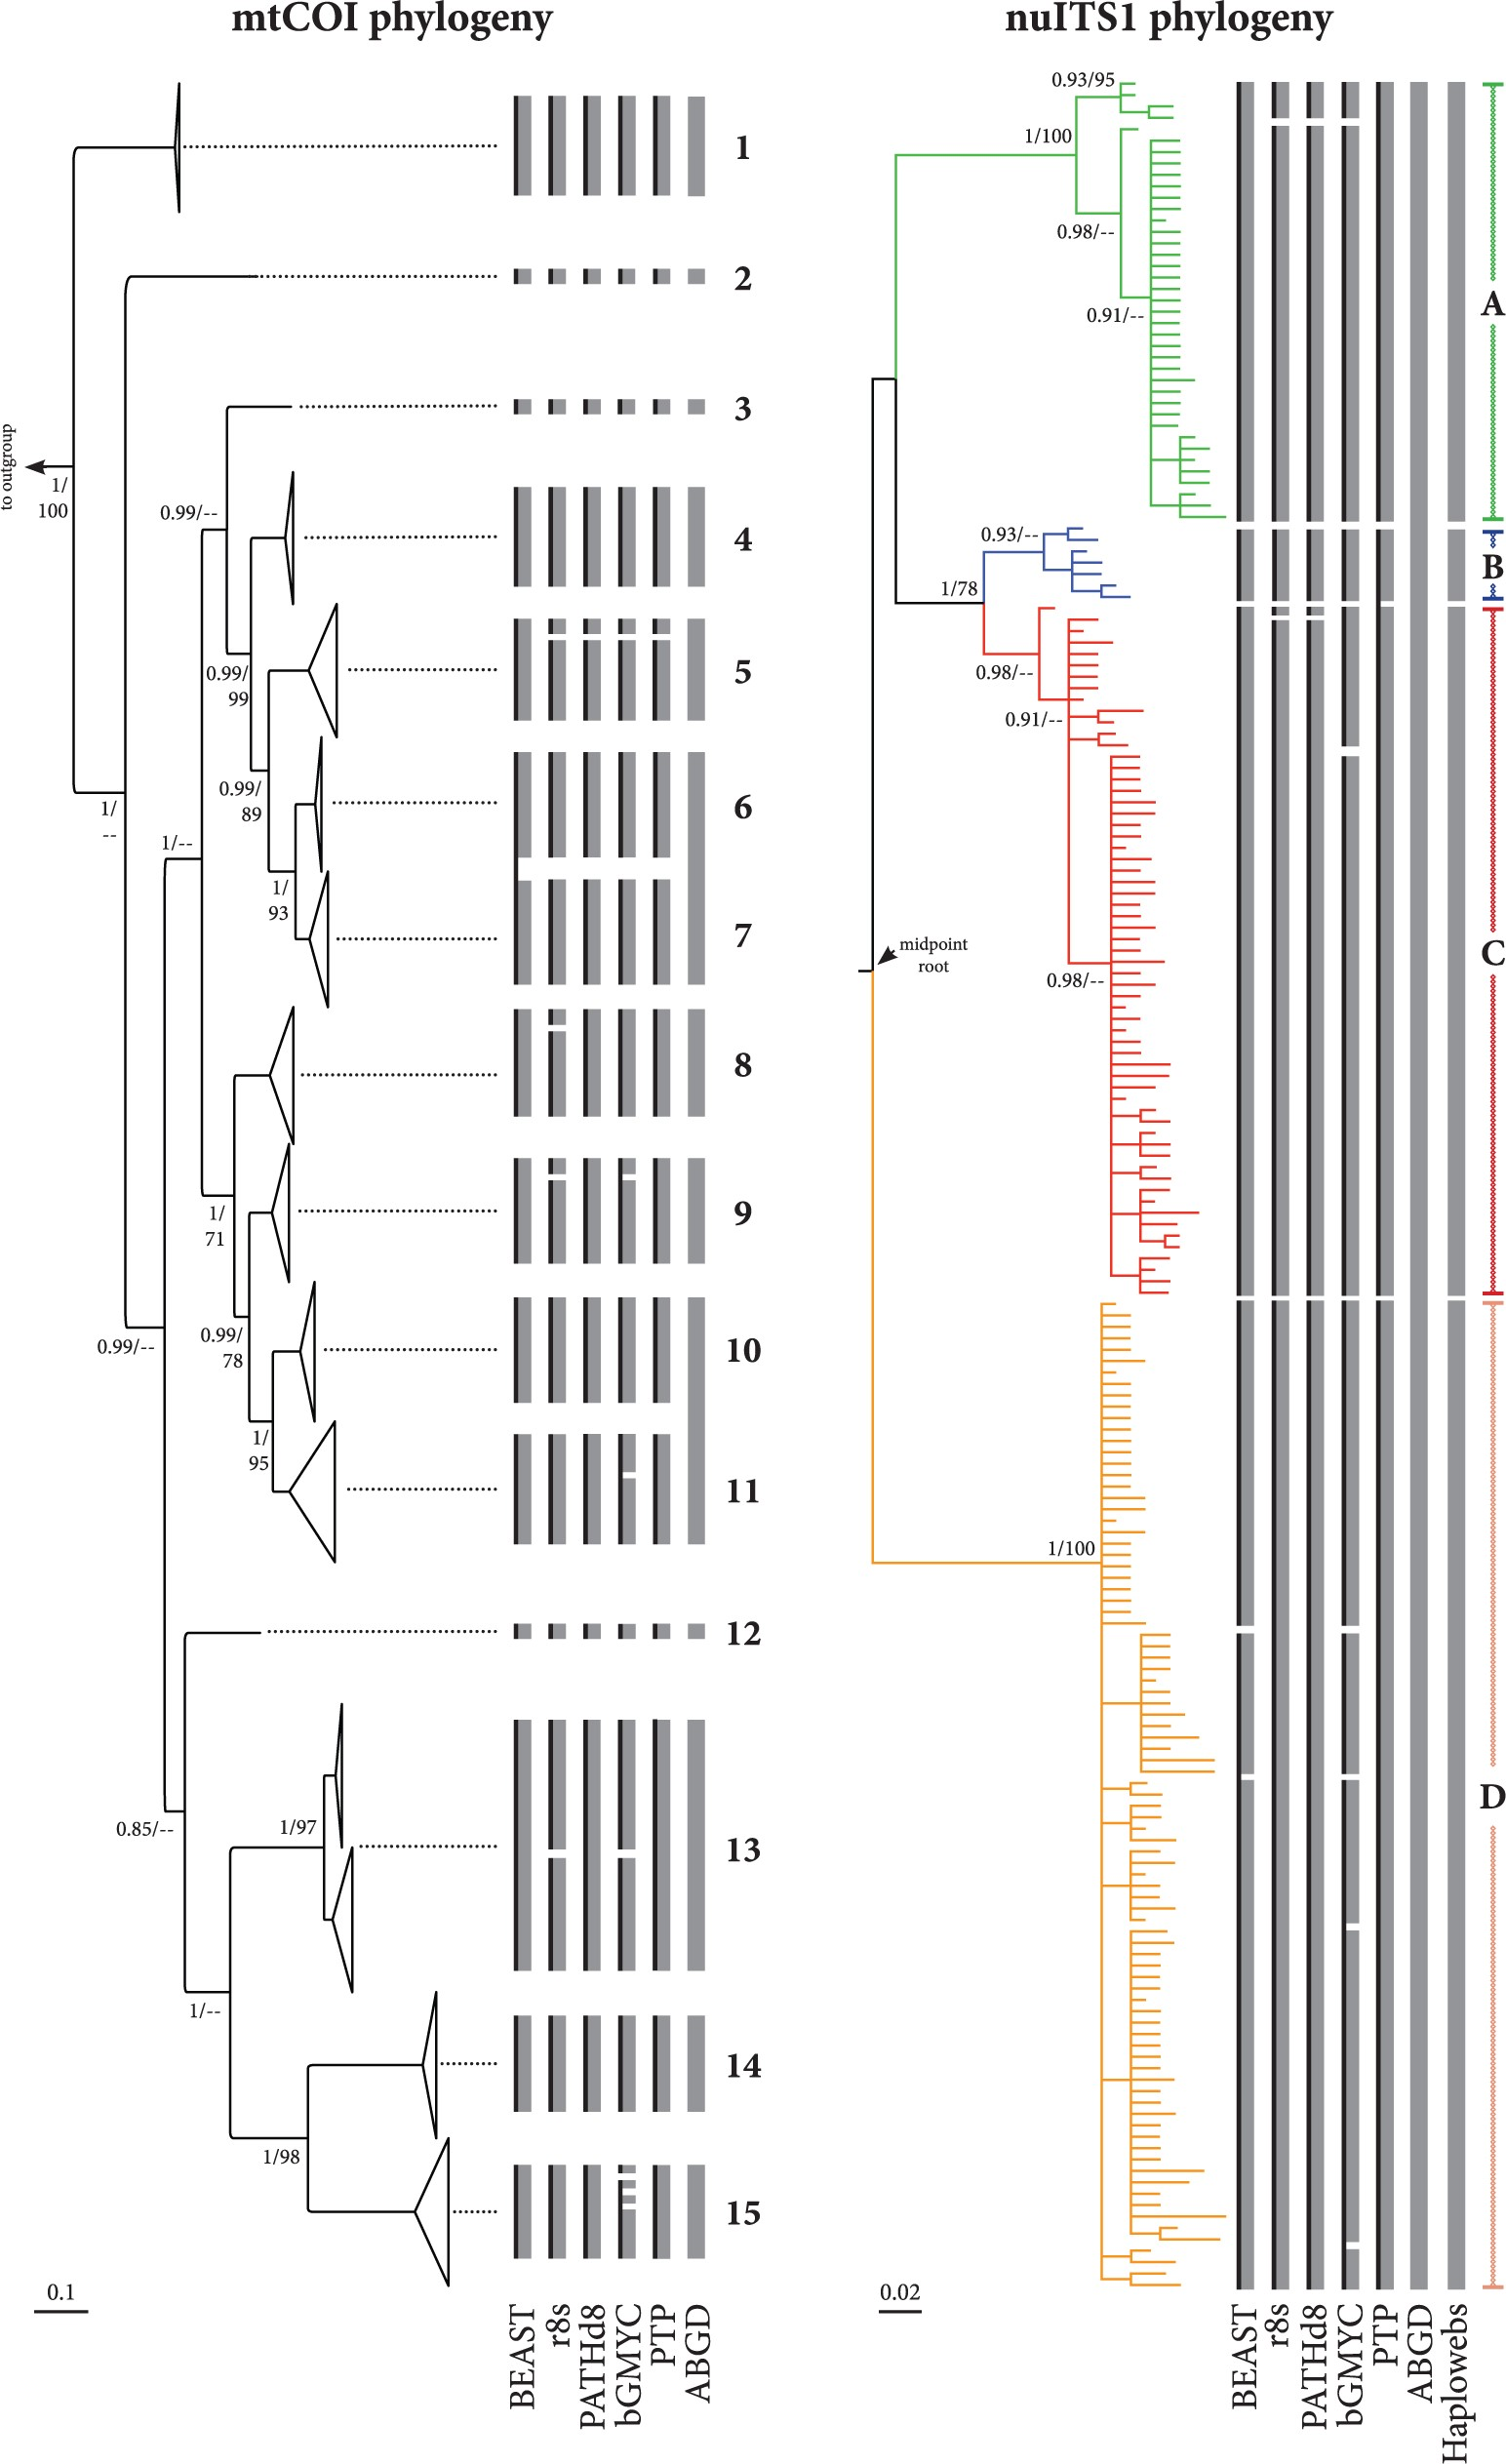
Figure 1. Bayesian majority rule (50%) phylograms based on the studied mtCOI and nuITS1 B. calyciflorus haplotypes. ...
Notes:
Figure 1. Bayesian majority rule (50%) phylograms based on the studied mtCOI and nuITS1 B. calyciflorus haplotypes. Gray boxes depict the delimitation estimated by each of the employed species delimitation methods. Black lines within the boxes depict delimitations after applying more conservative criteria. Numbers “1” to “15” and letters “A” to “D” describe mtCOI and nuITS1 delimited groups, respectively, according to the consensus of all methods. Node support is given as either Bayesian posterior probability (first number) or bootstrap support (second number), with values only above or equal 0.85 to posterior probability or 75% bootstrap support shown. Scale bars show the number of expected nucleotide changes per site.
Unless provided in the caption above, the following copyright applies to the content of this slide: © The Author(s) 2016. Published by Oxford University Press, on behalf of the Society of Systematic Biologists. All rights reserved. For Permissions, please email: journals.permissions@oup.com

Slide 2
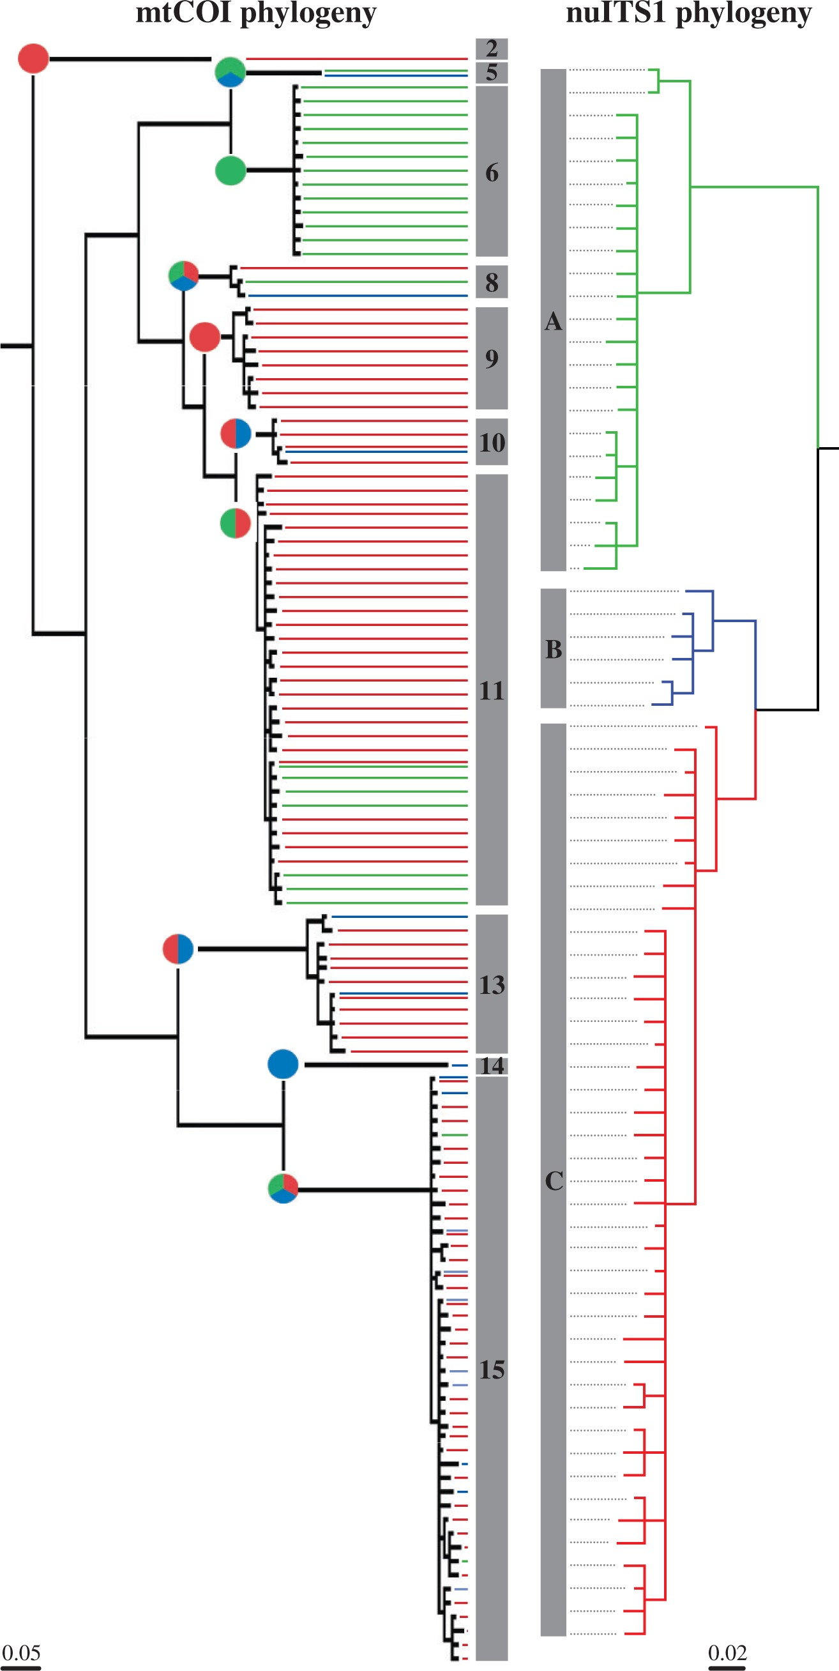
Figure 2. Bayesian majority rule (50%) phylograms reduced to include only the rotifer individuals that have been ...
Notes:
Figure 2. Bayesian majority rule (50%) phylograms reduced to include only the rotifer individuals that have been sequenced for both the mtCOI and nuITS1 markers. Pie charts are colored to describe the occurrence (not the amount) of the different nuITS1-delimited groups found in each of the mtCOI-delimited clusters. Scale bars show the number of expected nucleotide changes per site.
Unless provided in the caption above, the following copyright applies to the content of this slide: © The Author(s) 2016. Published by Oxford University Press, on behalf of the Society of Systematic Biologists. All rights reserved. For Permissions, please email: journals.permissions@oup.com

Slide 3
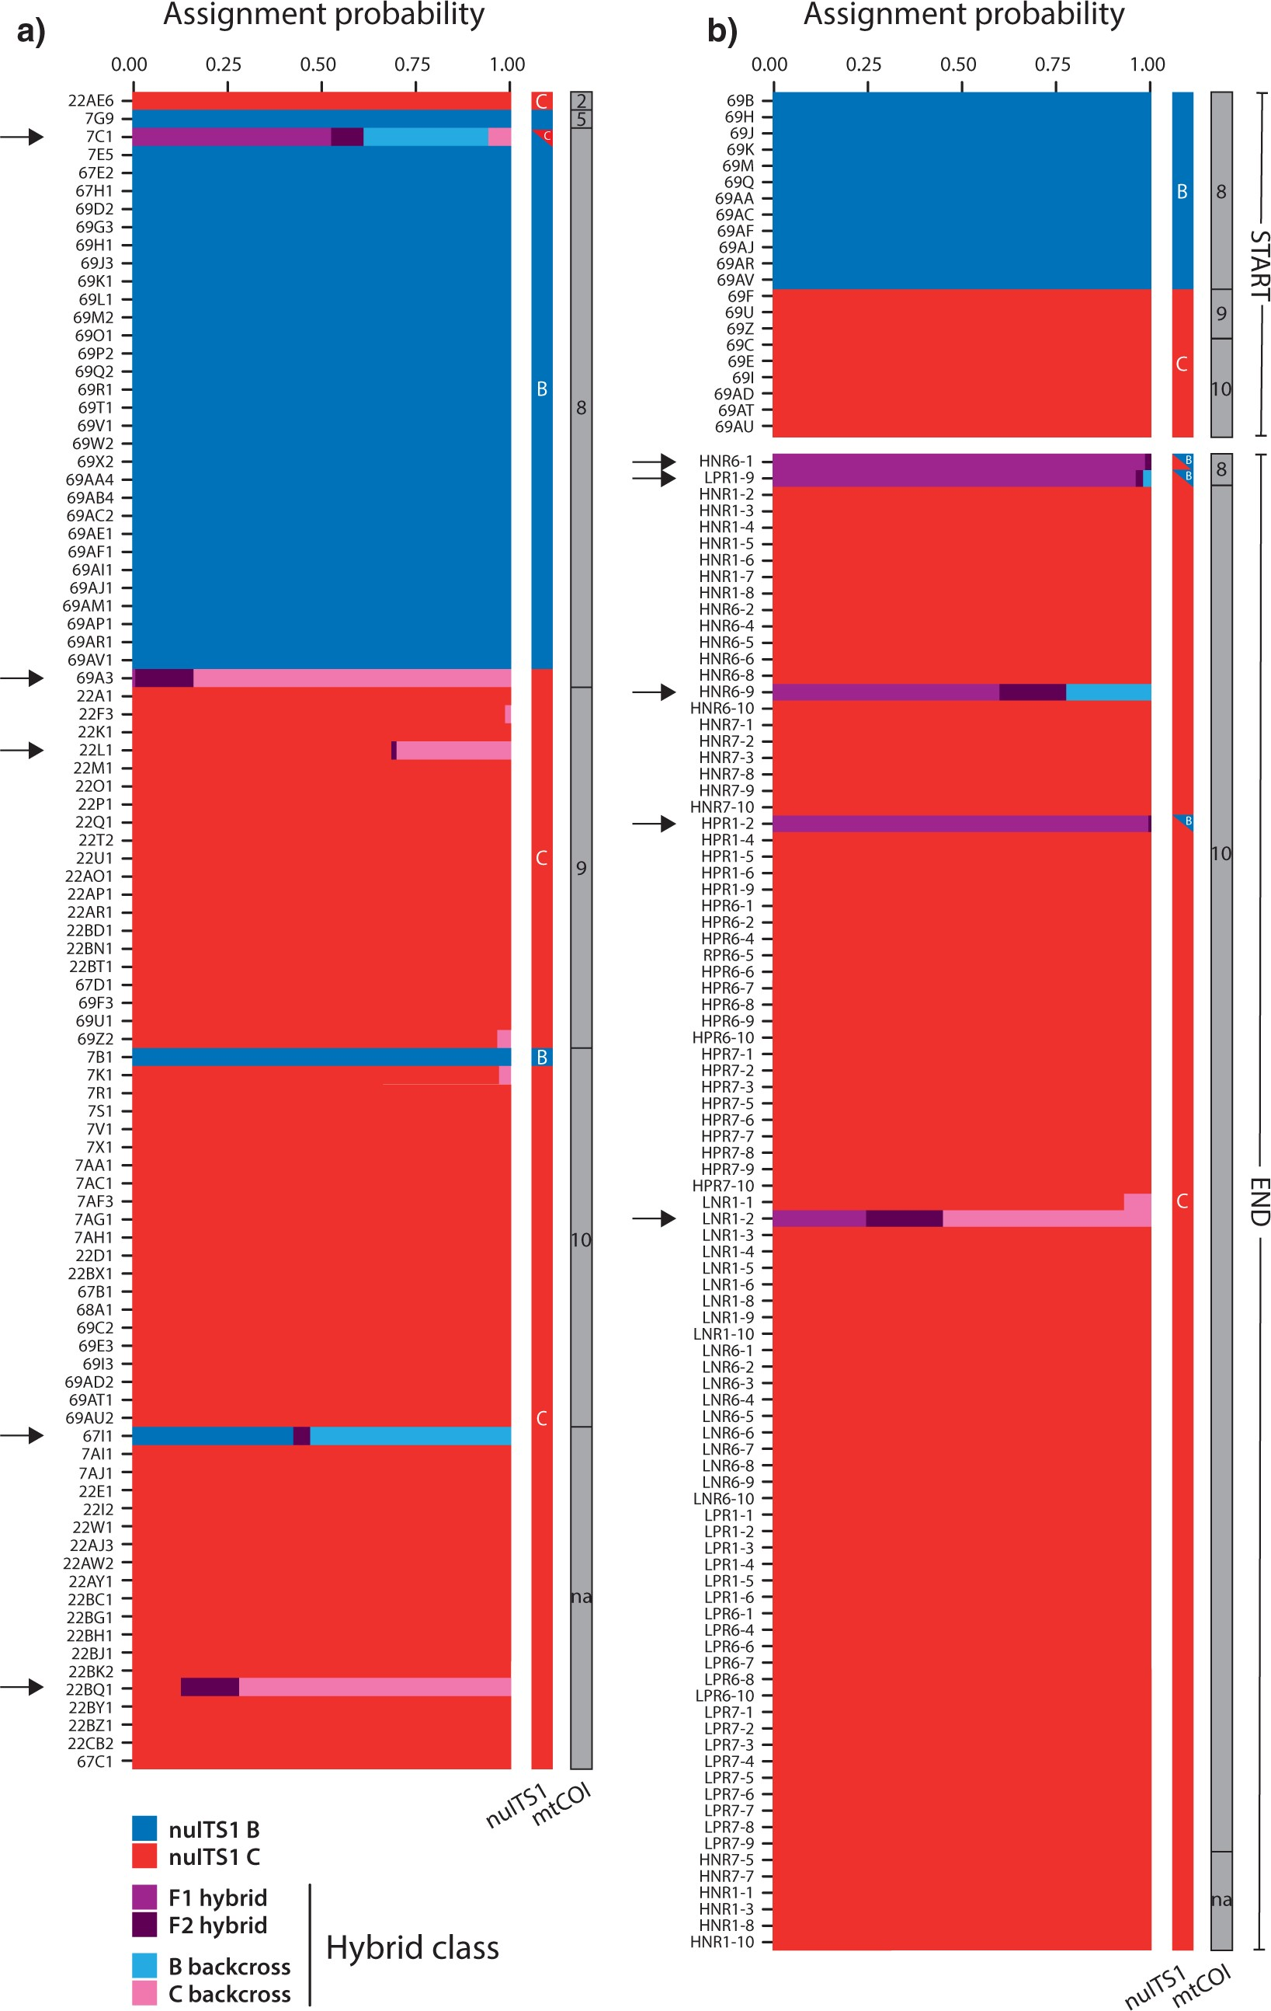
Figure 3. Results of the NewHybrids analysis assigning putative hybrid individuals (indicated with arrows) to different ...
Notes:
Figure 3. Results of the NewHybrids analysis assigning putative hybrid individuals (indicated with arrows) to different hybrid classes between the nuITS1 B and C rotifers (a) for wild-derived samples, and (b) at the start and at the end of the competition experiment. The mtCOI and nuITS1 assignment of each individual is also shown. Three of the hybrid rotifers in the competition experiment also produced a hybrid restriction pattern at the nuITS1 locus (blue triangles), while one wild-derived hybrid also displayed a nuITS1 B/C pattern in the haploweb (red triangle).
Unless provided in the caption above, the following copyright applies to the content of this slide: © The Author(s) 2016. Published by Oxford University Press, on behalf of the Society of Systematic Biologists. All rights reserved. For Permissions, please email: journals.permissions@oup.com

Slide 4
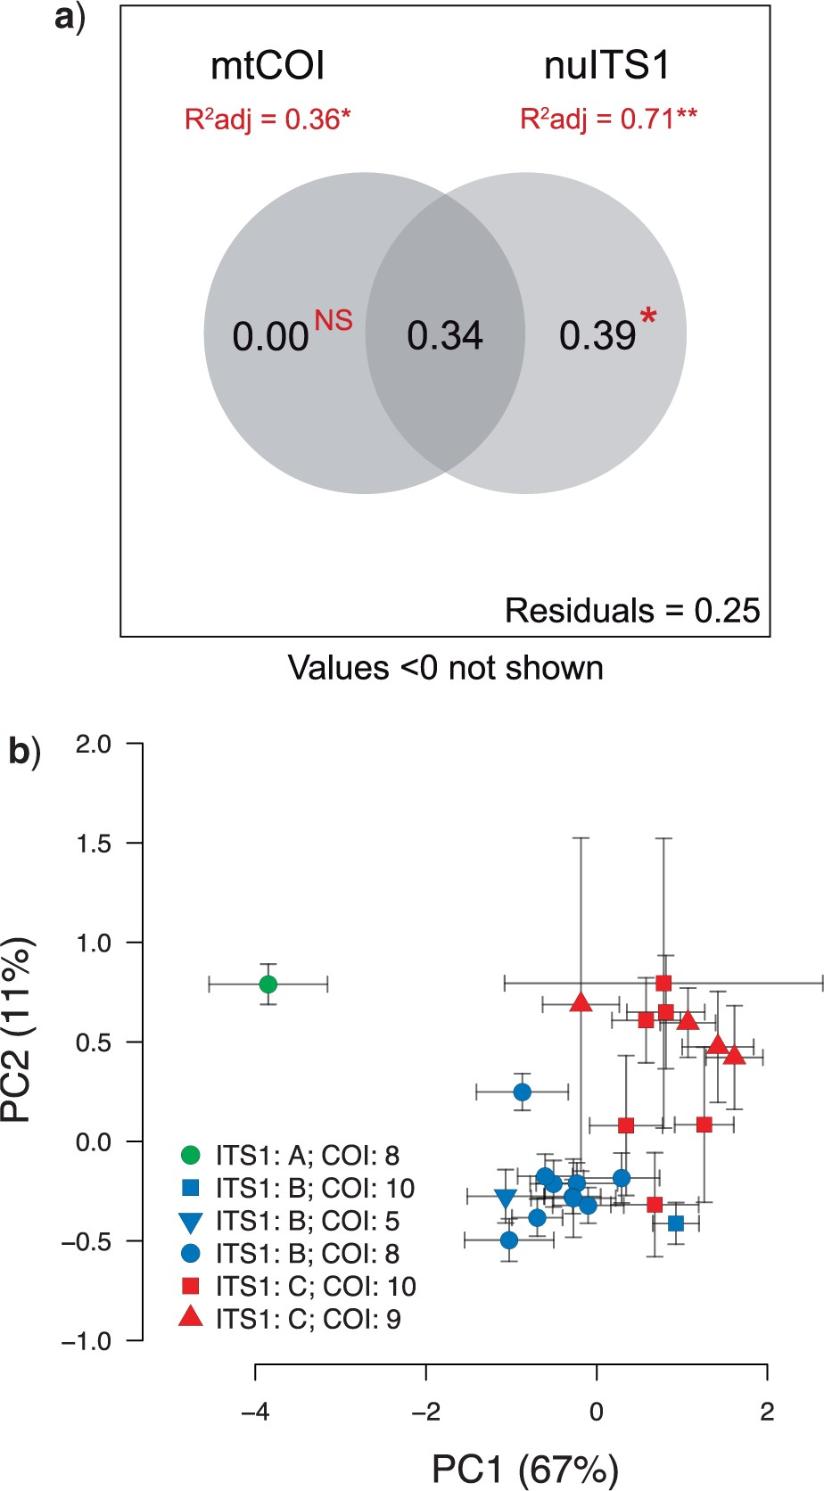
Figure 4. Analysis of the association between species delimitations and morphometry. (a) Venn diagram of the results ...
Notes:
Figure 4. Analysis of the association between species delimitations and morphometry. (a) Venn diagram of the results of the variation partitioning analysis that depicts the adjusted R2 -values and significance levels of the mtCOI- and nuITS1-based delimitations. Values outside the shaded areas represent marginal effects (i.e., the amount of variation explained when testing for each delimitation separately, R2 adj). Values in the intersection represent variation explained in common by both delimitations (collinear effects). Values in the shaded areas but outside of their intersection represent conditional effects (variation uniquely explained by each delimitation). *P<0.05 , **P<0.01 . (b) Representation of sample score averages of each of the investigated clones along the first two axes of a principal components analysis, performed on the morphometric variables. Error bars represent the variation between individuals of the same clone (twice the standard error of the mean). Point colors and shapes represent the nuITS1 and mtCOI delimitations, respectively.
Unless provided in the caption above, the following copyright applies to the content of this slide: © The Author(s) 2016. Published by Oxford University Press, on behalf of the Society of Systematic Biologists. All rights reserved. For Permissions, please email: journals.permissions@oup.com

