Slide 1
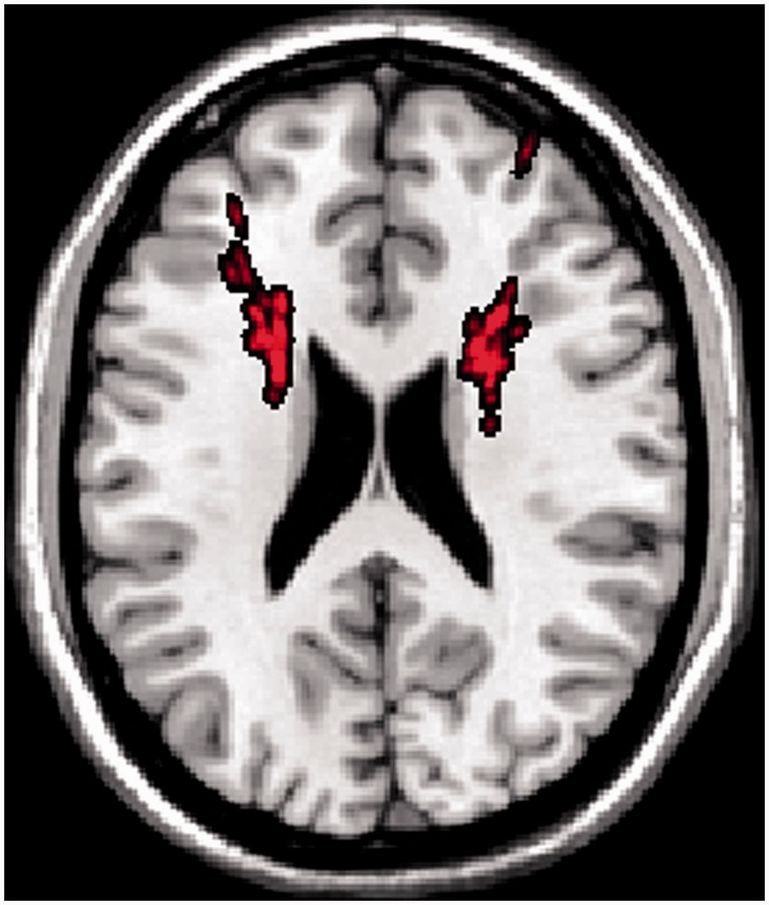
Figure 1 Slice through normalized mean mask of all electrode trajectories plotted over the single subject MNI template ...
Notes:
Figure 1 Slice through normalized mean mask of all electrode trajectories plotted over the single subject MNI template at a transversal slice at height z = 23, corresponding approximately to the slice in Morishita et al. (2014). None of our trajectories penetrate the caudate nucleus at this height (body of the caudate nucleus).
Unless provided in the caption above, the following copyright applies to the content of this slide: © The Author (2014). Published by Oxford University Press on behalf of the Guarantors of Brain. All rights reserved. For Permissions, please email: journals.permissions@oup.com

