Slide 1
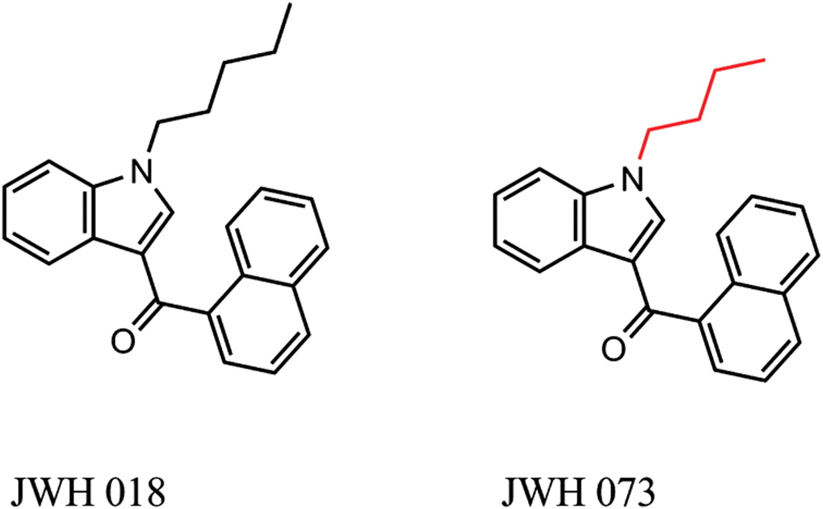
Figure 1. Chemical structures for JWH-018 and JWH-073.
Notes:
Figure 1. Chemical structures for JWH-018 and JWH-073.
Unless provided in the caption above, the following copyright applies to the content of this slide: © The Author [2012]. Published by Oxford University Press. All rights reserved. For Permissions, please email: journals.permissions@oup.com

Slide 2
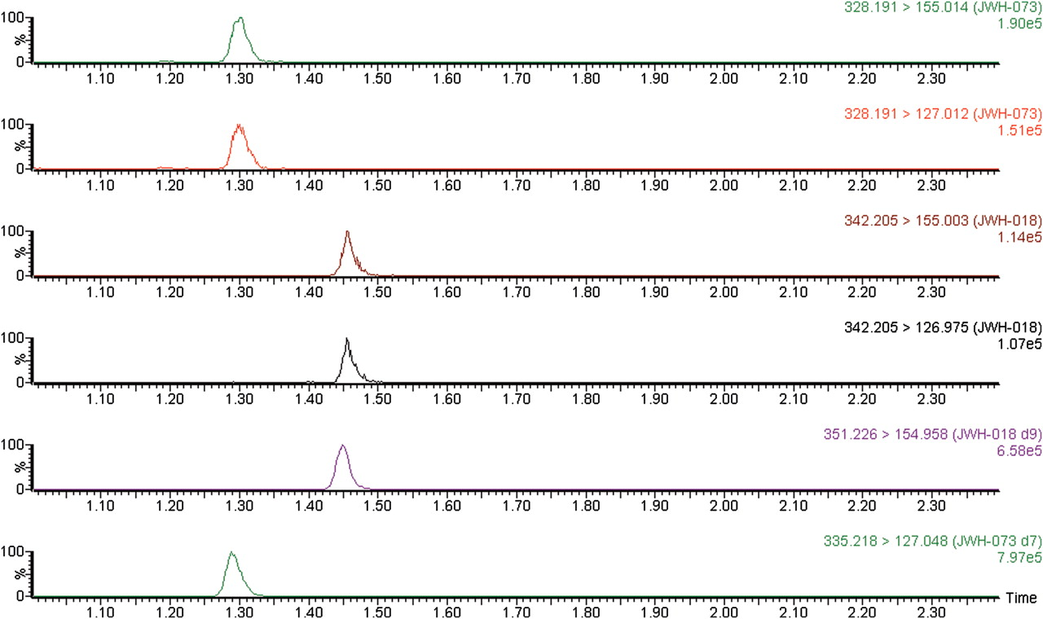
Figure 2. Analytes of interest in whole blood at the limit of quantitation (0.05 ng/mL) along with internal standards.
Notes:
Figure 2. Analytes of interest in whole blood at the limit of quantitation (0.05 ng/mL) along with internal standards.
Unless provided in the caption above, the following copyright applies to the content of this slide: © The Author [2012]. Published by Oxford University Press. All rights reserved. For Permissions, please email: journals.permissions@oup.com

Slide 3
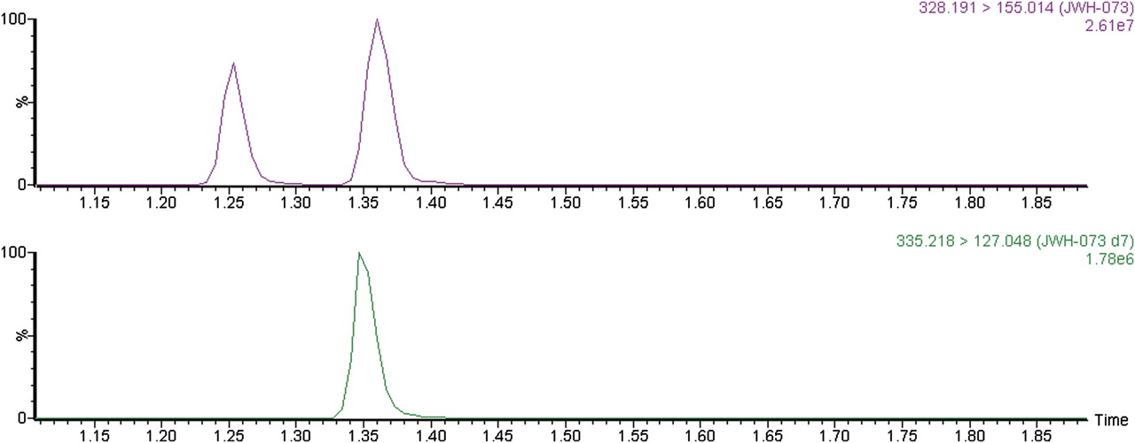
Figure 3. Chromatographic resolution between isobaric compounds JWH-015 and JWH-073.
Notes:
Figure 3. Chromatographic resolution between isobaric compounds JWH-015 and JWH-073.
Unless provided in the caption above, the following copyright applies to the content of this slide: © The Author [2012]. Published by Oxford University Press. All rights reserved. For Permissions, please email: journals.permissions@oup.com

Slide 4
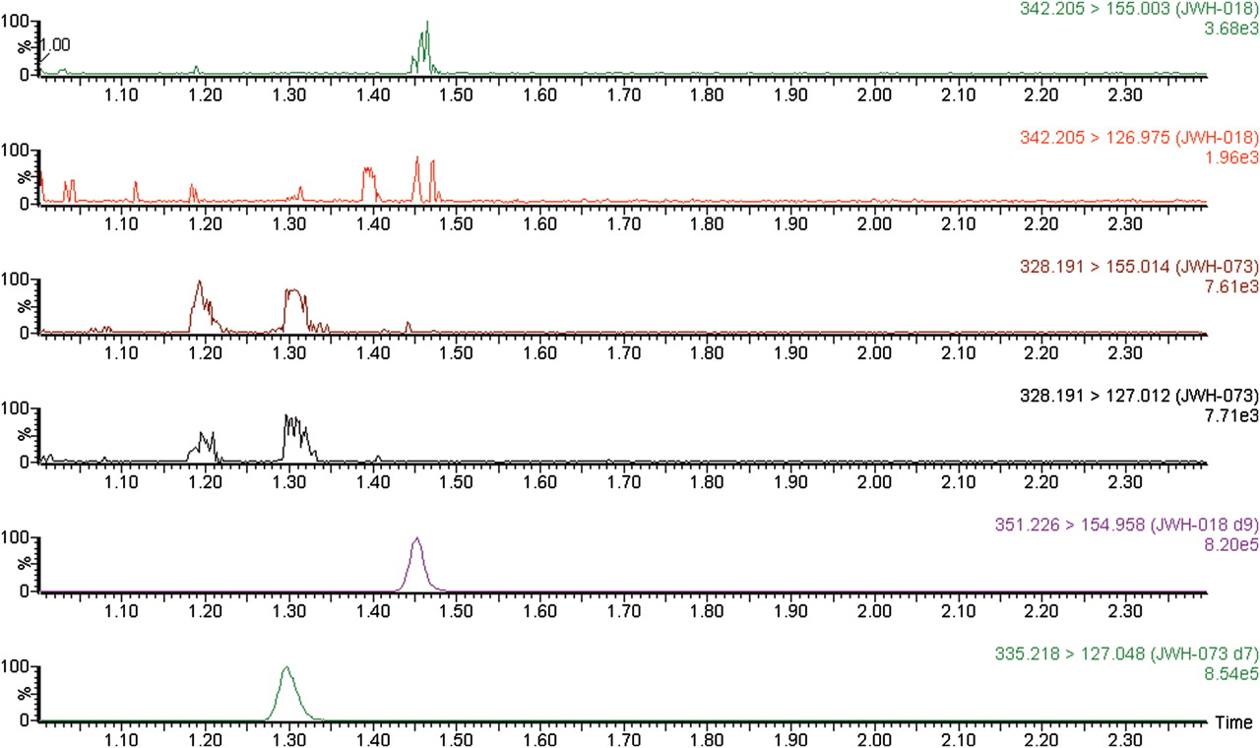
Figure 4. First blank specimen injected after a whole blood specimen spiked at 1,000 ng/mL.
Notes:
Figure 4. First blank specimen injected after a whole blood specimen spiked at 1,000 ng/mL.
Unless provided in the caption above, the following copyright applies to the content of this slide: © The Author [2012]. Published by Oxford University Press. All rights reserved. For Permissions, please email: journals.permissions@oup.com

Slide 5
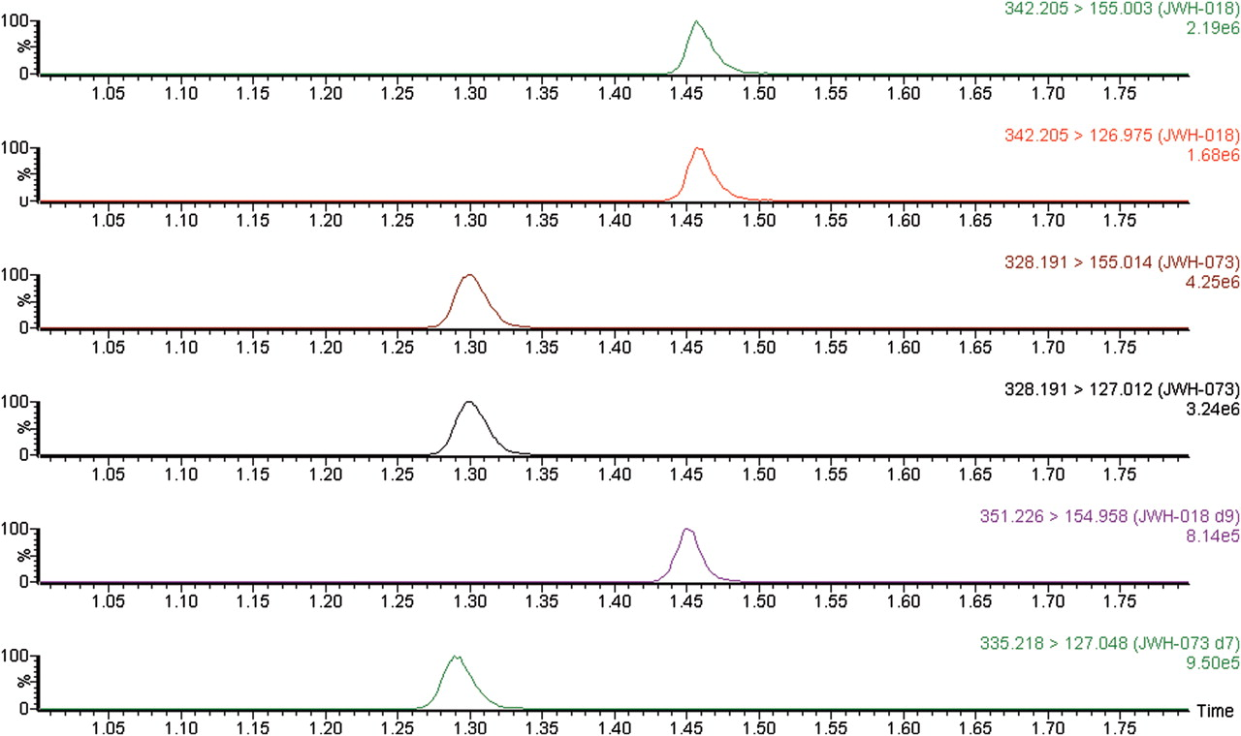
Figure 5. Chromatogram of authentic specimen: Case 2, JWH-018 (19.6 ng/mL), JWH-073 (68.3 ng/mL).
Notes:
Figure 5. Chromatogram of authentic specimen: Case 2, JWH-018 (19.6 ng/mL), JWH-073 (68.3 ng/mL).
Unless provided in the caption above, the following copyright applies to the content of this slide: © The Author [2012]. Published by Oxford University Press. All rights reserved. For Permissions, please email: journals.permissions@oup.com

