Slide 1
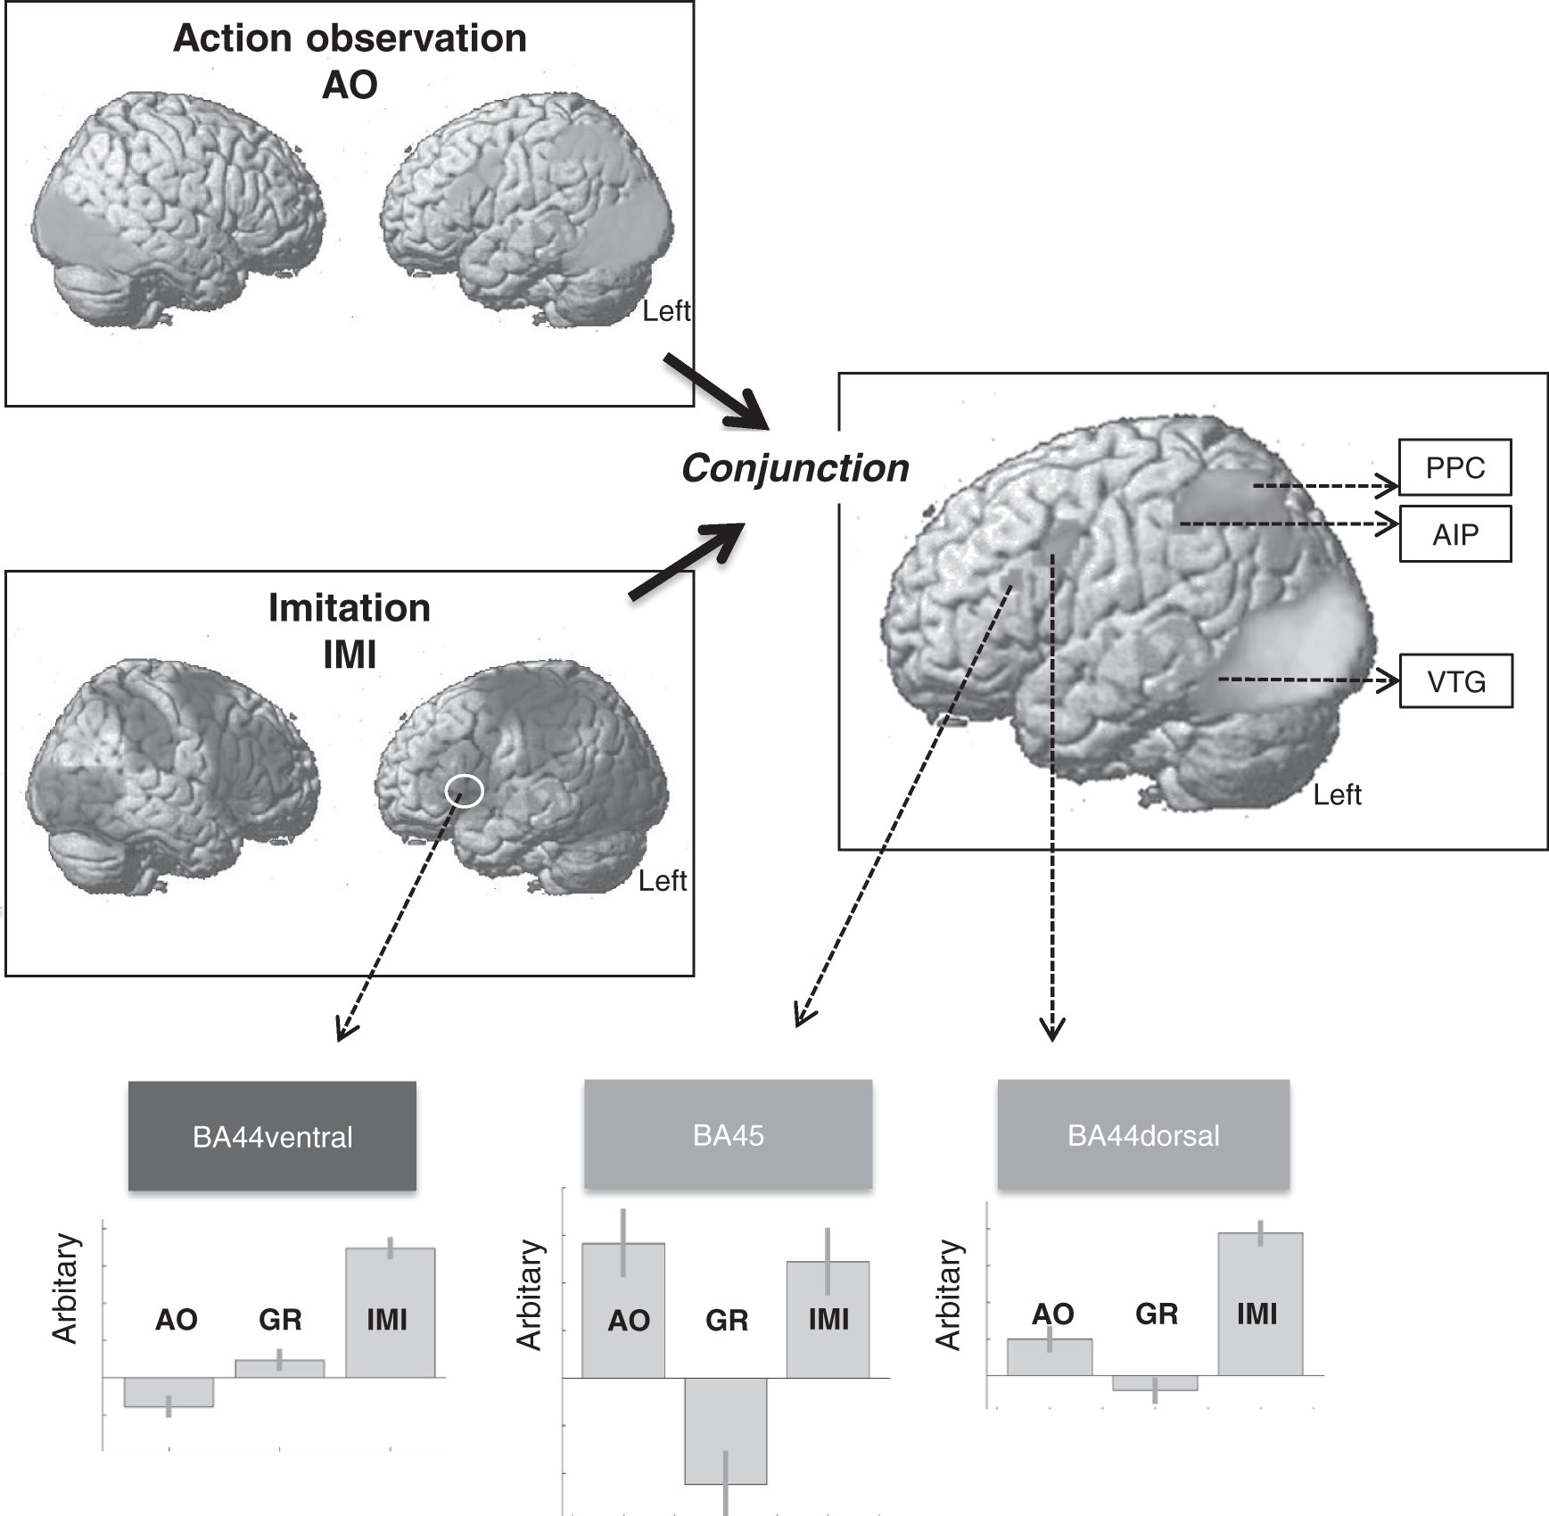
Figure 1. Activation map during action observation (AO in green) and imitation (IMI in blue) showed among other regions ...
Notes:
Figure 1. Activation map during action observation (AO in green) and imitation (IMI in blue) showed among other regions activation of the ventral and dorsal part of the pars opercularis (BA44ventral and BA44dorsal) and the pars triangularis (BA45) of the inferior frontal gyrus (IFG). The maximum peak voxel of the conjunction analysis of IMI and AO is presented in yellow and includes BA44dorsal and BA45 of IFG as well as the posterior parietal cortex (PPC; according to anatomy toolbox (superior parietal lobule; SPL; 7PC), the anterior intraparietal sulcus (AIP; according to anatomy toolbox hlp3), the ventral temporal gyrus (VTG), and the visual cortex. Plot bars of activation from maximum activated peak voxel are demonstrated during grasping an object (GR), IMI, and AO.
Unless provided in the caption above, the following copyright applies to the content of this slide: © The Author 2015. Published by Oxford University Press. All rights reserved. For Permissions, please e-mail: journals.permissions@oup.com

Slide 2
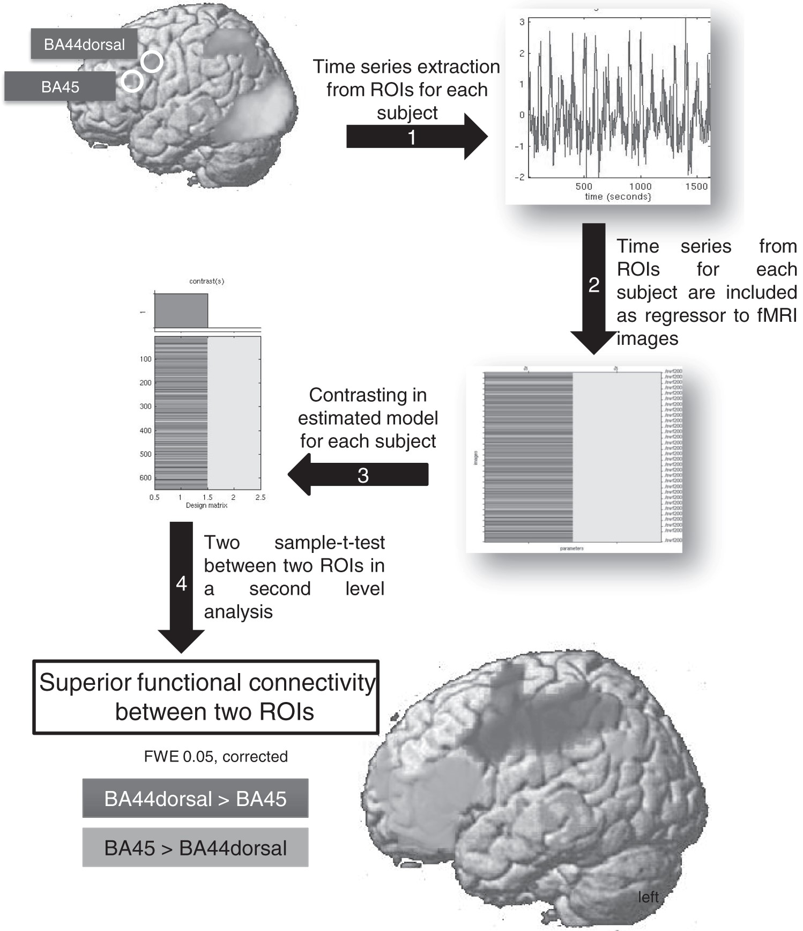
Figure 2. Functional connectivity of 2 regions of interest (ROIs) when contrasted against each other. In step 1, fMRI ...
Notes:
Figure 2. Functional connectivity of 2 regions of interest (ROIs) when contrasted against each other. In step 1, fMRI time series are extracted from ROIA (BA44dorsal) and ROIB (BA45) for each subject. In step 2, the extracted time series of each ROI are included as regressor to fMRI images for each subject. In step 3, the estimated model of step 2 is contrasted for each subject and each ROI. In the final analysis (step 4), a two-sample t-test was evaluated between the contrast of estimated model from ROIA (BA44dorsal) against ROIB (BA45) and vice versa. BA44dorsal shows more functional connectivity (in red) with the dorsal premotor cortex, the primary sensorimotor cortex, the posterior parietal cortex, the superior and inferior parietal lobule, as well as with the intraparietal sulcus and the ventral temporal gyrus in contrast to BA45. The BA45 revealed more functional connectivity with angular gyrus and more frontal areas (in green).
Unless provided in the caption above, the following copyright applies to the content of this slide: © The Author 2015. Published by Oxford University Press. All rights reserved. For Permissions, please e-mail: journals.permissions@oup.com

Slide 3
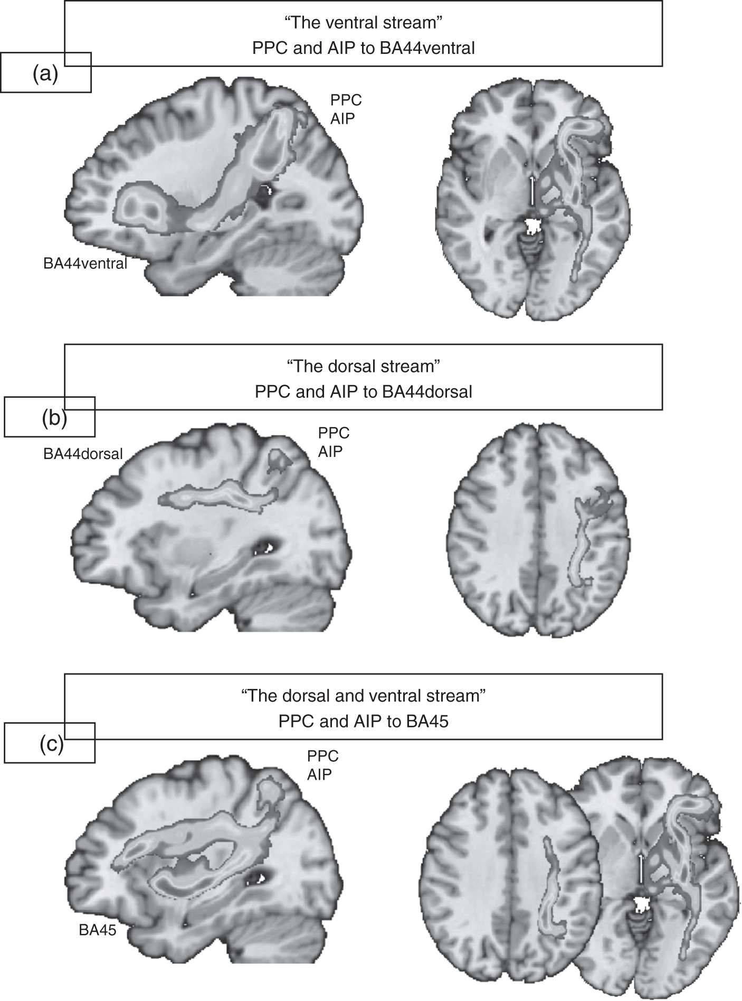
Figure 3. Seed regions were extracted from the conjunction analysis of IMI and AO: PPC (according to anatomy toolbox ...
Notes:
Figure 3. Seed regions were extracted from the conjunction analysis of IMI and AO: PPC (according to anatomy toolbox (superior parietal lobule; SPL; 7PC), AIP (according to anatomy toolbox hlp3), VTG, BA44dorsal and BA45, as well as maximum peak voxel of IFG activated during IMI and GR (BA44ventral). Anatomical contributions of the same postrolandic ROIs (PPC, AIP, and VTG) were calculated with BA44ventral, BA44dorsal, and BA45. (a) BA44ventral was connected with AIP and PPC via fibers passing through the extreme capsule (the fasciculus extreme capsule, EmC; the ventral stream). (b) BA44dorsal was connected with AIP and PPC along the superior longitudinal fasciculus (SLF). The bundle of the arcuate fasciculus (AF) arising from the VTG blends with SLF and connects VTG with BA44dorsal (is not pictured). (c) BA45 was connected with AIP and PPC via both the SLF (the dorsal stream) and the EmC (the ventral stream).
Unless provided in the caption above, the following copyright applies to the content of this slide: © The Author 2015. Published by Oxford University Press. All rights reserved. For Permissions, please e-mail: journals.permissions@oup.com

Slide 4
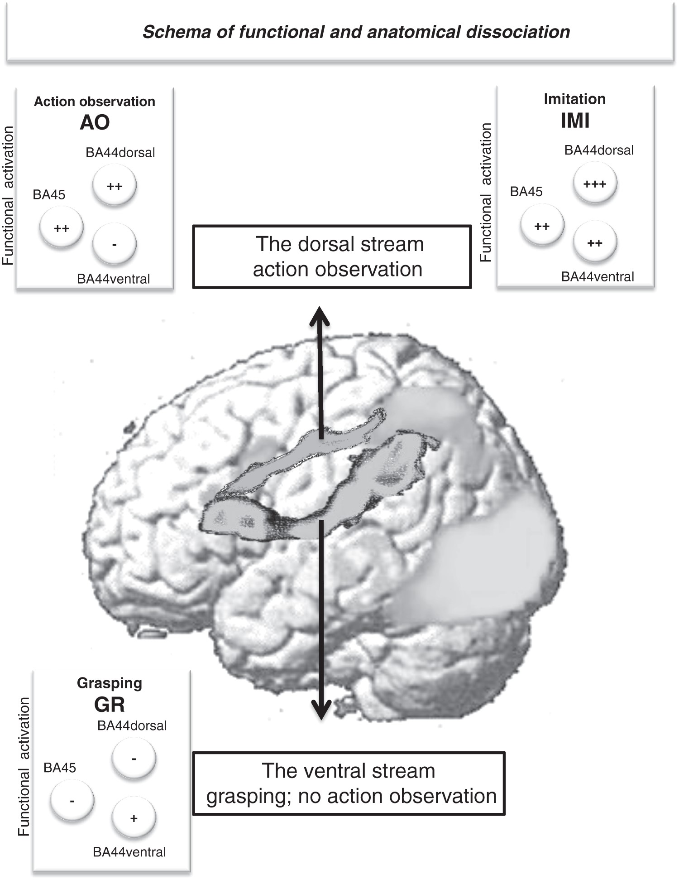
Figure 4. A schema of different networks based on current functional–anatomical findings. The BA44dorsal and BA45 are ...
Notes:
Figure 4. A schema of different networks based on current functional–anatomical findings. The BA44dorsal and BA45 are active during conditions with additional task regarding action observation (IMI and AO). These 2 regions are connected to the VTG (the ventral temporal cortex) with the fasciculus arcuatus (AF) and the superior longitudinalis fasciculus (SLF; the dorsal stream). The BA44ventral is active during hand movement (IMI and GR). The extreme capsule (EmC) projects information from the anterior intraparietal sulcus (AIP) and the posterior parietal cortex (PPC) to BA44ventral (the ventral stream). We suppose that this network is responsible for action performance. Plus-sign in white circle represents strength of activation degree during the task. IMI, imitation; AO, action observation; GR, grasping.
Unless provided in the caption above, the following copyright applies to the content of this slide: © The Author 2015. Published by Oxford University Press. All rights reserved. For Permissions, please e-mail: journals.permissions@oup.com

