Slide 1
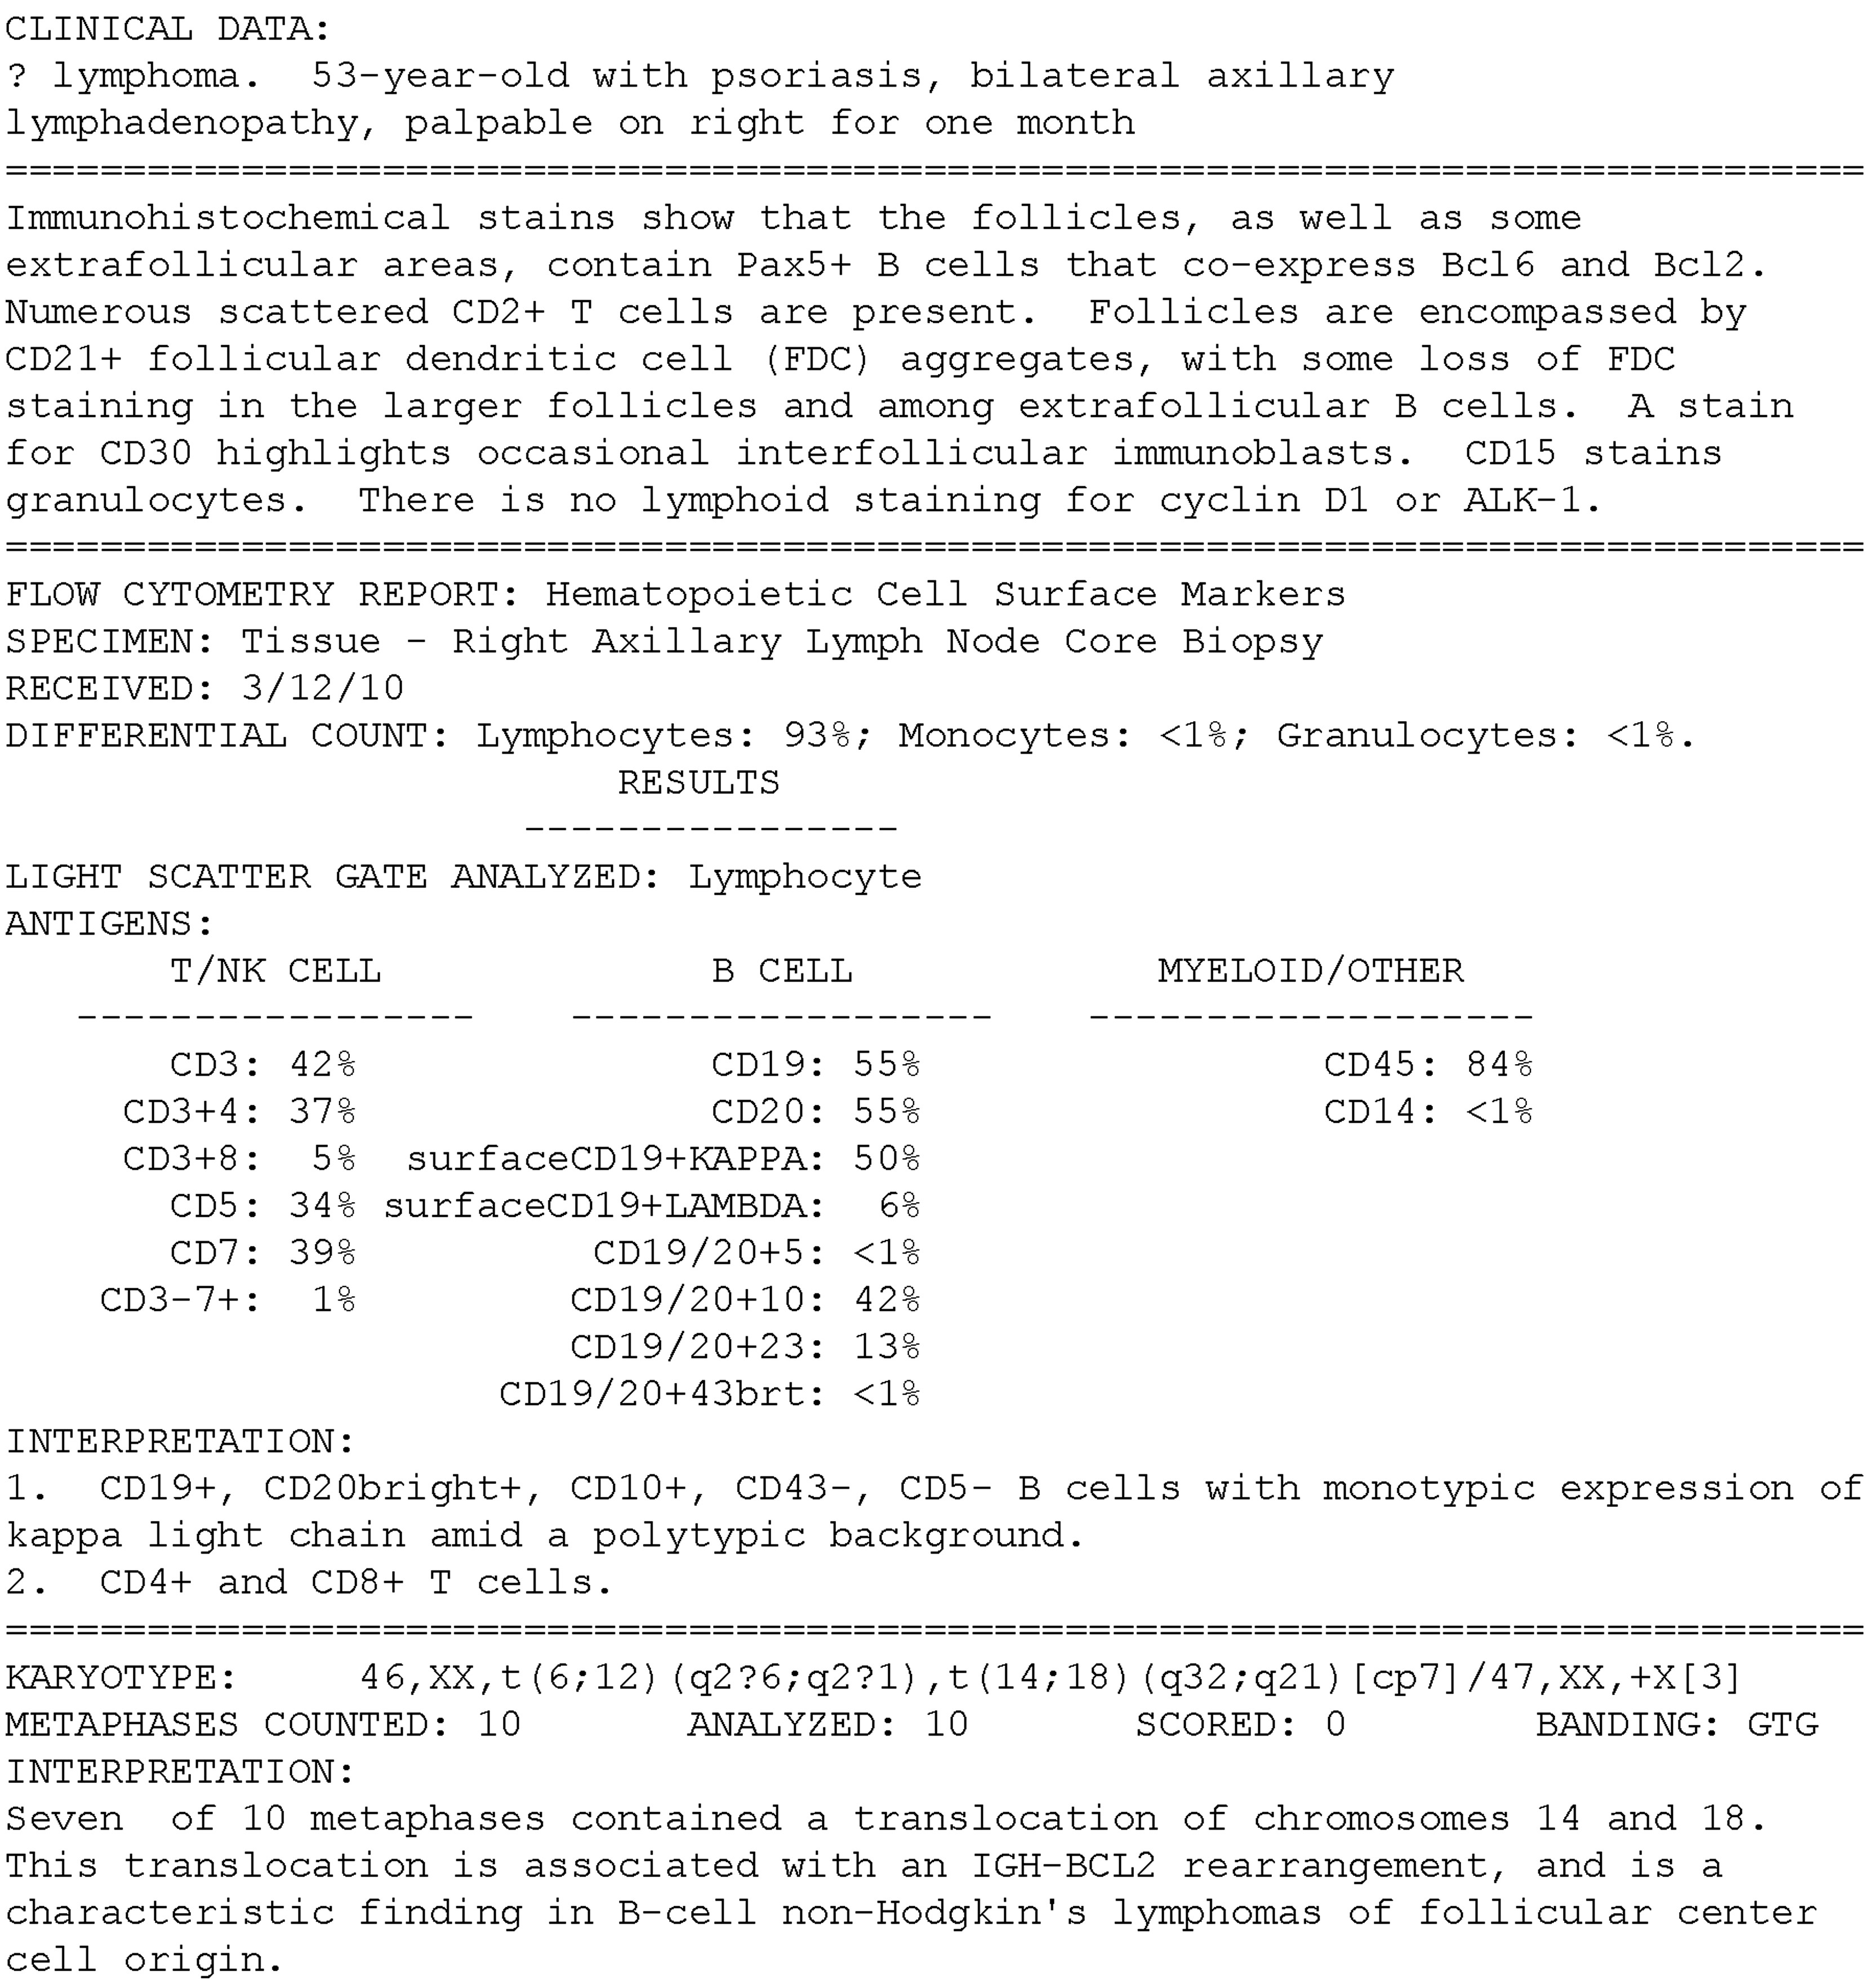
Figure 1 Massachusetts General Hospital pathology reports usually contain four sections with almost all information ...
Notes:
Figure 1 Massachusetts General Hospital pathology reports usually contain four sections with almost all information retained as narrative text. Clinical data, the first section, include patient age, medical history, and ongoing treatment procedures, etc. The second section, morphology and immunohistochemistry, describes cellular structural alterations appearing under a light microscope aided by a variety of dyes, some of which are conjugated to cell-specific antibodies. The third section is on flow cytometry, which describes the characteristic expression of various surface antigens on cells. The individual or combined percentages of antigens (eg, CD20, CD5 and CD10) are reported. Also reported are pathologists’ interpretations, which characterize these numbers (eg, + (ie, positive) or − (ie, negative)) relative to reference values. The fourth section is on cytogenetics, which records the presence of chromosomal aberrations such as translocations, insertions, and deletions, in the form of a ‘karyotype’ using a standardized nomenclature55 that is not natural language processing friendly. However, the accompanying ‘interpretation’ section describes these aberrations in narrative text. Dates and age etc are replaced with realistic surrogates for deidentification.
Unless provided in the caption above, the following copyright applies to the content of this slide: Published by the BMJ Publishing Group Limited. For permission to use (where not already granted under a licence) please go to http://group.bmj.com/group/rights-licensing/permissions

Slide 2
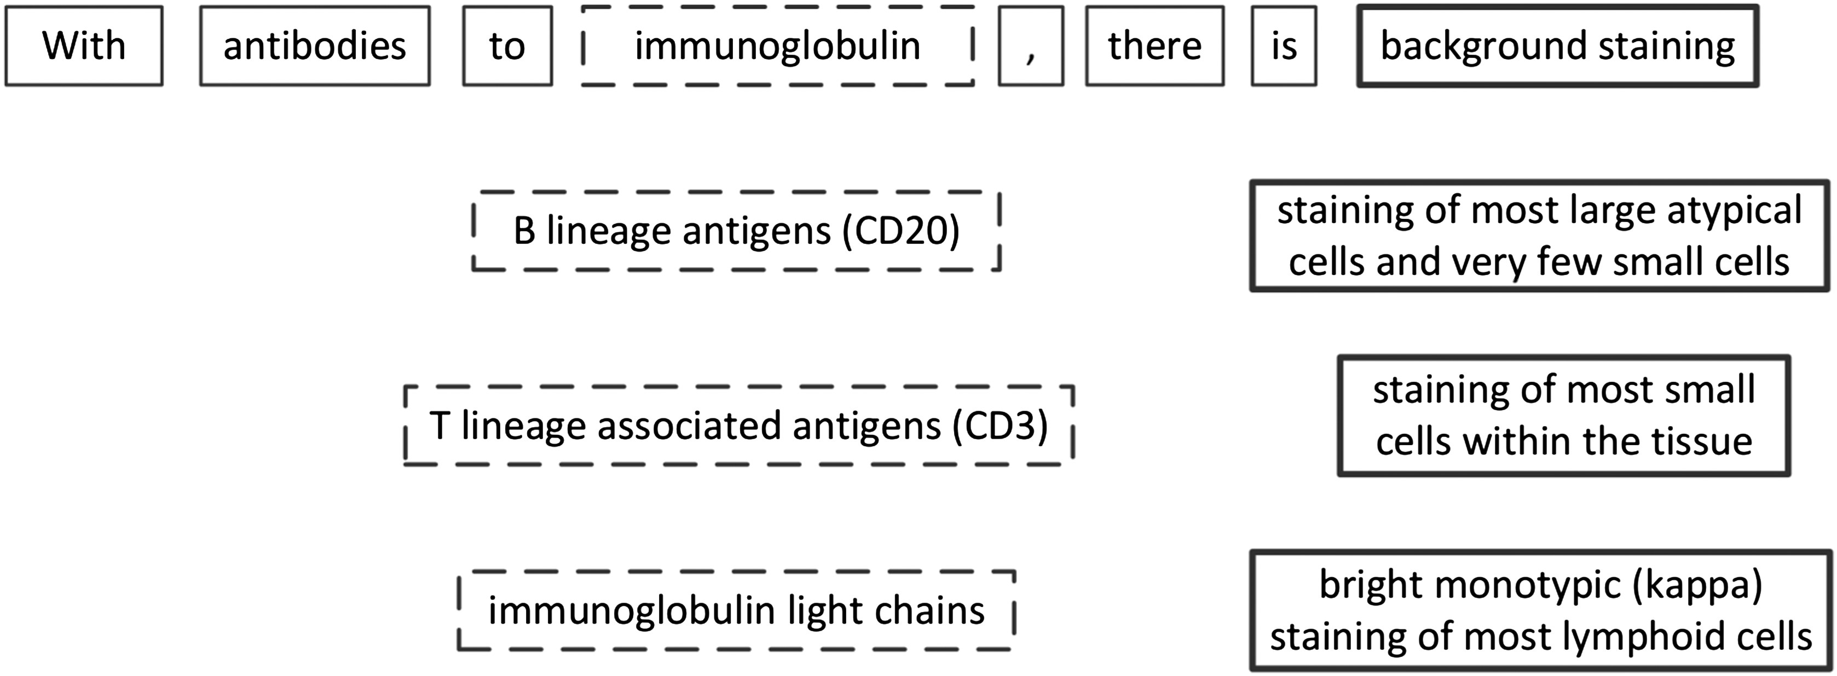
Figure 2 A variety of sentences frequently occurring in our corpus describe the relations among cells, staining, and ...
Notes:
Figure 2 A variety of sentences frequently occurring in our corpus describe the relations among cells, staining, and antigens/antibodies. Dash-outline blocks indicate ‘what type of antigens’; bold-outline blocks indicate ‘what kind of staining’.
Unless provided in the caption above, the following copyright applies to the content of this slide: Published by the BMJ Publishing Group Limited. For permission to use (where not already granted under a licence) please go to http://group.bmj.com/group/rights-licensing/permissions

Slide 3
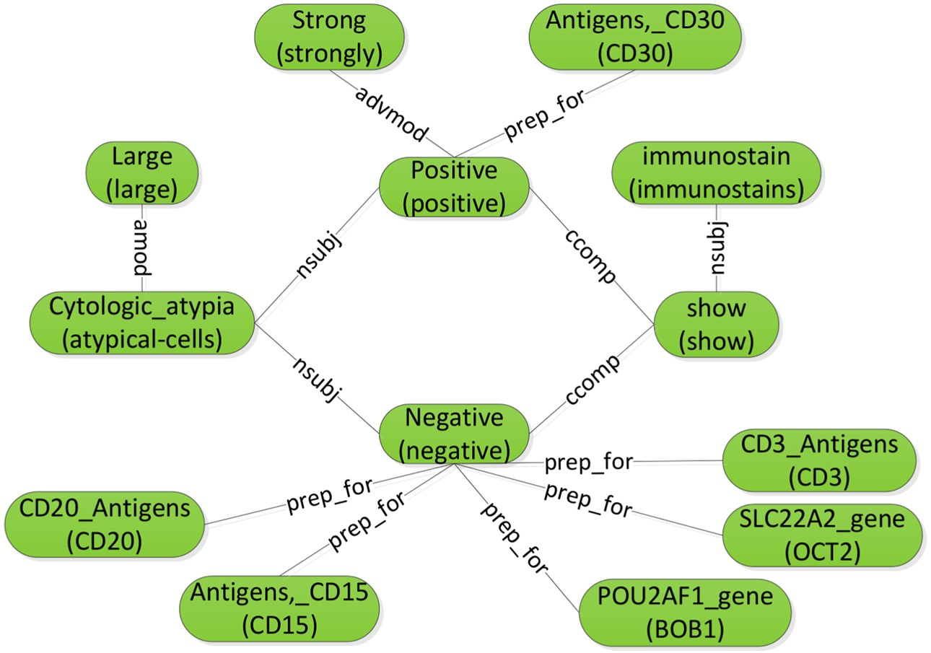
Figure 3 Constructing the sentence graph from the results of two-phase dependency parsing.
Notes:
Figure 3 Constructing the sentence graph from the results of two-phase dependency parsing.
Unless provided in the caption above, the following copyright applies to the content of this slide: Published by the BMJ Publishing Group Limited. For permission to use (where not already granted under a licence) please go to http://group.bmj.com/group/rights-licensing/permissions

Slide 4
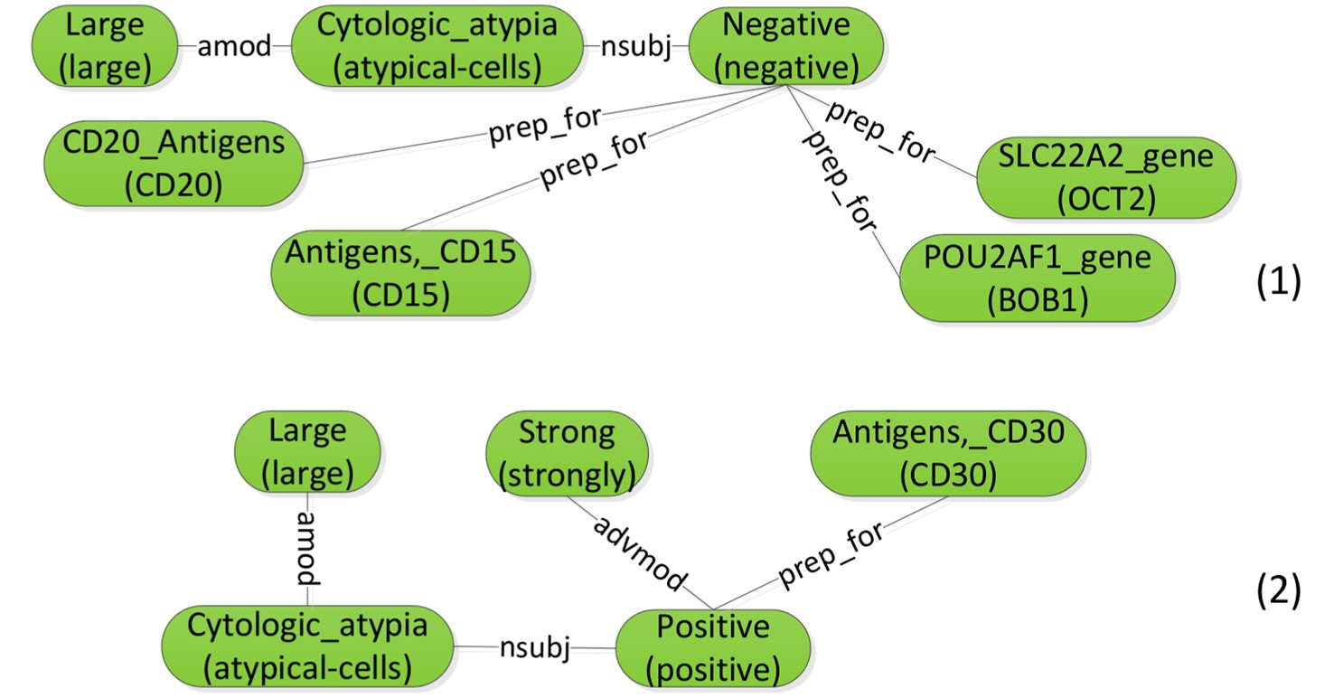
Figure 4 Example subgraphs for the sentence graph in figure 3.
Notes:
Figure 4 Example subgraphs for the sentence graph in figure 3.
Unless provided in the caption above, the following copyright applies to the content of this slide: Published by the BMJ Publishing Group Limited. For permission to use (where not already granted under a licence) please go to http://group.bmj.com/group/rights-licensing/permissions

