Slide 1
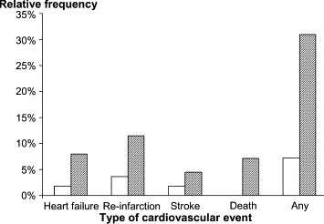
Fig. 1 Major cardiovascular events in relation to glucose tolerance. Relative frequency of each major cardiovascular ...
Notes:
Fig. 1 Major cardiovascular events in relation to glucose tolerance. Relative frequency of each major cardiovascular event among patients with normal (NGT; open bars) or abnormal glucose tolerance (AGT=IGT or DM; hatched bars). Reported events comprise severe heart failure, non-fatal re-infarction, non-fatal stroke, cardiovascular death and total number of events and are reported as crude proportions.
Unless provided in the caption above, the following copyright applies to the content of this slide: The European Society of Cardiology

Slide 2
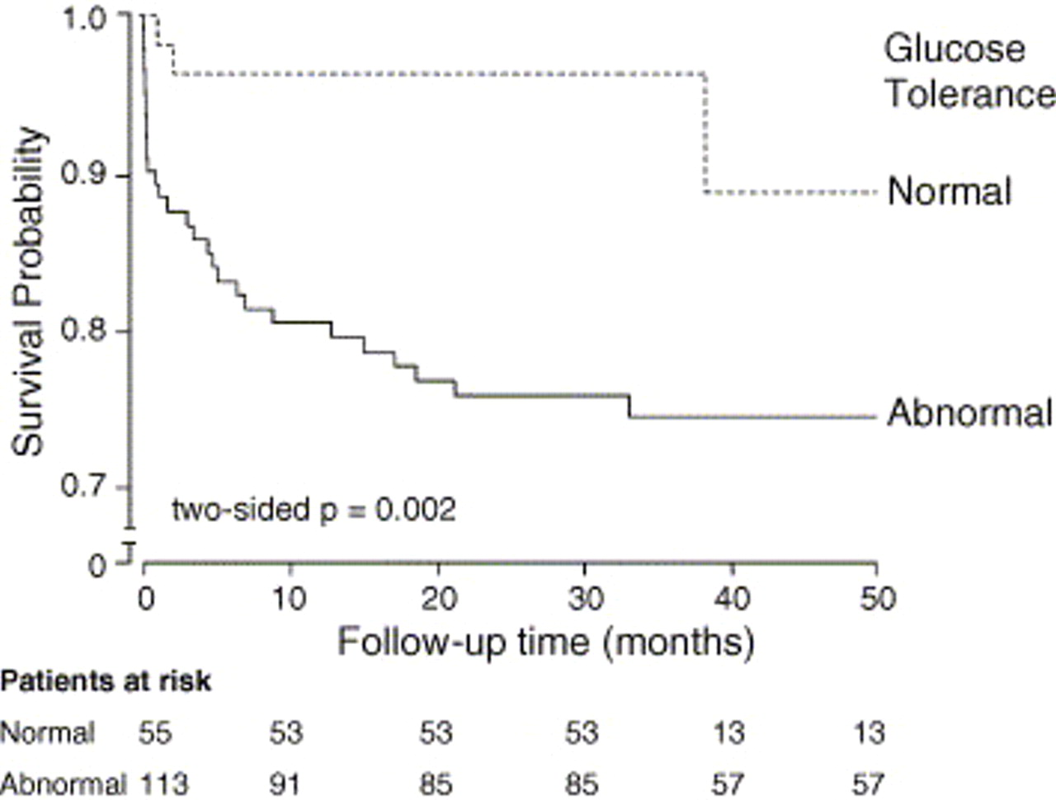
Fig. 2 Time to the first major cardiovascular event Kaplan–Meier curves for patients with normal (dashed line) and ...
Notes:
Fig. 2 Time to the first major cardiovascular event Kaplan–Meier curves for patients with normal (dashed line) and abnormal glucose tolerance (solid line). The Wilcoxon test for difference between groups, p=0.0021. Major cardiovascular events represent the first occurrence of a non-fatal stroke, non-fatal re-infarction, severe heart failure necessitating hospitalisation or cardiovascular death. Numbers below graph are the number of patients at risk at different times of observation.
Unless provided in the caption above, the following copyright applies to the content of this slide: The European Society of Cardiology

