Slide 1
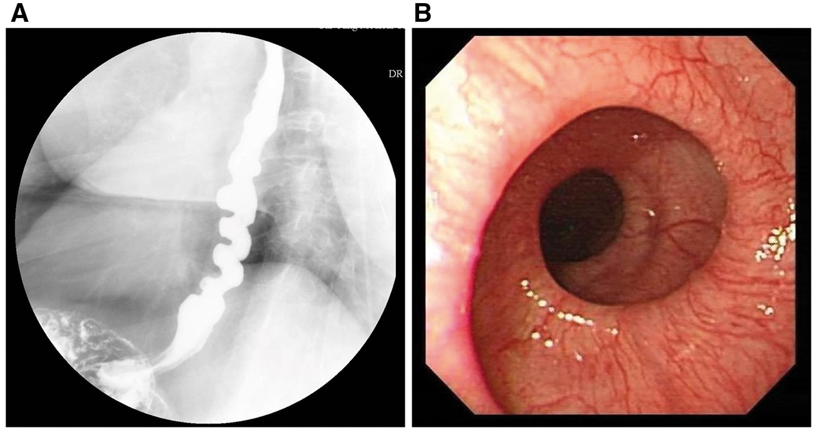
Figure 1 (A) Barium examination of upper gastrointestinal initially showed the esophagus presented typical corkscrew ...
Notes:
Figure 1 (A) Barium examination of upper gastrointestinal initially showed the esophagus presented typical corkscrew features of the distal esophagus. (B) Upper gastrointestinal endoscopy revealed an abnormal appearance of the esophagus-like winding staircase.
Unless provided in the caption above, the following copyright applies to the content of this slide: © The Author 2017. Published by Oxford University Press on behalf of the Association of Physicians. All rights reserved. For Permissions, please email: journals.permissions@oup.com

