Slide 1
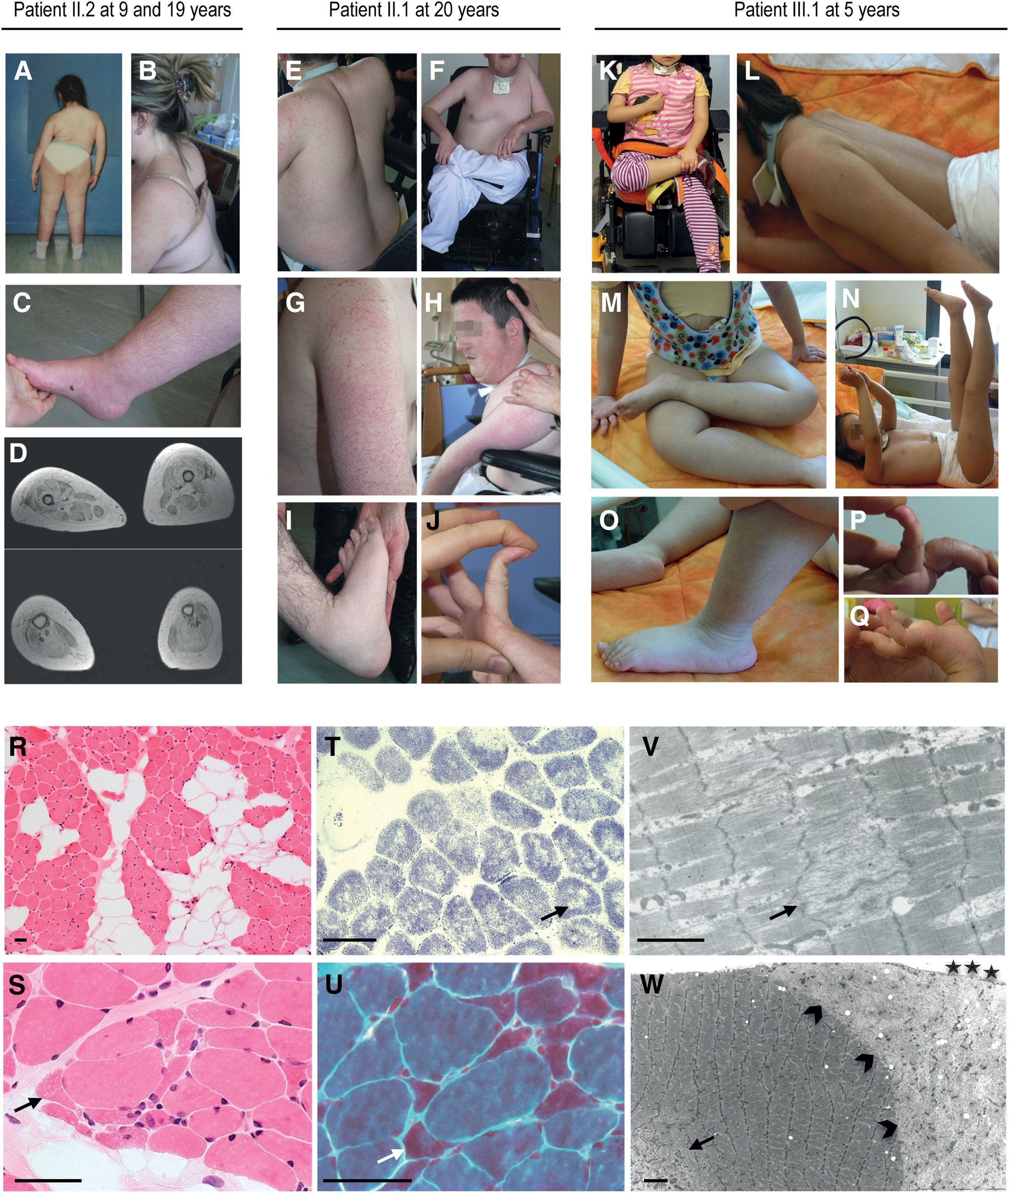
Figure 1. Clinical and histological presentation. Upper panel: clinical findings in the mildest (Patient II.2 at ages 9 ...
Notes:
Figure 1. Clinical and histological presentation. Upper panel: clinical findings in the mildest (Patient II.2 at ages 9 (A) and 19 (B–D) years), the intermediate (II.1, E–J) and the most severe (III.1, K–Q) surviving patients. Only Patient II.2 was able to walk a few steps independently between the ages of 4 and 11 years (A). Major axial muscle weakness led to severe scoliosis (A) that required arthrodesis in patients beyond their first decade of life (B, E) and was associated with dorsal hyperlordosis (B, E, L) and cervical spine rigidity (H: maximum neck flexion). Note the identical spontaneous position of II.1 and III.1 (unknown to each other): they form a triangle with their lower body to support their highly hypotonic trunk (F, K). Limb muscles retained partial antigravity strength (N). Joint hyperlaxity was present in all patients (F, H–K, M, P). Limb joint contractures were absent in non-ambulant Patient III.1 and mild and localized in II.1 and II.2 (C). Finger flexor contractures upon wrist extension were very mild in Patient III.1 (Q) and absent in II.1 and II.2. Note follicular hyperkeratosis (G) and increased leg subcutaneous adipose tissue in females (C, D, M, O). Lower limb MRI in II.2 (D) showed major adipose replacement of muscles, predominantly in quadriceps, posterior thigh muscles and soleus (D). Lower panel: quadriceps muscle biopsies from Patients II.2 (R–T and V) and III.1 (U, W). Transversal frozen sections stained with hematoxylin–eosin (R, S), SDH (T) and modified Gomori trichrome (U); ultrastructural longitudinal sections (V, W). Note fibro-adipose replacement in Patient II.2 and rare fibres with nuclear centralisations (R). All samples showed multiple areas lacking oxidative activity in most fibres (T, arrow) which corresponded on EM to short zones of mitochondrial depletion and sarcomere disorganization (minicores) (V and W, arrows). In Patient III.1, abundant small angular fibres contained areas which stained red on Gomori trichrome (U, arrow) were dark blue on NADPH-TR and corresponded on EM to subsarcolemmal accumulations of disorganized sarcomere components lacking thick filaments (caps, W, arrowheads). Some scattered similar fibres were retrospectively observed in Patient's II.2 biopsy (S, arrow) but could not be found on EM. Note coexistence in the same fibre of a minicore and a cap localized immediate under the sarcolemmal membrane (stars, W). Scale bars = 50 μm (R–U), 2 μm (V–W).
Unless provided in the caption above, the following copyright applies to the content of this slide: © The Author 2016. Published by Oxford University Press. All rights reserved. For Permissions, please email: journals.permissions@oup.com

Slide 2
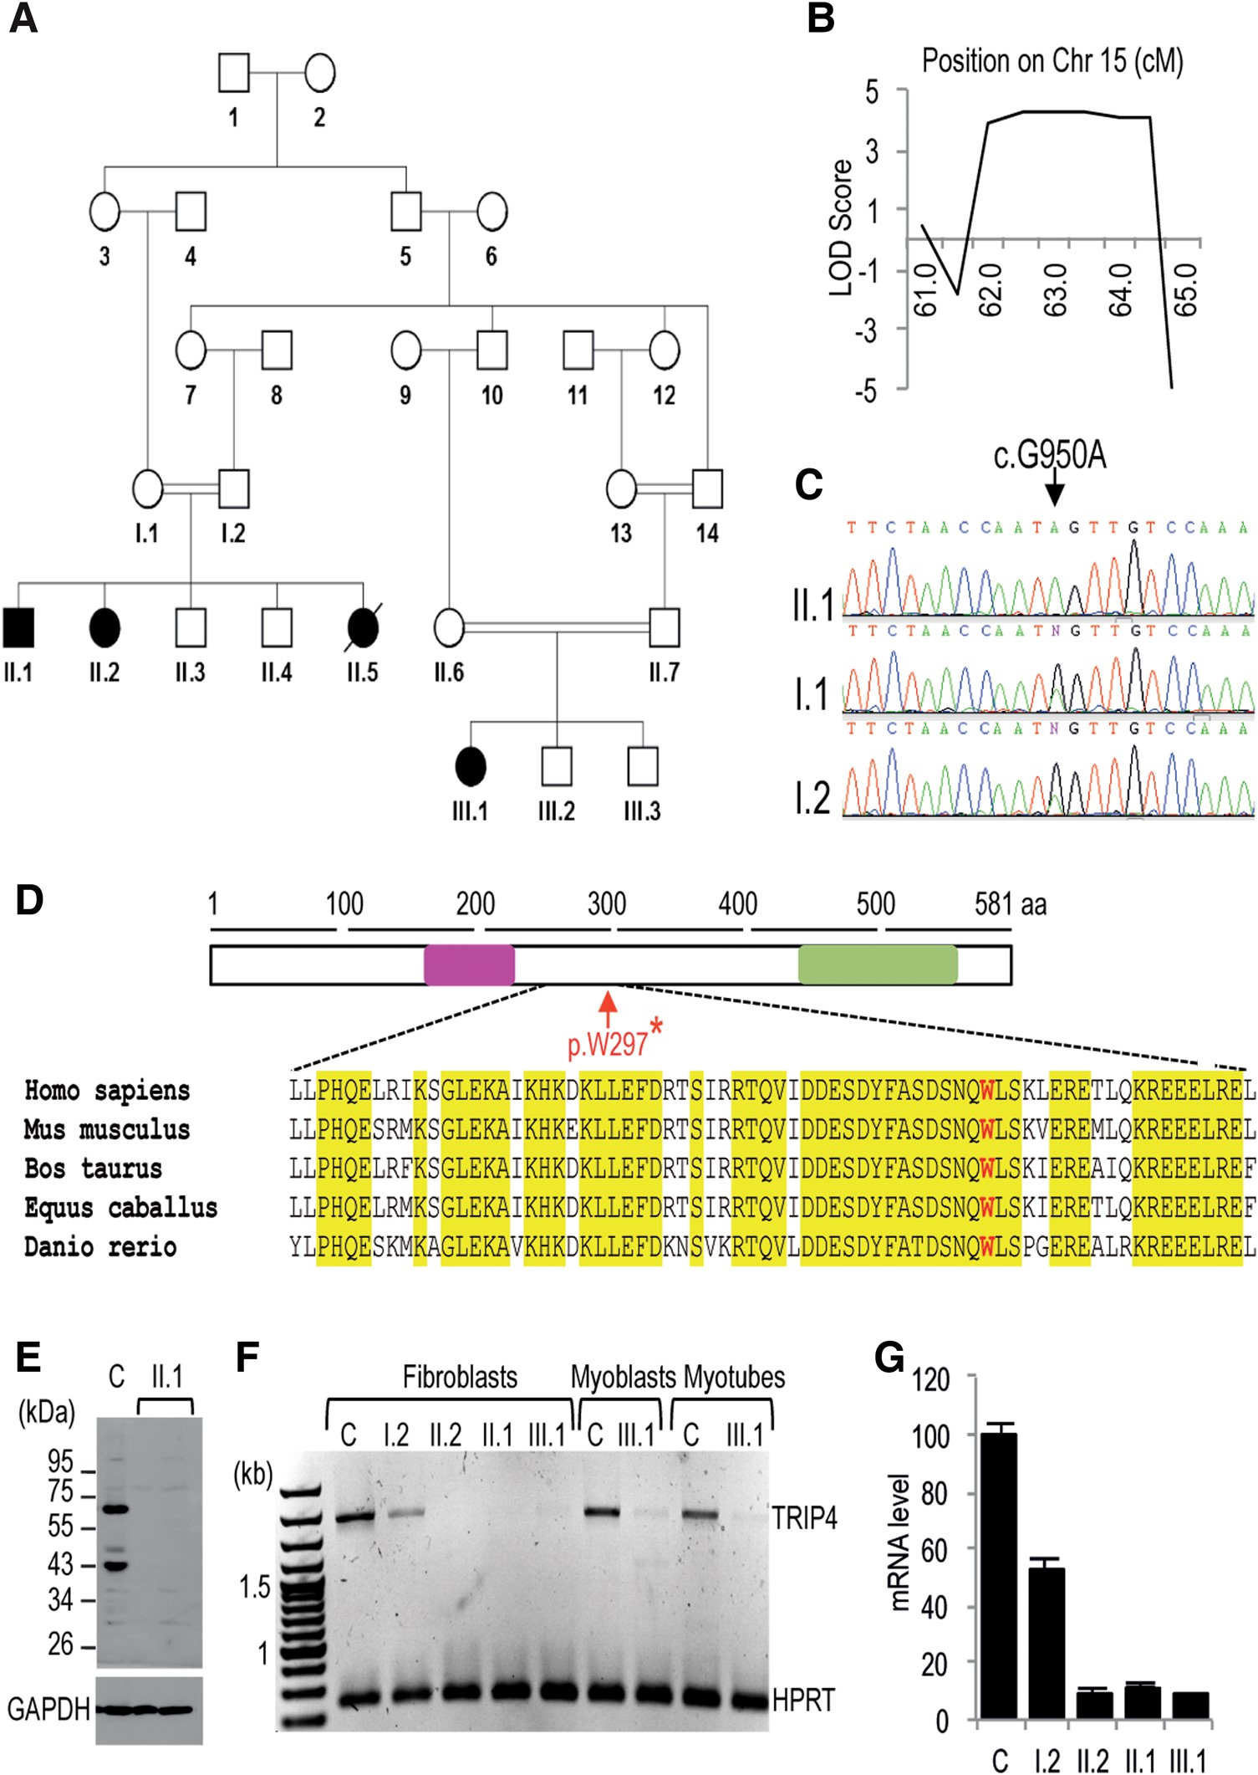
Figure 2. Molecular analysis of the TRIP4 gene. (A) Simplified family pedigree including two branches which encompass ...
Notes:
Figure 2. Molecular analysis of the TRIP4 gene. (A) Simplified family pedigree including two branches which encompass four affected patients. Solid symbols and barred symbols denote affected and deceased subjects, respectively; double lines indicate consanguinity. (B) Novel 2.6 Mb locus on Chr15q22, showing a LOD score of >3.8. (C) The TRIP4 variant c.G950A (NM_016213)—arrow—was homozygous in genomic DNA from Patient II.1 and heterozygous in his parents I.1 and I.2. (D) Schematic representation of the 581 amino acid ASC-1 protein with the relative localization of its zinc finger (pink) and ASCH (green) domains; the protein sequence around the p.W297* mutation (in red) has unknown roles but is highly conserved. (E) Western blot of ASC-1 in fibroblasts from Patient II.1 and a healthy control (C). Antibodies directed against the N-terminal half of ASC-1 showed two bands in the control sample, including one at the full-length ASC-1 expected size (65 kDa) and a second 43 kDa band whose significance is unclear. No band was present in II.1, either at 65 kDa or at the predicted size of the putative truncated protein (32 kDa). Comparable results were obtained in Patients II.2 and III.1 (data not shown). (F) Semi-quantitative electrophoresis gel showing reduced levels of the full-length TRIP4 cDNA (1.8 kbp) in fibroblasts from the heterozygous mother I.2 and severe transcript depletion both in fibroblasts and in primary cultured muscle cells from patients compared with healthy control samples (C). No alternatively spliced isoform was present. (G) qRT-PCR on primary fibroblasts confirming major depletion of TRIP4 mRNA in patients (residual expression: 8.8%, in II.2, 12% in II.1 and 9% in III.1) and a 53% residual amount in the heterozygous mother (I.2).
Unless provided in the caption above, the following copyright applies to the content of this slide: © The Author 2016. Published by Oxford University Press. All rights reserved. For Permissions, please email: journals.permissions@oup.com

Slide 3
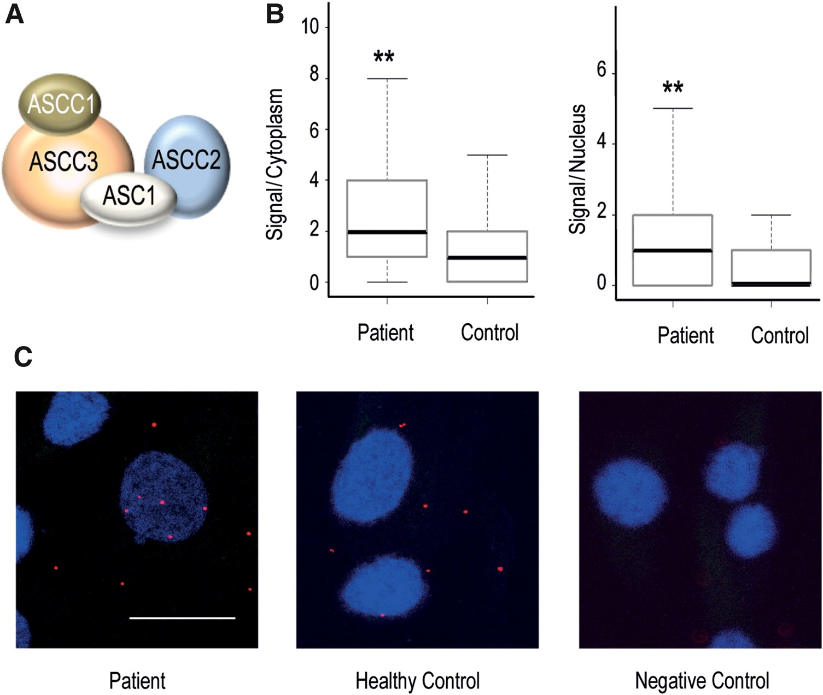
Figure 3. ASCC2 and ASCC3 interaction in the absence of ASC-1. (A) Schematic representation of the ASC-1 tetrameric ...
Notes:
Figure 3. ASCC2 and ASCC3 interaction in the absence of ASC-1. (A) Schematic representation of the ASC-1 tetrameric complex. (B) PLA in fibroblasts from Patient II.1 compared with a healthy control showed significant differences in the number of interacting events between ASCC2 and ASCC3 both in cytosol (P-value = 2.2e−16) and nucleus (P-value = 0.009). (C) In situ PLA probed human fibroblasts for visualization of ASCC2/ASCC3 interactions (red dots). Nuclei are labelled in blue (DAPI). The negative control was performed by incubating with the anti-ASCC3 antibody alone. Scale bar = 20 μm.
Unless provided in the caption above, the following copyright applies to the content of this slide: © The Author 2016. Published by Oxford University Press. All rights reserved. For Permissions, please email: journals.permissions@oup.com

Slide 4
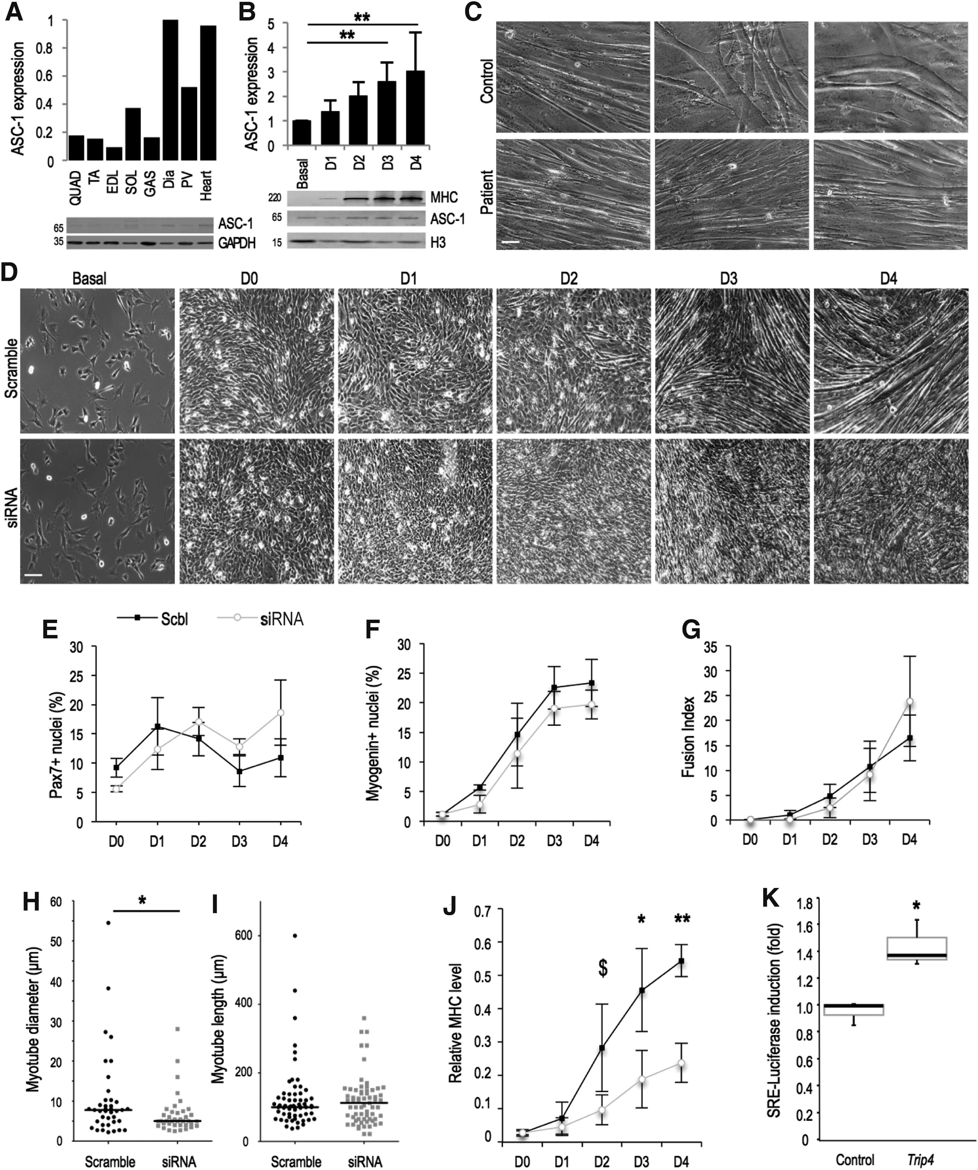
Figure 4. ASC-1 expression profile and impact on myofibre growth. (A) ASC-1 quantification by western blot in adult ...
Notes:
Figure 4. ASC-1 expression profile and impact on myofibre growth. (A) ASC-1 quantification by western blot in adult murine striated muscles, compared with GAPDH. (B) ASC-1 levels (compared with histone H3) during differentiation of murine myoblastic C2C12 cells, in confluent proliferative cells (Basal) and 1–4 days after differentiation induction by serum withdrawal (D1–D4). (C) Brightfield pictures of primary human myotubes from a healthy control (top panel) and from Patient III.1 (bottom panel) after 7 days of differentiation. Myotube aspect was comparable between control and patient in some fields (left column), but the largest myotubes observed in each sample (middle and right columns) showed different sizes. (D–J) siRNA knock-down of Trip4 in C2C12 cells showing defective myofibre growth. Brightfield pictures (D) and quantitative studies (E–G, J) were performed immediately after plating to confirm comparable cell density (basal, D), in confluent proliferative cells prior to serum withdrawal (D0, D–G, J) and/or 1–4 days after switch into differentiation medium (D1–D4, D–G, J). Trip4 KD cells showed no differences in the percentage of Pax7 or Myogenin-positive nuclei (E, F) or fusion index (G) compared with the scramble control, but formed myotubes which at D3 had a significantly smaller mean diameter (H), comparable length (I) and dramatically reduced MHC levels (by western blot, J). (K) Induction of expression of a SRE-luciferase 3DA.Luc reporter (SRF-controlled luciferase) in proliferating C2C12 transfected with a Trip4-expressing construct (pCITO-Trip4) relatively to the corresponding empty vector pCITO (control). QUAD, quadriceps; TA, tibialis anterior; EDL, extensor digitorum longus; SOL, soleus; GAS, gastrocnemius; Dia, diaphragm; PV, paravertebral muscles; Scbl, scramble control; siRNA, Trip4 siRNA knock-down. Scale bars = 10 μm (c) and 100 μm (d). $P < 0.06, *P < 0.05, **P < 0.01.
Unless provided in the caption above, the following copyright applies to the content of this slide: © The Author 2016. Published by Oxford University Press. All rights reserved. For Permissions, please email: journals.permissions@oup.com

