Slide 1
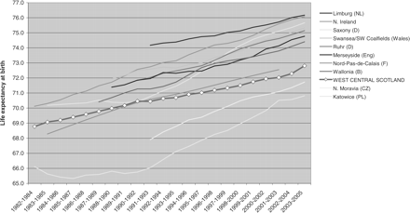
Figure 1 Male life expectancy at birth, West Central Scotland and 10 post-industrial regions, calculated from original ...
Notes:
Figure 1 Male life expectancy at birth, West Central Scotland and 10 post-industrial regions, calculated from original source mortality and population data.
Unless provided in the caption above, the following copyright applies to the content of this slide: © The Author 2009. Published by Oxford University Press on behalf of the European Public Health Association. All rights reserved.

Slide 2
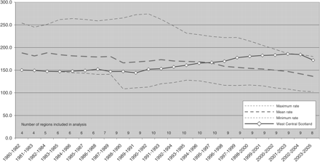
Figure 2 All-cause mortality: EASRs (3 year rolling averages) 1980–2005, working age 15–44, males. WCS in context of ...
Notes:
Figure 2 All-cause mortality: EASRs (3 year rolling averages) 1980–2005, working age 15–44, males. WCS in context of maximum, minimum and mean rates for selected European regions.
Unless provided in the caption above, the following copyright applies to the content of this slide: © The Author 2009. Published by Oxford University Press on behalf of the European Public Health Association. All rights reserved.

Slide 3
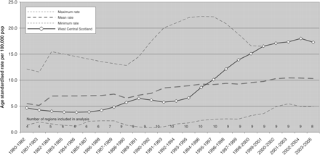
Figure 3 Chronic liver disease and cirrhosis mortality: EASRs (3 year rolling averages) 1980–2005, working age 15–44, ...
Notes:
Figure 3 Chronic liver disease and cirrhosis mortality: EASRs (3 year rolling averages) 1980–2005, working age 15–44, males. WCS in context of maximum, minimum and mean rates for selected European regions.
Unless provided in the caption above, the following copyright applies to the content of this slide: © The Author 2009. Published by Oxford University Press on behalf of the European Public Health Association. All rights reserved.

Slide 4
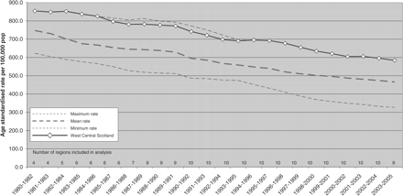
Figure 4 All-cause mortality: EASRs (3 year rolling averages) 1980–2005, working age 45–64, females. WCS in context of ...
Notes:
Figure 4 All-cause mortality: EASRs (3 year rolling averages) 1980–2005, working age 45–64, females. WCS in context of maximum, minimum and mean rates for selected European regions.
Unless provided in the caption above, the following copyright applies to the content of this slide: © The Author 2009. Published by Oxford University Press on behalf of the European Public Health Association. All rights reserved.

