Slide 1
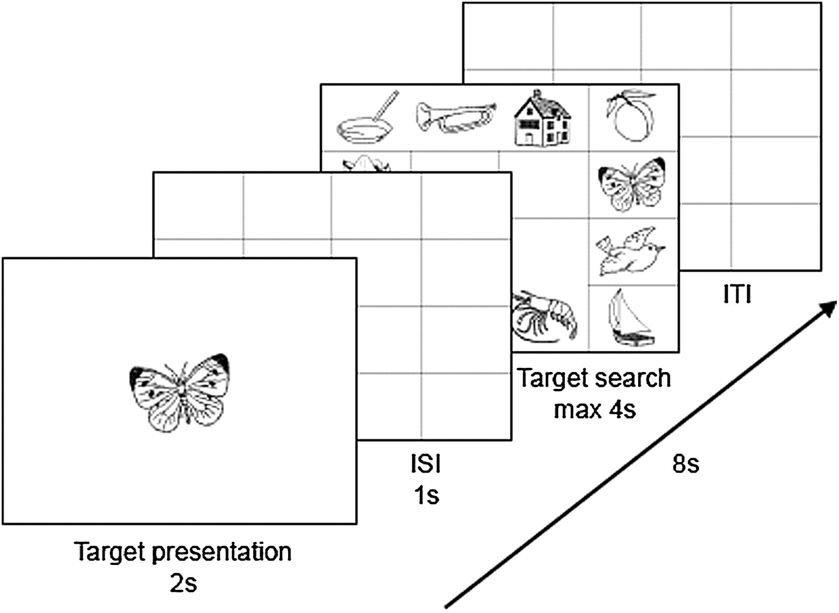
Figure 1. Illustration of a trial sequence.
Notes:
Figure 1. Illustration of a trial sequence.
Unless provided in the caption above, the following copyright applies to the content of this slide: © The Author 2011. Published by Oxford University Press. All rights reserved. For permissions, please e-mail: journals.permissions@oup.com

Slide 2
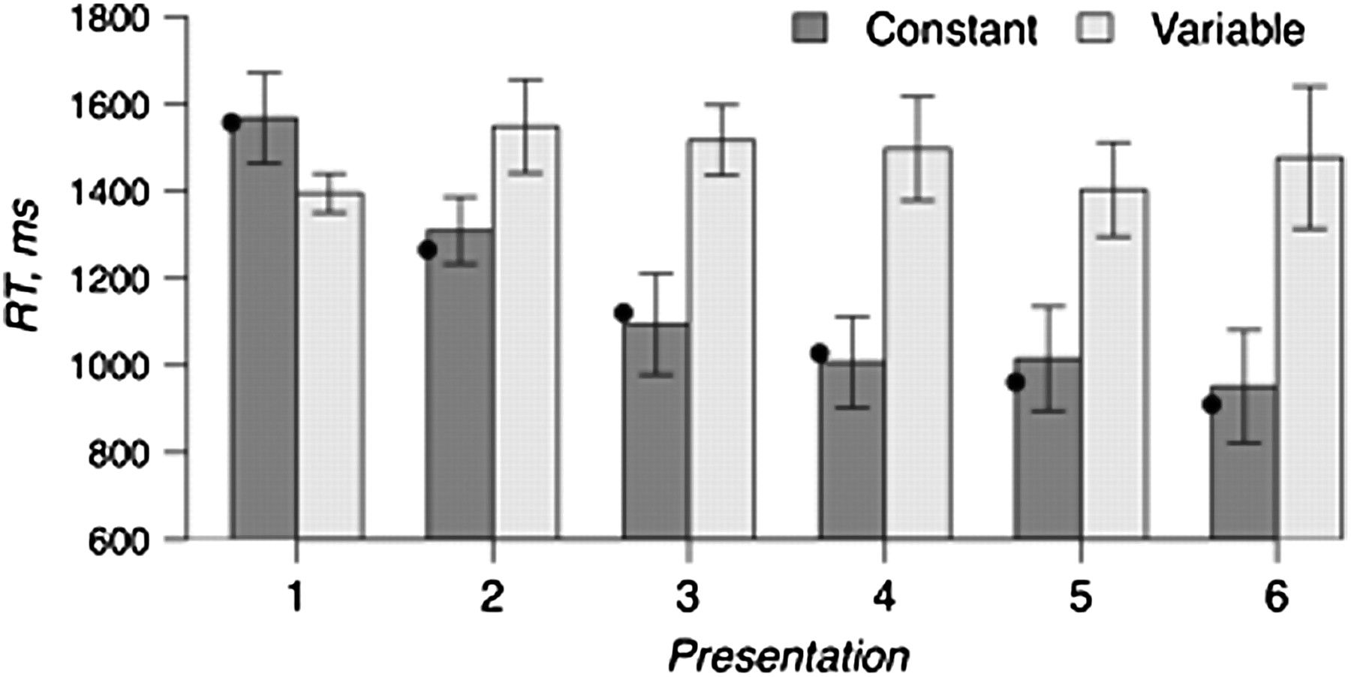
Figure 2. Mean correct RT for locating targets that appeared in constant locations (Constant) versus variable locations ...
Notes:
Figure 2. Mean correct RT for locating targets that appeared in constant locations (Constant) versus variable locations (Variable). Black dots on the plot show a power function fit (y = 1557.5 × x−0.3) to search RT for “constant” targets.
Unless provided in the caption above, the following copyright applies to the content of this slide: © The Author 2011. Published by Oxford University Press. All rights reserved. For permissions, please e-mail: journals.permissions@oup.com

Slide 3
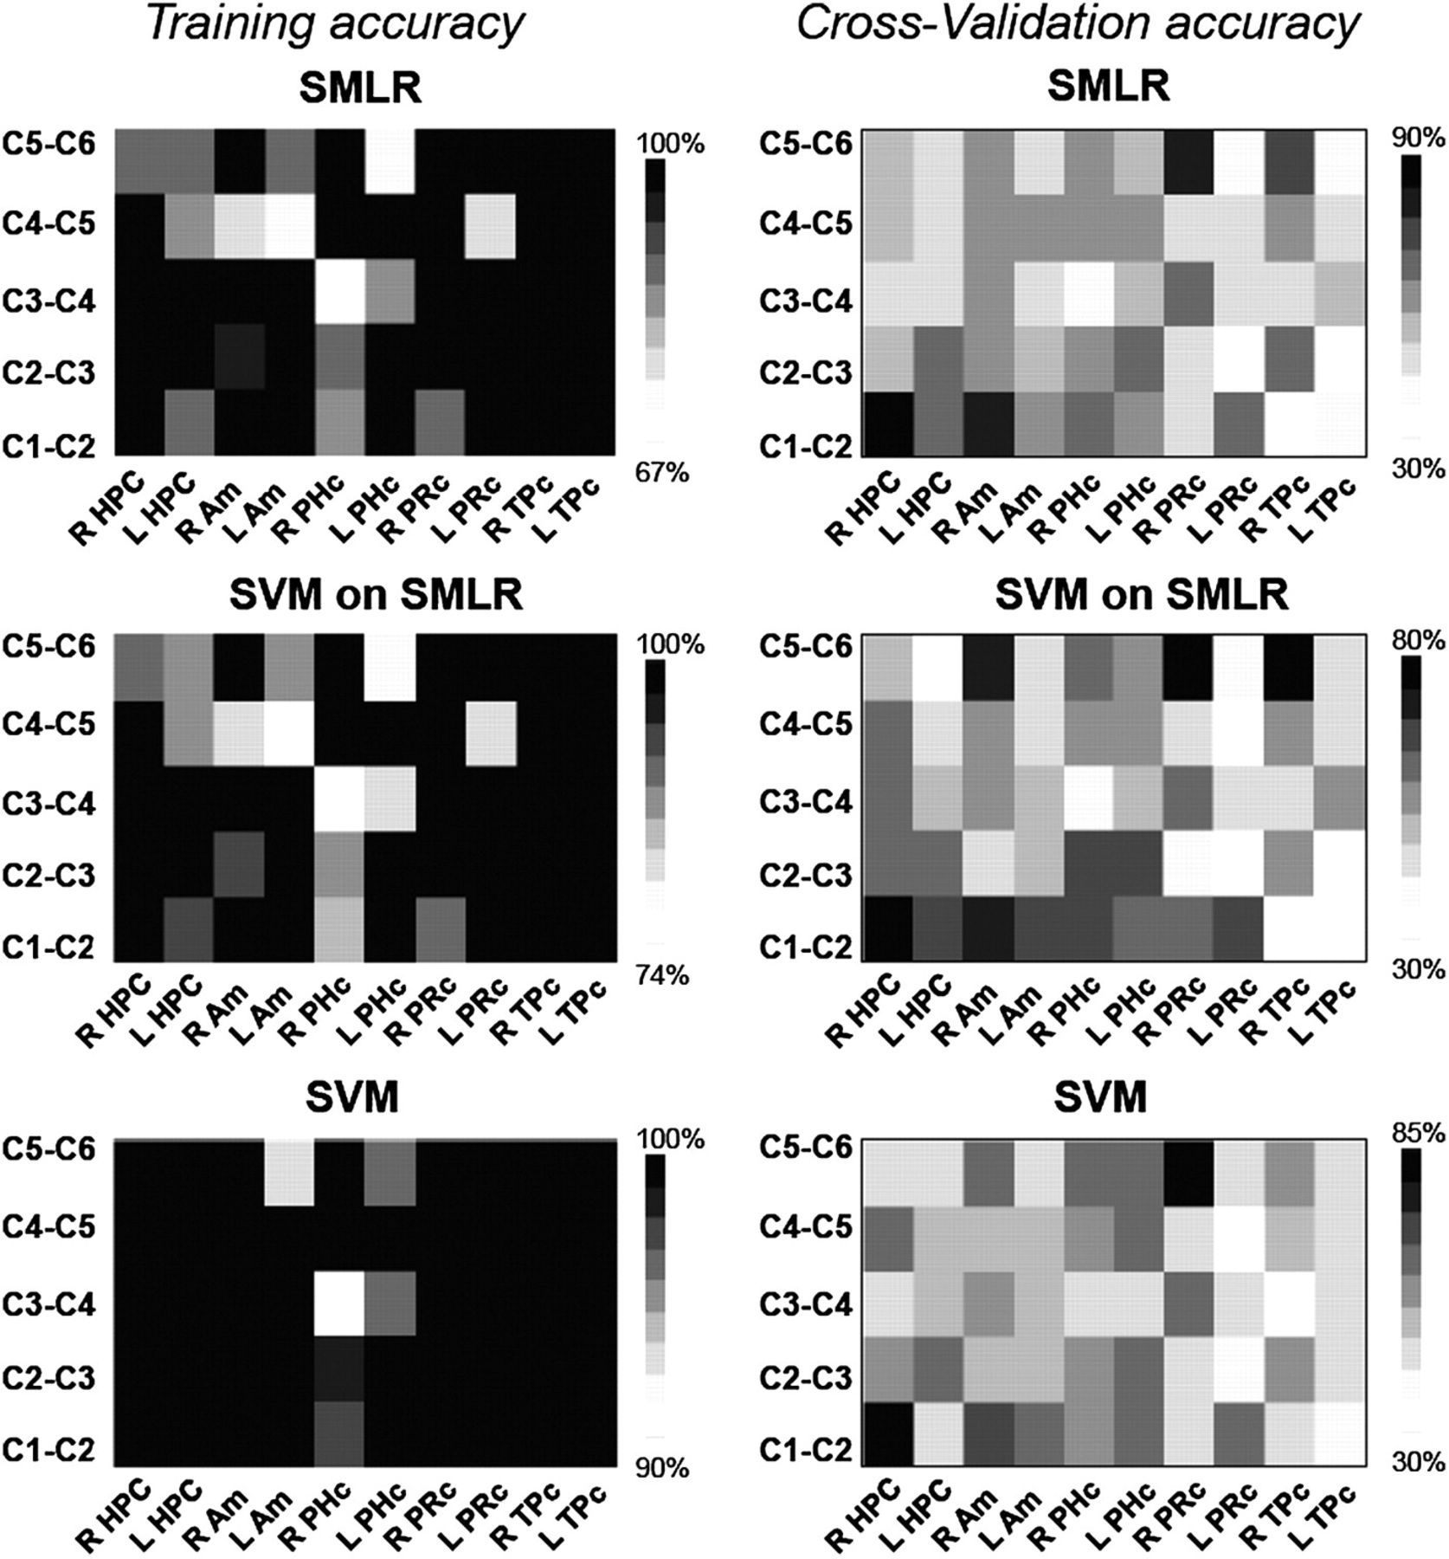
Figure 3. Training and CV accuracy for SMLR and SVM classifiers. The darker the square, the higher the classification ...
Notes:
Figure 3. Training and CV accuracy for SMLR and SVM classifiers. The darker the square, the higher the classification accuracy. The MTL subregions are shown on the x-axis. The classification conditions are shown on the y-axis. “C” stands for a constant object–location association (e.g., C1-C2 refers to classification of the first presentation of a target in a constant location vs. the second presentation of the target in the same location). “R” stands for right, “L” stands for left. Am; amygdala.
Unless provided in the caption above, the following copyright applies to the content of this slide: © The Author 2011. Published by Oxford University Press. All rights reserved. For permissions, please e-mail: journals.permissions@oup.com

Slide 4
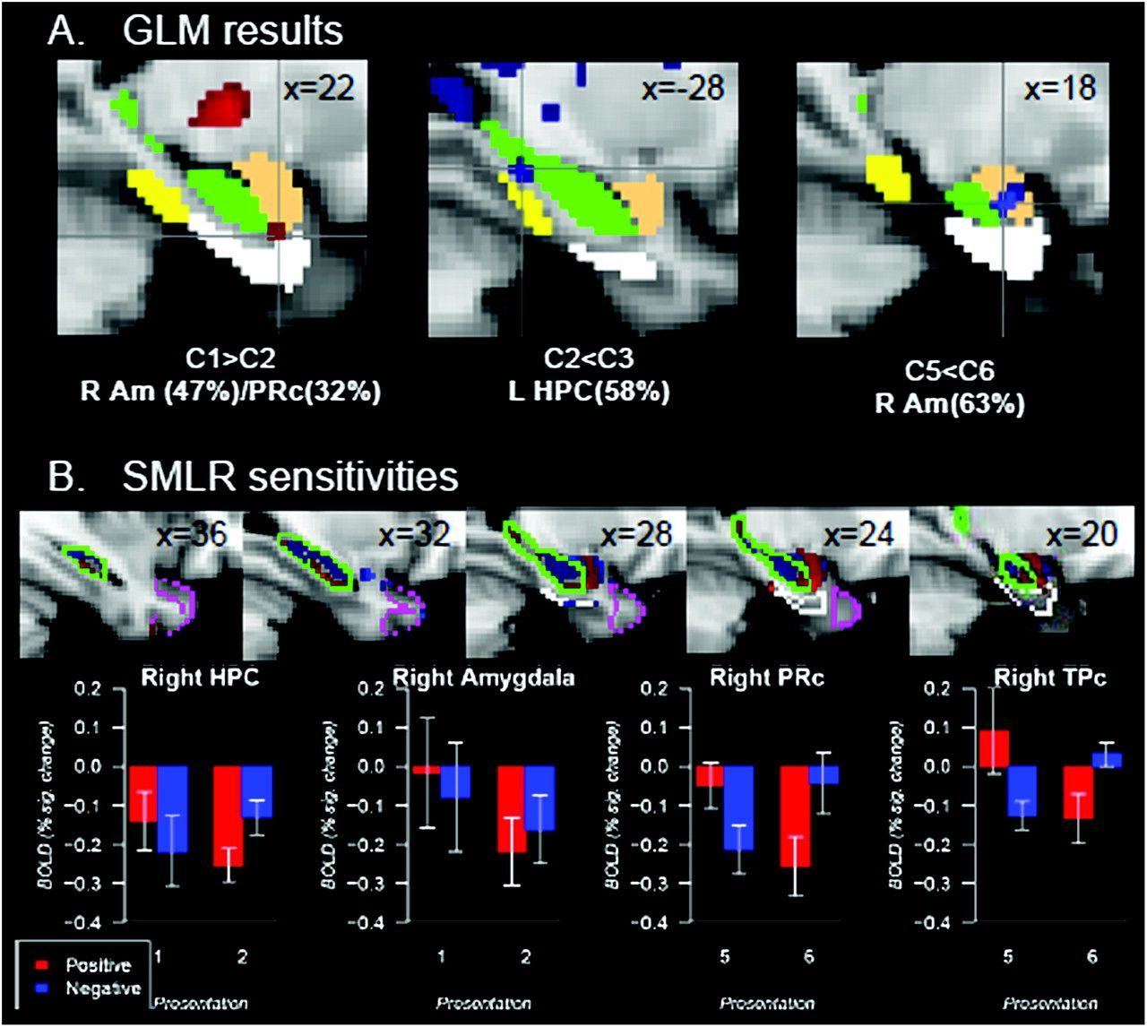
Figure 4. (A) The results of the GLM analysis in right amygdala (R Am) and left hippocampus (L HPC). “C” stands for ...
Notes:
Figure 4. (A) The results of the GLM analysis in right amygdala (R Am) and left hippocampus (L HPC). “C” stands for constant object–location associations. A number next to the “C” indicates the presentation number (e.g., C1 means the first presentation of constant pairings). (B) Top images represent diagnostic sensitivity of voxels to comparison conditions as revealed by the SMLR classifier (C1 vs. C2 in right HPC and amygdala, C5 vs. C6 in right PRc and TPc). A bottom figure illustrates BOLD signal changes relative to a resting baseline in right HPC, amygdala, PRc, and TPc as a function of repetition and voxel sensitivity. A tan mask represents amygdala, a green mask and a contour represent HPC, a white mask and a contour represent PRc, a yellow mask represents PHc, a magenta contour represents TPc. All regions are presented according to the Harvard-Oxford cortical and subcortical structural probability atlases with the probability for a voxel to be in a specific region at 50–100%.
Unless provided in the caption above, the following copyright applies to the content of this slide: © The Author 2011. Published by Oxford University Press. All rights reserved. For permissions, please e-mail: journals.permissions@oup.com

