Slide 1
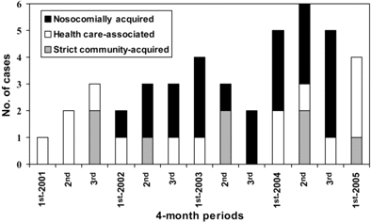
Figure 1 Distribution of episodes of bacteremia due to extended-spectrum β-lactamase–producing Escherichia coli during ...
Notes:
Figure 1 Distribution of episodes of bacteremia due to extended-spectrum β-lactamase–producing Escherichia coli during the study period, according to acquisition.
Unless provided in the caption above, the following copyright applies to the content of this slide: © 2006 by the Infectious Diseases Society of America

Slide 2
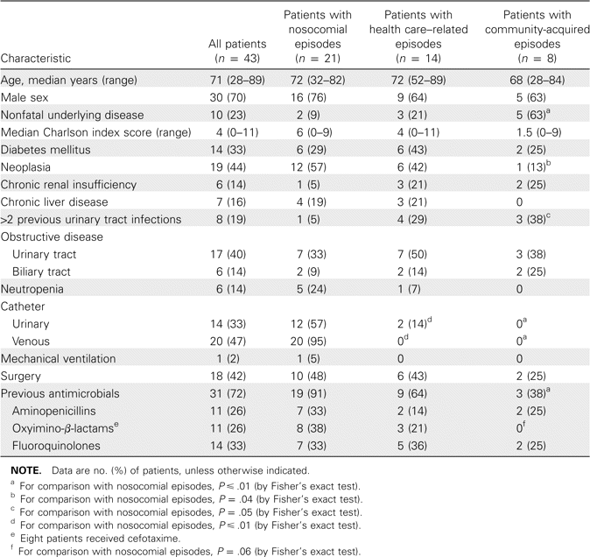
Table 1 Features and predisposing factors of 43 patients with bacteremia due to extended-spectrum ...
Notes:
Table 1 Features and predisposing factors of 43 patients with bacteremia due to extended-spectrum β-lactamase–producing Escherichia coli according to acquisition.
Unless provided in the caption above, the following copyright applies to the content of this slide: © 2006 by the Infectious Diseases Society of America

Slide 3
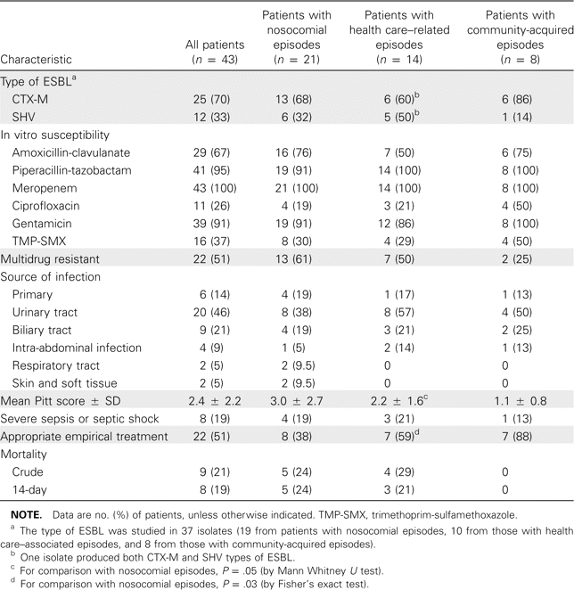
Table 2 Microbiological data, clinical features, and outcome of 43 patients with bacteremia due to extended-spectrum ...
Notes:
Table 2 Microbiological data, clinical features, and outcome of 43 patients with bacteremia due to extended-spectrum β-lactamase (ESBL)–producing Escherichia coli.
Unless provided in the caption above, the following copyright applies to the content of this slide: © 2006 by the Infectious Diseases Society of America

Slide 4
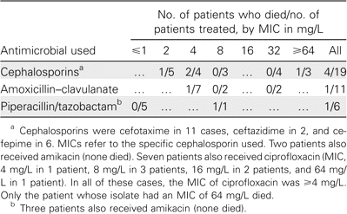
Table 3 Outcome of patients treated empirically with cephalosporins or β-lactam/β-lactamase–inhibitors.
Notes:
Table 3 Outcome of patients treated empirically with cephalosporins or β-lactam/β-lactamase–inhibitors.
Unless provided in the caption above, the following copyright applies to the content of this slide: © 2006 by the Infectious Diseases Society of America

