Slide 1
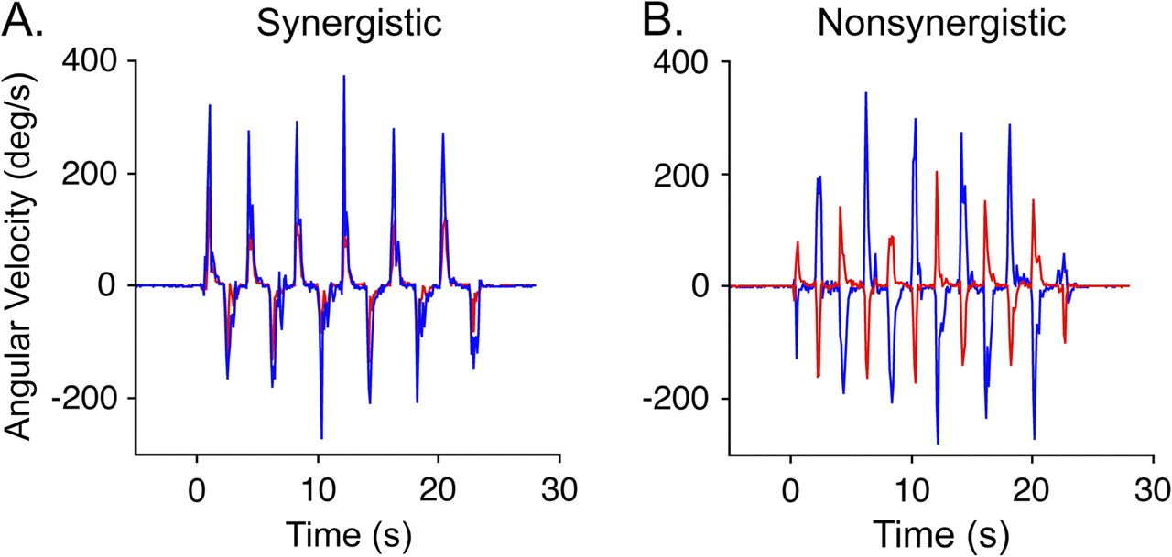
Figure 1. Angular velocity time series of digit movement acquired during fMRI from a representative control subject. ...
Notes:
Figure 1. Angular velocity time series of digit movement acquired during fMRI from a representative control subject. Measurements of the thumb (red) and middle finger (blue) during a movement epoch are shown. (A) Time series of the synergistic hand motor task showing the digits moving in unison. (B) Time series of the nonsynergistic hand motor task showing the thumb and middle finger moving in opposite directions.
Unless provided in the caption above, the following copyright applies to the content of this slide: © The Author 2007. Published by Oxford University Press. All rights reserved. For permissions, please e-mail: journals.permissions@oxfordjournals.org

Slide 2
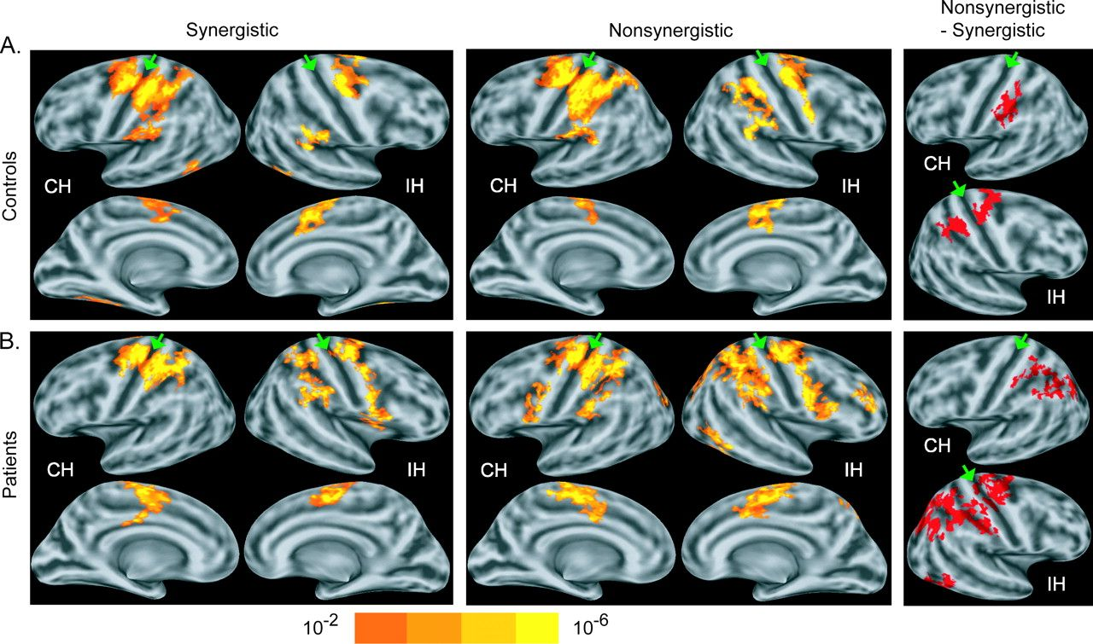
Figure 2. Functional MRI results showing cortical activation in normal control subjects (A) and chronic stroke patients ...
Notes:
Figure 2. Functional MRI results showing cortical activation in normal control subjects (A) and chronic stroke patients (B) during unilateral performance of synergistic and nonsynergistic motor tasks and the differences in activation between the 2 tasks. First and second columns: Group-average statistical maps of activation during performance of each of the motor tasks (P < 0.01, corrected, 1-sample t-test). First row are lateral surfaces of the hemispheres; second row are medial surfaces of the hemispheres. CH = contralateral (ipsilesional in patients) hemisphere. IH = ipsilateral (contralesional in patients) hemisphere. Third column: clusters of significantly increased activation during performance of the nonsynergistic relative to the synergistic motor task (P < 0.05, corrected, paired t-test). Maps are overlaid on a model of the group-average, inflated cortical surface. Dark gray regions are the fundus of a sulcus; light gray regions are the crowns of a gyrus. Green arrowheads point to central sulcus.
Unless provided in the caption above, the following copyright applies to the content of this slide: © The Author 2007. Published by Oxford University Press. All rights reserved. For permissions, please e-mail: journals.permissions@oxfordjournals.org

Slide 3
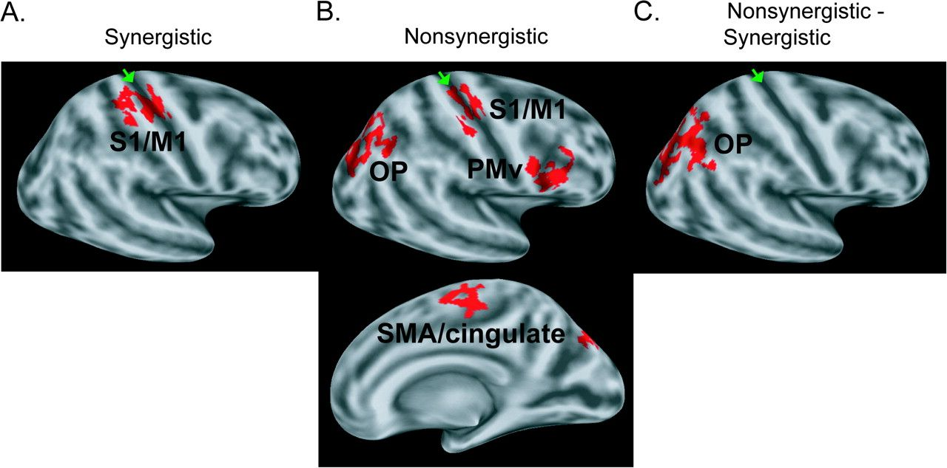
Figure 3. Functional MRI results showing differences in cortical activation in chronic stroke patients compared with ...
Notes:
Figure 3. Functional MRI results showing differences in cortical activation in chronic stroke patients compared with normal control subjects during performance of the hand motor tasks. (A) Between-group differences in activation during the synergistic motor task. Patients showed a significant (P < 0.01, corrected, unpaired t-test) increase in activation in the contralesional S1/M1. (B) Between-group differences in activation during the nonsynergistic motor task. Patients showed significant increases in activation in the contralesional S1/M1 (P < 0.05, corrected, unpaired t-test), PMv (P < 0.01), occipitoparietal cortex (OP; P < 0.01), and SMA/cingulate (P < 0.05). (C) Between-group differences in cortical activation changes associated with performance of the nonsynergistic motor task versus the synergistic motor task. Patients showed a significant task-dependent increase in activation in the contralesional OP (P < 0.01, corrected, unpaired t-test) relative to that in controls.
Unless provided in the caption above, the following copyright applies to the content of this slide: © The Author 2007. Published by Oxford University Press. All rights reserved. For permissions, please e-mail: journals.permissions@oxfordjournals.org

