Slide 1
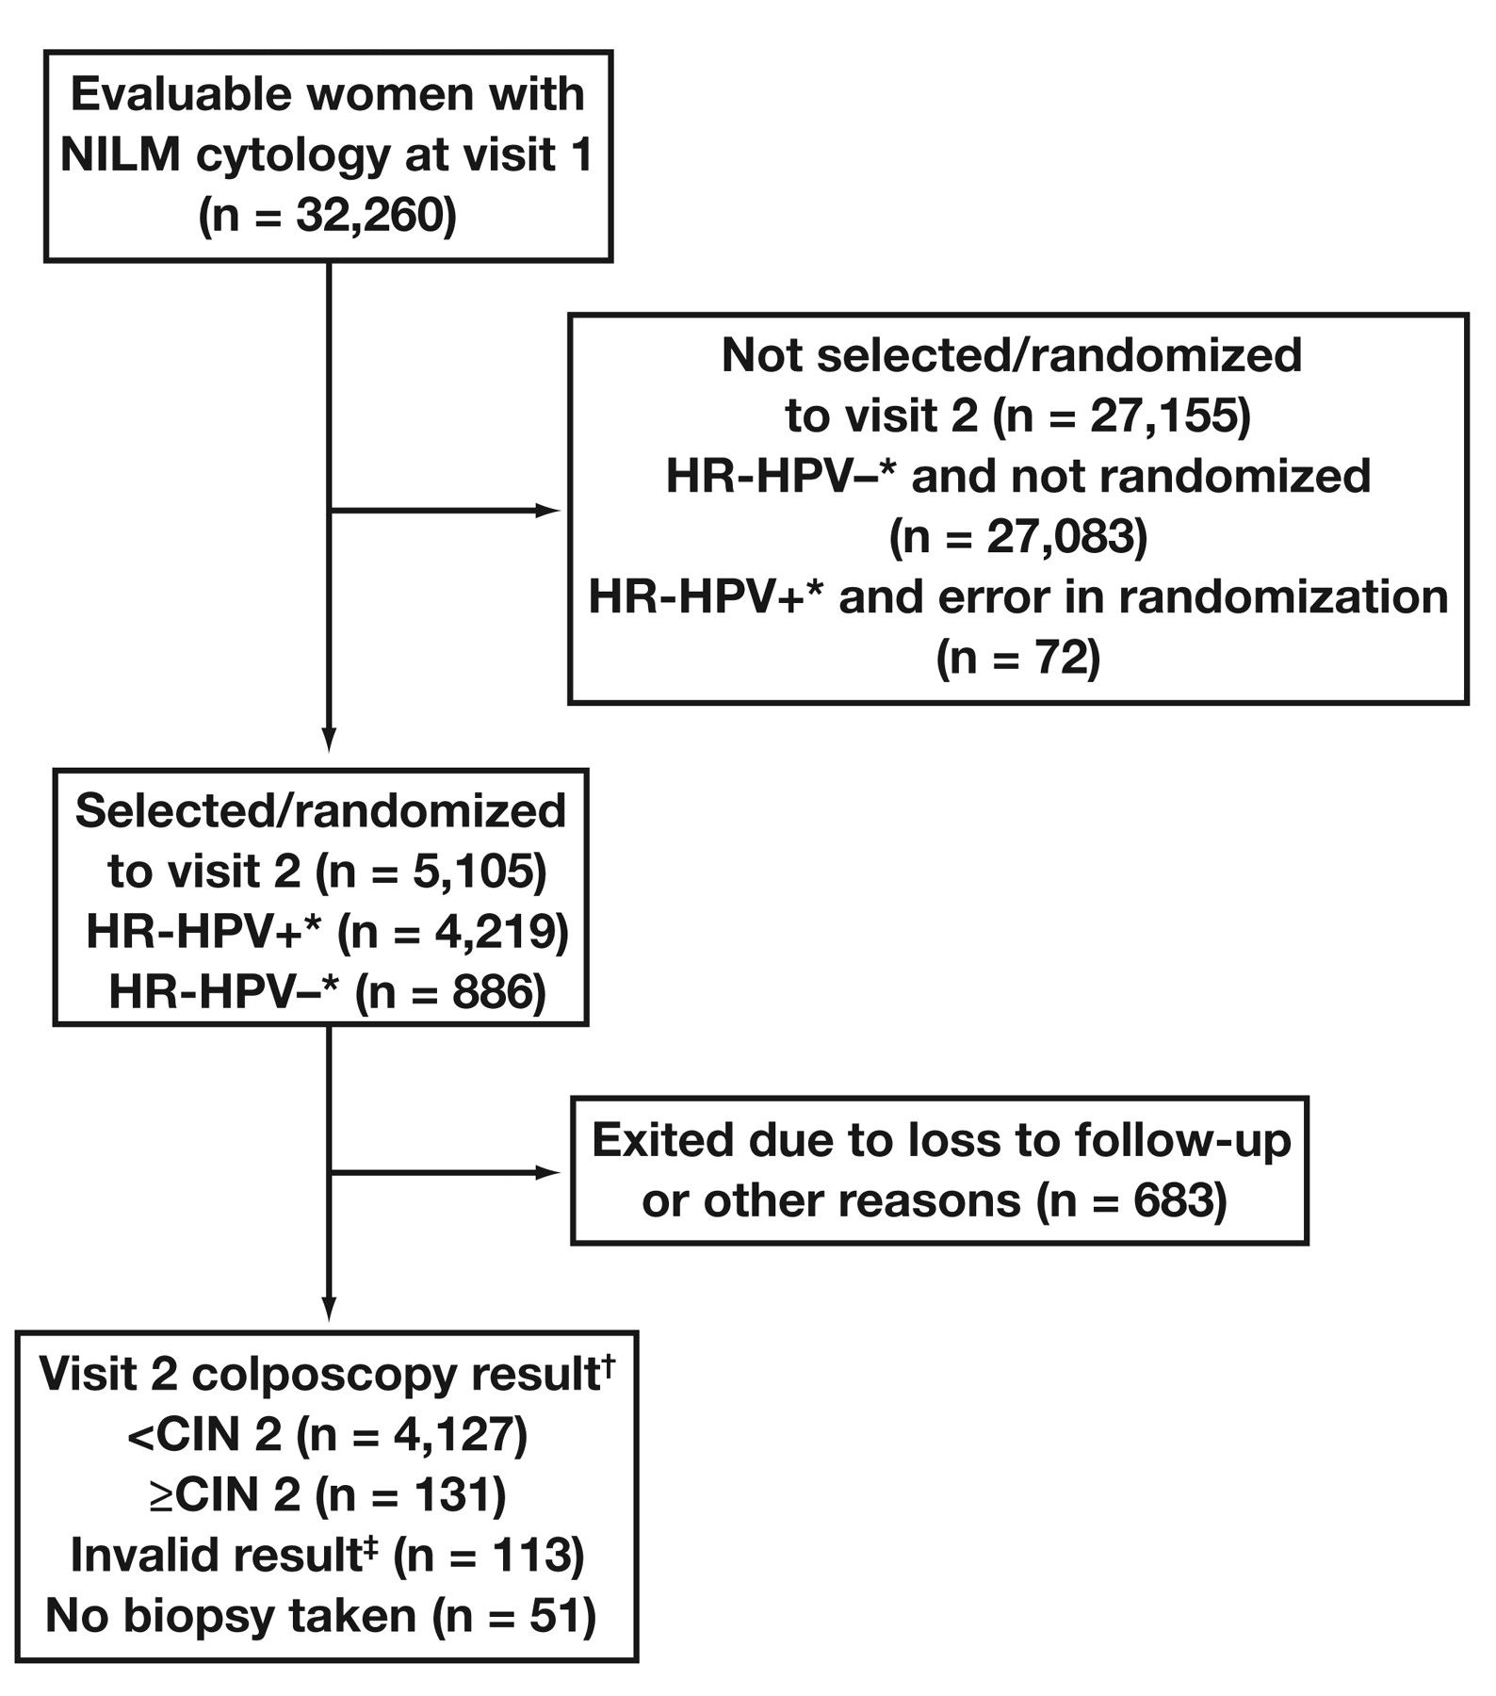
Figure 1 Flow of evaluable women 30 years or older with NILM cytology through the study. * By Roche ...
Notes:
Figure 1 Flow of evaluable women 30 years or older with NILM cytology through the study. * By Roche first-generation HPV tests. † Biopsy obtained according to a standardized protocol and reviewed by central pathology review panel. ‡ Invalid biopsy result includes biopsy sample inadequate for analysis and biopsy sample obtained outside of 12-wk window. CIN, cervical intraepithelial neoplasia; HPV, human papillomavirus; HR, high-risk; NILM, negative for intraepithelial lesions or malignancy.
Unless provided in the caption above, the following copyright applies to the content of this slide: © American Society for Clinical Pathology

