Slide 1
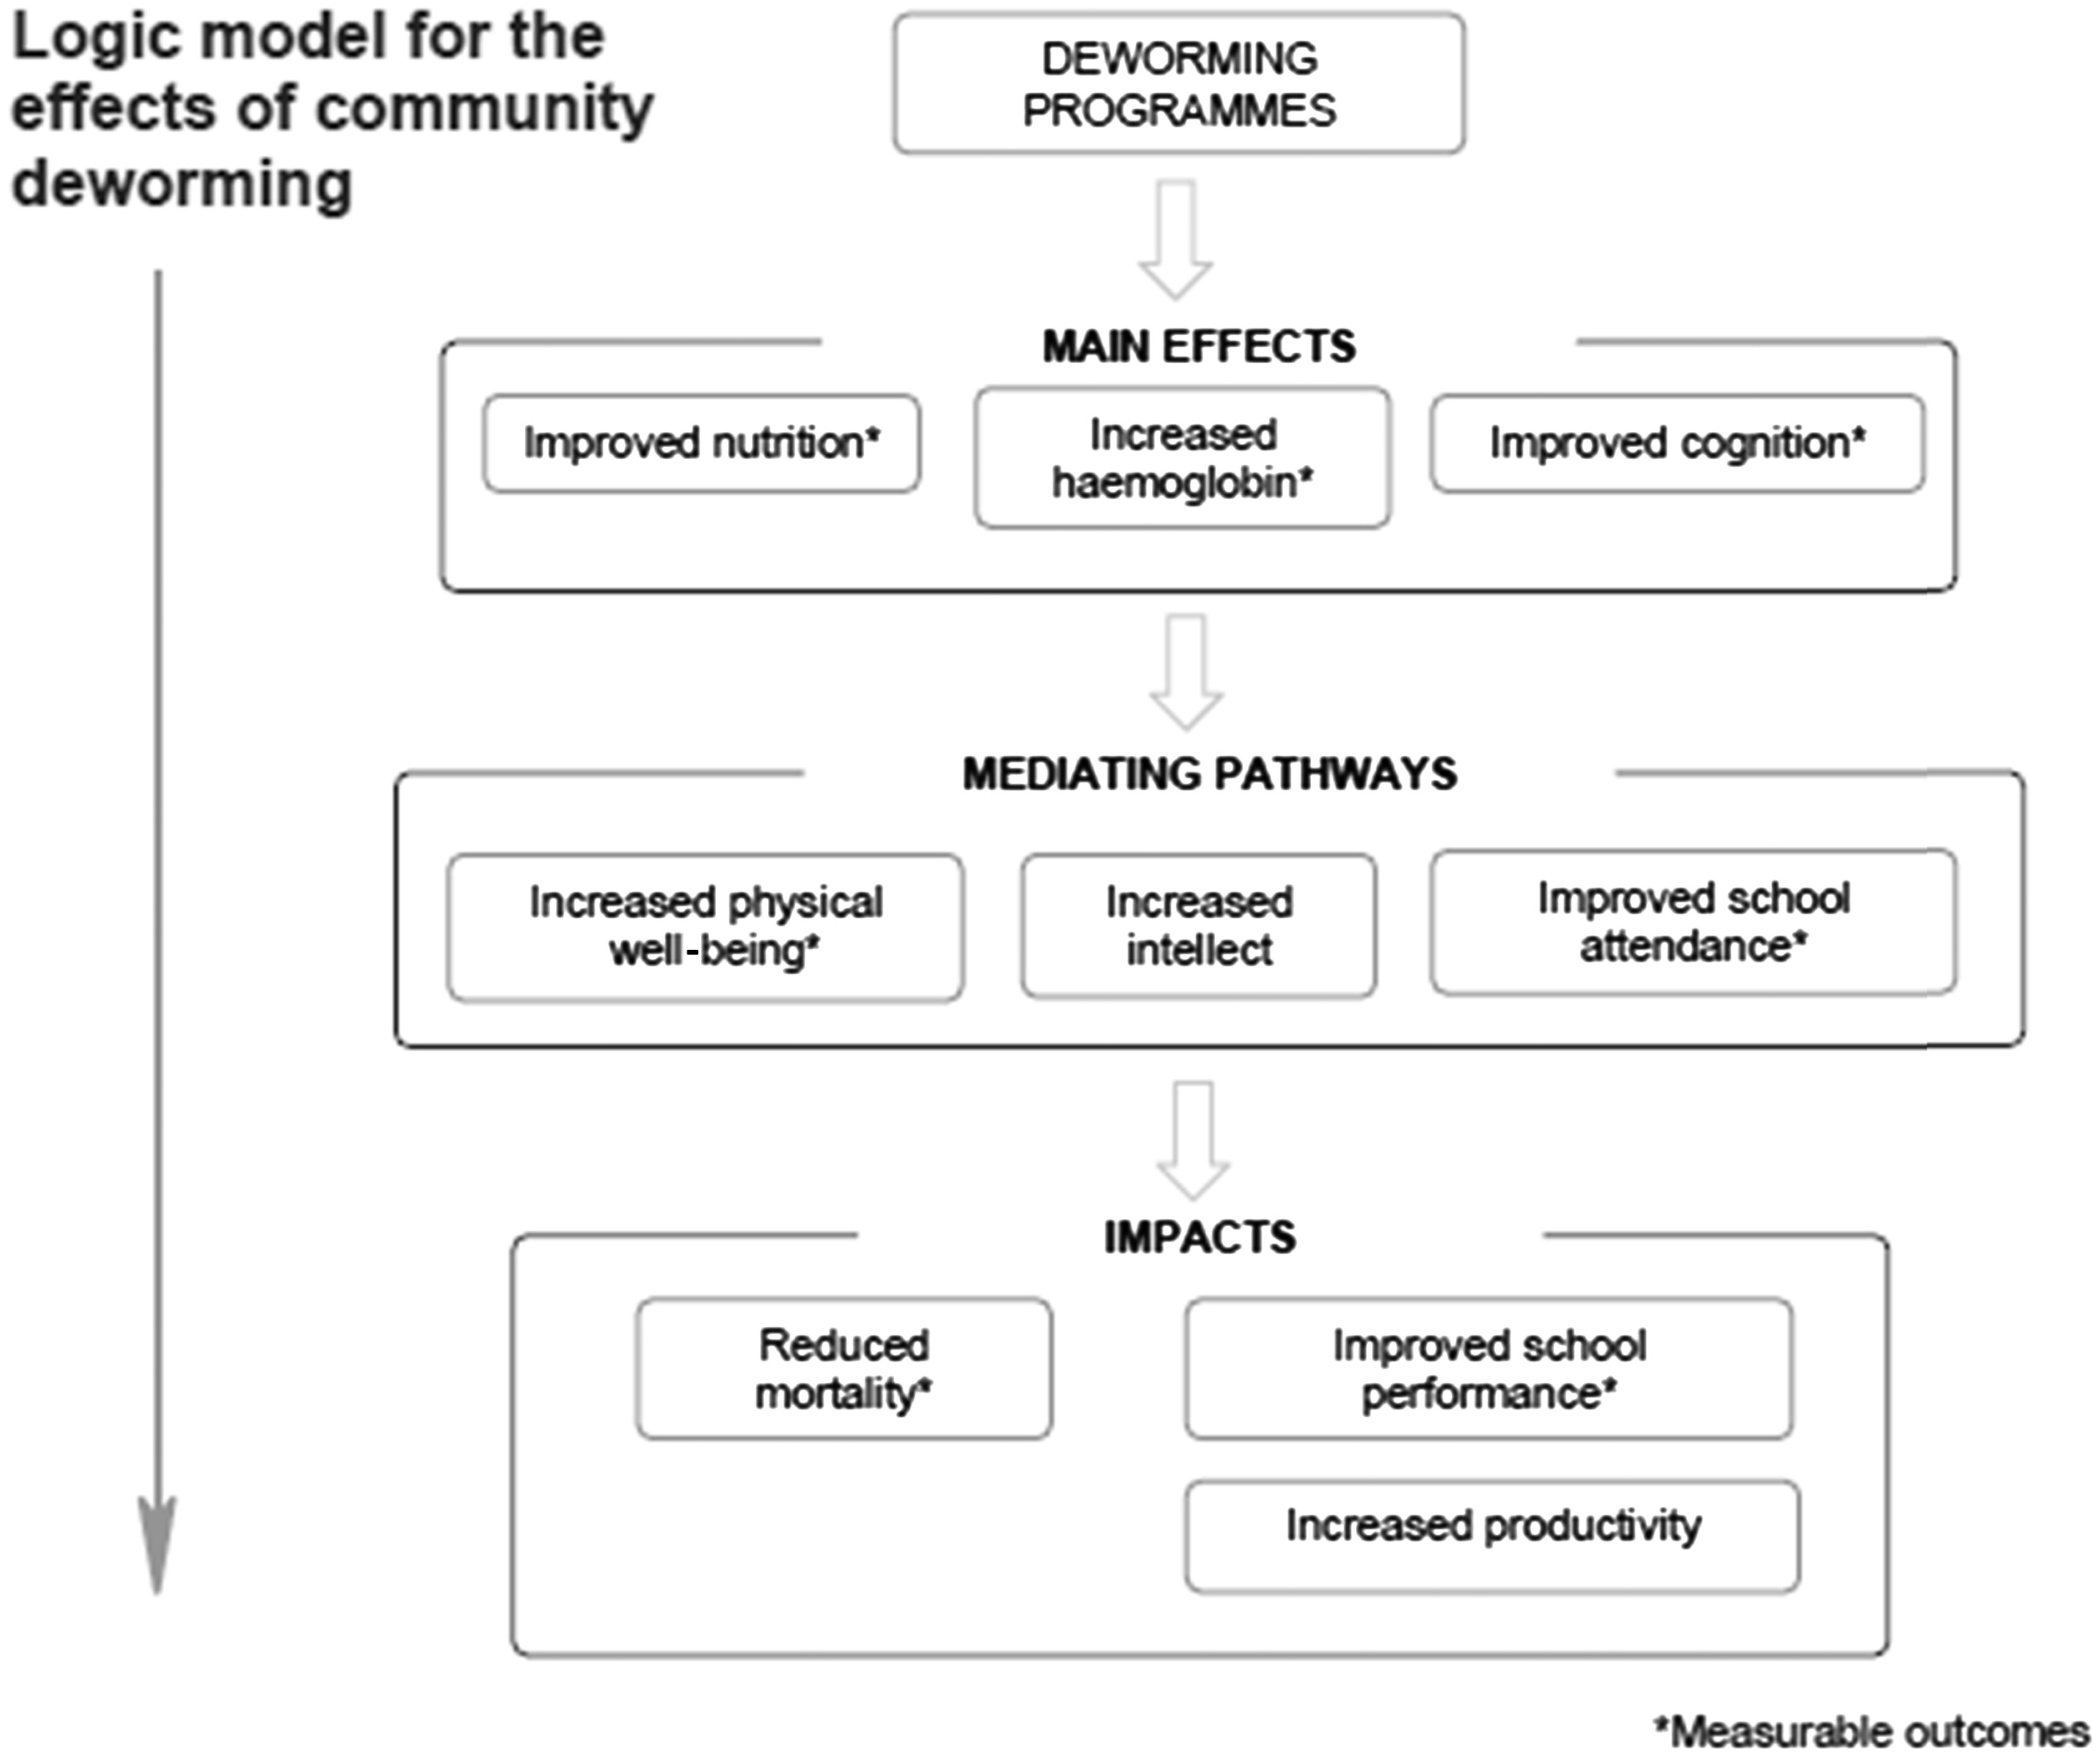
Figure 1. Logic model for the effects of community deworming. Reproduced with permission from Taylor-Robinson ...
Notes:
Figure 1. Logic model for the effects of community deworming. Reproduced with permission from Taylor-Robinson 2015.6
Unless provided in the caption above, the following copyright applies to the content of this slide: © The Author 2017. Published by Oxford University Press on behalf of the International Epidemiological Association.This is an Open Access article distributed under the terms of the Creative Commons Attribution Non-Commercial License (http://creativecommons.org/licenses/by-nc/4.0/), which permits non-commercial re-use, distribution, and reproduction in any medium, provided the original work is properly cited. For commercial re-use, please contact journals.permissions@oup.com

