Slide 1
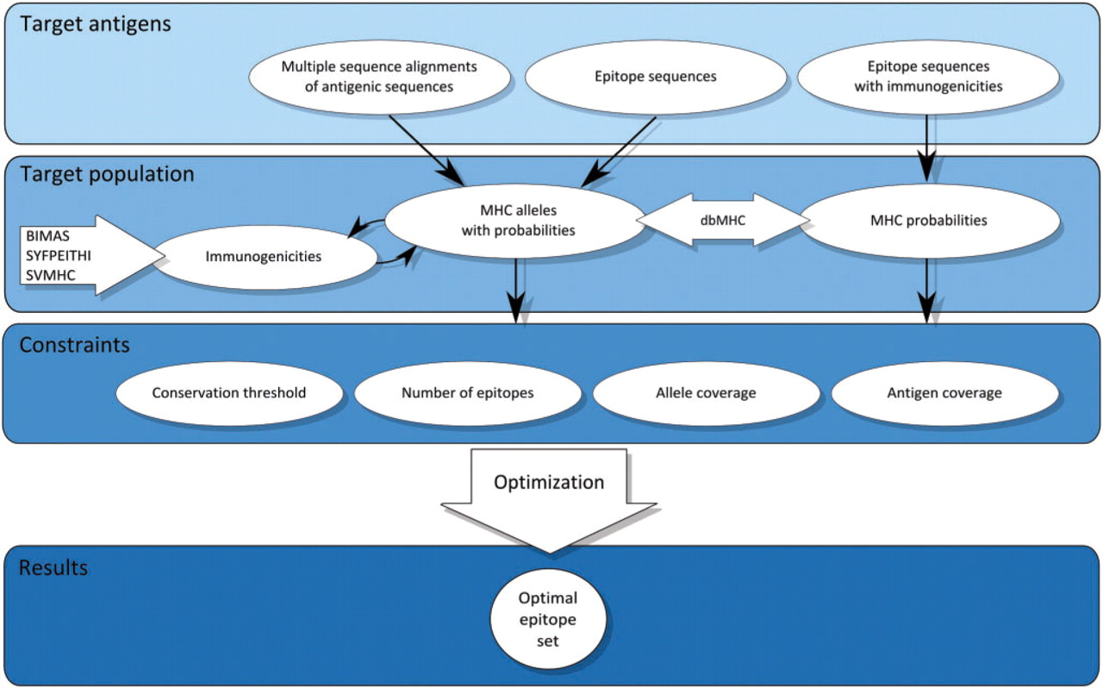
Figure 1. Structure of the OptiTope web interface. OptiTope is divided into four parts: target antigens, target ...
Notes:
Figure 1. Structure of the OptiTope web interface. OptiTope is divided into four parts: target antigens, target population, constraints and results. (i) Target antigens: three different formats of antigenic sequences can be entered: (a) a list of multiple sequence alignments of target-specific antigens, (b) a list of epitopes and (c) a table of epitopes with (experimentally determined) immunogenicities with respect to specific alleles. (ii) Target population: the information required to specify the target population (MHC alleles and corresponding probabilities) depends on the chosen input format. (iii) Constraints: OptiTope offers a set of constraints, which can be modified or excluded by the user. (iv) Results: if feasible, OptiTope presents an optimal set of epitopes.
Unless provided in the caption above, the following copyright applies to the content of this slide: © 2009 The Author(s)This is an Open Access article distributed under the terms of the Creative Commons Attribution Non-Commercial License (http://creativecommons.org/licenses/by-nc/2.0/uk/) which permits unrestricted non-commercial use, distribution, and reproduction in any medium, provided the original work is properly cited.

Slide 2
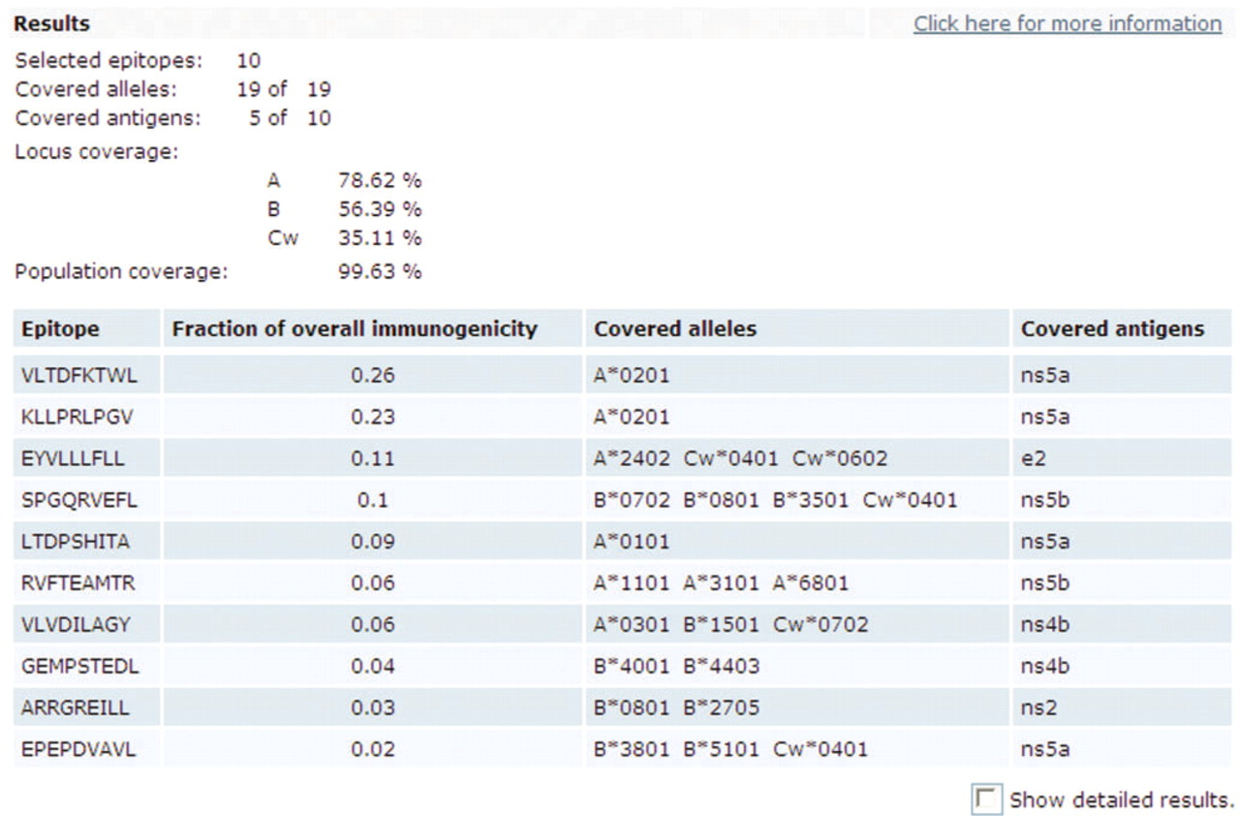
Figure 2. A screenshot from the results page of OptiTope.
Notes:
Figure 2. A screenshot from the results page of OptiTope.
Unless provided in the caption above, the following copyright applies to the content of this slide: © 2009 The Author(s)This is an Open Access article distributed under the terms of the Creative Commons Attribution Non-Commercial License (http://creativecommons.org/licenses/by-nc/2.0/uk/) which permits unrestricted non-commercial use, distribution, and reproduction in any medium, provided the original work is properly cited.

