Slide 1
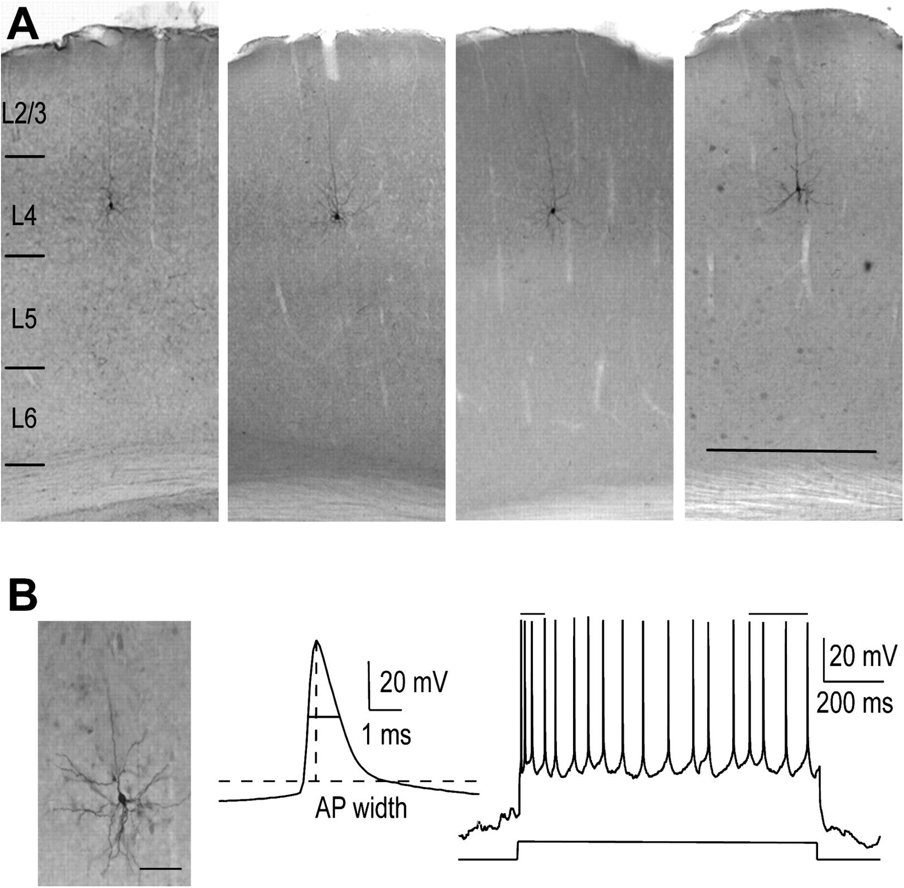
Figure 1. ISI-targeted in vivo whole-cell recordings from regular spiking layer 4 pyramids. (A) Histochemical labeling ...
Notes:
Figure 1. ISI-targeted in vivo whole-cell recordings from regular spiking layer 4 pyramids. (A) Histochemical labeling of byocitin-filled L4Ns recorded in vivo by ISI-targeted whole-cell recordings. Sections are counterstained for cytochrome C to reveal layer 4. Pictures are montages of microphotographs taken from adjacent sections to show the untufted apical dendrite. Bar: 500 μm. (B) Recorded cells were regular spiking, as defined by their “broad” APs (example of AP width measurement in the middle trace) and by their adapting firing pattern in response to 1 s current injection (right). The adaptation ratio was calculated as the ratio between the mean of the first and the last 3 interspike intervals (top lines) fired in response to a current injection able to evoke at least 10 APs. Bar: 50 μm.
Unless provided in the caption above, the following copyright applies to the content of this slide: © The Author 2011. Published by Oxford University Press. All rights reserved. For permissions, please e-mail: journals.permissions@oup.com

Slide 2
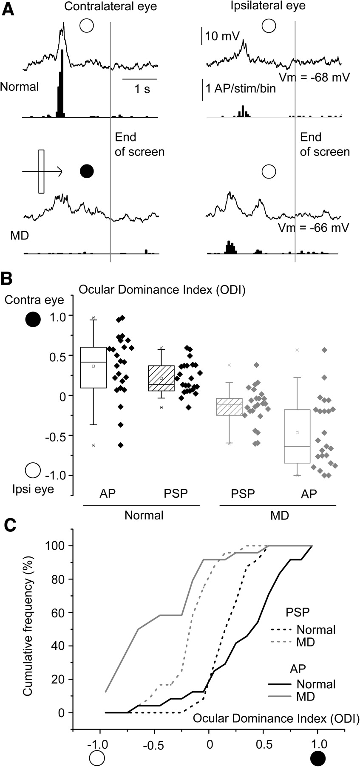
Figure 2. The shift of ocular preference caused by MD in L4Ns was larger at suprathreshold level. (A) Example of PSP ...
Notes:
Figure 2. The shift of ocular preference caused by MD in L4Ns was larger at suprathreshold level. (A) Example of PSP (traces) and AP (PSTHs) responses of L4Ns in bV1 to contralateral and ipsilateral eye stimulation with optimally oriented moving bars in a normal rat (top) and upon long-term MD (bottom). Traces and PSTHs have been obtained after averaging the responses to 20 stimulus passages. The light bar starts moving at the sweep beginning and reaches the end of the screen in correspondence of the gray vertical lines. (B) Box plots of sub- and suprathreshold ODIs of L4Ns recorded in normal (black) and MD (gray) rats. Note that, in both groups, the ocular preference for the dominant eye (the contra- and ipsilateral in normals and MD rats, respectively) is sharper at suprathreshold level. MD effects are thus more pronounced at suprathreshold level (paired t-tests, P < 0.05). (C) Plot showing the cumulative frequency distributions of the ODIs at PSP level (dashed lines) and AP level (continuous lines) in normal (black) and MD (gray) rats. This confirms that, in normal rats, the contralateral bias of visual responses is sharper at suprathreshold level and that the effects of MD on the ocular preference shift are larger at suprathreshold level (Kolmogorov–Smirnov test, P < 0.01).
Unless provided in the caption above, the following copyright applies to the content of this slide: © The Author 2011. Published by Oxford University Press. All rights reserved. For permissions, please e-mail: journals.permissions@oup.com

Slide 3
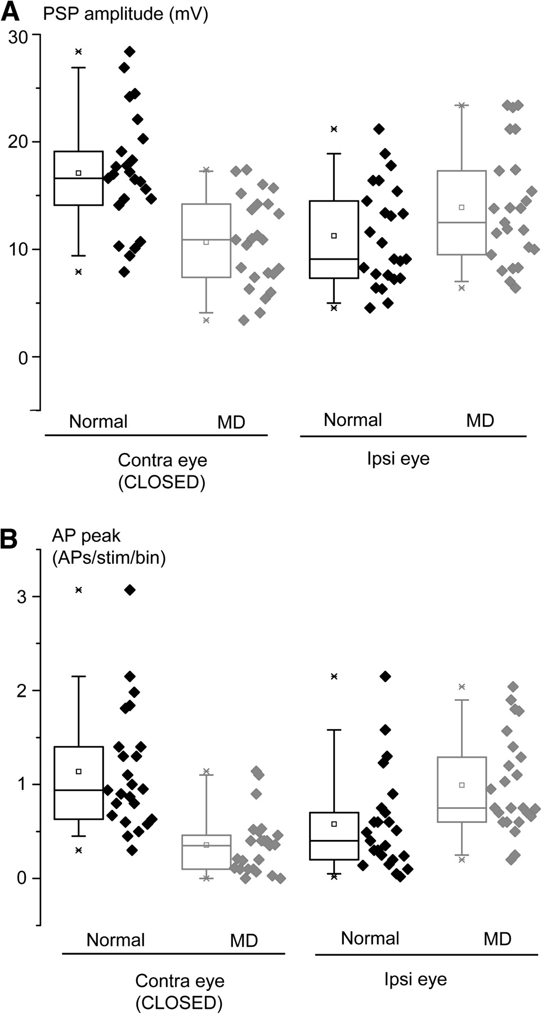
Figure 3. MD shifted the ocular preference of L4Ns mostly by depressing closed-eye responses. Box plots showing the ...
Notes:
Figure 3. MD shifted the ocular preference of L4Ns mostly by depressing closed-eye responses. Box plots showing the amplitude of subthreshold (A) and suprathreshold (B) responses of L4Ns to independent stimulation of the 2 eyes in normal (black) and MD (gray) rats. (A) Loss of synaptic responsiveness to the contralateral deprived eye was significant, while potentiation of open-eye responses only approached significance (t-tests, P < 0.001 and P = 0.07, respectively). (B) In the case of suprathreshold responses, both depression of the closed contralateral eye responses and potentiation of the open ipsilateral eye responses were significant (Mann–Whitney rank sum tests, P < 0.001 and P < 0.01, respectively).
Unless provided in the caption above, the following copyright applies to the content of this slide: © The Author 2011. Published by Oxford University Press. All rights reserved. For permissions, please e-mail: journals.permissions@oup.com

Slide 4
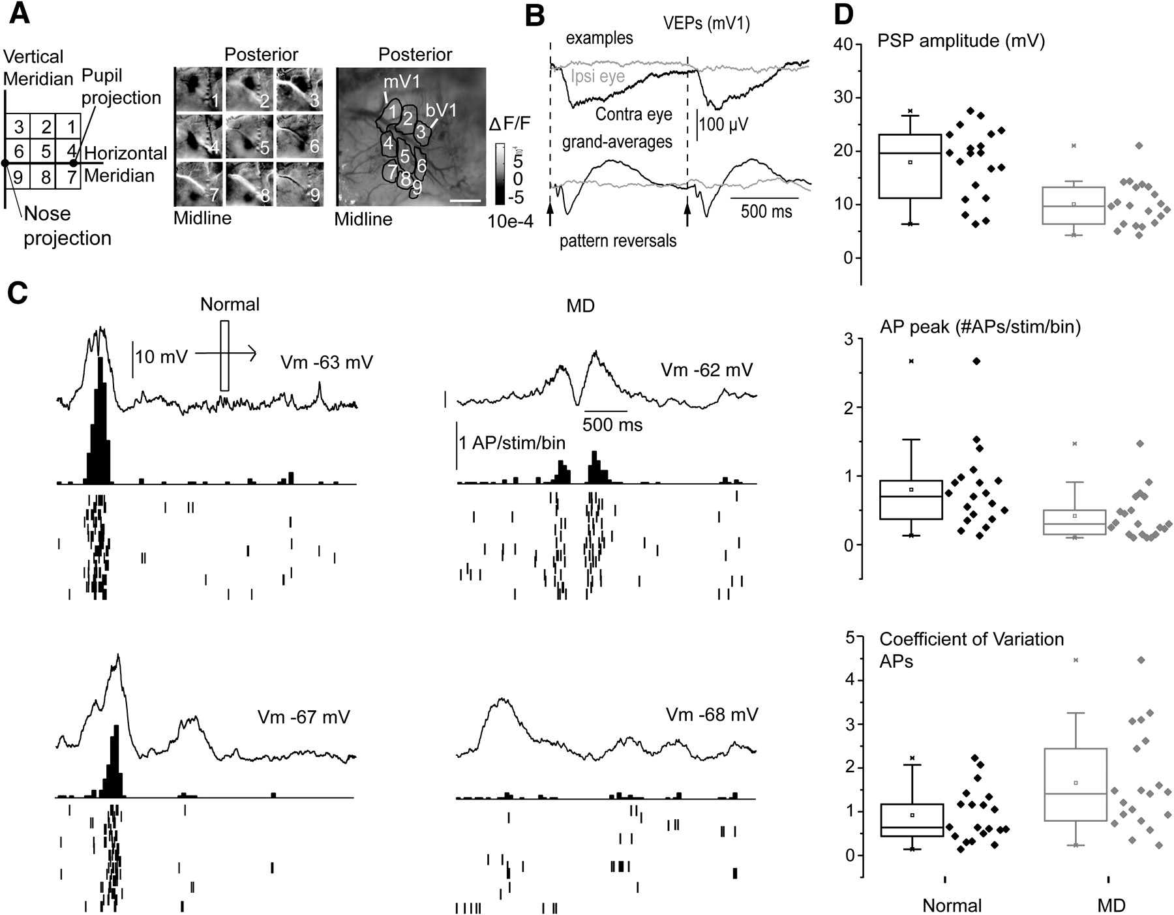
Figure 4. MD reduced sub- and suprathreshold visual responsiveness of L4Ns in mV1. (A) mV1 was identified by means of ...
Notes:
Figure 4. MD reduced sub- and suprathreshold visual responsiveness of L4Ns in mV1. (A) mV1 was identified by means of ISI. 20° × 20° spots were presented to the contralateral eye in the visual field positions shown on the left sketch. The corresponding ISI spots (middle) were overlaid with the green vasculature image (right). Craniotomies were then opened in correspondence of the spot positions number 3 and 1 for recordings in bV1 and mV1, respectively. Bar: 1 mm. (B) Example (top) and grand average (bottom) of VEP responses showing lack of VEP responses in mV1 to stationary gratings alternating at 0.5 Hz upon ipsilateral eye stimulation (gray). (C) Examples of sub- and suprathreshold (PSTH) responses of L4Ns recorded in mV1 in normal and long-term MD rats to contralateral (deprived) eye stimulation. Note the reduced amplitude of subthreshold responses in MD rats. (D) Top: MD decreases the amplitude of PSP responses of L4Ns in mV1 upon MD compared with normal rats (t-test, P < 0.001). Middle: MD reduces the peak amplitude of AP responses of L4Ns in mV1 (Mann–Whitney rank sum test, P = 0.01). Bottom: MD causes a reduction of reliability of visually driven spiking, as expressed by a significant increase in the median of the coefficients of variation of visually driven spike counts on a trial-to-trial basis (Mann–Whitney rank sum test, P < 0.05).
Unless provided in the caption above, the following copyright applies to the content of this slide: © The Author 2011. Published by Oxford University Press. All rights reserved. For permissions, please e-mail: journals.permissions@oup.com

Slide 5
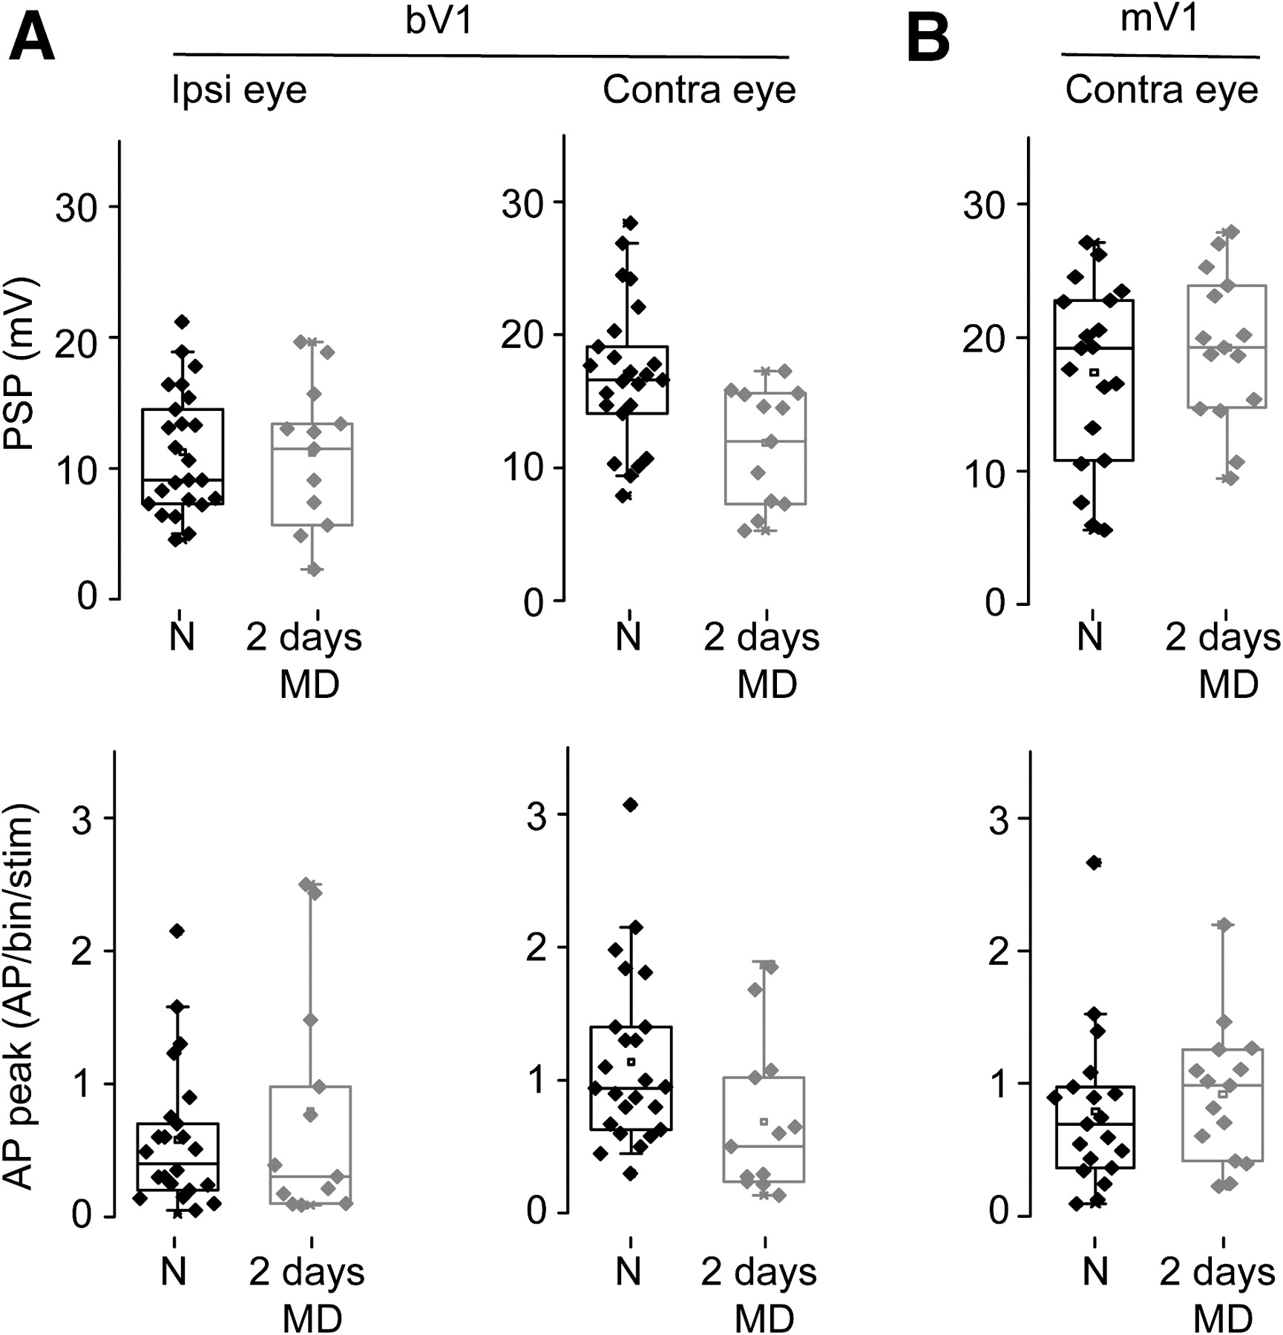
Figure 5. A brief MD episode depressed visually driven synaptic responses in bV1 but not in mV1. (A) In bV1, 2 days of ...
Notes:
Figure 5. A brief MD episode depressed visually driven synaptic responses in bV1 but not in mV1. (A) In bV1, 2 days of MD did not cause potentiation of ipsilateral open-eye responses (left column) at both PSP (top; t-test, P = 0.97) and AP level (bottom; Mann–Whitney rank sum test, P = 0.7) but were sufficient to significantly depress contralateral deprived-eye responses (right column) for both PSPs (top; t-test, P < 0.05) and APs (bottom; Mann–Whitney rank sum test, P < 0.05). (B) The same manipulation did not significantly depress PSP (top; t-test, P = 0.6) or AP (bottom; Mann–Whitney rank sum test, P = 0.1) responses in L4Ns of mV1.
Unless provided in the caption above, the following copyright applies to the content of this slide: © The Author 2011. Published by Oxford University Press. All rights reserved. For permissions, please e-mail: journals.permissions@oup.com

Slide 6
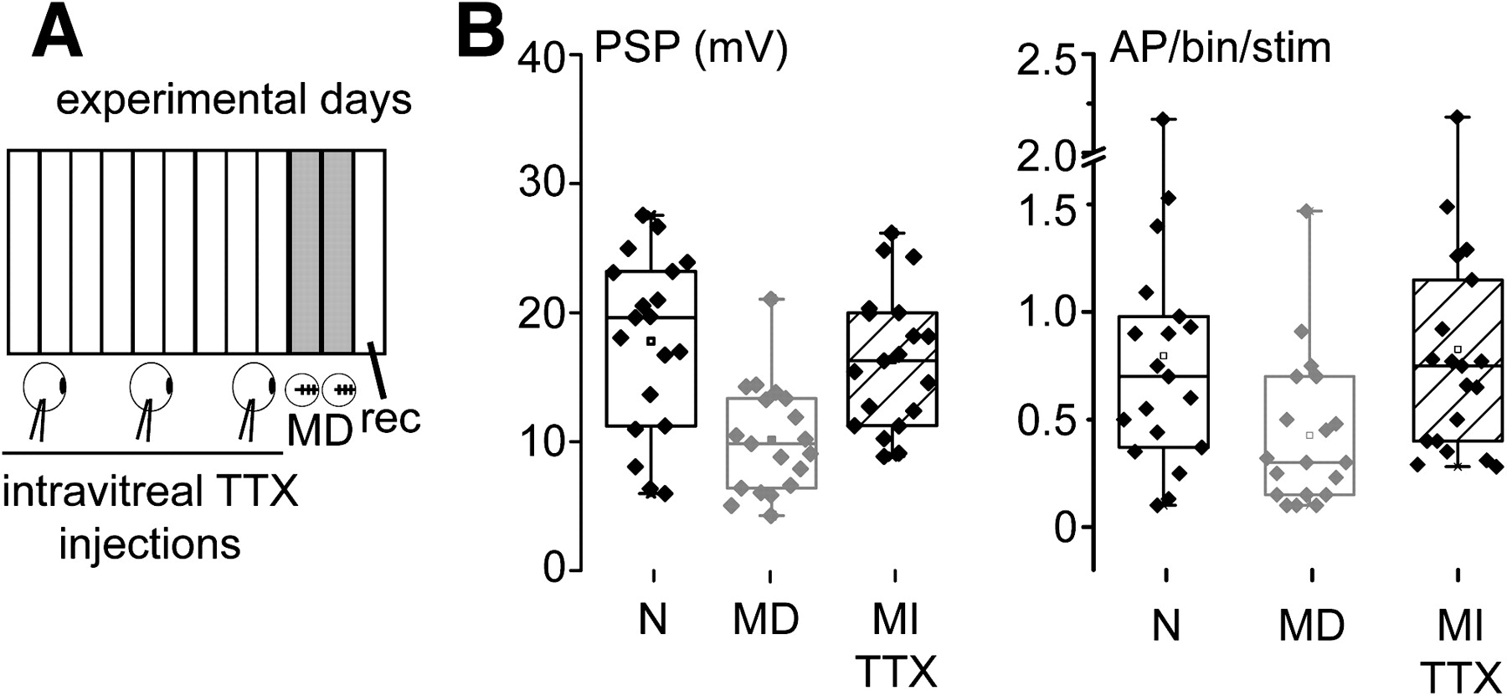
Figure 6. Retinal inactivation by intravitreal TTX did not depress PSP and AP visual responses in L4Ns of mV1. (A) ...
Notes:
Figure 6. Retinal inactivation by intravitreal TTX did not depress PSP and AP visual responses in L4Ns of mV1. (A) Sketch of the experimental design for the MI experiment. Animals were subjected to daily intravitreal injections of TTX for 9 days and then to 2 days of MD to allow for TTX washout before electrophysiological recordings. (B) Box plots showing the PSP (left) and AP (right) responses of L4Ns in mV1 upon MI. Note that only MD was able to depress sub- and suprathreshold visual responsiveness, whereas MI failed to do so (dashed boxes; PSPs: one-way ANOVA and Tukey post hoc test, P = 0.7; APs: ANOVA on ranks, Dunn post hoc test, P = 0.42).
Unless provided in the caption above, the following copyright applies to the content of this slide: © The Author 2011. Published by Oxford University Press. All rights reserved. For permissions, please e-mail: journals.permissions@oup.com

Slide 7
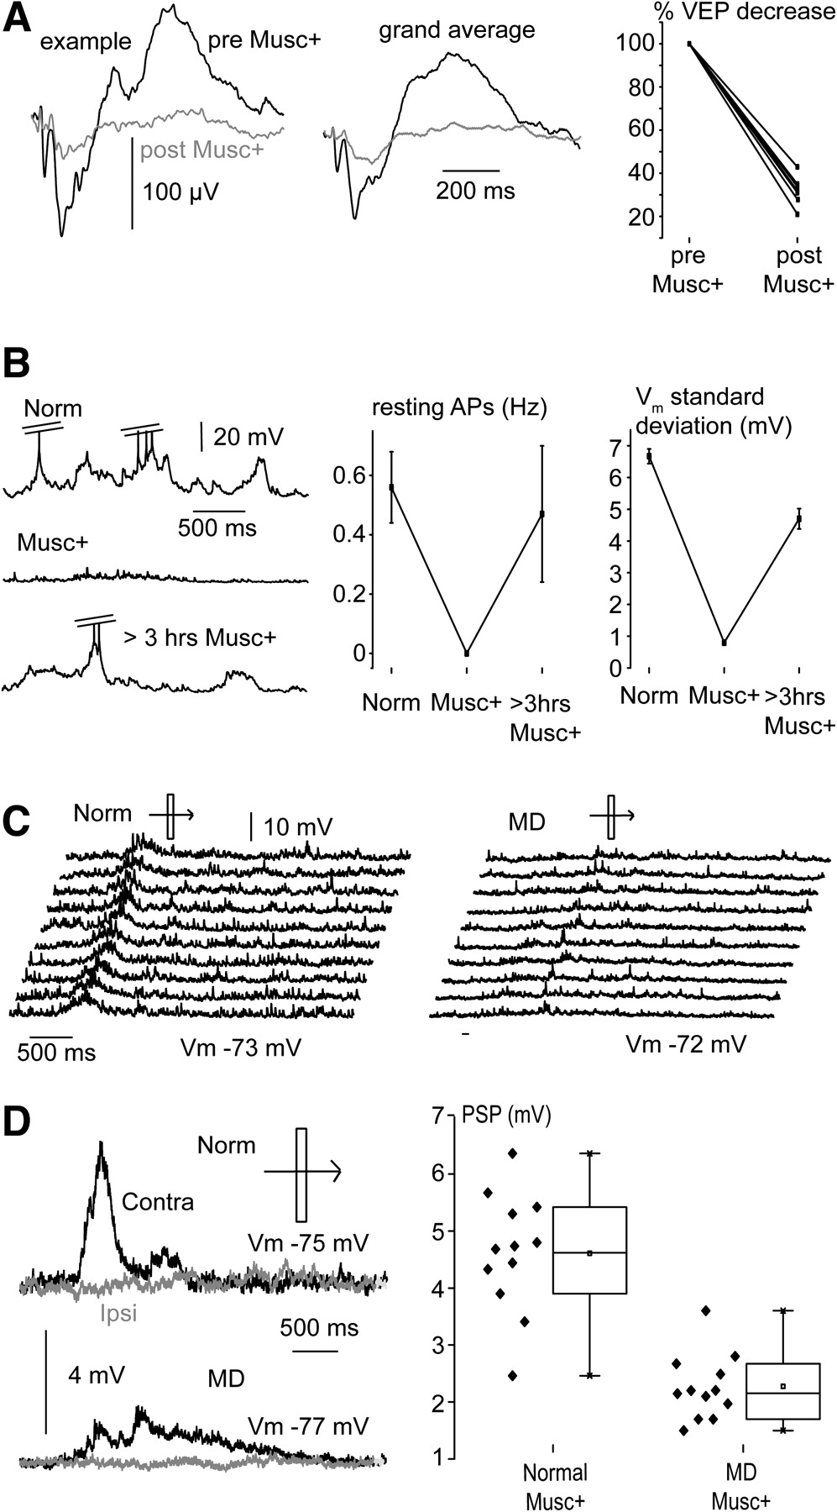
Figure 7. MD depresses visually driven thalamic inputs onto L4Ns in mV1. (A) Example and grand averages of the VEP ...
Notes:
Figure 7. MD depresses visually driven thalamic inputs onto L4Ns in mV1. (A) Example and grand averages of the VEP responses (left and middle, respectively) recorded in mV1 before (black traces) and after (gray traces) muscimol+ application observed at steady state (Musc+). Note the large decrease in the VEP amplitude after muscimol+ injection, relative to premuscimol+ application (right panel; paired t-test, P < 0.001). (B) Left panel: examples of sub- and suprathreshold activity of intracellularly recorded L4Ns in controls and within 1 h from muscimol+ application (Musc+). After more than 3 h from muscimol+ application, spontaneous activity had recovered to premuscimol+ levels. APs are truncated at −30 mV. Note the complete silencing of AP activity (middle panel) and the disappearance of the large Up-to-Down state subthreshold oscillations (right panel). The amplitude of subthreshold spontaneous oscillations is expressed by the SD of the Vm signal. (C) Ten subsequent sweeps showing the subthreshold responses to light bar movement presented to the contralateral eye into 2 L4Ns recorded from a control (left) and an MD (right) rat upon muscimol+ application. Note the marked decrease of the subthreshold responses in the MD rat. (D) Subthreshold responses to contralateral eye stimulation of L4Ns recorded in a normal (top) and MD (bottom) rat. Note that ipsilateral eye stimulation did not evoke subthreshold responses, indicating the lack of ipsilaterally driven thalamocortical inputs. Right plot: MD significantly reduced the amplitude of visually driven thalamocortical inputs onto L4Ns of mV1 (t-test, P < 0.001).
Unless provided in the caption above, the following copyright applies to the content of this slide: © The Author 2011. Published by Oxford University Press. All rights reserved. For permissions, please e-mail: journals.permissions@oup.com

Slide 8
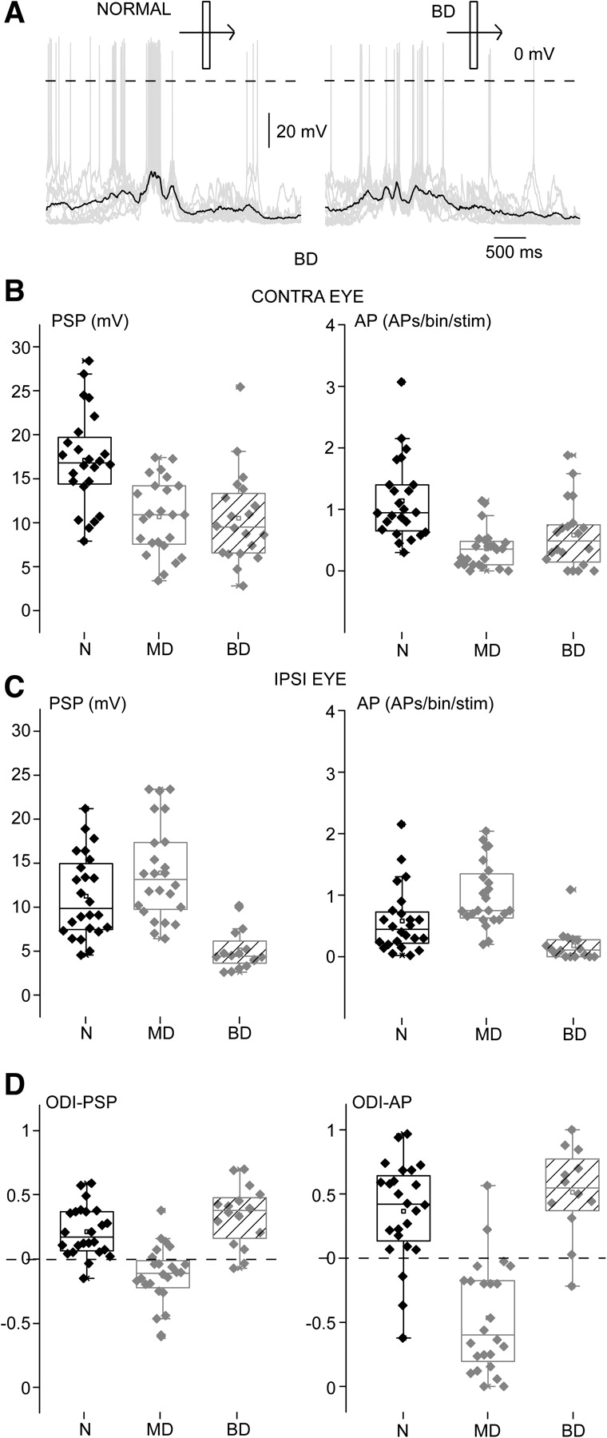
Figure 8. BD depressed synaptic and spike responsiveness in L4Ns of bV1. (A) Examples of sub- and suprathreshold visual ...
Notes:
Figure 8. BD depressed synaptic and spike responsiveness in L4Ns of bV1. (A) Examples of sub- and suprathreshold visual responses to an optimally oriented moving light bar in a L4N recorded from a control (left) and a rat subjected to BD (right). Overlaid sweeps are in gray, the averaged synaptic response—obtained upon AP removal—is in black. (B) PSP and AP responses to contralateral eye stimulation in normal (N), MD, and BD rats. BD significantly decreased visual responsiveness at both sub- and suprathreshold level (PSP: one-way ANOVA, P < 0.001 and Tukey post hoc test, P < 0.05; APs: one-way ANOVA on ranks, P < 0.001 and Dunn post hoc test, P < 0.05) with respect to controls, and at levels comparable to MD. (C) PSP and AP responses to ipsilateral eye stimulation in N, MD, and BD rats. BD significantly decreased visual responsiveness at both sub- and suprathreshold levels (one-way ANOVA on ranks, P < 0.001; Dunn post hoc test, P 0.2).
Unless provided in the caption above, the following copyright applies to the content of this slide: © The Author 2011. Published by Oxford University Press. All rights reserved. For permissions, please e-mail: journals.permissions@oup.com

