Slide 1
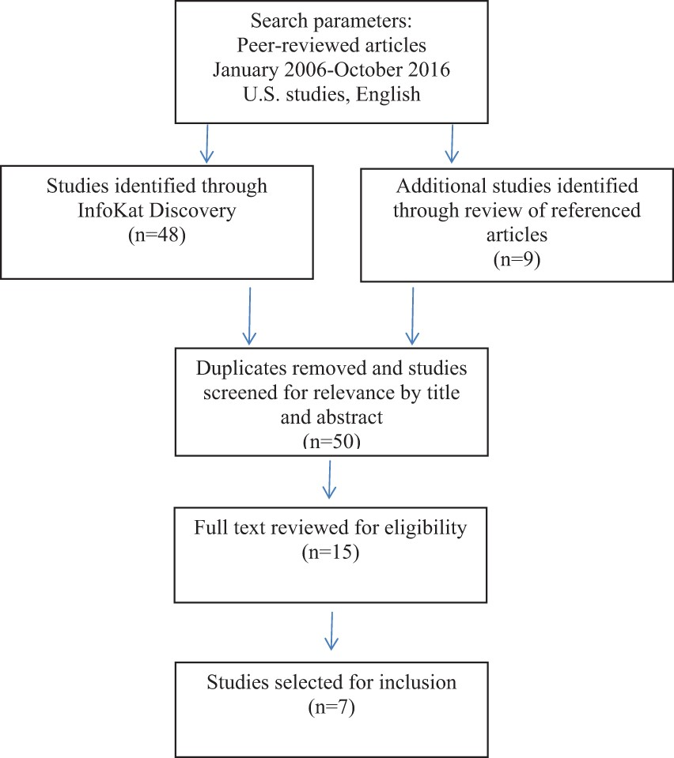
Fig. 1. Flow diagram of identification of studies for inclusion.
Notes:
Fig. 1. Flow diagram of identification of studies for inclusion.
Unless provided in the caption above, the following copyright applies to the content of this slide: � The Author 2017. Published by Oxford University Press. All rights reserved. For permissions, please email: journals.permissions@oup.com

