Slide 1
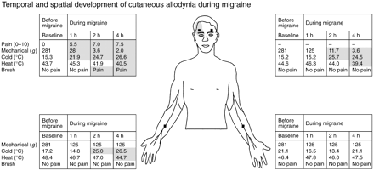
Fig. 1 Mechanical, cold and heat pain threshold changes in the ipsi- (patient's right side) and contralateral head ...
Notes:
Fig. 1 Mechanical, cold and heat pain threshold changes in the ipsi- (patient's right side) and contralateral head and the two forearms during a single migraine attack. The referred pain area is marked on the face. In the absence of migraine, this patient was pain-free and his skin sensitivity was normal. One hour into the migraine, he developed cold and mechanical cutaneous allodynia on the ipsilateral head (indicated by shaded areas in the tables) but not in any other site. Two hours into the attack, the allodynia increased on the ipsilateral head and appeared on the contralateral head and ipsilateral forearm. At 4 h, heat allodynia was also detected while mechanical and cold allodynia continued to increase. Black squares indicate sites of sensory testing.
Unless provided in the caption above, the following copyright applies to the content of this slide: © Oxford University Press 2000

Slide 2
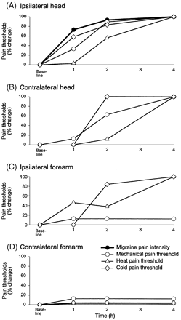
Fig. 2 Site-specific development profile of pain (bold line in A) and the three modalities of cutaneous allodynia ...
Notes:
Fig. 2 Site-specific development profile of pain (bold line in A) and the three modalities of cutaneous allodynia (A–D). The values of pain intensity and pain thresholds at each time point and each site are presented as a percentage of the respective maximal change. Note that the allodynia is not fully developed in the first 2 h of the attack.
Unless provided in the caption above, the following copyright applies to the content of this slide: © Oxford University Press 2000

Slide 3
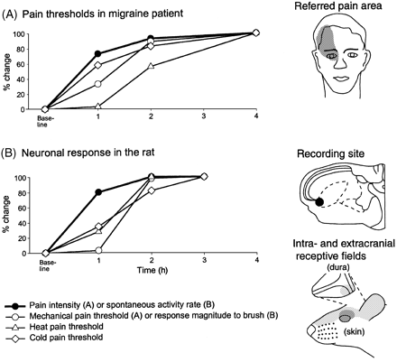
Fig. 3 The development of pain and allodynia during the patient migraine (A) parallels the development of central ...
Notes:
Fig. 3 The development of pain and allodynia during the patient migraine (A) parallels the development of central sensitization in the animal model (B) (adapted from Burstein et al., 1998). The line drawings in A illustrate spontaneous pain and pain threshold changes in response to mechanical, cold and heat stimulation of the human periorbital skin ipsilateral to the migraine. The line drawings in B illustrate changes in the response properties of a wide dynamic range neuron in lamina V of the spinal trigeminal nucleus that receives convergent input from the dura and the skin. The neuron sensitized following a brief chemical stimulation of its dural receptive field. First, it developed spontaneous activity and then it began to respond to mechanical, cold and heat skin stimulation that prior to the sensitization induced minimal or no responses.
Unless provided in the caption above, the following copyright applies to the content of this slide: © Oxford University Press 2000

