Slide 1
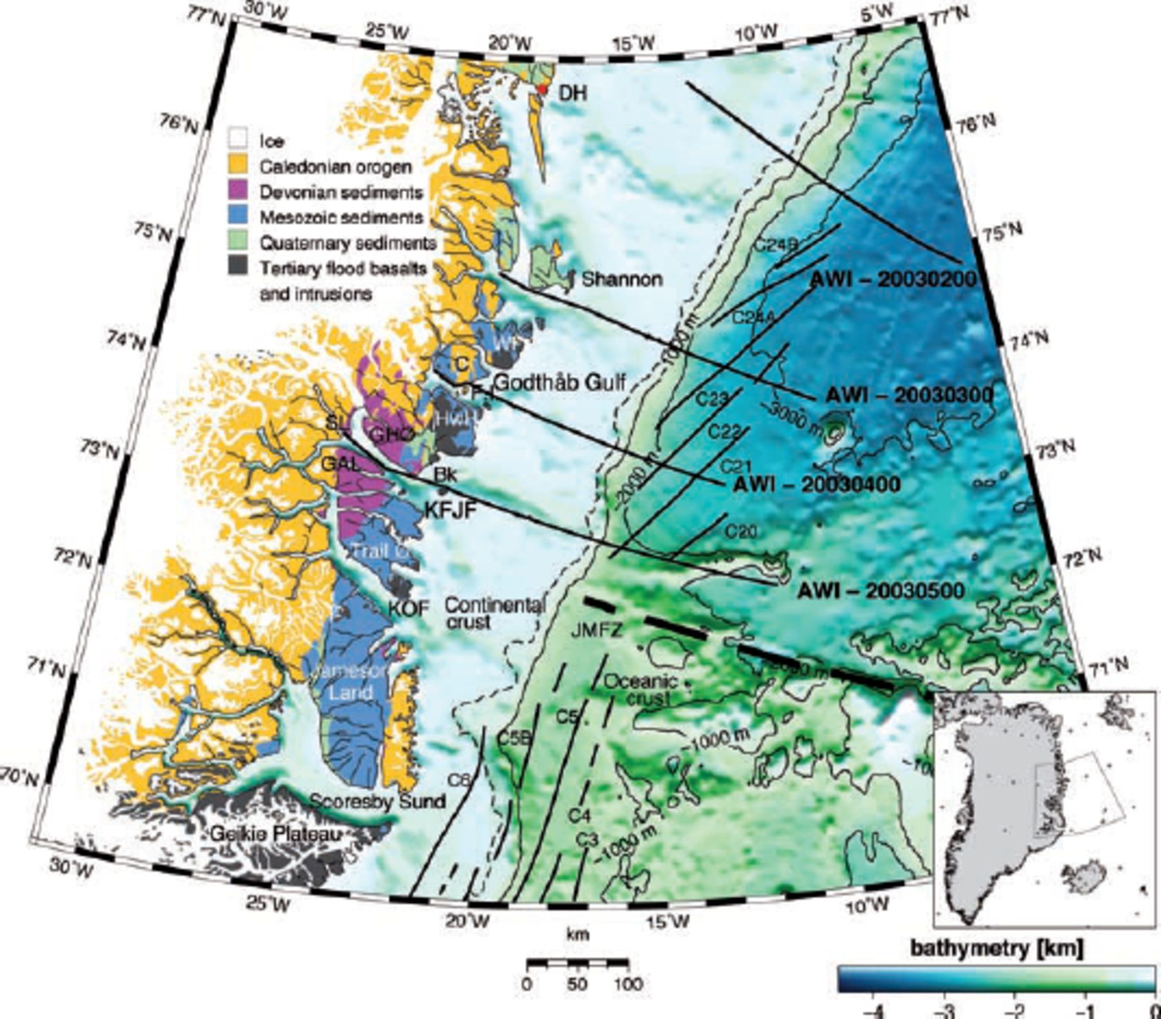
Figure 1. Simplified geological map of East Greenland Fjord Region after Escher and Pulvertaft (Escher & Pulvertaft ...
Notes:
Figure 1. Simplified geological map of East Greenland Fjord Region after Escher and Pulvertaft (Escher & Pulvertaft 1995) (copyright Geological Survey of Denmark and Greenland) and Henriksen et al. (2000). IBCAO Bathymetry after Jakobsson et al. (2000). Bk: Bontekoe Ø. C: Clavering Ø. DH: Danmarkshavn (magnetic base station). F.I.: Finsch Island. GAL: Günnar Anderson Land. GHØ: Gauss Halvø. HwH: Hold with Hope. JMFZ: Jan Mayen Fracture Zone. KFJF: Kejser Franz Joseph Fjord. KOF: Kong Oscar Fjord. SL: Strindberg Land. WF: Wolaston Foreland. All seismic profiles acquired in 2003 shown as thick solid black lines. Thin solid black lines mark ocean spreading anomalies. Thick dashed line represents the location of JMFZ as reference. Thin dashed line marks the smoothed shelf edge (330 m). Scale is valid for 73°N.
Unless provided in the caption above, the following copyright applies to the content of this slide: © 2007 The Author Journal compilation © 2007 RAS

Slide 2
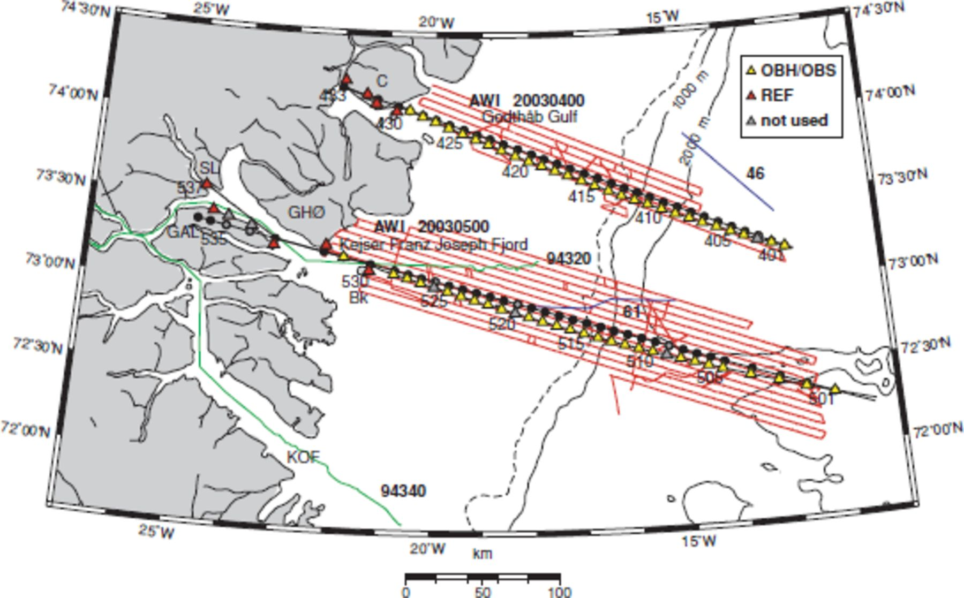
Figure 2. Location of the Godthåb Gulf and Kejser Franz Joseph Fjord seismic refraction profiles. Red lines show flight ...
Notes:
Figure 2. Location of the Godthåb Gulf and Kejser Franz Joseph Fjord seismic refraction profiles. Red lines show flight lines of the airborne magnetic survey. Yellow triangles show locations of the OBS/OBH, red triangles represent locations of REF land stations. Black dots show the locations of the receivers projected onto the straight line, as described in the text. Gray triangles and dots mark unused receiver stations. First, last and every fifth location are labelled. Green lines represent seismic refraction profiles after Schlindwein & Jokat (1999); blue lines mark multi channel seismic profiles after Hinz et al. (1987). For additional labels see Fig. 1. Scale is valid for 73°N.
Unless provided in the caption above, the following copyright applies to the content of this slide: © 2007 The Author Journal compilation © 2007 RAS

Slide 3
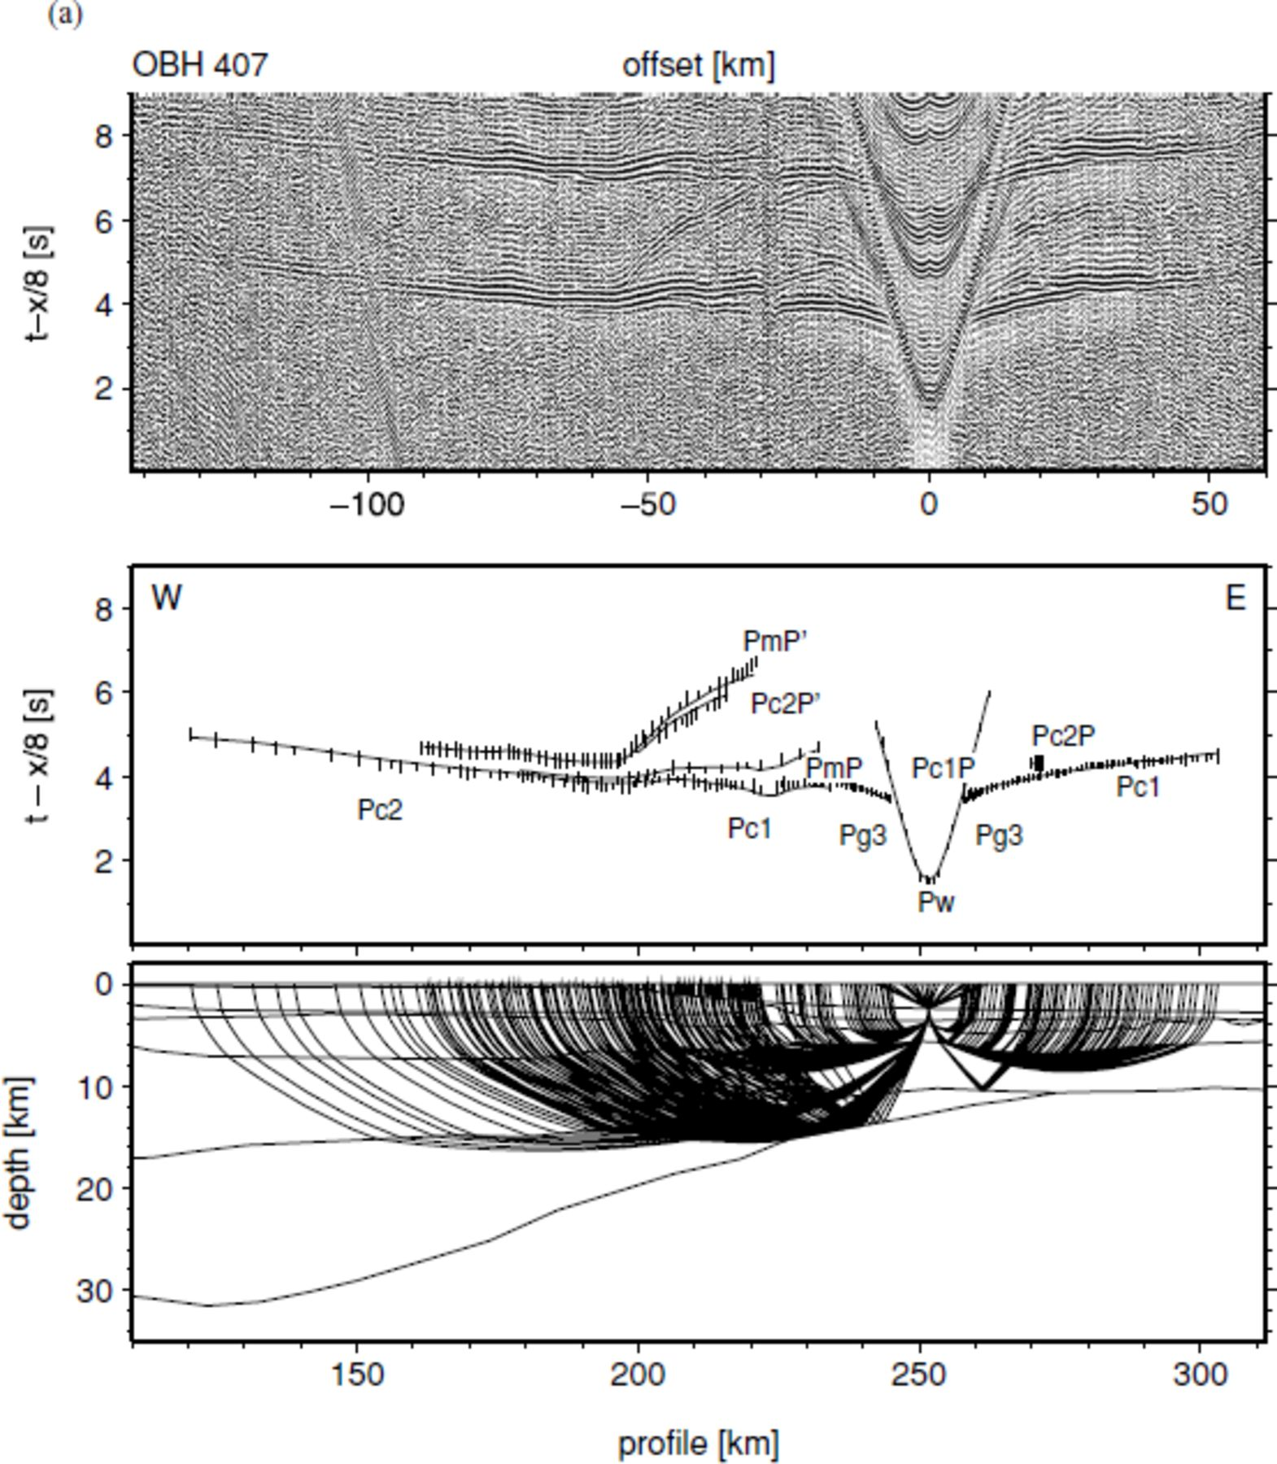
Figure 7. Examples of recorded seismic data from profile AWI-20030400. A 4.5–12 Hz bandpass filter was applied. The ...
Notes:
Figure 7. Examples of recorded seismic data from profile AWI-20030400. A 4.5–12 Hz bandpass filter was applied. The signals are scaled by automatic gain control in windows of 2 s. The traveltime is reduced by 8 km s−1. Observed phases are labelled (see Table 2). The ray coverage of each station is marked in the lower model. (a) Station 407 represents recordings of the oceanic crust and the eastern COT. Note the multiple reflected phase PmP′ and Pc2P′. (b) Station 415 is placed within the COT and shows typical shorter offsets. (c) OBH 423 is located near the landward termination of the COT. (d) Land station 431 shows typical long offsets. Note the poor quality of data between km 150 and 250. A filter of 4.5–21 Hz was here applied. The offset between the first arrivals and the location is due to the horizontal deviation of the station to the ship track.
Unless provided in the caption above, the following copyright applies to the content of this slide: © 2007 The Author Journal compilation © 2007 RAS

Slide 4
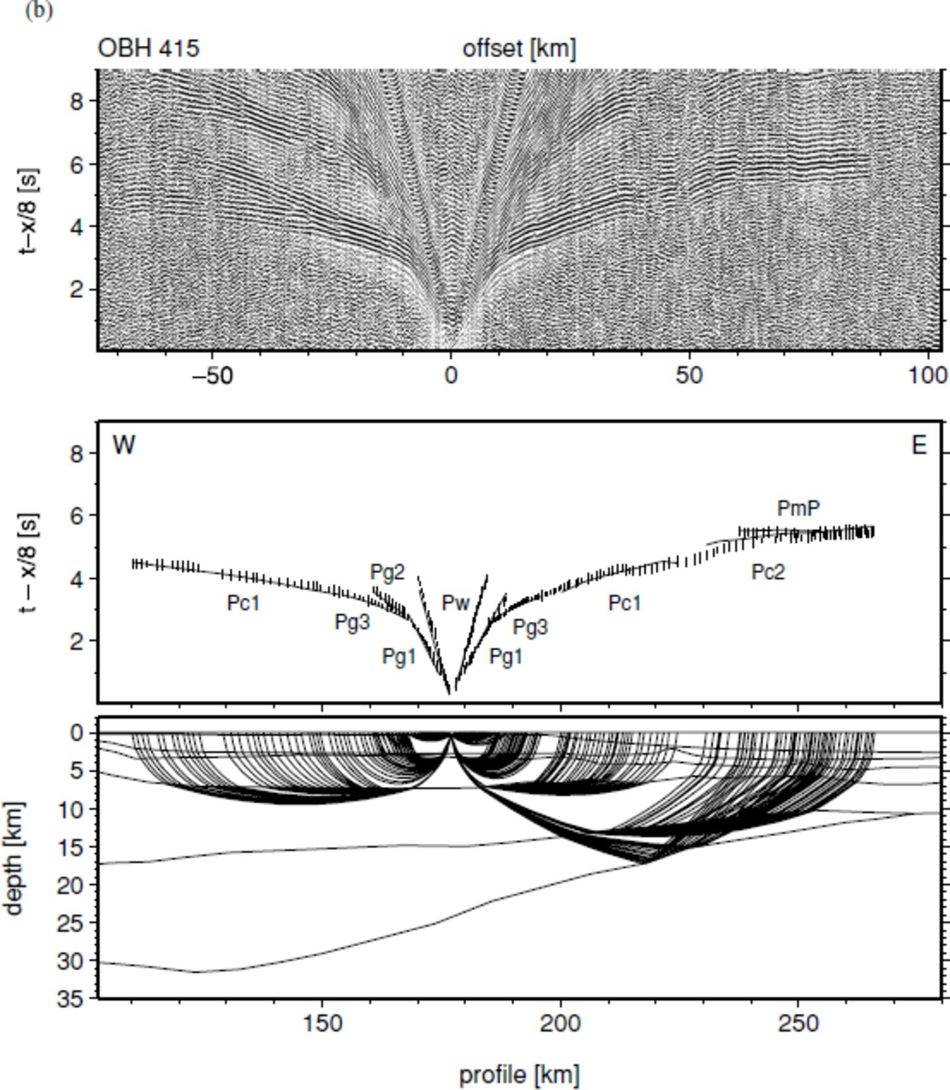
Figure 7. Examples of recorded seismic data from profile AWI-20030400. A 4.5–12 Hz bandpass filter was applied. The ...
Notes:
Figure 7. Examples of recorded seismic data from profile AWI-20030400. A 4.5–12 Hz bandpass filter was applied. The signals are scaled by automatic gain control in windows of 2 s. The traveltime is reduced by 8 km s−1. Observed phases are labelled (see Table 2). The ray coverage of each station is marked in the lower model. (a) Station 407 represents recordings of the oceanic crust and the eastern COT. Note the multiple reflected phase PmP′ and Pc2P′. (b) Station 415 is placed within the COT and shows typical shorter offsets. (c) OBH 423 is located near the landward termination of the COT. (d) Land station 431 shows typical long offsets. Note the poor quality of data between km 150 and 250. A filter of 4.5–21 Hz was here applied. The offset between the first arrivals and the location is due to the horizontal deviation of the station to the ship track.
Unless provided in the caption above, the following copyright applies to the content of this slide: © 2007 The Author Journal compilation © 2007 RAS

Slide 5
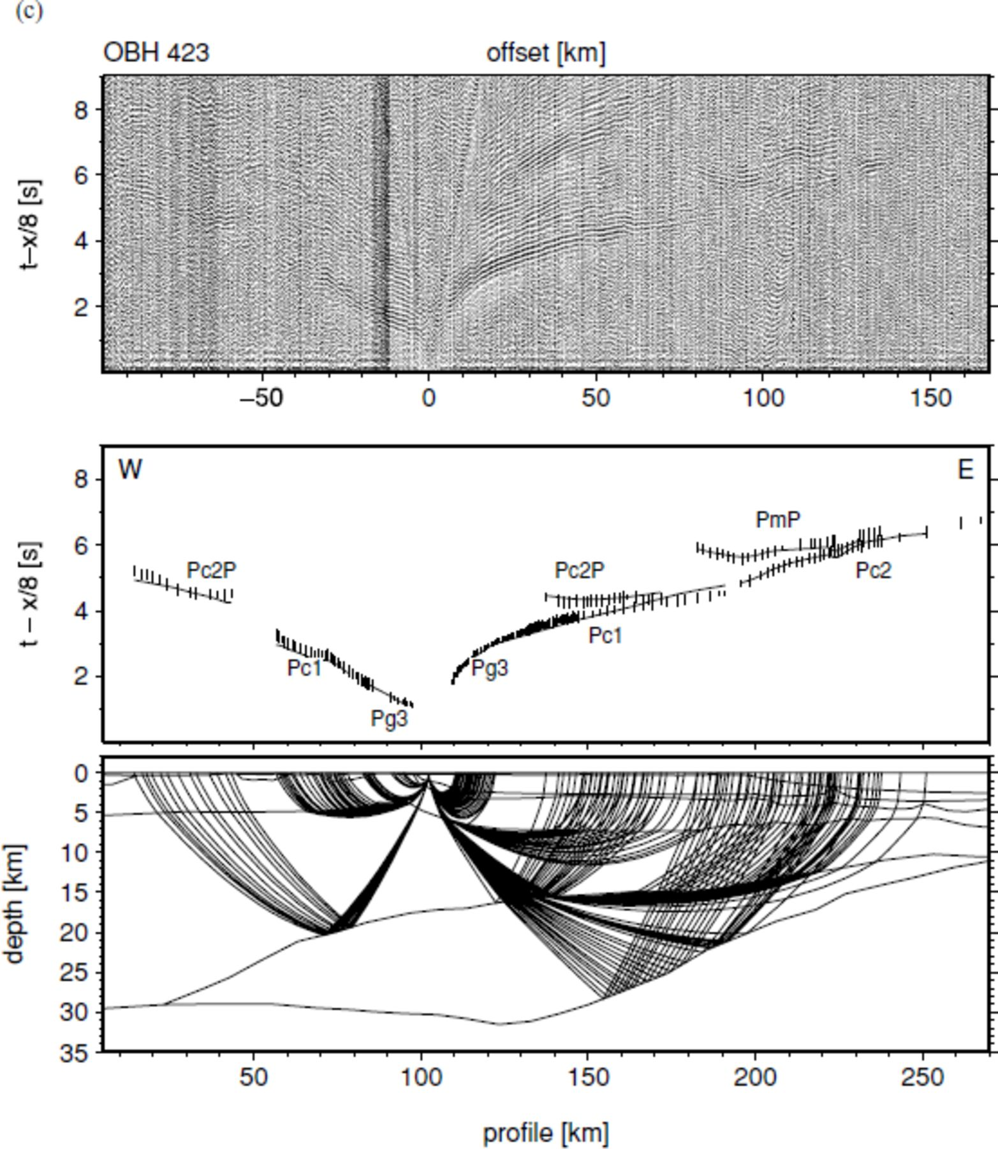
Figure 7. Examples of recorded seismic data from profile AWI-20030400. A 4.5–12 Hz bandpass filter was applied. The ...
Notes:
Figure 7. Examples of recorded seismic data from profile AWI-20030400. A 4.5–12 Hz bandpass filter was applied. The signals are scaled by automatic gain control in windows of 2 s. The traveltime is reduced by 8 km s−1. Observed phases are labelled (see Table 2). The ray coverage of each station is marked in the lower model. (a) Station 407 represents recordings of the oceanic crust and the eastern COT. Note the multiple reflected phase PmP′ and Pc2P′. (b) Station 415 is placed within the COT and shows typical shorter offsets. (c) OBH 423 is located near the landward termination of the COT. (d) Land station 431 shows typical long offsets. Note the poor quality of data between km 150 and 250. A filter of 4.5–21 Hz was here applied. The offset between the first arrivals and the location is due to the horizontal deviation of the station to the ship track.
Unless provided in the caption above, the following copyright applies to the content of this slide: © 2007 The Author Journal compilation © 2007 RAS

Slide 6
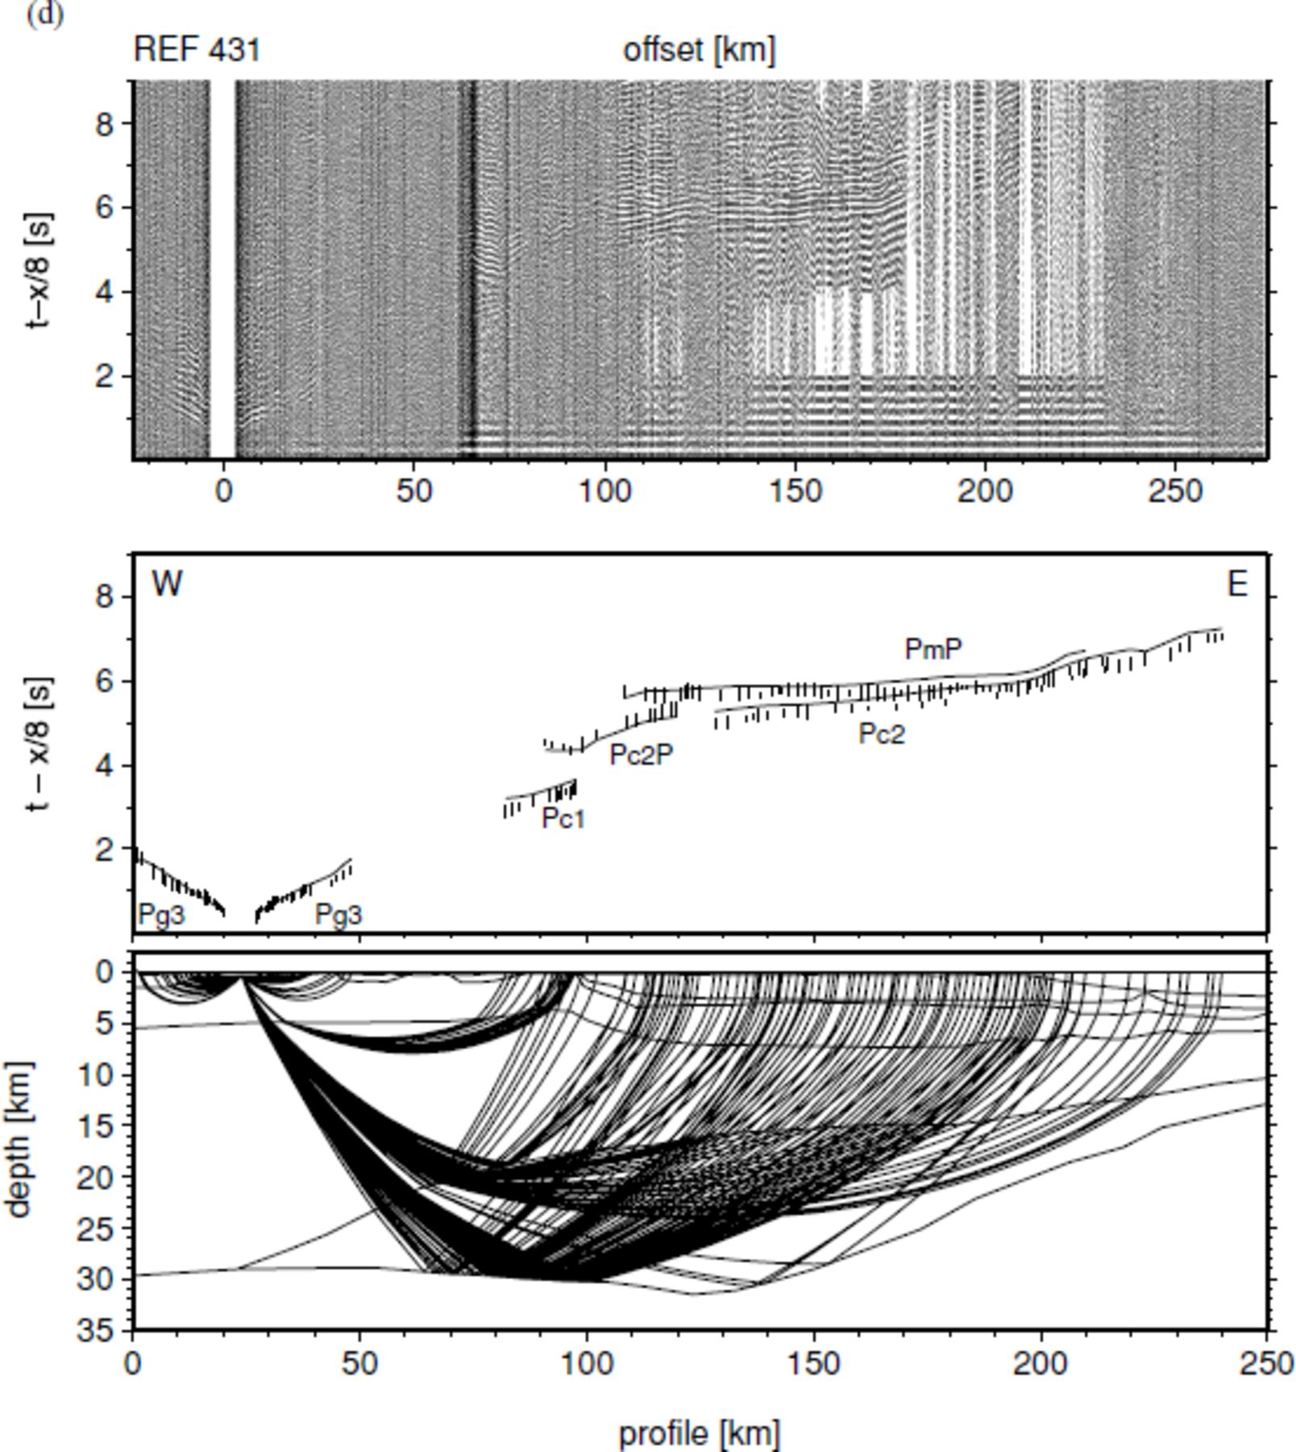
Figure 7. Examples of recorded seismic data from profile AWI-20030400. A 4.5–12 Hz bandpass filter was applied. The ...
Notes:
Figure 7. Examples of recorded seismic data from profile AWI-20030400. A 4.5–12 Hz bandpass filter was applied. The signals are scaled by automatic gain control in windows of 2 s. The traveltime is reduced by 8 km s−1. Observed phases are labelled (see Table 2). The ray coverage of each station is marked in the lower model. (a) Station 407 represents recordings of the oceanic crust and the eastern COT. Note the multiple reflected phase PmP′ and Pc2P′. (b) Station 415 is placed within the COT and shows typical shorter offsets. (c) OBH 423 is located near the landward termination of the COT. (d) Land station 431 shows typical long offsets. Note the poor quality of data between km 150 and 250. A filter of 4.5–21 Hz was here applied. The offset between the first arrivals and the location is due to the horizontal deviation of the station to the ship track.
Unless provided in the caption above, the following copyright applies to the content of this slide: © 2007 The Author Journal compilation © 2007 RAS

Slide 7
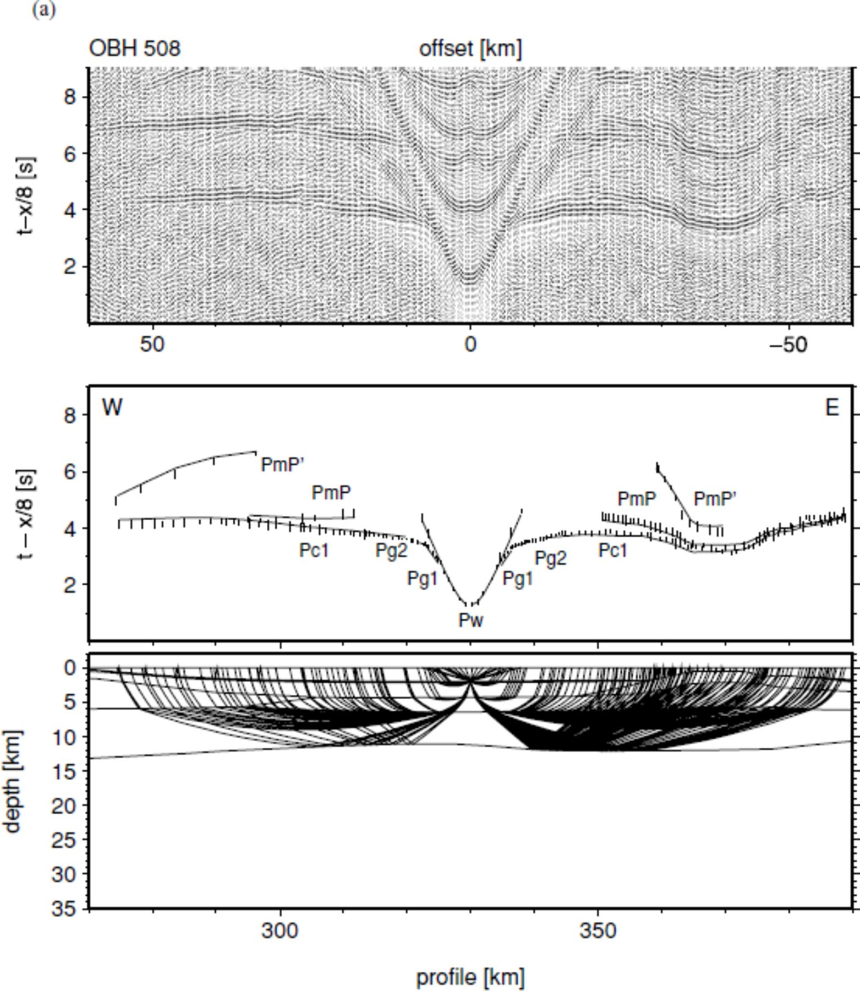
Figure 8. Examples of recorded seismic data from profile AWI-20030500. For data descriptions see Fig. 7. (a) OBH 508 ...
Notes:
Figure 8. Examples of recorded seismic data from profile AWI-20030500. For data descriptions see Fig. 7. (a) OBH 508 represents recordings of the oceanic basin west of the ridge and the eastern COT. Note the multiple reflected phase PmP′ near ±50 km. (b) OBH 518 shows delayed arrivals due to thick Cenozoic sediments within the COT. (c) OBH 529 is located at the landward termination of the COT. (d) Continental crust, LCB and the western part of the COT are covered by station REF 536.
Unless provided in the caption above, the following copyright applies to the content of this slide: © 2007 The Author Journal compilation © 2007 RAS

Slide 8
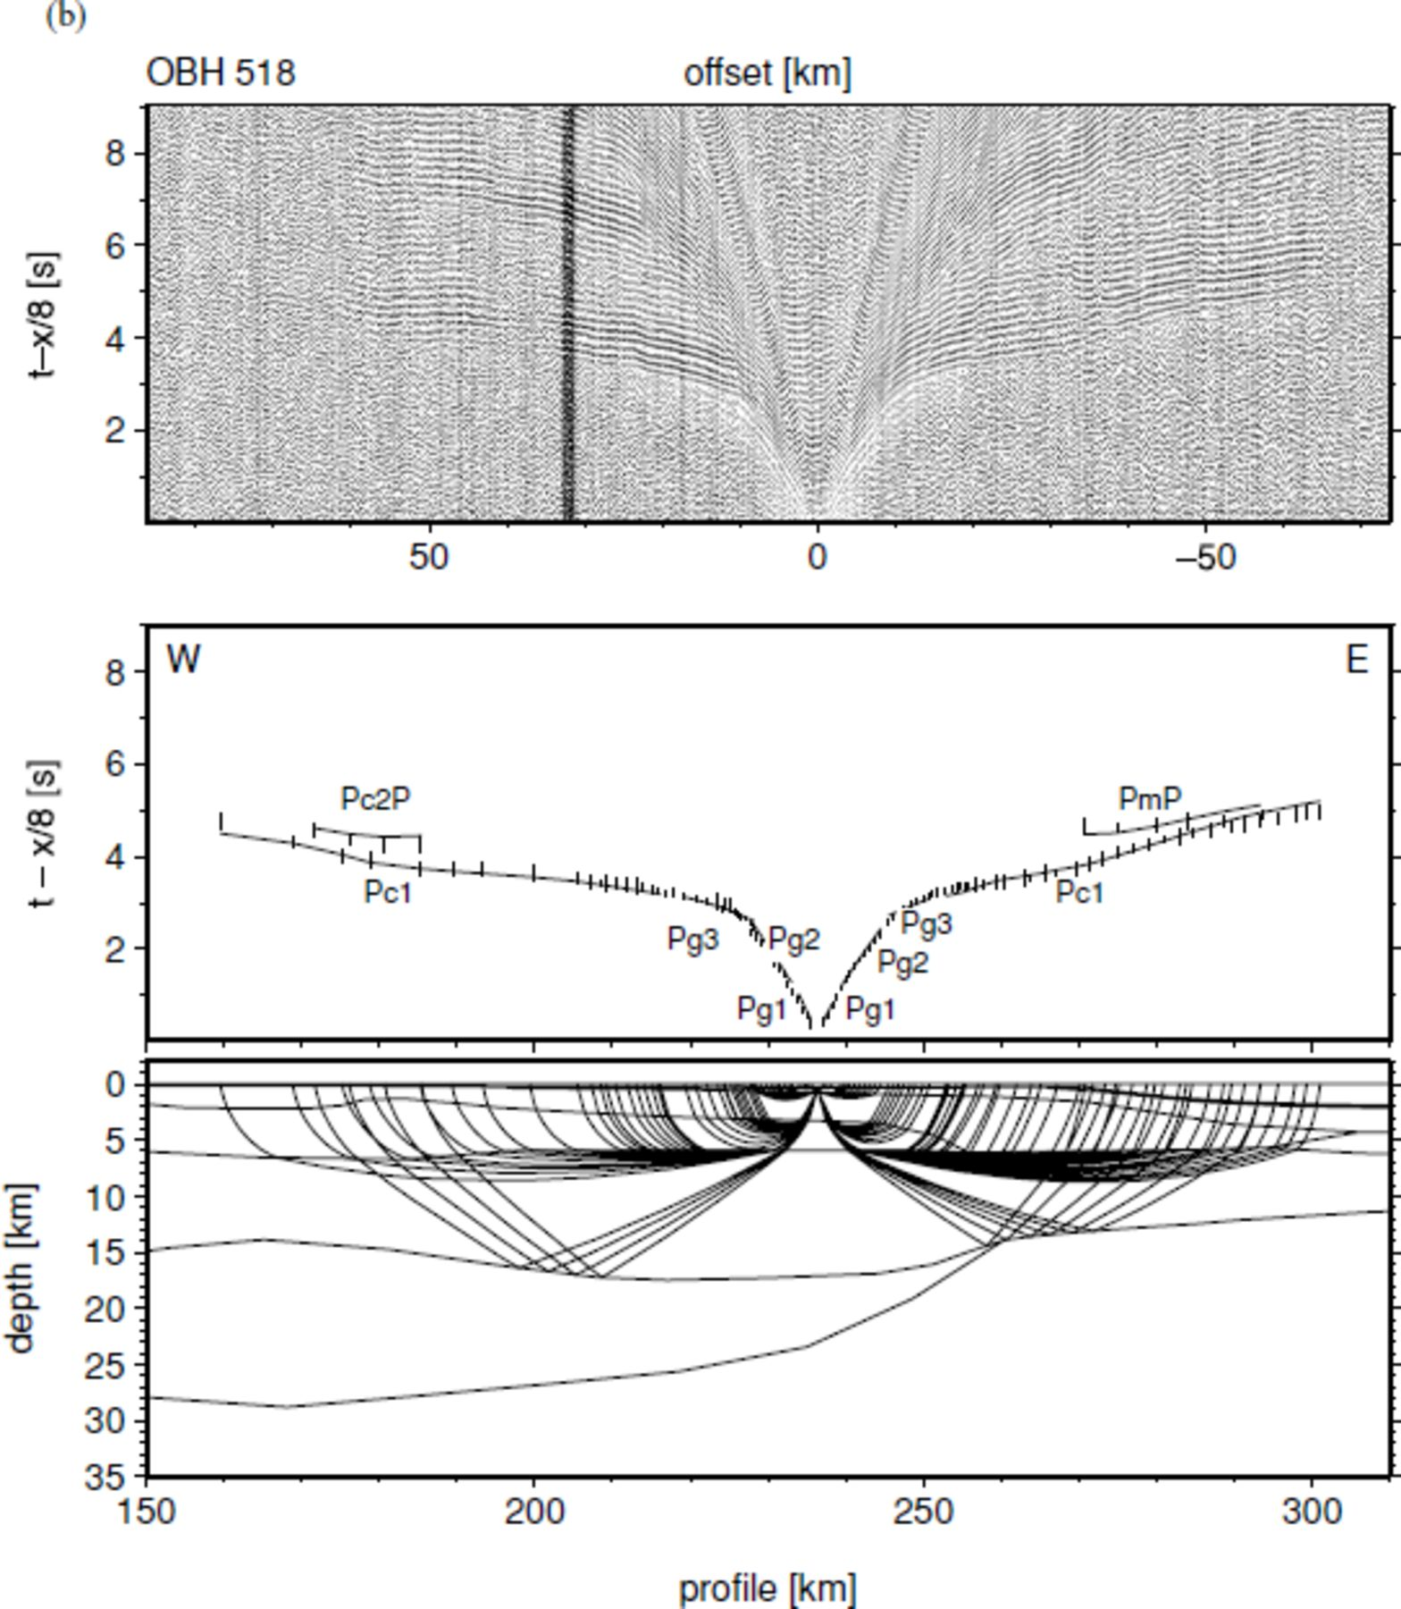
Figure 8. Examples of recorded seismic data from profile AWI-20030500. For data descriptions see Fig. 7. (a) OBH 508 ...
Notes:
Figure 8. Examples of recorded seismic data from profile AWI-20030500. For data descriptions see Fig. 7. (a) OBH 508 represents recordings of the oceanic basin west of the ridge and the eastern COT. Note the multiple reflected phase PmP′ near ±50 km. (b) OBH 518 shows delayed arrivals due to thick Cenozoic sediments within the COT. (c) OBH 529 is located at the landward termination of the COT. (d) Continental crust, LCB and the western part of the COT are covered by station REF 536.
Unless provided in the caption above, the following copyright applies to the content of this slide: © 2007 The Author Journal compilation © 2007 RAS

Slide 9
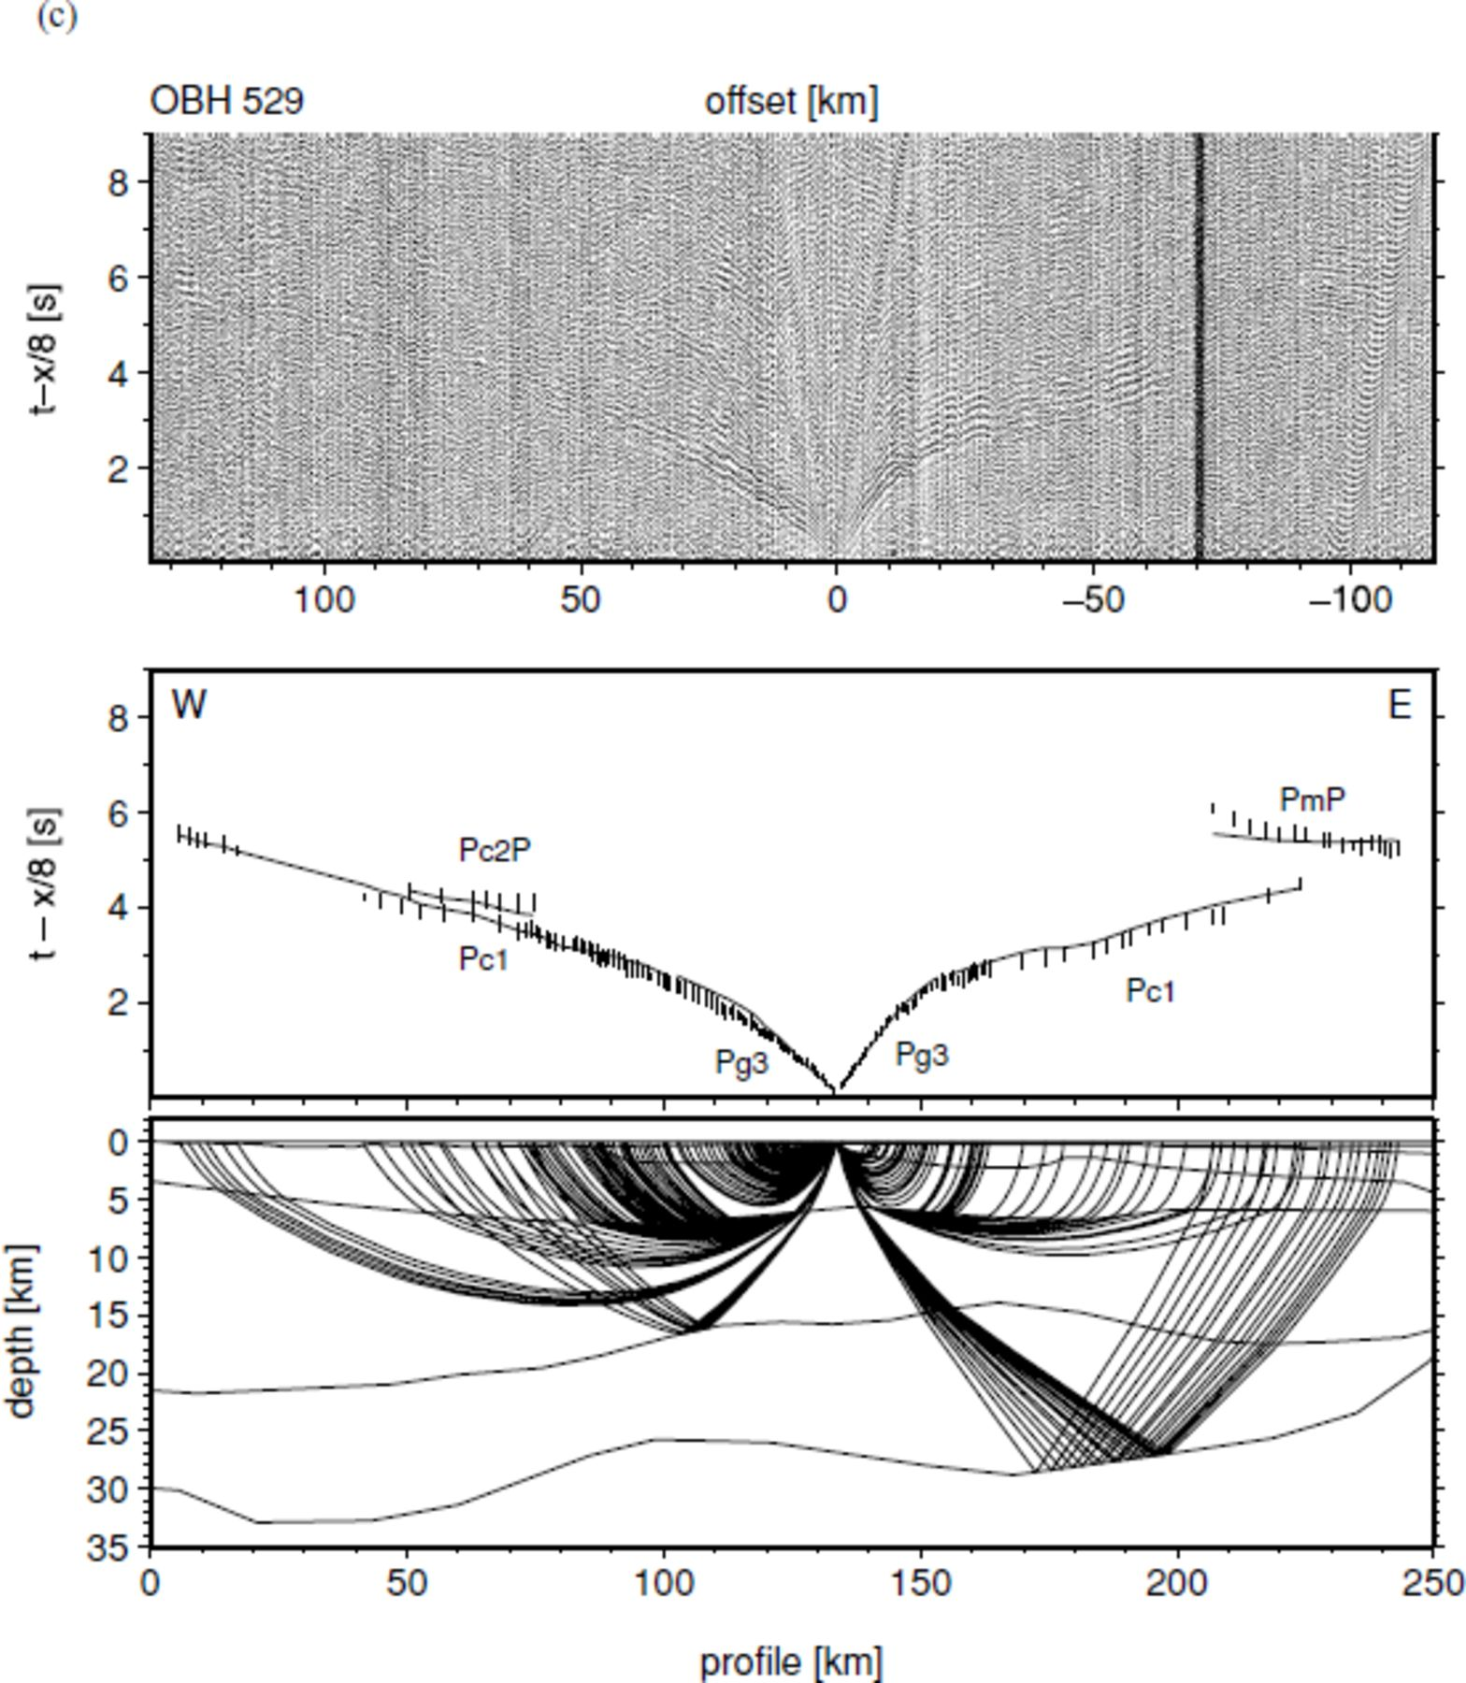
Figure 8. Examples of recorded seismic data from profile AWI-20030500. For data descriptions see Fig. 7. (a) OBH 508 ...
Notes:
Figure 8. Examples of recorded seismic data from profile AWI-20030500. For data descriptions see Fig. 7. (a) OBH 508 represents recordings of the oceanic basin west of the ridge and the eastern COT. Note the multiple reflected phase PmP′ near ±50 km. (b) OBH 518 shows delayed arrivals due to thick Cenozoic sediments within the COT. (c) OBH 529 is located at the landward termination of the COT. (d) Continental crust, LCB and the western part of the COT are covered by station REF 536.
Unless provided in the caption above, the following copyright applies to the content of this slide: © 2007 The Author Journal compilation © 2007 RAS

Slide 10
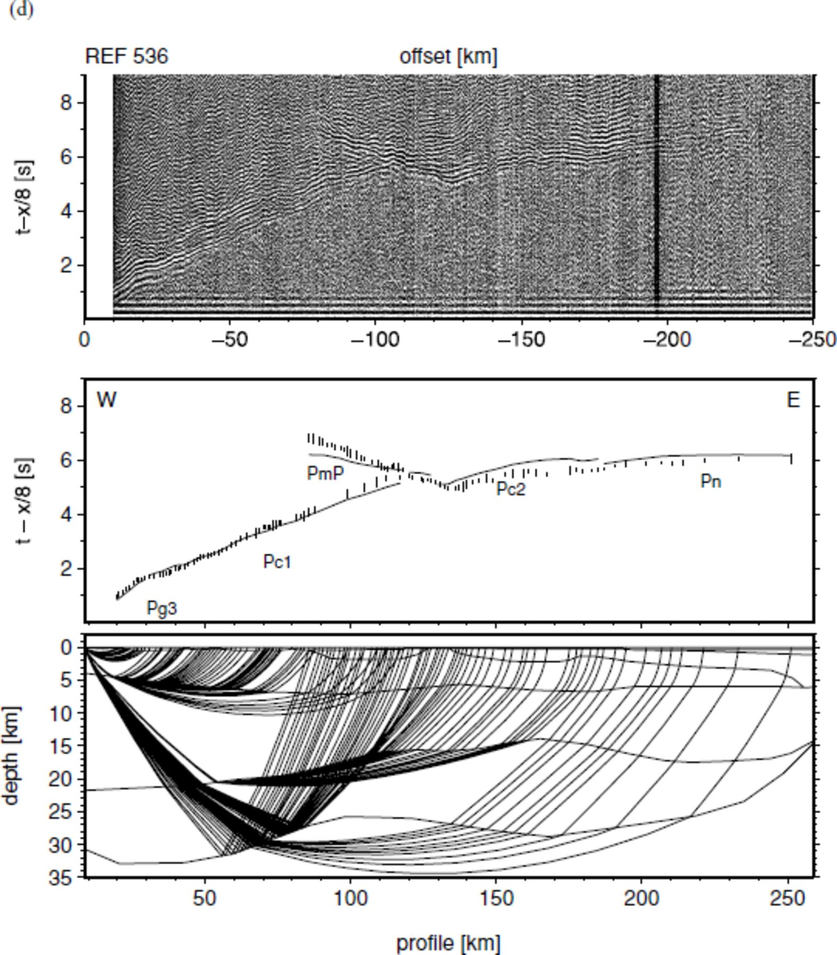
Figure 8. Examples of recorded seismic data from profile AWI-20030500. For data descriptions see Fig. 7. (a) OBH 508 ...
Notes:
Figure 8. Examples of recorded seismic data from profile AWI-20030500. For data descriptions see Fig. 7. (a) OBH 508 represents recordings of the oceanic basin west of the ridge and the eastern COT. Note the multiple reflected phase PmP′ near ±50 km. (b) OBH 518 shows delayed arrivals due to thick Cenozoic sediments within the COT. (c) OBH 529 is located at the landward termination of the COT. (d) Continental crust, LCB and the western part of the COT are covered by station REF 536.
Unless provided in the caption above, the following copyright applies to the content of this slide: © 2007 The Author Journal compilation © 2007 RAS

Slide 11
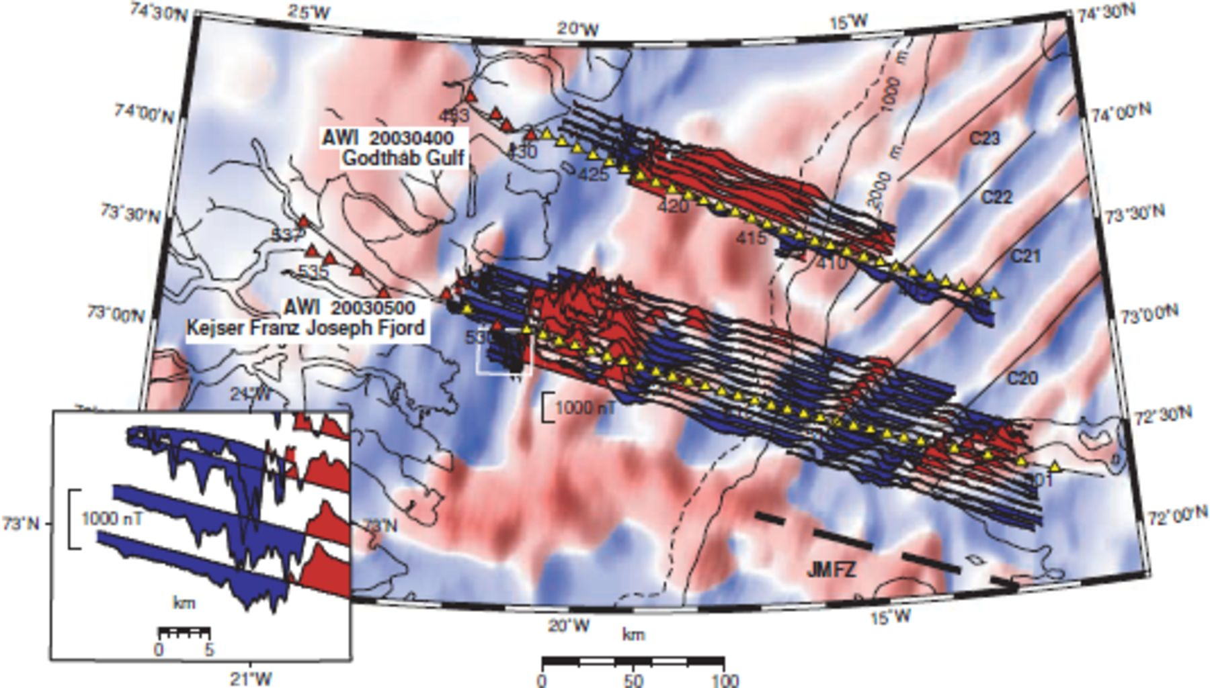
Figure 3. Wiggle plot along new magnetic survey traverse lines. See text for range of maximum values. Background shows ...
Notes:
Figure 3. Wiggle plot along new magnetic survey traverse lines. See text for range of maximum values. Background shows regional magnetic grid (Verhoef et al. 1996). Positive values are red, negative values are blue. Seismic profiles are shown as in Fig. 2. Spreading anomalies modified after Escher & Pulvertaft (1995). White box denotes portion of map depict in inset. Note the short wavelength magnetic variations within the pronounced negative magnetic anomaly. Scale is valid for 73°N.
Unless provided in the caption above, the following copyright applies to the content of this slide: © 2007 The Author Journal compilation © 2007 RAS

Slide 12
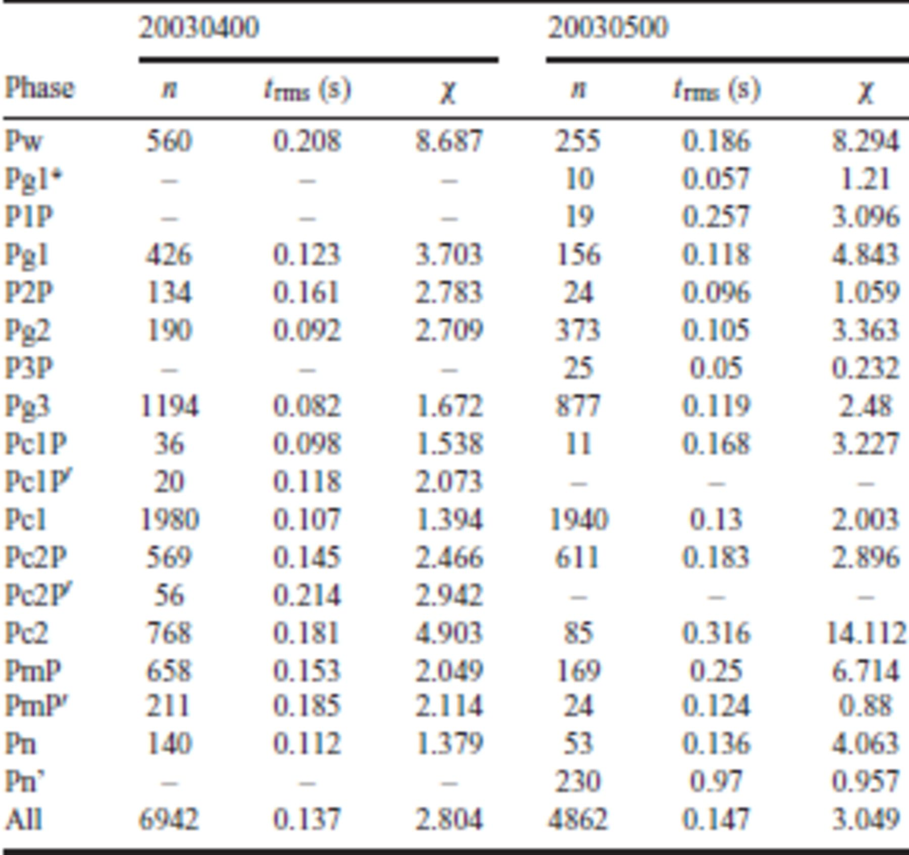
Table 1. Number of used observations (n), rms misfit between calculated and observed picked traveltimes ...
Notes:
Table 1. Number of used observations (n), rms misfit between calculated and observed picked traveltimes (trms) in seconds and normalized χ for individual phases of each profile. See Table 2 for phase nomenclature.
Unless provided in the caption above, the following copyright applies to the content of this slide: © 2007 The Author Journal compilation © 2007 RAS

Slide 13
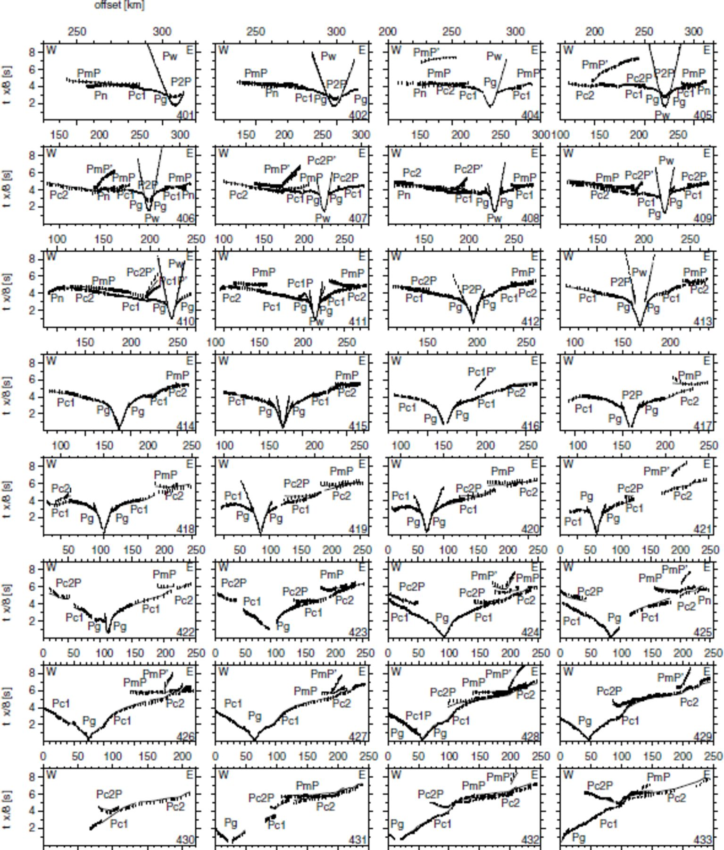
Figure 4. Observed and calculated P-wave arrivals for profile AWI-20030400. Observed arrivals are assigned with a ...
Notes:
Figure 4. Observed and calculated P-wave arrivals for profile AWI-20030400. Observed arrivals are assigned with a vertical error bar. The picked arrival time is in the centre. Lines show the calculated arrivals. Note the variety of PmP′ and Pc2P′ phases. See Table 2 for nomenclature of phases. Short offset phases are not differentiated and labelled as Pg.
Unless provided in the caption above, the following copyright applies to the content of this slide: © 2007 The Author Journal compilation © 2007 RAS

Slide 14
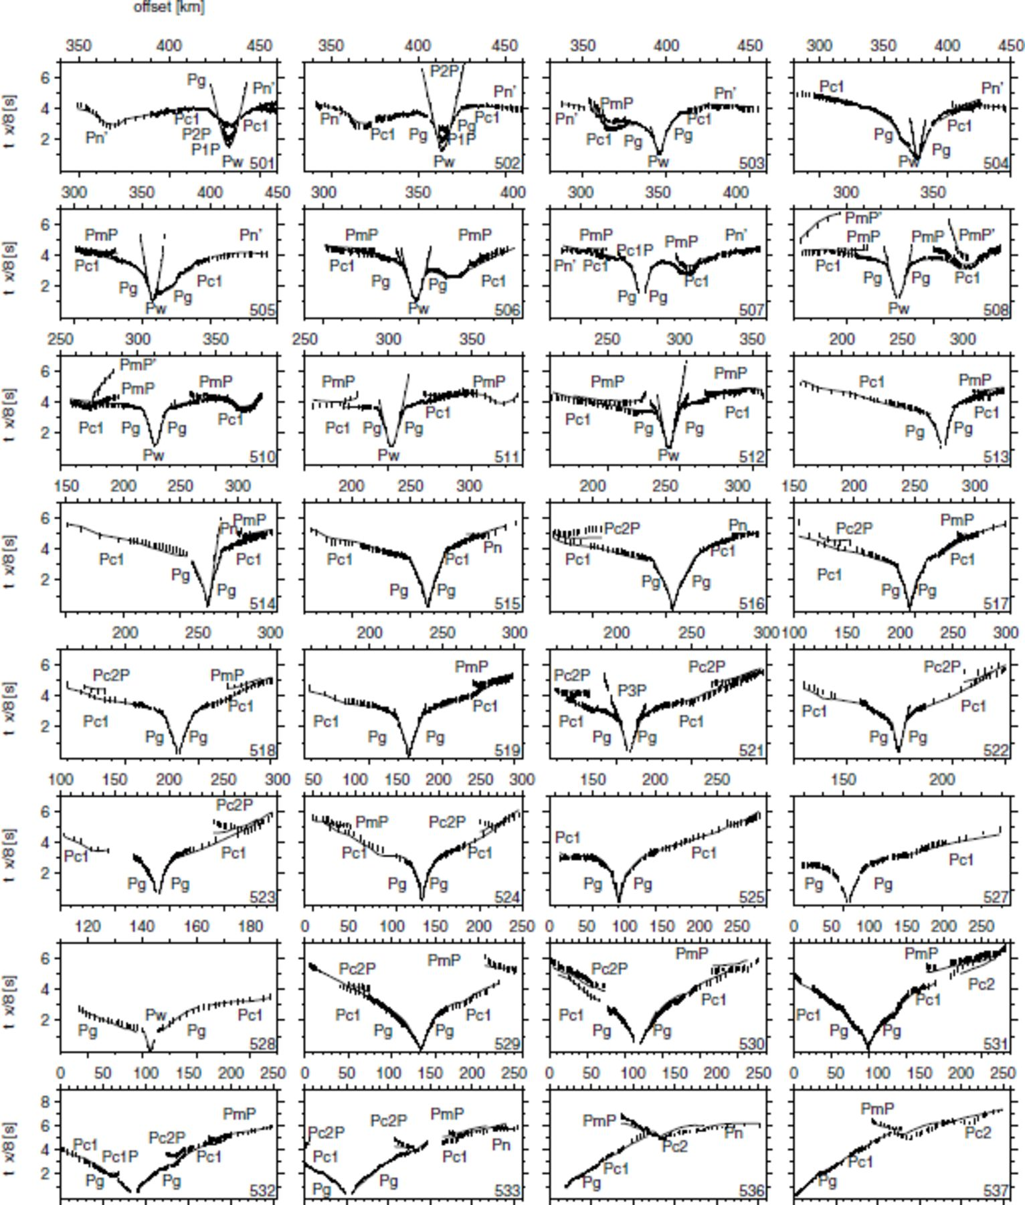
Figure 5. Observed and calculated P-wave arrivals for profile AWI-20030500. See Fig. 4 and Table 2 for explanations.
Notes:
Figure 5. Observed and calculated P-wave arrivals for profile AWI-20030500. See Fig. 4 and Table 2 for explanations.
Unless provided in the caption above, the following copyright applies to the content of this slide: © 2007 The Author Journal compilation © 2007 RAS

Slide 15
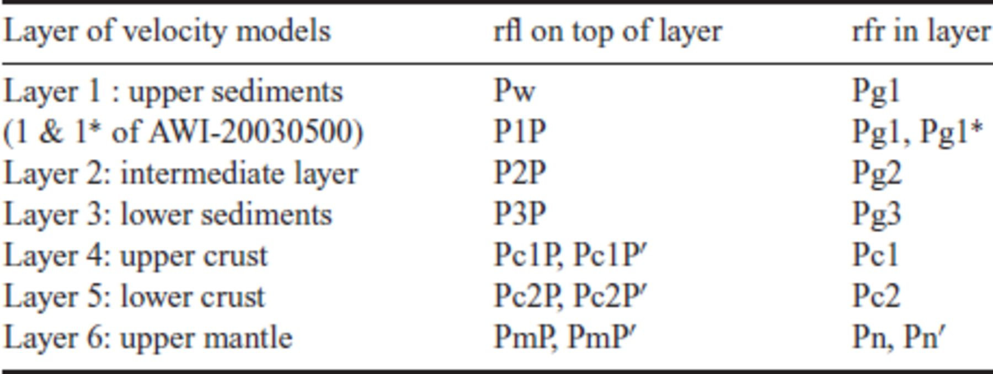
Table 2. Nomenclature of seismic phases.
Notes:
Table 2. Nomenclature of seismic phases.
Unless provided in the caption above, the following copyright applies to the content of this slide: © 2007 The Author Journal compilation © 2007 RAS

Slide 16
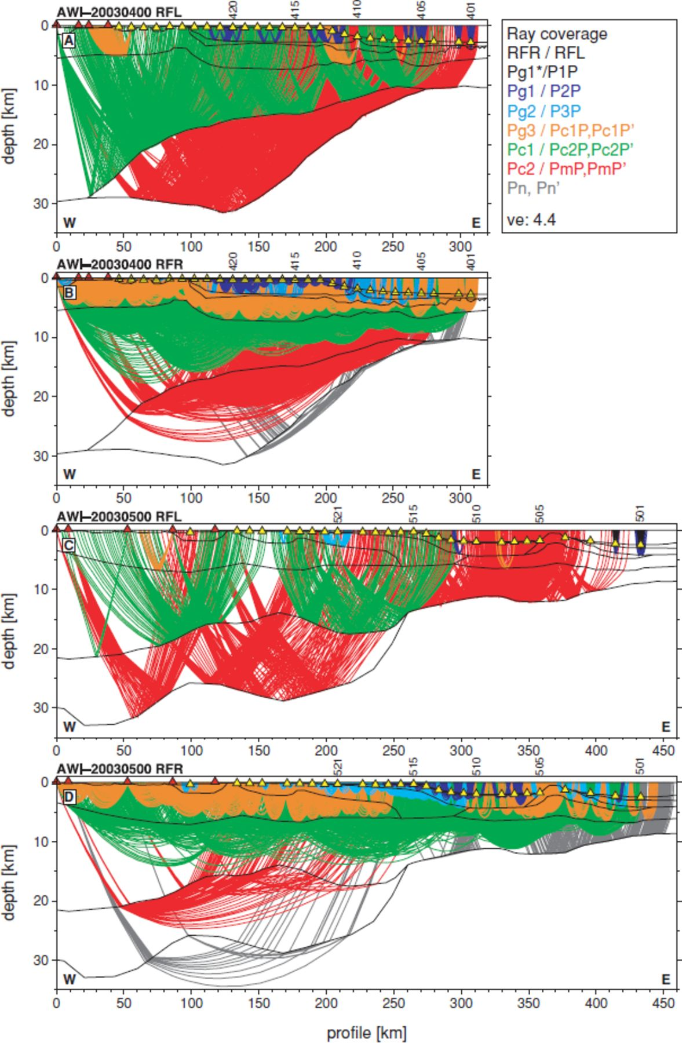
Figure 6. Ray tracing for both profiles. RFL: reflected rays. RFR: refracted rays. Vertical exaggeration is 4.4. ...
Notes:
Figure 6. Ray tracing for both profiles. RFL: reflected rays. RFR: refracted rays. Vertical exaggeration is 4.4. Triangles represent receiver station locations as in Fig. 2. The different colours symbolize the rays for the individual layers. See Table 2 for a further explanation of the phases. (A) All reflected rays for profile AWI-20030400. Note the excellent coverage of the intra crustal reflector and the Moho by Pc2P and PmP phases. From km 270 on Pc2P phases equal PmP phases. (B) All refracted rays for profile AWI-20030400. Only individual Pn phases traced the upper mantle. (C) All reflected rays for profile AWI-20030500. From km 260 on Pc2P equal PmP phases. (D) All refracted rays for AWI-20030500. See text for model parameters and velocities.
Unless provided in the caption above, the following copyright applies to the content of this slide: © 2007 The Author Journal compilation © 2007 RAS

Slide 17
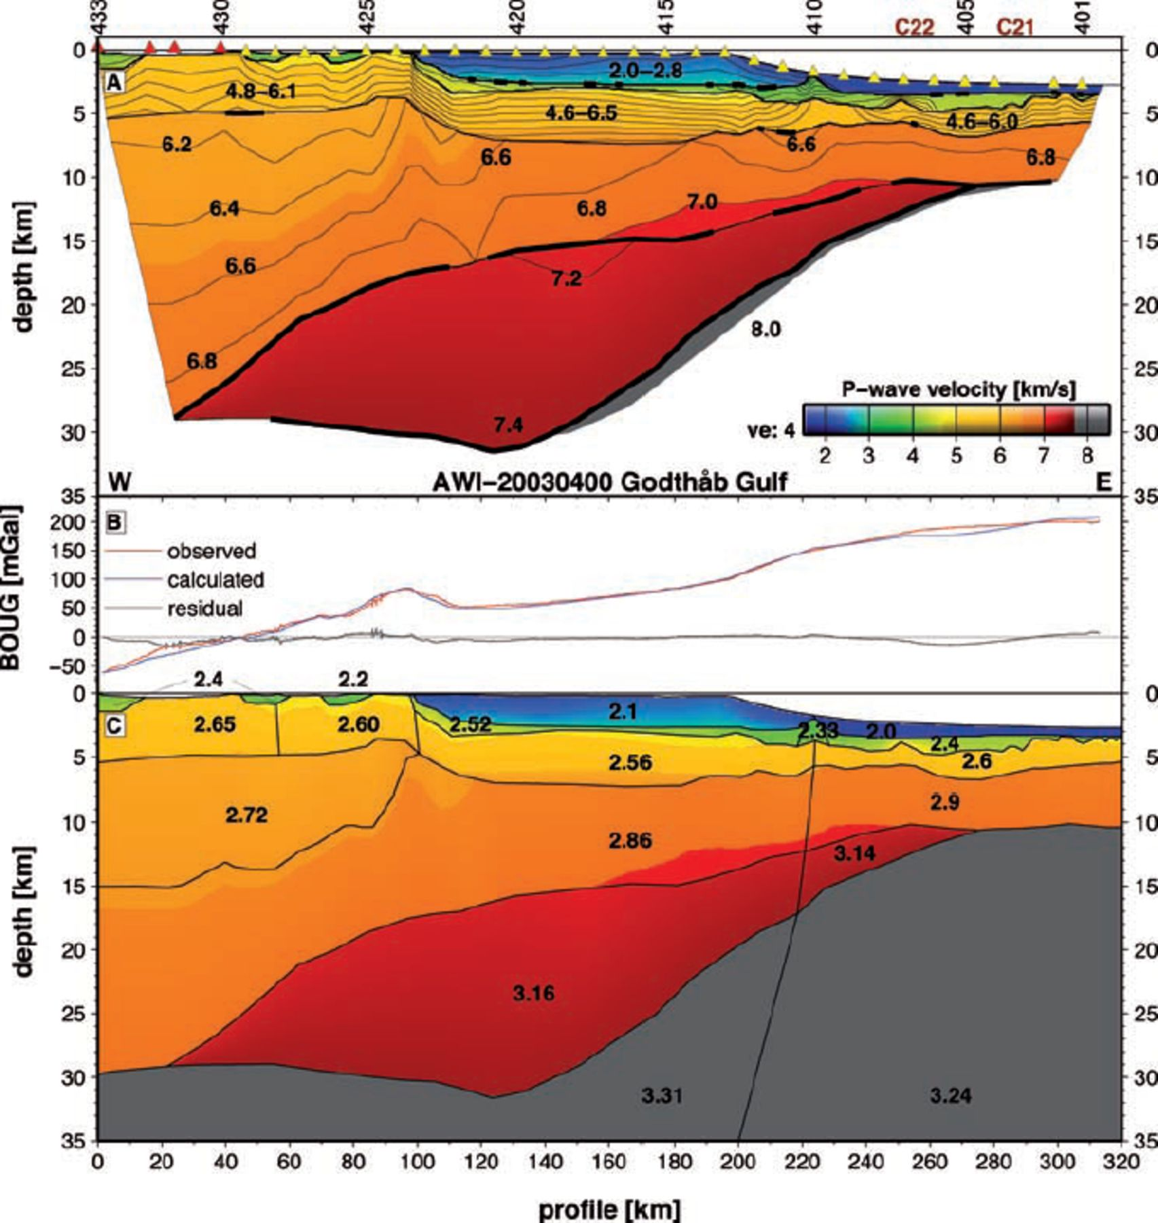
Figure 9. (A) Interpolated P-wave velocity model for profile AWI-20030400. Contour lines are from 1.6 to 7.4 km ...
Notes:
Figure 9. (A) Interpolated P-wave velocity model for profile AWI-20030400. Contour lines are from 1.6 to 7.4 km s−1 every 0.2 km s−1. Selected contours are individually labelled. Reflectors are marked by thick black lines. The minimum and maximum velocities are shown in the upper layers. See text for other areas with no velocities labelled. Triangles show receiver locations. C21 and C22 mark the position of magnetic ocean spreading anomalies (Fig. 3). Vertical exaggeration is 4 and comparable to Figs 10–12. The model is only shown where it is constrained by rays. (B) Observed and calculated Bouguer gravity anomalies given in mGal. Black line shows residuals. (C) 2-D gravity modelling for profile AWI-20030400. Background shows velocity grid as above. Black lines mark density polygons. Velocity layers were split into individual polygons where appropriate. P-wave velocities was converted to density using a formal approximation after Ludwig et al. (1970). Water was assigned with 2.67 g cm−3 and no terrain correction was applied within the fjord. Densities are given in g cm−3.
Unless provided in the caption above, the following copyright applies to the content of this slide: © 2007 The Author Journal compilation © 2007 RAS

Slide 18
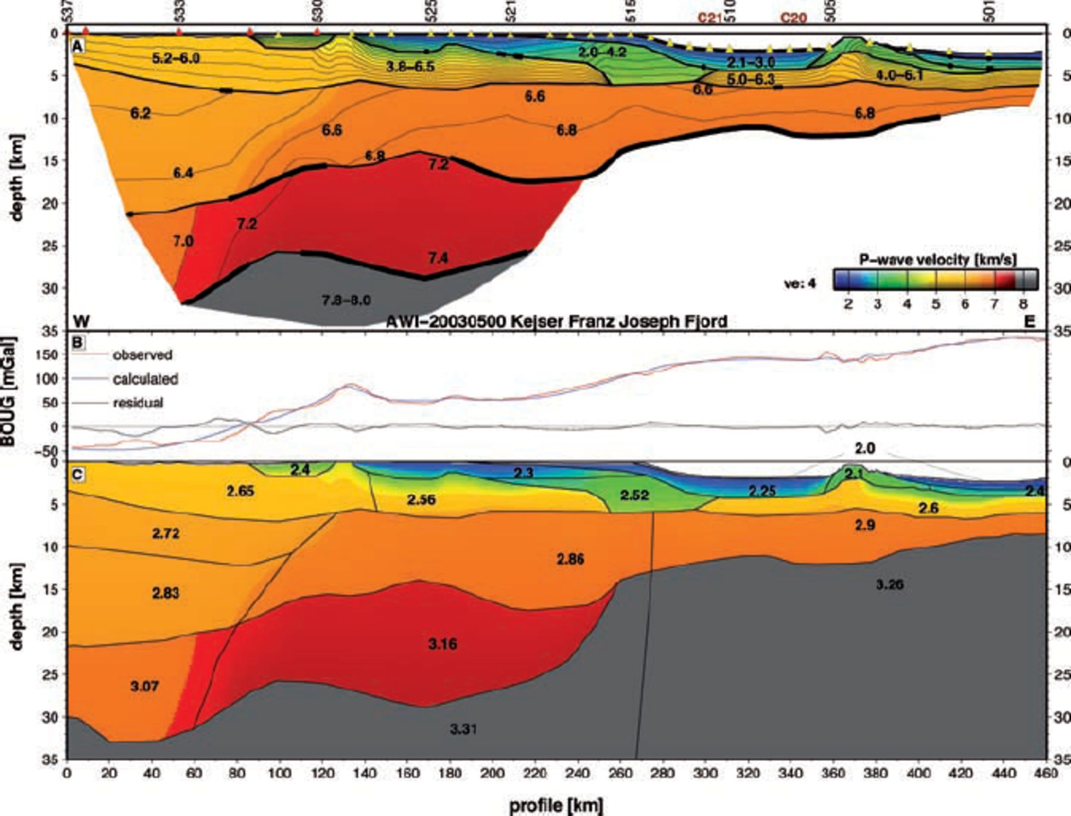
Figure 10. (A) Interpolated P-wave velocity model for profile AWI-20030500. Model descriptions are as in Fig. 9. C20 and ...
Notes:
Figure 10. (A) Interpolated P-wave velocity model for profile AWI-20030500. Model descriptions are as in Fig. 9. C20 and C21 mark position of magnetic ocean spreading anomalies. (B) Observed and calculated Bouguer gravity anomalies given in mGal. Black line shows residuals. (C) 2-D gravity modelling for profile AWI-20030500. Model descriptions are as in Fig. 9C.
Unless provided in the caption above, the following copyright applies to the content of this slide: © 2007 The Author Journal compilation © 2007 RAS

Slide 19
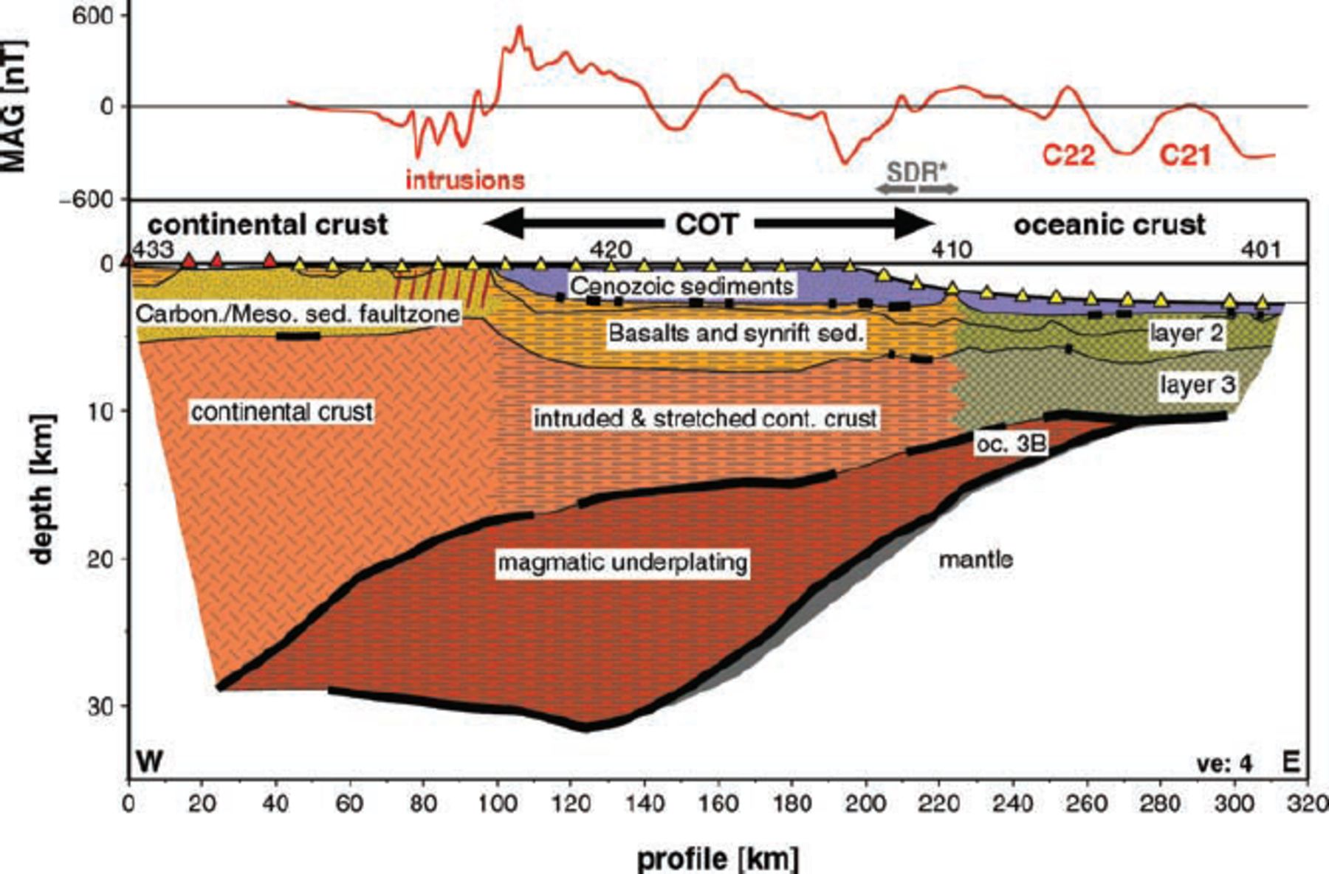
Figure 11. Bottom: Interpretation of the P-wave velocity model of profile AWI-20030400. Thick black lines mark ...
Notes:
Figure 11. Bottom: Interpretation of the P-wave velocity model of profile AWI-20030400. Thick black lines mark wide-angle reflections. Geological units are indicated. COT: continent-ocean transition zone. oc. 3B: oceanic layer 3B. SDR*: Projection of the area of seaward dipping reflectors from profile 46 after Hinz et al. (1987) (see text). Parallel red lines symbolize the location of shallow intrusions as seen in the magnetic data. Different geological units are marked by different patterns. Note the wide COT and the thick magmatic underplating. Top: red curve shows projected magnetic anomalies (MAG) along the seismic line. Data derived from 5 km magnetic grid (not shown) of the newly acquired airborne data. Note the high amplitude and short wavelength variations within the area of the pronounced negative magnetic anomaly (see Fig. 2). C22 and C21 mark magnetic ocean spreading anomalies.
Unless provided in the caption above, the following copyright applies to the content of this slide: © 2007 The Author Journal compilation © 2007 RAS

Slide 20
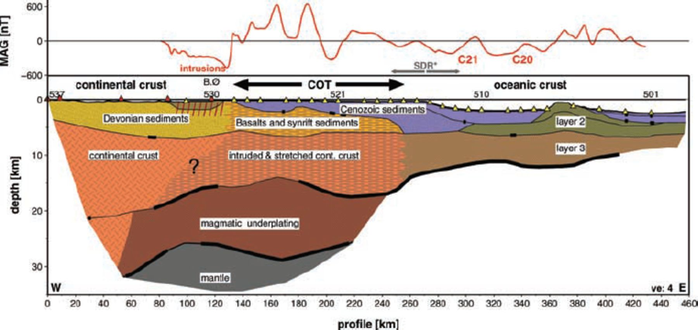
Figure 12. Interpretation of the P-wave velocity model of profile AWI-20030500. See Fig. 11 for descriptions. B.Ø: ...
Notes:
Figure 12. Interpretation of the P-wave velocity model of profile AWI-20030500. See Fig. 11 for descriptions. B.Ø: Bontekoe Ø. SDR*: Projection of the area of seaward dipping reflectors (see text) from profile 61 after Hinz et al. (1987). Large question-mark marks the questionable landward boundary of the COT within the crust due the lateral increase of seismic velocities (see Fig. 10).
Unless provided in the caption above, the following copyright applies to the content of this slide: © 2007 The Author Journal compilation © 2007 RAS

Slide 21
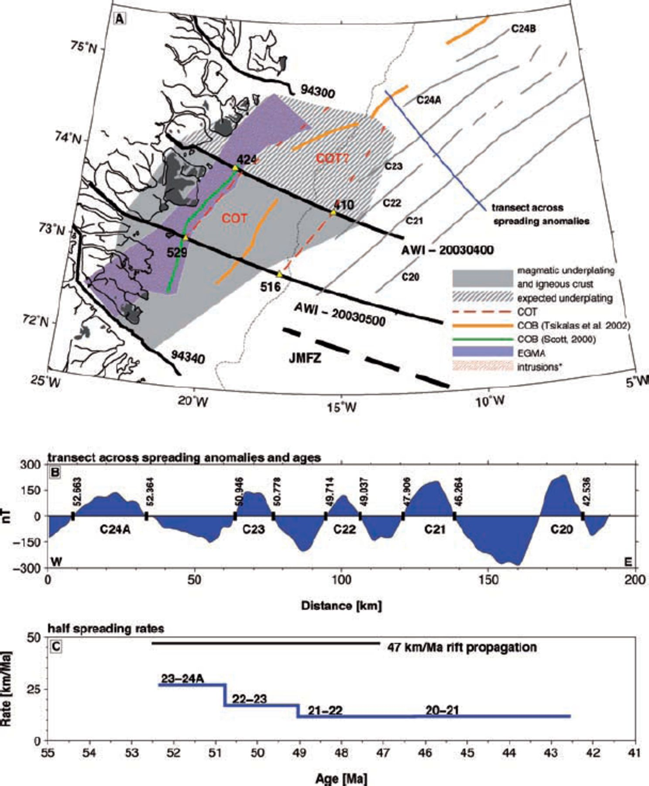
Figure 13. (A) Simplified summary of the structural results. COT: continent-ocean transition zone. COB: continent-ocean ...
Notes:
Figure 13. (A) Simplified summary of the structural results. COT: continent-ocean transition zone. COB: continent-ocean boundary. Intrusions*: Interpretation of crustal and sedimentary volcanic intrusions from short wavelength magnetic anomalies (see Fig. 3) interpolated along the negative magnetic anomaly (EGMA; East Greenland magnetic anomaly). Black lines show seismic profiles. Selected receiver locations are shown. Thin blue line shows the transect used to determine the half spreading rates (see below). Ocean spreading anomalies modified after Escher & Pulvertaft (1995) (extended to north). Black areas mark onshore basalts. (B) Magnetic wiggle along blue transect in Fig. 13A. Ages after Cande & Kent (1995). (C) Half spreading rates calculated for C24A-C21 are shown in blue. Black line shows average rift propagation velocity between C24A and C21 along their landward limits.
Unless provided in the caption above, the following copyright applies to the content of this slide: © 2007 The Author Journal compilation © 2007 RAS

Slide 22
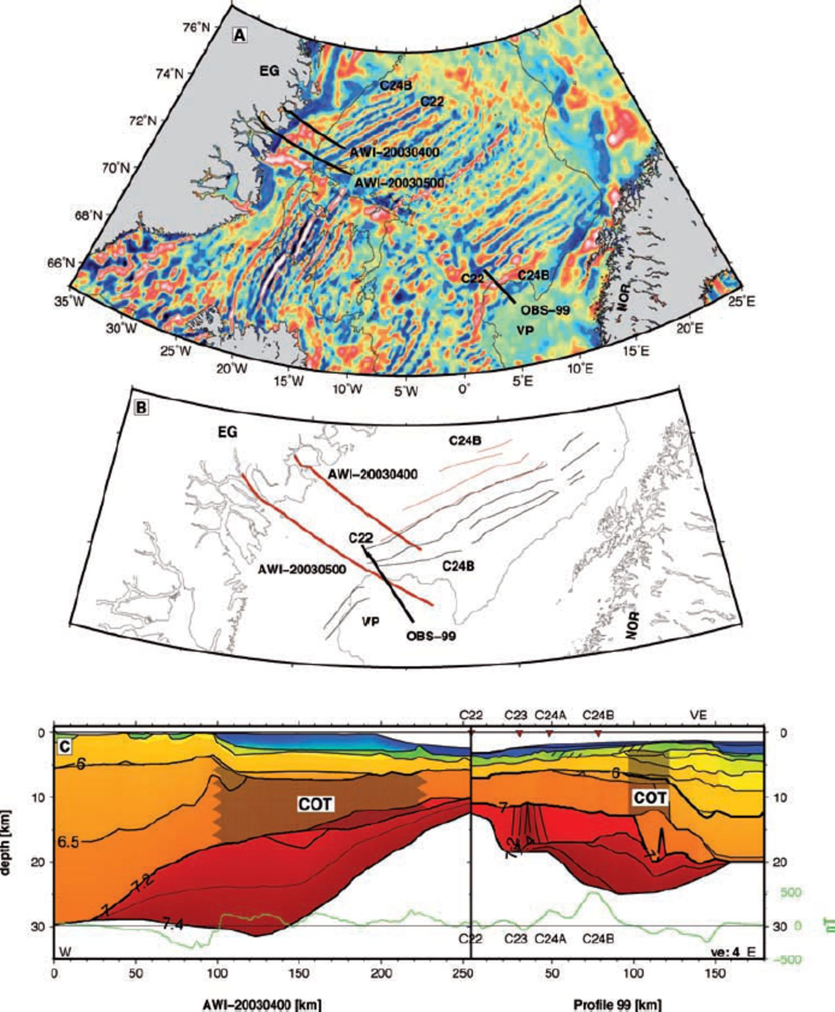
Figure 14. Comparison of the East Greenland profile AWI-20030400 and the Vøring Margin seismic profile OBS-99 after ...
Notes:
Figure 14. Comparison of the East Greenland profile AWI-20030400 and the Vøring Margin seismic profile OBS-99 after Mjelde et al. (2005). (A) Present-day location of seismic profiles shown as black lines. Background shows regional magnetic grid (Verhoef et al. 1996). White lines mark spreading anomalies. C22 and C24B are labelled. Thin black lines represent the 1500 m bathymetric contour. (B) 49.7 Ma (C22) reconstrucion after Rowley & Lottes (1988). Thick lines show seismic profiles. Thin red lines mark locations of western magnetic anomalies C24B-C22. Thin black lines mark eastern spreading anomalies. The present-day 1500 m contour is shown as reference. (C) Line-up of both P-wave velocity models in same scale (vertical exaggeration: 4). Colours equivalent to Fig. 9. Selected contour lines are shown and labelled (6.0, 6.5, 7.0, 7.2 and 7.4 km s−1). Shading marks the COTs. Green line shows regional magnetic data along the transects. Spreading anomalies are shown after Mjelde et al. (2005). Note the different occurrence of the anomalies on both sides. VE: Vøring Escarpment.
Unless provided in the caption above, the following copyright applies to the content of this slide: © 2007 The Author Journal compilation © 2007 RAS

Slide 23
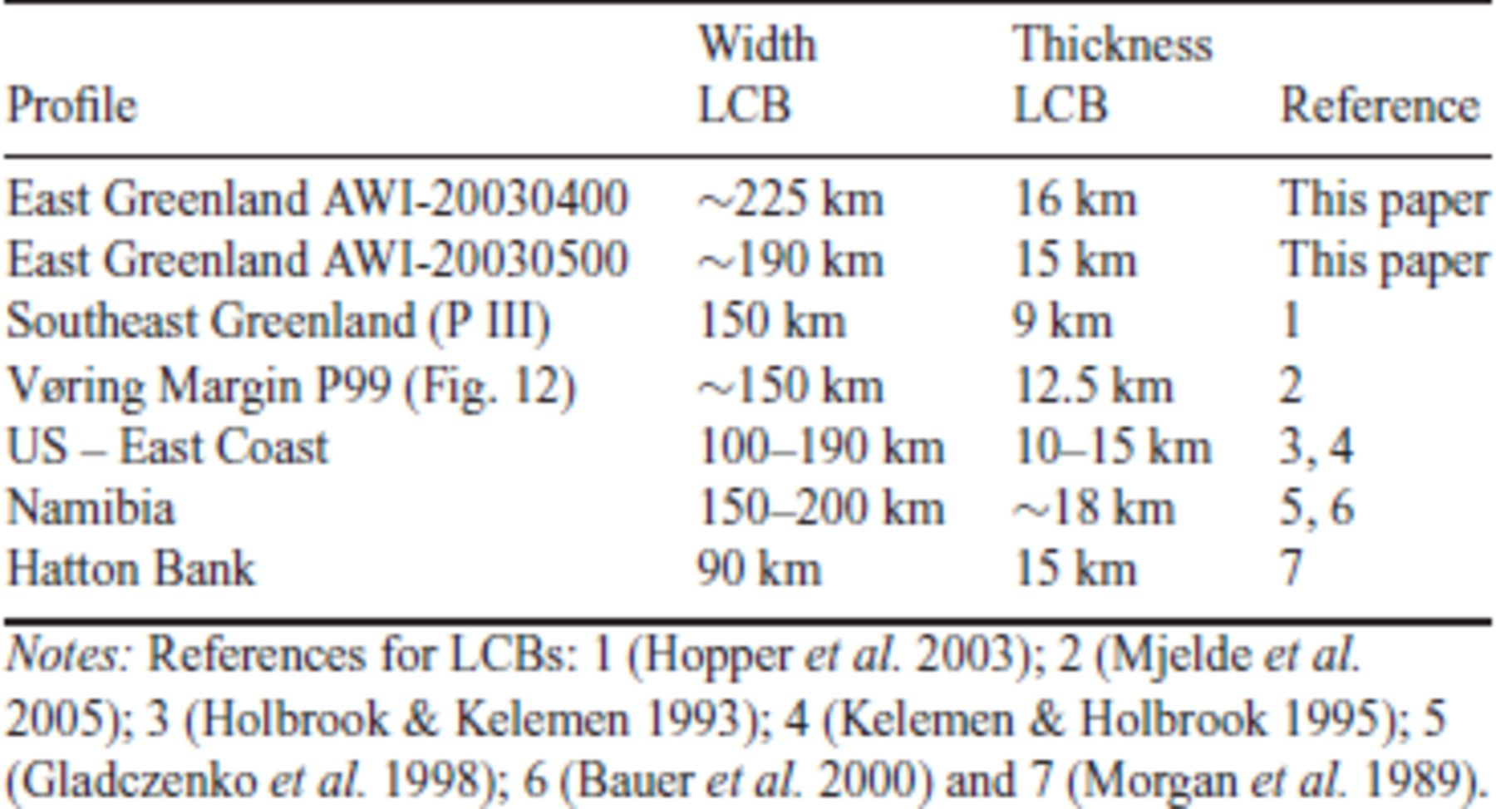
Table 3. Maximum widths and thicknesses of lower crustal bodies (LCB).
Notes:
Table 3. Maximum widths and thicknesses of lower crustal bodies (LCB).
Unless provided in the caption above, the following copyright applies to the content of this slide: © 2007 The Author Journal compilation © 2007 RAS

