Slide 1
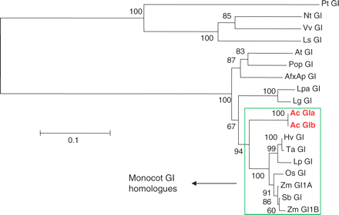
Fig. 1 Section of a neighbor–joining (NJ) tree showing the evolutionary relationships (based on amino acid ...
Notes:
Fig. 1 Section of a neighbor–joining (NJ) tree showing the evolutionary relationships (based on amino acid sequences) among GI homologs. Full-length and partial gene sequences were included in this analysis and numbers represent bootstrap values from 1,000 replicates. The tree was constructed using Clustal X (Thompson et al. 1997) and the bar indicates 0.1 substitutions per site. Accession numbers: PtGI (Pinus taeda), TC105492; NtGI (Nicotiana tabacum), DV162002; VvGI (Vitis vinifera), TC75660; LsGI (Lactuca sativa), TC27622; AtGI (Arabidopsis thaliana), NM_102124; Pop GI (Populus), TC124305; AfxAp GI (Aquilegia formosa × pubescens), TC20877; Lpa GI (Lemna paucicostata), AB210843; Lg GI (Lemna gibba), AB210848; Ac GIa (Allium cepa), GC232756; Ac GIb, GC232757; Hv GI (Hordeum vulgare), AY740523; Ta GI (Triticum aestivum), AF543844; Lp (Lolium perenne), DQ534010; Os GI (Oryza sativa), NM_001048755; Zm GI1A (Zea mays), BK006299; Zm GI1B: BK006298; Sb GI (Sorghum bicolor), TC113678. TC numbers refer to unigenes made up of ESTs held by the Dana-Farber Cancer Institute (http://compbio.dfci .harvard.edu/tgi/).
Unless provided in the caption above, the following copyright applies to the content of this slide: © The Author 2010. Published by Oxford University Press on behalf of Japanese Society of Plant Physiologists. All rights reserved. For permissions, please email: journals.permissions@oxfordjournals.org

Slide 2
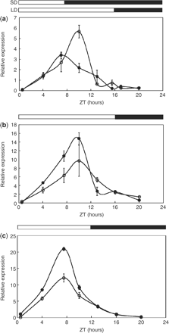
Fig. 2 Average expression of AcGI over 24 h in onion leaves. (a) LD (open circles) and SD (filled circles) ...
Notes:
Fig. 2 Average expression of AcGI over 24 h in onion leaves. (a) LD (open circles) and SD (filled circles) expression in Renate F1 (LD variety), relative to EF1α. (b) LD expression in Agrifound Dark (SD variety, open circles) and Candy F1 (ID variety, filled circles), relative to β-tubulin. (c) SD expression in Agrifound Dark (open circles) and Candy F1 (filled circles), relative to β-tubulin. Error bars represent the SEM of six replicates. White and black bars represent light/dark cycles.
Unless provided in the caption above, the following copyright applies to the content of this slide: © The Author 2010. Published by Oxford University Press on behalf of Japanese Society of Plant Physiologists. All rights reserved. For permissions, please email: journals.permissions@oxfordjournals.org

Slide 3
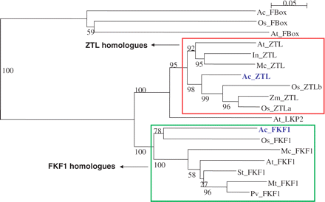
Fig. 3 Neighbor–joining (NJ) tree showing the evolutionary relationships (based on amino acid sequences) between ...
Notes:
Fig. 3 Neighbor–joining (NJ) tree showing the evolutionary relationships (based on amino acid sequences) between members of the FKF1/ZTL gene family. The tree was constructed using Clustal X (Thompson et al. 1997) and is rooted through a clade containing other F-box genes. Numbers represent bootstrap values from 1,000 replicates and the bar indicates 0.05 substitutions per site. Accession numbers: Ac_FBox (Allium cepa), GQ232752; Os_FBox (Oryza sativa), NM_001067833; At_FBox (Arabidopsis thaliana), NM_104033; At_ZTL, NM_105475; In_ZTL (Impomoea nil), DQ309278; Mc_ZTL (Mesembryanthemum crystallinum), AY371291; Ac_ZTL, GQ232755; Os_ZTLa, NM_001064973; Os_ZTLb, AK111850; Zm_ZTL (Zea mays), AY104996; At_LKP2, NM_179652; Ac_FKF1, GQ232754; Os_FKF, NM_001074600; Mc_FKF1, AY371291; At_FKF1, NM_105475; St_FKF1 (Solanum tuberosum), DR751881; Mt_FKF1 (Medicago truncatula), TC130448; Pv_FKF1 (Phaseolus vulgaris), EF643234. TC numbers refer to unigenes made up of ESTs held by the Dana-Farber Cancer Institute (http://compbio.dfci.harvard.edu/tgi/).
Unless provided in the caption above, the following copyright applies to the content of this slide: © The Author 2010. Published by Oxford University Press on behalf of Japanese Society of Plant Physiologists. All rights reserved. For permissions, please email: journals.permissions@oxfordjournals.org

Slide 4
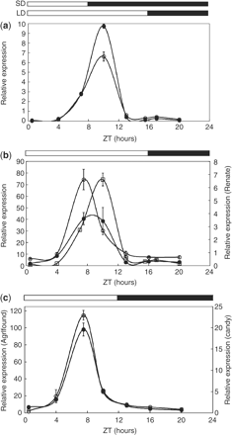
Fig. 4 Average expression of AcFKF1 over 24 h in onion leaves, relative to β-tubulin. (a) LD (open circles) and SD ...
Notes:
Fig. 4 Average expression of AcFKF1 over 24 h in onion leaves, relative to β-tubulin. (a) LD (open circles) and SD (filled circles) expression in Renate F1 (LD variety). (b) LD expression in Agrifound Dark (SD variety, open circles) and Candy F1 (ID variety, filled circles) compared with Renate F1 (open squares). (c) SD expression in Agrifound Dark (open circles) and Candy F1 (filled circles). Error bars represent the SEM of six replicates. White and black bars represent light/dark cycles.
Unless provided in the caption above, the following copyright applies to the content of this slide: © The Author 2010. Published by Oxford University Press on behalf of Japanese Society of Plant Physiologists. All rights reserved. For permissions, please email: journals.permissions@oxfordjournals.org

Slide 5
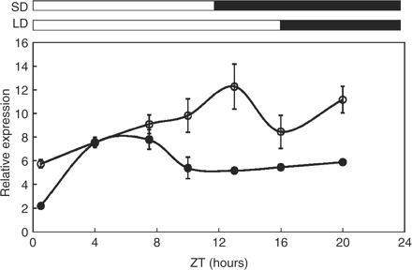
Fig. 5 Average 24 h expression of AcZTL in the leaves of Agrifound Dark (SD variety) in LD (open circles) and SD ...
Notes:
Fig. 5 Average 24 h expression of AcZTL in the leaves of Agrifound Dark (SD variety) in LD (open circles) and SD (filled circles) conditions relative to β-tubulin. Error bars represent the SEM of six replicates. White and black bars denote light/dark cycles.
Unless provided in the caption above, the following copyright applies to the content of this slide: © The Author 2010. Published by Oxford University Press on behalf of Japanese Society of Plant Physiologists. All rights reserved. For permissions, please email: journals.permissions@oxfordjournals.org

