Slide 1
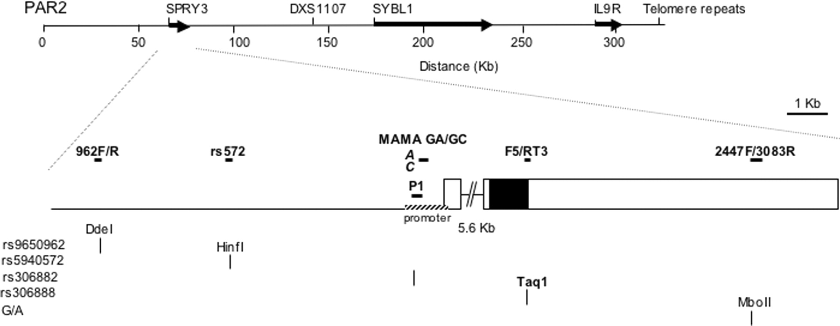
Figure 1. Map of PAR2 region. Position of the genes identified, represented as black bold arrows, is reported ...
Notes:
Figure 1. Map of PAR2 region. Position of the genes identified, represented as black bold arrows, is reported in a total length of 330 kb. SYBL1 and SPRY3 genes are separated by ~99 kb. A magnification of SPRY3 gene is shown. Patterned and large black bars indicate the promoter and the coding region, respectively, and horizontal and vertical lines represent primer pairs used and SNPs, respectively. Shown also is the polymorphic site, where specific MAMA primers are located in the promoter region, and RFLPs used for ChIP analysis.
Unless provided in the caption above, the following copyright applies to the content of this slide: © The Author 2006. Published by Oxford University Press. All rights reserved. For Permissions, please email: journals.permissions@oxfordjournals.org

Slide 2
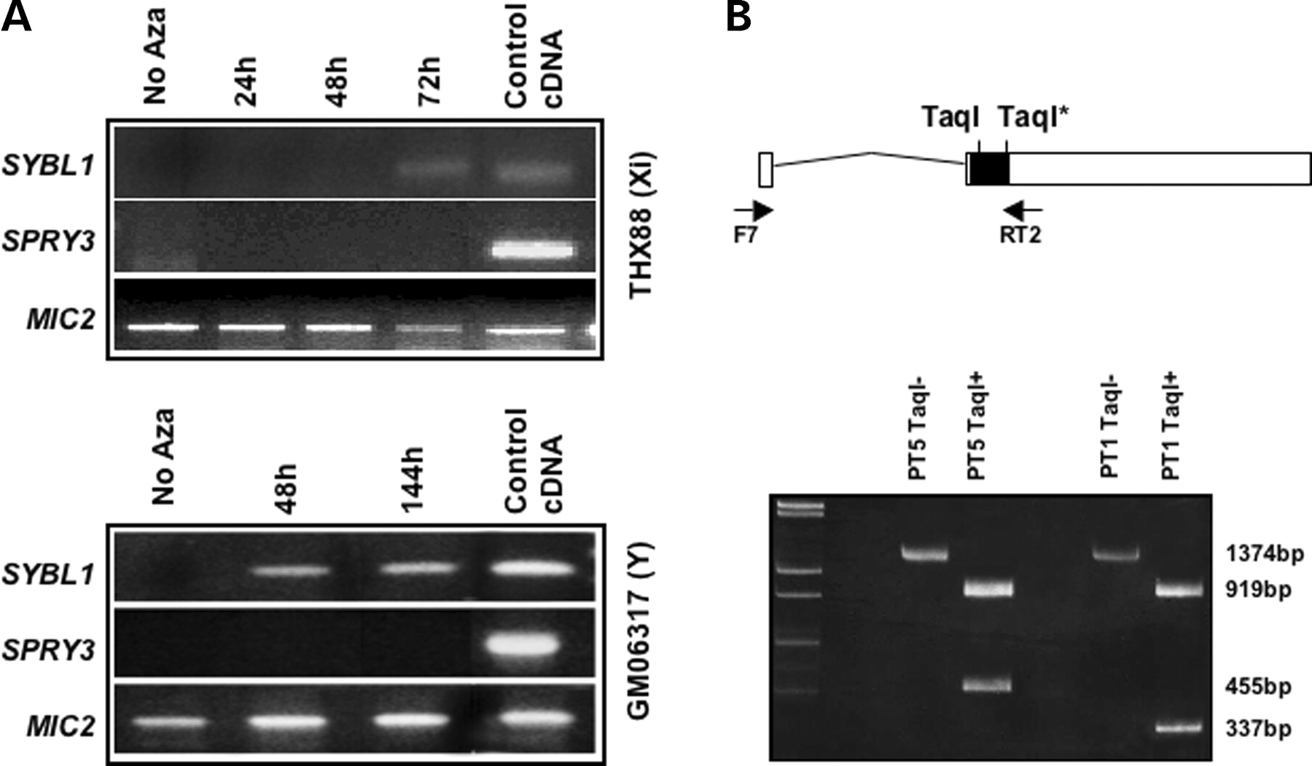
Figure 2. Reactivation of SPRY3. (A) Effect of 5aCdr treatment, which reactivates SYBL1, does not reactivate ...
Notes:
Figure 2. Reactivation of SPRY3. (A) Effect of 5aCdr treatment, which reactivates SYBL1, does not reactivate SPRY3 expression in inactive X (Xi) and Y hybrids. MIC2 expression has been used as control. Hours of treatment are indicated. (B) SPRY3 does not escape from silencing in ICF cells. Allele-specific expression analysis by RT–PCR in lymphoblastoid cells from two ICF patients (PT5 and PT1) heterozygous for TaqI RFLP. The product of the primers F7/RT2, 1374 bp in length, was digested with TaqI endonuclease, which cuts in two different positions, giving a 919 bp fragment in all samples and a 455 bp fragment that will be cleaved into 337 and 118 bp fragments in the allele with the polymorphic restriction site (see the map for details).
Unless provided in the caption above, the following copyright applies to the content of this slide: © The Author 2006. Published by Oxford University Press. All rights reserved. For Permissions, please email: journals.permissions@oxfordjournals.org

Slide 3
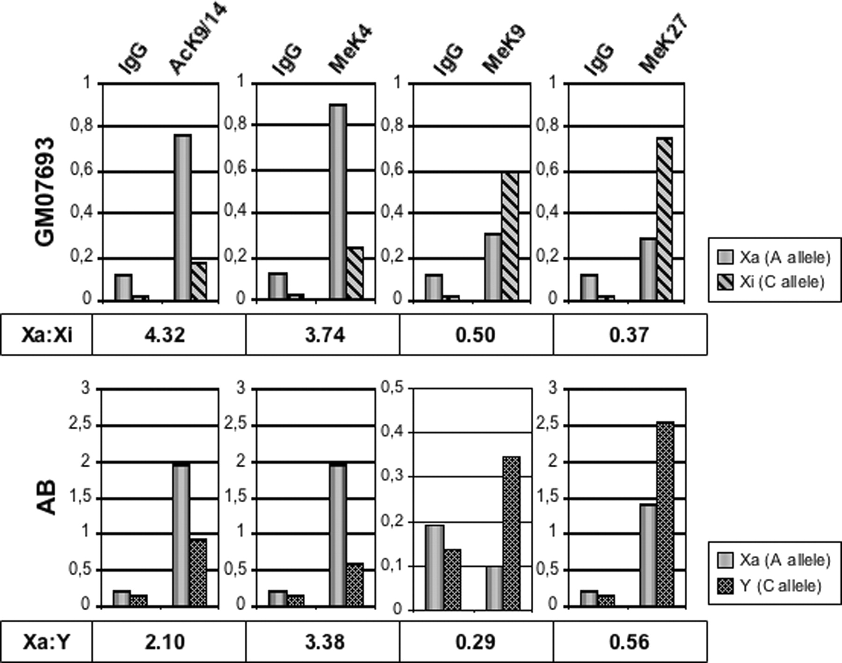
Figure 3. Different histone modifications mark Xi/Y alleles repression and Xa allele expression. ...
Notes:
Figure 3. Different histone modifications mark Xi/Y alleles repression and Xa allele expression. Allele-specific semi-quantitative PCR of the promoter region (MAMA GA/GC) was performed after chromatin immunoprecipitation on lymphoblastoid cell line AB (male) and GM07693 (skewed female fibroblast). Following electrophoretic separation of bands, the relative IP and input intensities of allele-specific bands were quantified. The relative level of immunoprecipitation is presented in the bar graph as a fraction of the input, obtained by dividing averaged values of the precipitated material by the averaged values of the corresponding input chromatin. Dimethyl-K4 and acetyl-K9/14 clearly mark the expressed allele; di/trimethyl-K27 and dimethyl-K9 mark repressed ones. For each antibody immunoprecipitation, we used an IgG rabbit antiserum as a control for specificity. Numbers reported in the table under the graphics correspond to the allelic ratio (Xa/Xi and X/Y).
Unless provided in the caption above, the following copyright applies to the content of this slide: © The Author 2006. Published by Oxford University Press. All rights reserved. For Permissions, please email: journals.permissions@oxfordjournals.org

Slide 4
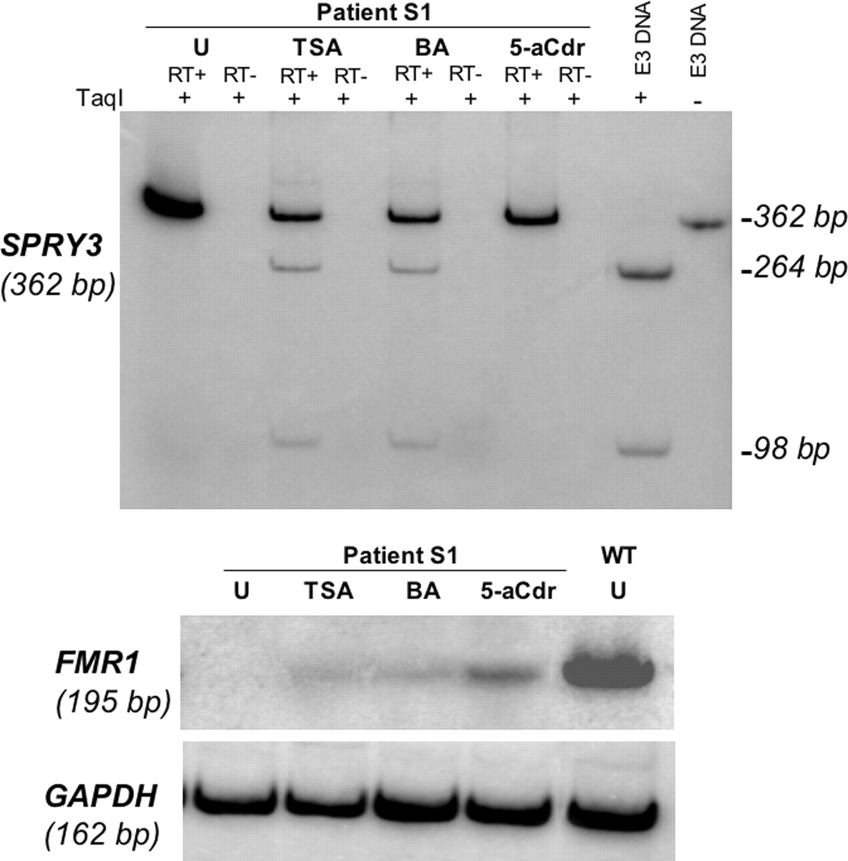
Figure 4. Treatment with HDACs inhibitors (TSA, BA) reactivates SPRY3 Y repressed allele. S1 fragile-X cell ...
Notes:
Figure 4. Treatment with HDACs inhibitors (TSA, BA) reactivates SPRY3 Y repressed allele. S1 fragile-X cell line, heterozygous for SPRY3 TaqI RFLP, were treated with different drugs altering histone acetylation (TSA, BA) or DNA methylation (5aCdr). Top: RNA from treated cells has been extracted then reverse transcribed and digested with TaqI (see Materials and Methods). Lanes 1 and 2, untreated (U) sample; lanes 3 and 4, S1 TSA treated; lanes 5 and 6, BA treated; lanes 7 and 8, 5aCdr treated. RT+ and RT− samples are reported. Note the HDACs treatments bring to SPRY3 biallelic expression; conversely, after 5aCdr treatment, no reactivation and monoallelic expression are visible. Below: same cDNAs from treated and untreated cells amplified by using FMR1 primers (24). Note a slight reactivation upon treatment of BA and TSA, robust after 5aCdr treatment. Normalization with GAPDH primers has been carried out; WT, normal control sample.
Unless provided in the caption above, the following copyright applies to the content of this slide: © The Author 2006. Published by Oxford University Press. All rights reserved. For Permissions, please email: journals.permissions@oxfordjournals.org

Slide 5
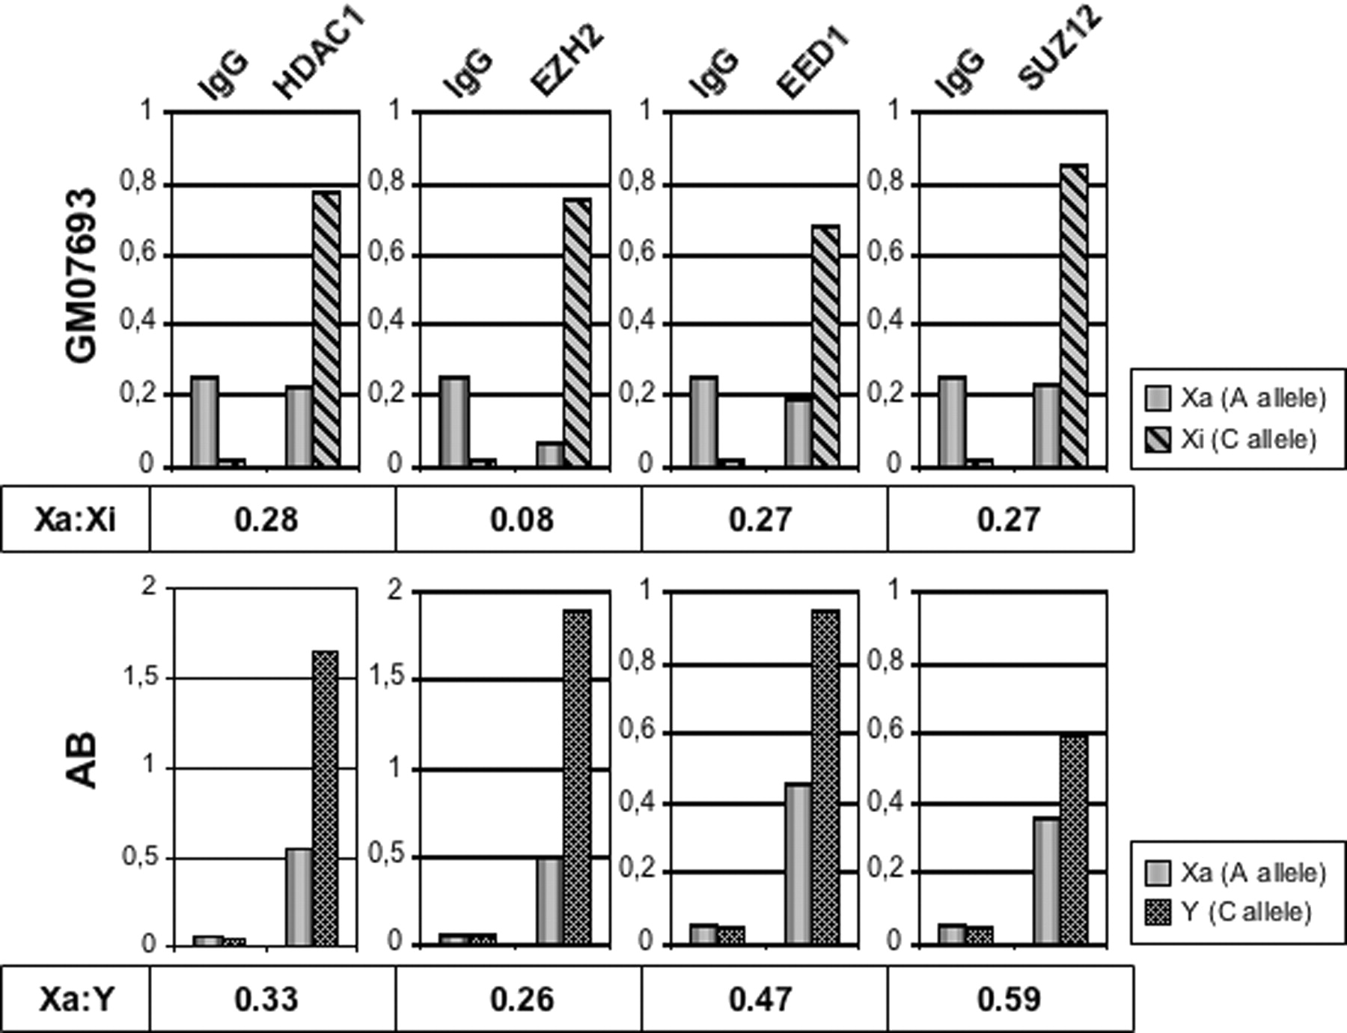
Figure 5.In vivo binding of EZH2, SUZ12, EED1 and HDACI on the silenced Xi/Y SPRY3 promoters. Chromatin ...
Notes:
Figure 5.In vivo binding of EZH2, SUZ12, EED1 and HDACI on the silenced Xi/Y SPRY3 promoters. Chromatin immunoprecipitation on lymphoblastoid cell line AB (male) and GM07693 (skewed female fibroblast) was followed by allele-specific PCR (MAMA) as described in Figure 3. Histograms show specific enrichment of these proteins on repressed alleles.
Unless provided in the caption above, the following copyright applies to the content of this slide: © The Author 2006. Published by Oxford University Press. All rights reserved. For Permissions, please email: journals.permissions@oxfordjournals.org

Slide 6
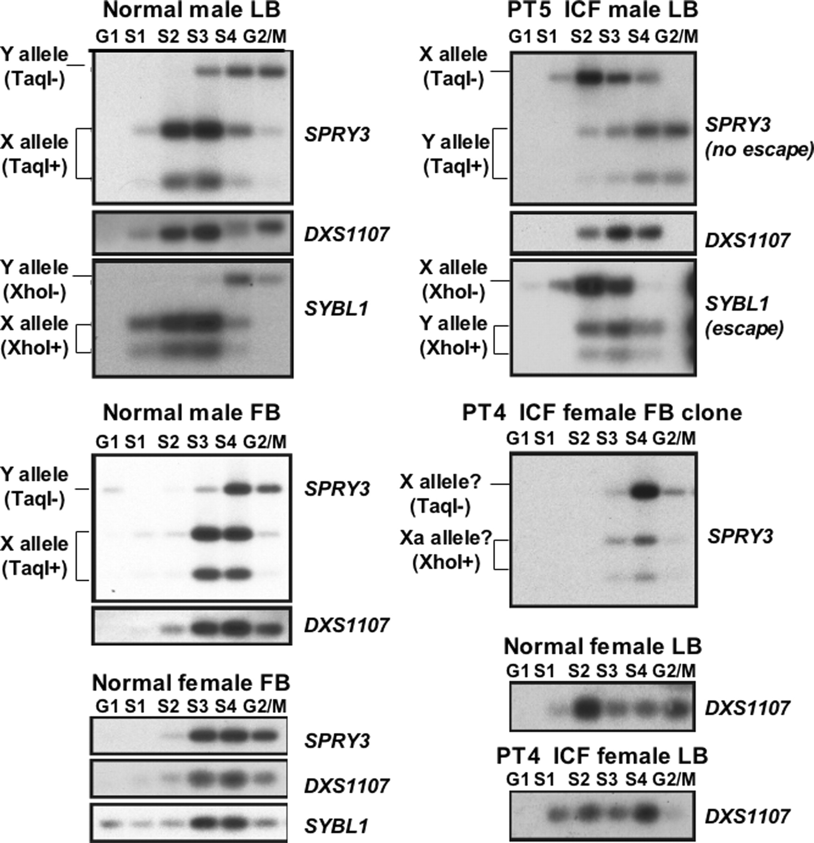
Figure 6. Replication timing in the PAR2 region, present on both the X and Y chromosomes, was examined using ...
Notes:
Figure 6. Replication timing in the PAR2 region, present on both the X and Y chromosomes, was examined using a BrdU incorporation method. The X and Y alleles of SPRY3 and SYBL1 can be distinguished in informative males using polymorphic restriction sites; the chromosomal assignment of alleles can be done in males using RT–PCR analysis because the Y alleles of these genes are usually silent. In females, we cannot distinguish the active from the inactive allele in uncloned populations. LB, lymphoblasts.
Unless provided in the caption above, the following copyright applies to the content of this slide: © The Author 2006. Published by Oxford University Press. All rights reserved. For Permissions, please email: journals.permissions@oxfordjournals.org

