Slide 1
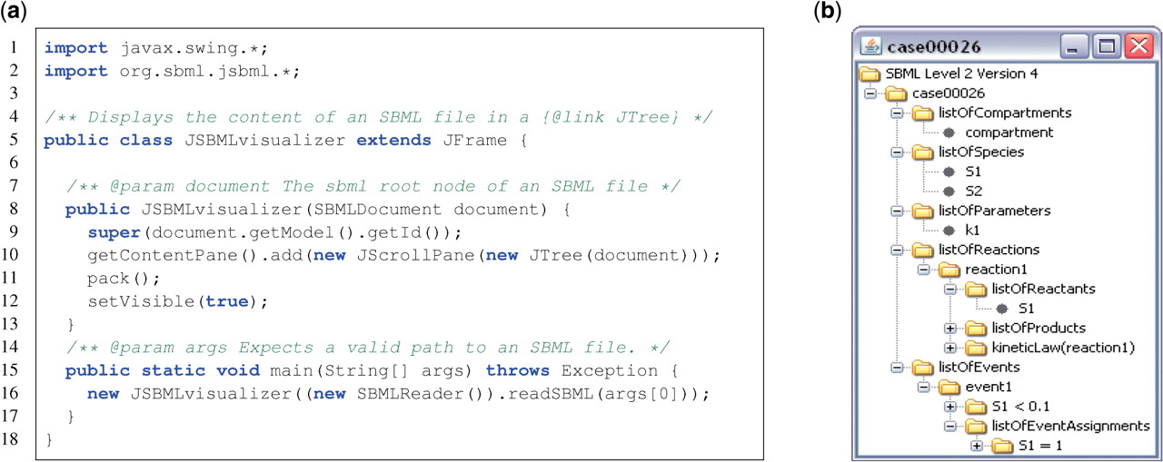
Fig. 1. (a) The SBML parser in JSBML understands the hierarchical data structure of SBML; (b) Example for SBML test ...
Notes:
Fig. 1. (a) The SBML parser in JSBML understands the hierarchical data structure of SBML; (b) Example for SBML test case 26. Using JSBML for reading and visualizing an SBML file. The type SBase extends the Java interfaces Serializable for saving JSBML objects in binary form or sending them over a network connection, Cloneable for creating deep object copies and TreeNode. The last interface allows callers to apply any recursive operation, such as using JTree for display [see (b) for an example].
Unless provided in the caption above, the following copyright applies to the content of this slide: © The Author(s) 2011. Published by Oxford University Press.This is an Open Access article distributed under the terms of the Creative Commons Attribution Non-Commercial License (http://creativecommons.org/licenses/by-nc/2.5), which permits unrestricted non-commercial use, distribution, and reproduction in any medium, provided the original work is properly cited.

