Slide 1
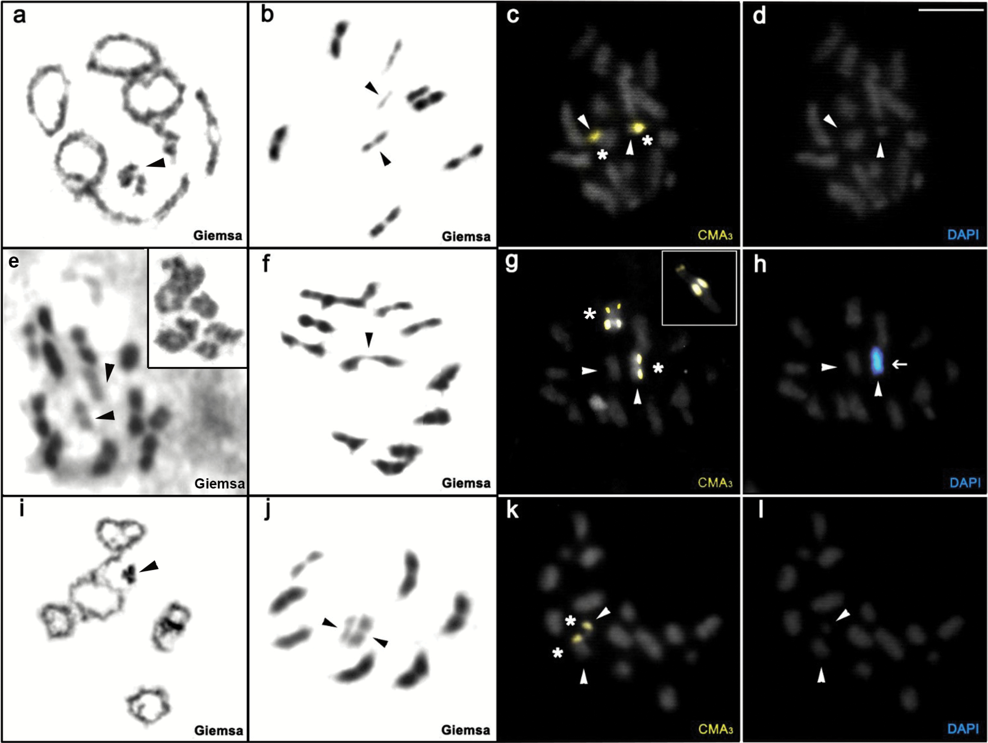
Figure 1. Meiotic and mitotic stages by conventional staining and fluorochromes (CMA₃/DAPI) of three species ...
Notes:
Figure 1. Meiotic and mitotic stages by conventional staining and fluorochromes (CMA3/DAPI) of three species of the genus Belostoma. (a–d) Belostoma horvathi: (a) Diplotene/Diakinesis; (b) Metaphase I; (c) Mitotic metaphase; (d) Mitotic metaphase; (e–h) Belostoma cummingsi: (e) Metaphase I. Note in the box one diplotene/partial diakinesis showing the predominance of 2 chiasmata by bivalent; (f) Metaphase II; (g) Metaphase II. Note in the box the bivalent with size heteromorphism of GC-rich blocks; (h) Metaphase II; (i–l) Belostoma candidulum: (i) Diplotene/Diakinesis; (j) Metaphase I (k) Metaphase II (l) Metaphase II. The arrowheads indicate the sex chromosomes. Arrows indicate the blocks DAPI+. Asterisks indicate CMA3+ blocks. Bar = 10 µm.
Unless provided in the caption above, the following copyright applies to the content of this slide: © The American Genetic Association 2016. All rights reserved. For permissions, please e-mail: journals.permissions@oup.com

Slide 2
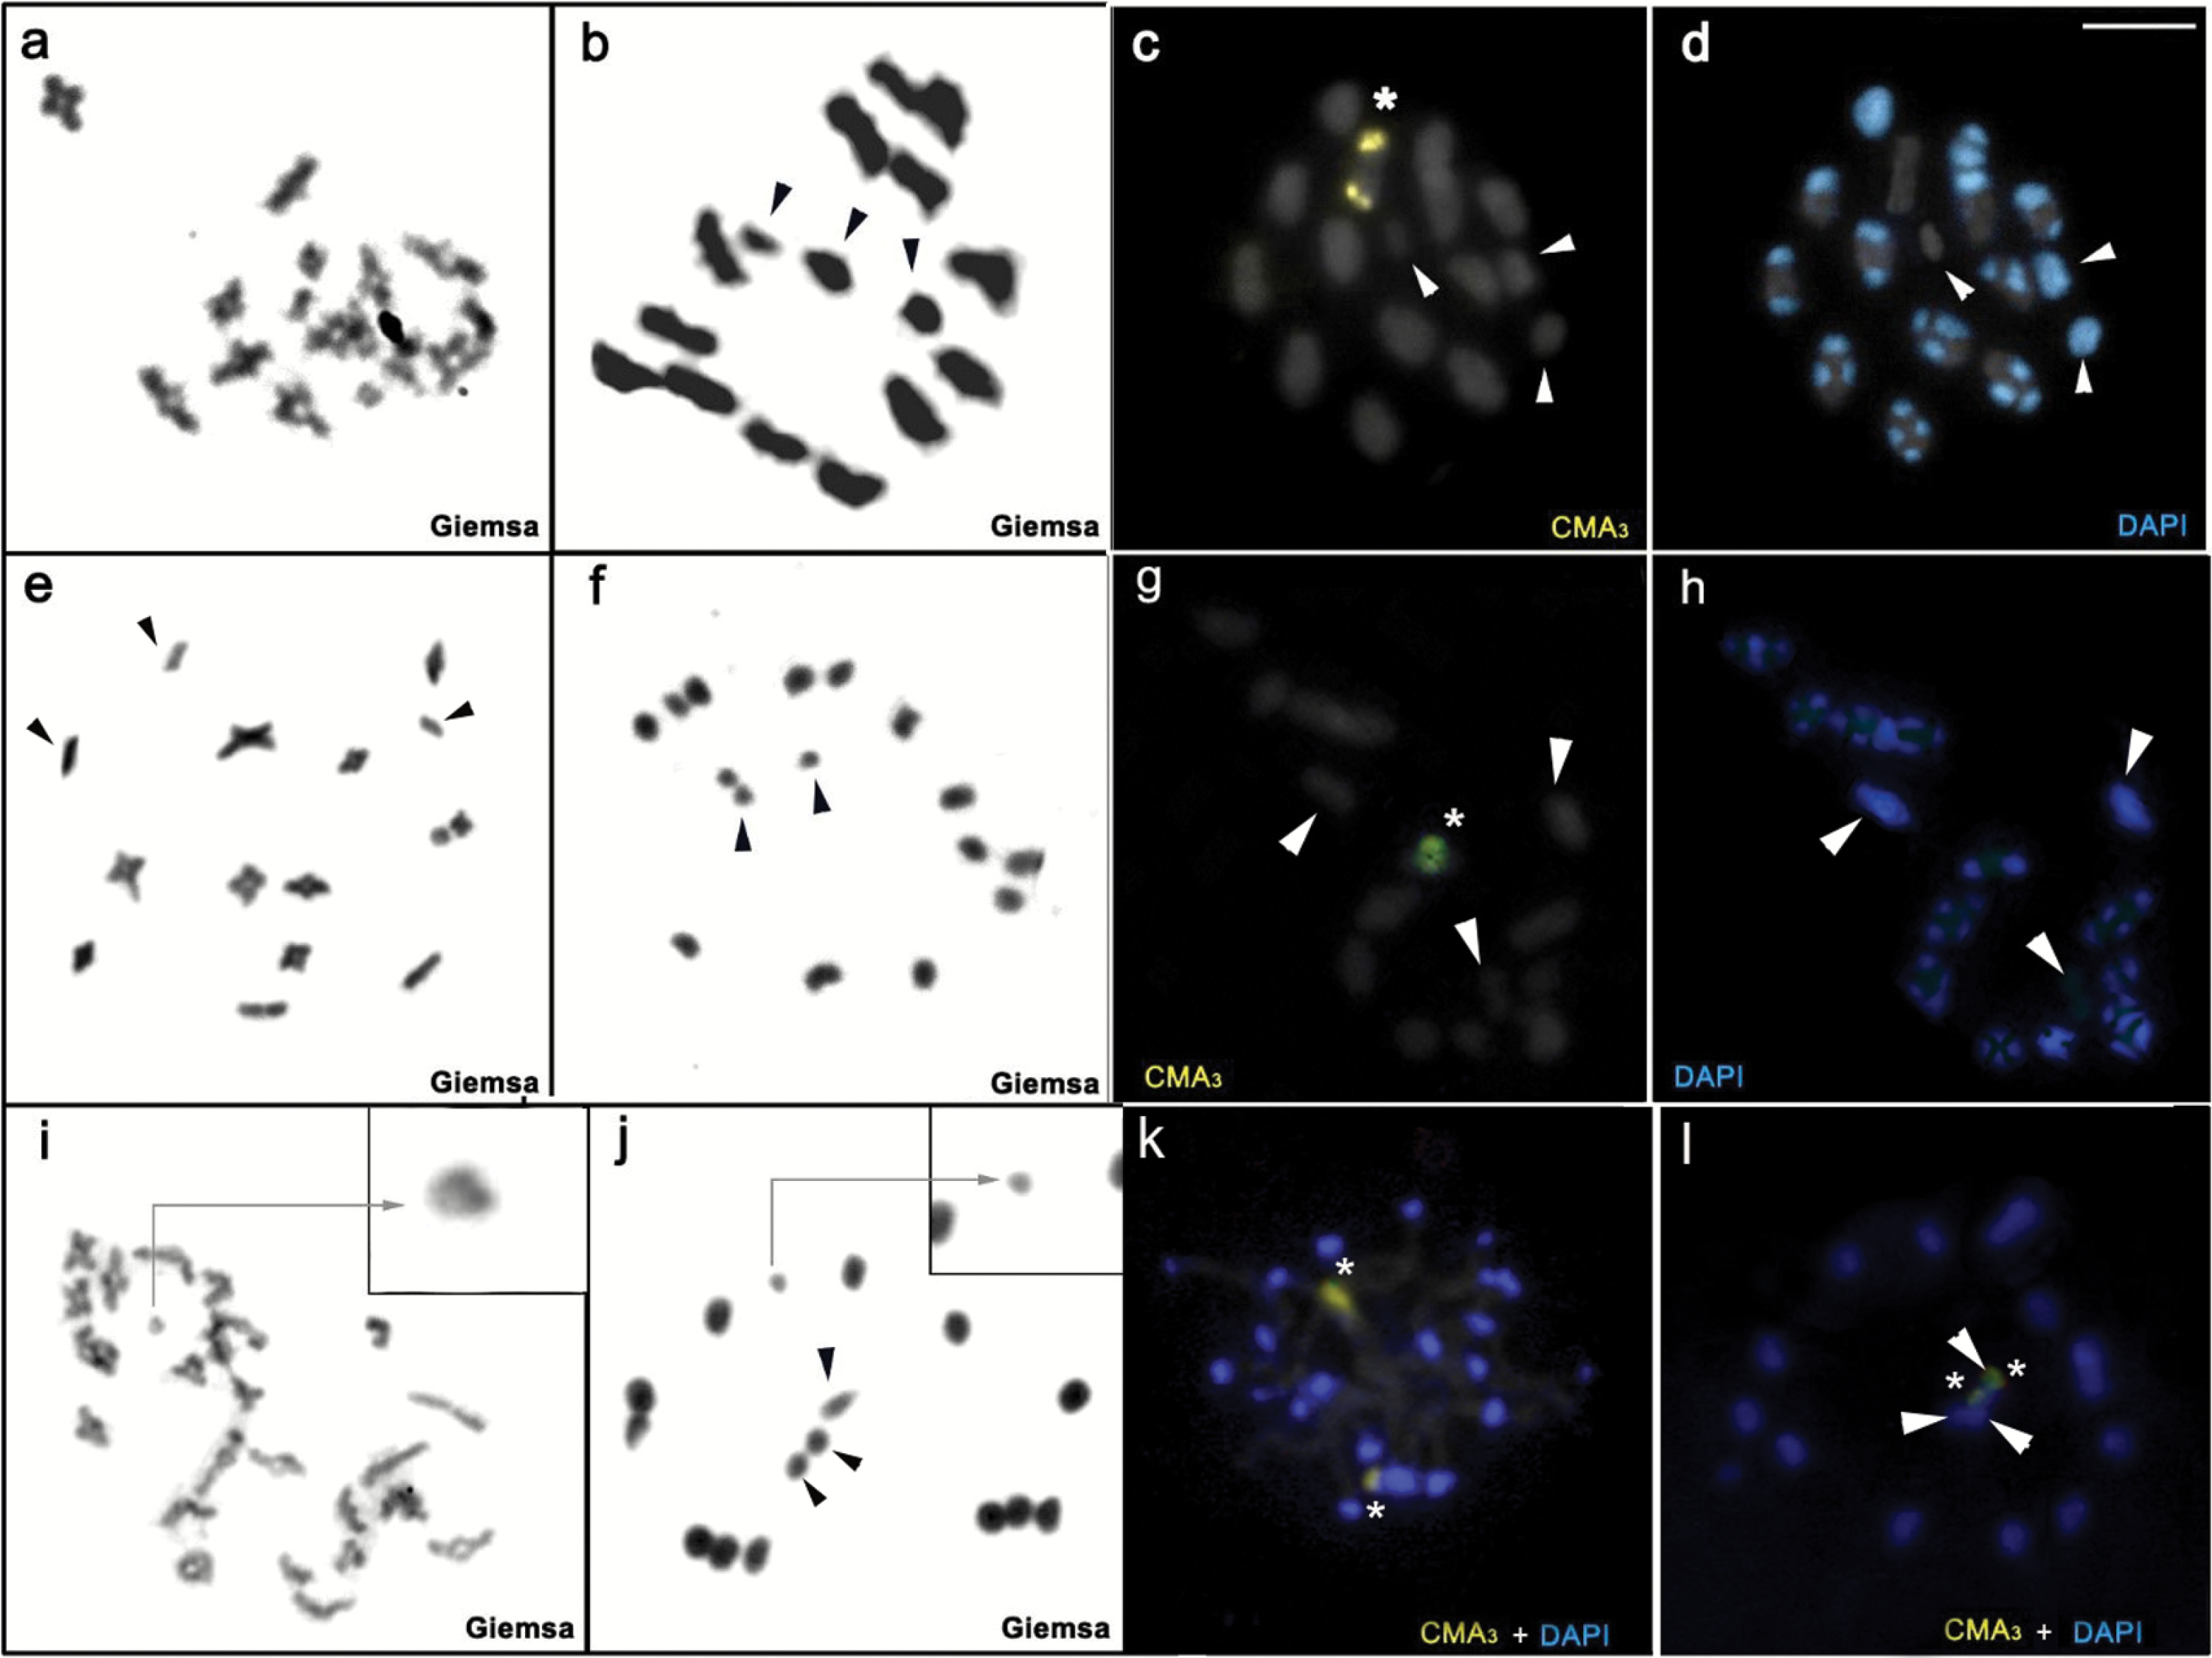
Figure 2. Meiotic and mitotic stages by conventional staining and fluorochromes (CMA₃/DAPI) of three species ...
Notes:
Figure 2. Meiotic and mitotic stages by conventional staining and fluorochromes (CMA3/DAPI) of three species of the genus Belostoma. (a–d) Belostoma dentatum: (a) Diplotene/Diakinesis; (b) Metaphase II; (c) Metaphase II; (d) Metaphase II; (e–h) Belostoma elongatum: (e) Diplotene/Diakinesis; (f) Metaphase II; (g) Diplotene/Diakinesis; (h) Diplotene/Diakinesis; (i–l) Belostoma discretum: (i) Diplotene/Diakinesis. Note in the box smaller chromosomes with chiasm; (j) Metaphase II. Note in the box the smallest bivalent. (k) Pachytene. Note terminal bands DAPI+ and 2 CMA+ bands. (l) Metaphase II. Note CMA+ bands in 2 sex chromosomes. The arrowheads indicate the sex chromosomes. Asterisks indicate CMA3+ blocks. Bar = 10 µm.
Unless provided in the caption above, the following copyright applies to the content of this slide: © The American Genetic Association 2016. All rights reserved. For permissions, please e-mail: journals.permissions@oup.com

Slide 3
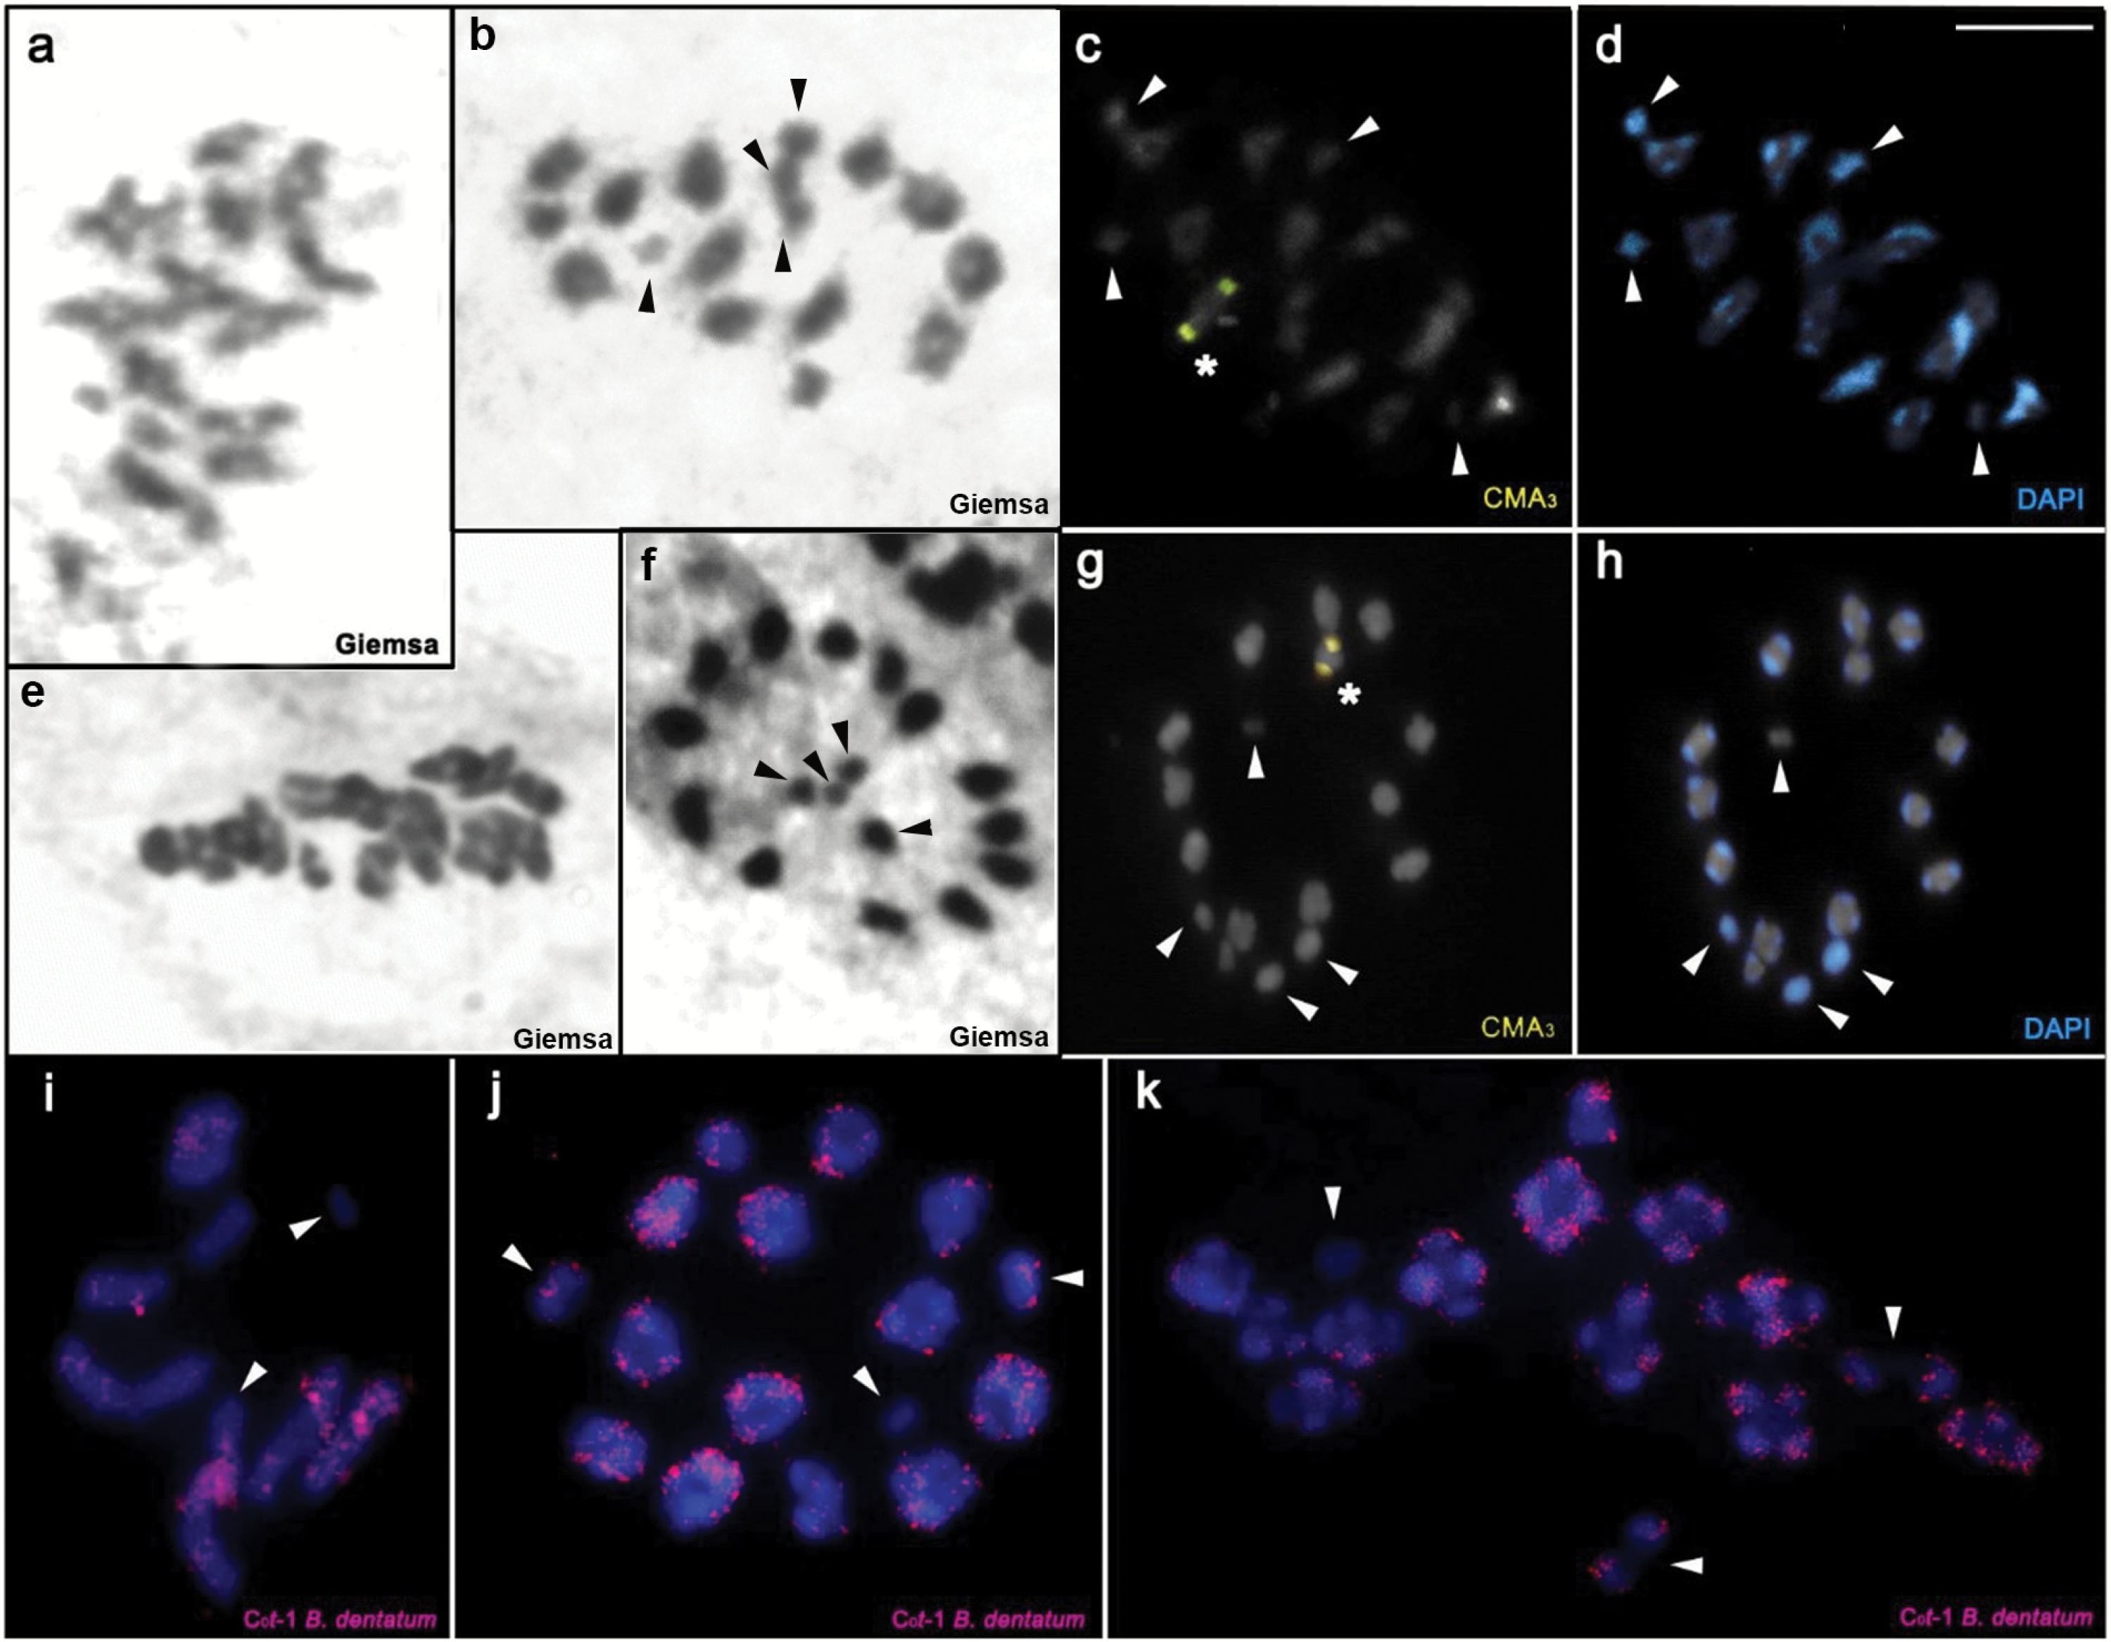
Figure 3. Meiotic and mitotic stages by conventional staining and fluorochromes (CMA₃/DAPI) of 2 species of ...
Notes:
Figure 3. Meiotic and mitotic stages by conventional staining and fluorochromes (CMA3/DAPI) of 2 species of the genus Belostoma: (a–d) Belostoma testaceopallidum: (a) Diplotene/Diakinesis; (b) Metaphase II; (c) Metaphase II; (d) Metaphase II; (e–h) Belostoma dilatatum: (e) Diplotene/Diakinesis. Note the predominance of a chiasm by bivalent; (f) Metaphase II; (g) Metaphase II; (h) Metaphase II; (i–k) Fluorescent in situ hybridization with C0t-1 probe isolated from Belostoma dentatum: (i) Metaphase II of Belostoma horvathi; (j) Metaphase II of B. dentatum; (k) Diplotene/Diakinesis of B. dentatum. The arrowheads indicate the sex chromosomes. Asterisks indicate CMA3+ blocks. Bar = 10 µm.
Unless provided in the caption above, the following copyright applies to the content of this slide: © The American Genetic Association 2016. All rights reserved. For permissions, please e-mail: journals.permissions@oup.com

Slide 4
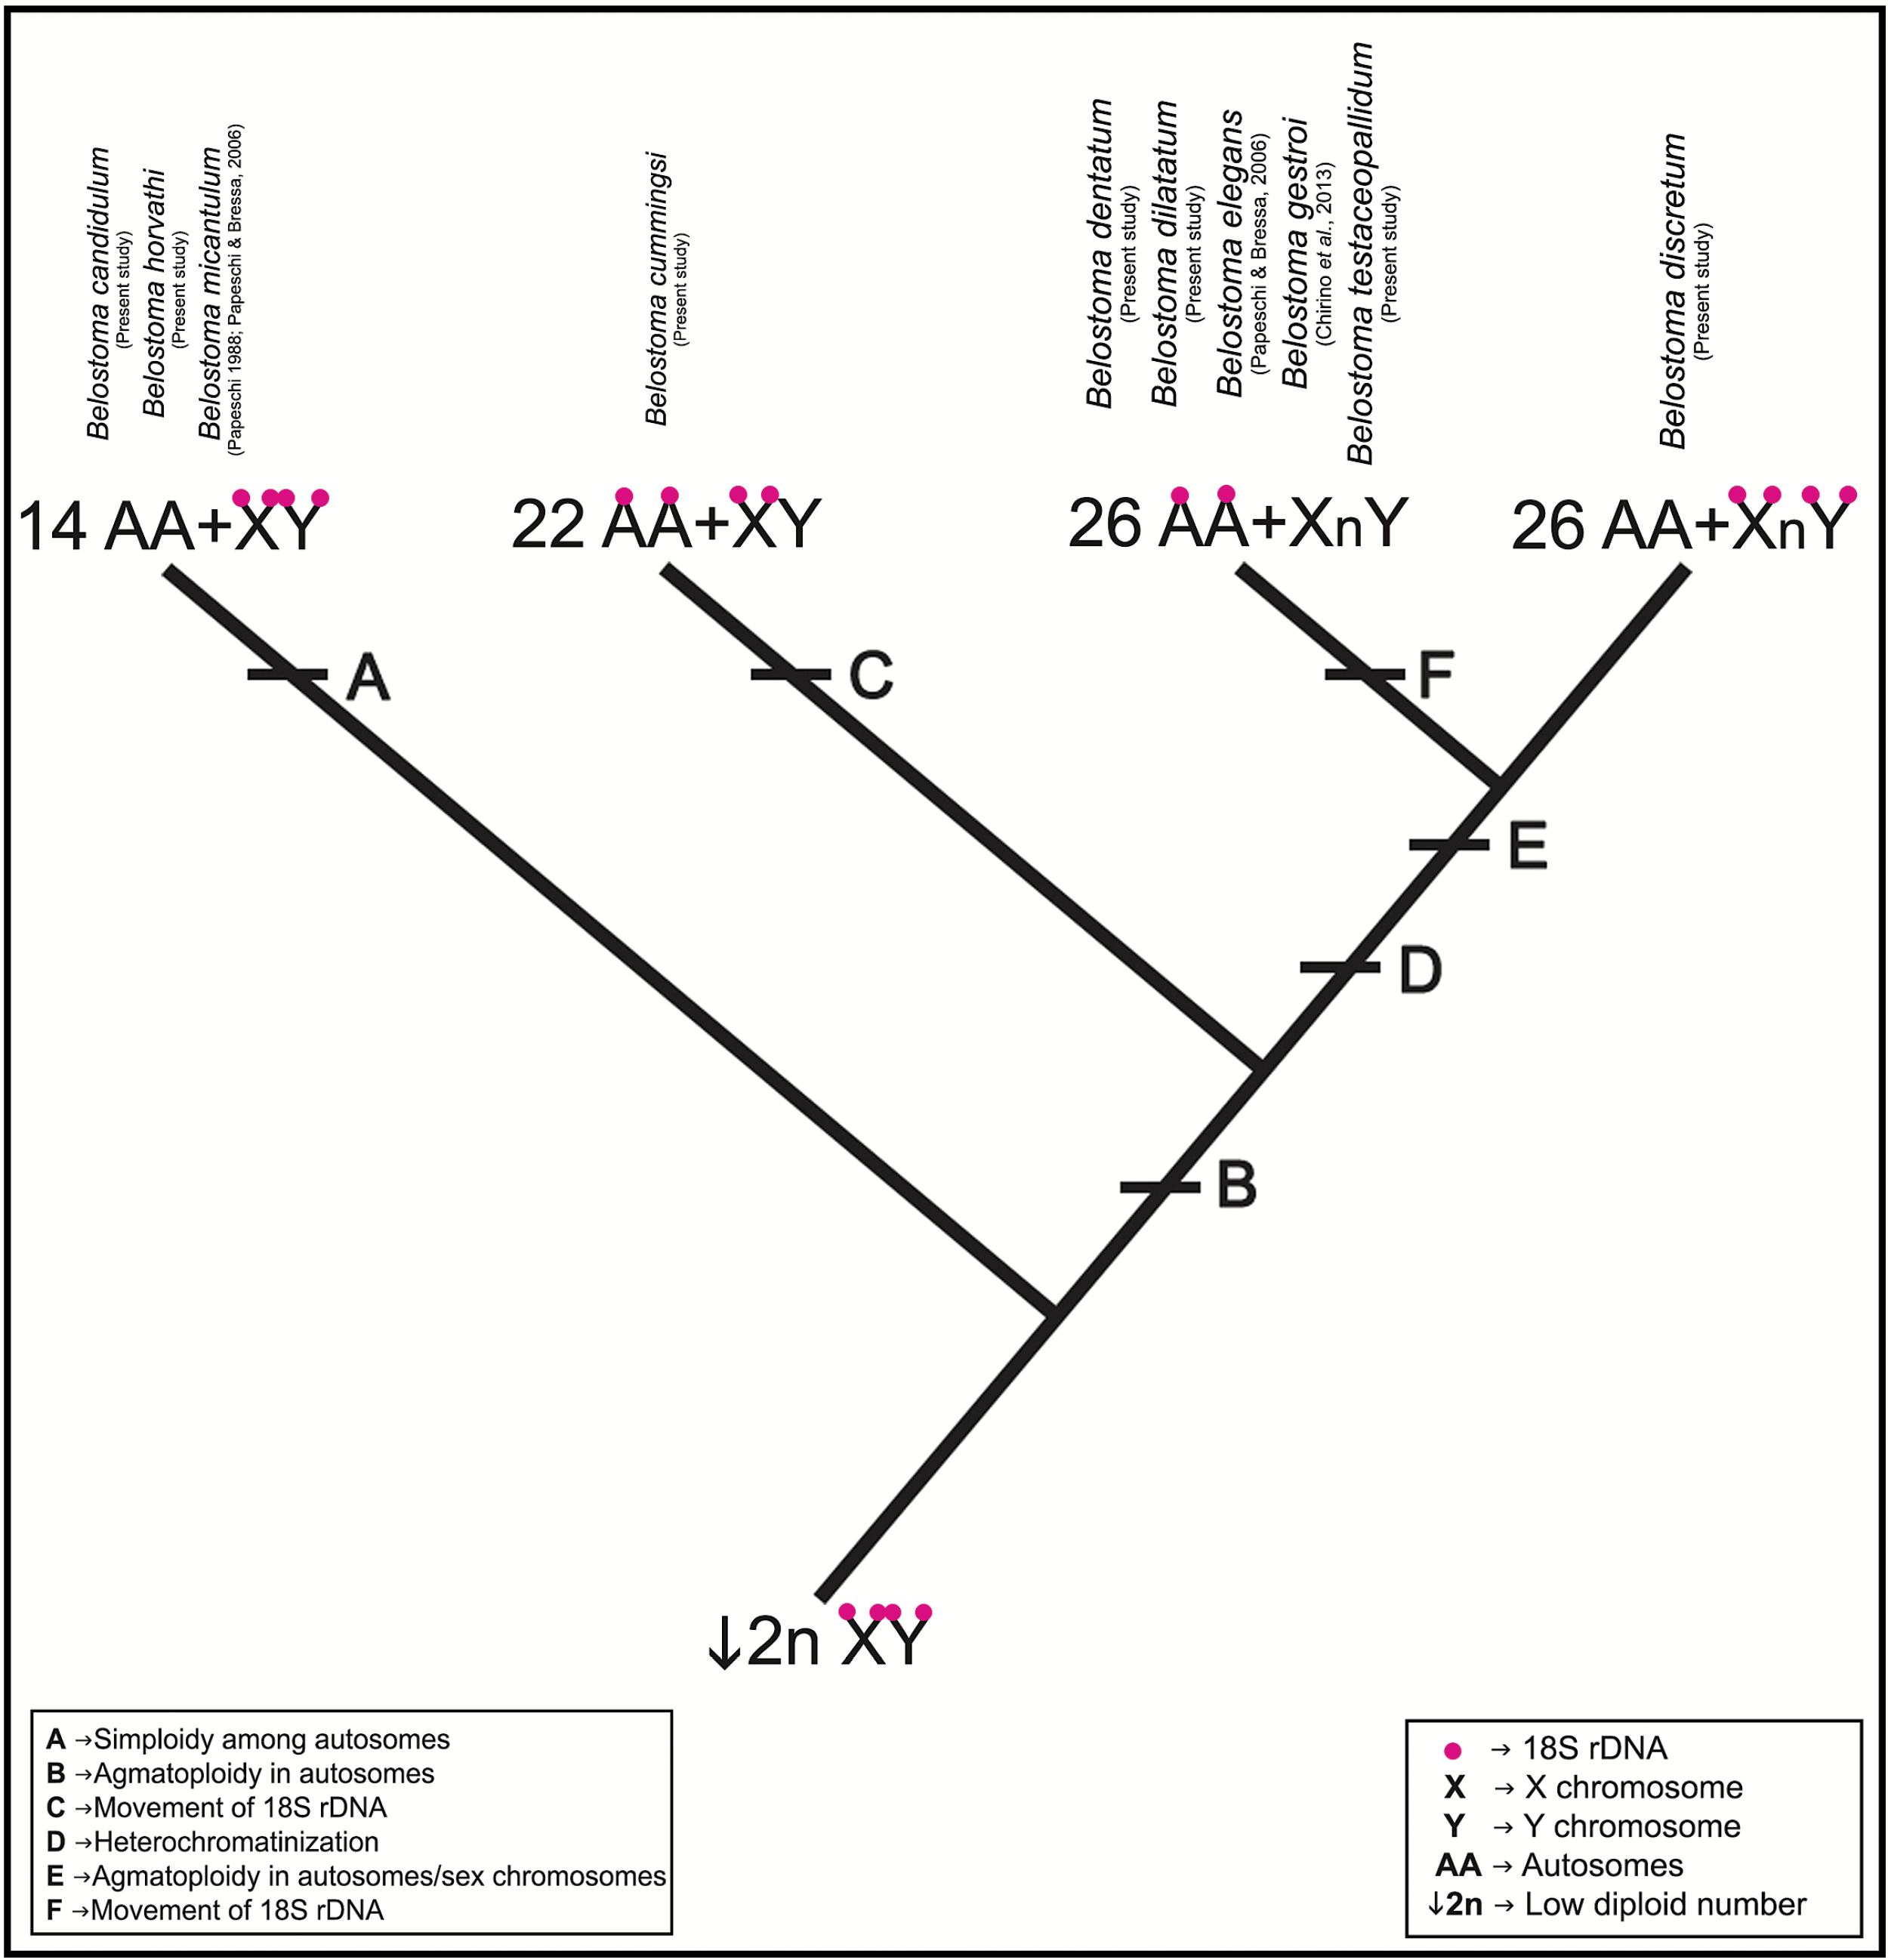
Figure 6. Representation of the new hypothesis of chromosomal evolution to genus Belostoma.
Notes:
Figure 6. Representation of the new hypothesis of chromosomal evolution to genus Belostoma.
Unless provided in the caption above, the following copyright applies to the content of this slide: © The American Genetic Association 2016. All rights reserved. For permissions, please e-mail: journals.permissions@oup.com

Slide 5
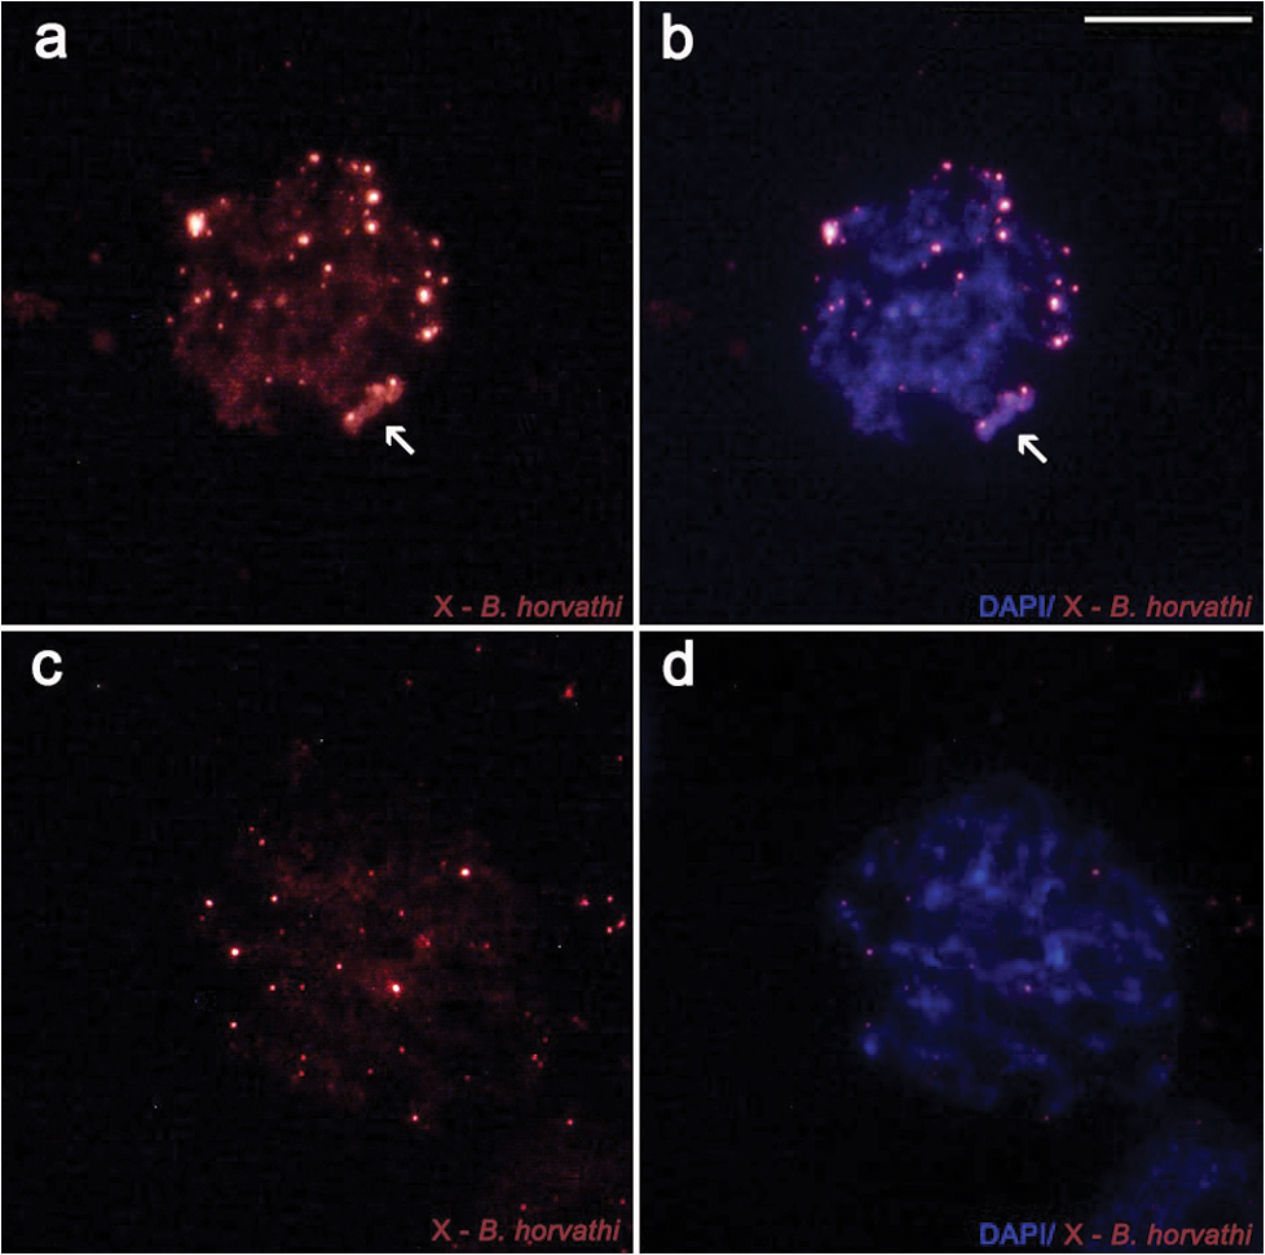
Figure 5. Fluorescent in situ hybridiztion with microdissected X probe from Belostoma horvathi. (a, b) Initial ...
Notes:
Figure 5. Fluorescent in situ hybridiztion with microdissected X probe from Belostoma horvathi. (a, b) Initial pachytene of B. horvathi. (c, d) Initial pachytene of Belostoma dentatum. The arrows indicate the heteropycnotic block corresponding to chromosome X.
Unless provided in the caption above, the following copyright applies to the content of this slide: © The American Genetic Association 2016. All rights reserved. For permissions, please e-mail: journals.permissions@oup.com

Slide 6
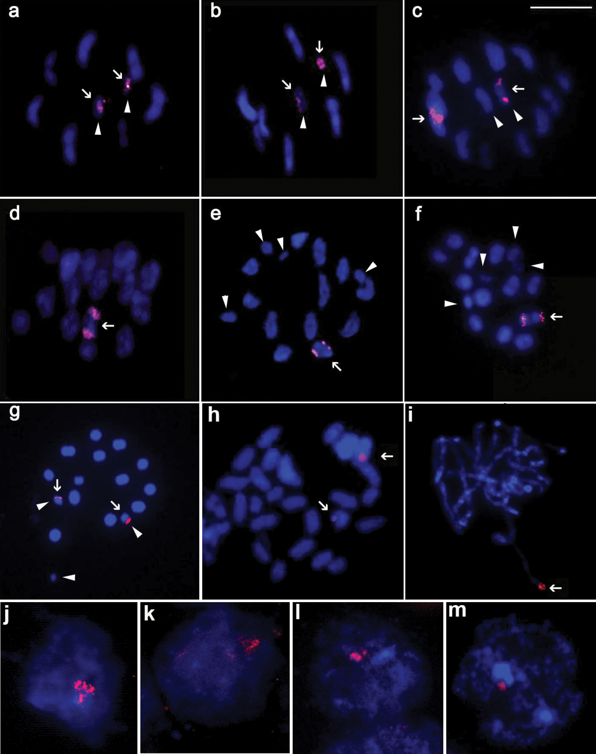
Figure 4. Fluorescent in situ hybridization with 18S rDNA probe. (a) Metaphase II of Belostoma horvathi. (b) Metaphase ...
Notes:
Figure 4. Fluorescent in situ hybridization with 18S rDNA probe. (a) Metaphase II of Belostoma horvathi. (b) Metaphase II of Belostoma candidulum. (c) Metaphase II of Belostoma cummingsi. (d) Metaphase II of Belostoma dentatum. (e) Metaphase II of Belostoma testaceopallidum. (f) Metaphase II of Belostoma dilatatum. (g) Metaphase II of Belostoma discretum. (h) Mitotic metáphase of Belostoma elongatum; (i) Pachytene of B. elongatum. (j–m) Interphase nucelus. (j) B. horvathi; (k) B. testaceopallidum (l) Belostoma cummingsi; (m) B. discretum. Note the proximity of the 18S rDNA cistrons in interphase nuclei. Arrows indicate DNAr 18S. Arrowheads indicate the sex chromosomes. Bar = 10 µm.
Unless provided in the caption above, the following copyright applies to the content of this slide: © The American Genetic Association 2016. All rights reserved. For permissions, please e-mail: journals.permissions@oup.com

