Slide 1
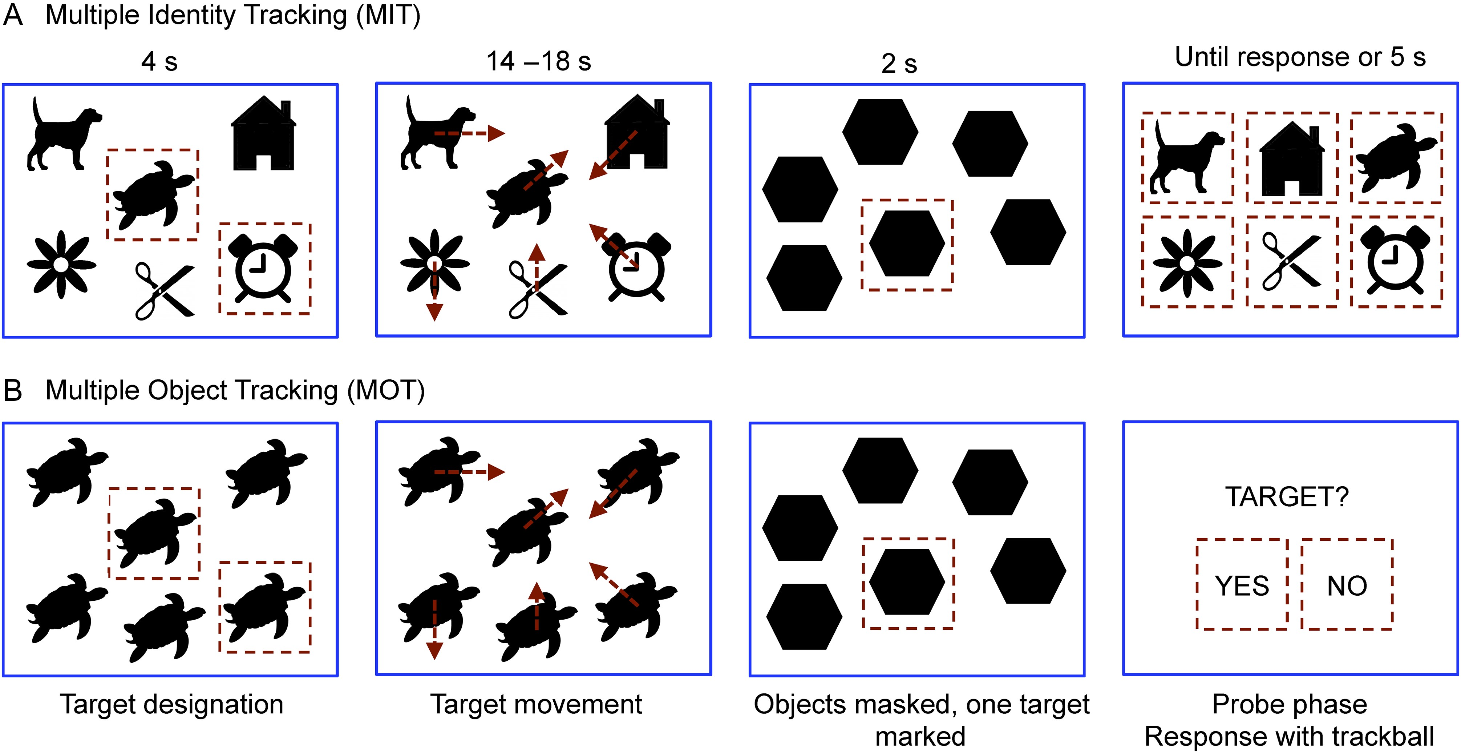
Figure 1. Experimental design for MIT (A) and MOT (B). Participants were first shown an array of items, of which the ...
Notes:
Figure 1. Experimental design for MIT (A) and MOT (B). Participants were first shown an array of items, of which the to-be-tracked items (0, 2, or 4) were flashed. Subsequently, the targets moved around the screen for from 14 to 18 s, after which they were replaced with visual masks, of which one was flashed. In the MIT probe phase, participants were shown all the items from the tracking array and asked to designate which one of them occupied the location of the flashed mask. In the MOT probe phase, participants responded whether or not the location occupied by the flashed mask contained one of the targets. In Experiment 2, a fixation cross stayed on the screen throughout the trials, and the color of the cross indicated whether or not participants were allowed to move their eyes. Note: Items shown here are for visualization purposes only and were not used in the experiments; the real task involved 8 different objects.
Unless provided in the caption above, the following copyright applies to the content of this slide: © The Author 2016. Published by Oxford University Press. This is an Open Access article distributed under the terms of the Creative Commons Attribution Non-Commercial License (http://creativecommons.org/licenses/by-nc/4.0/), which permits non-commercial re-use, distribution, and reproduction in any medium, provided the original work is properly cited. For commercial re-use, please contact journals.permissions@oup.com

Slide 2
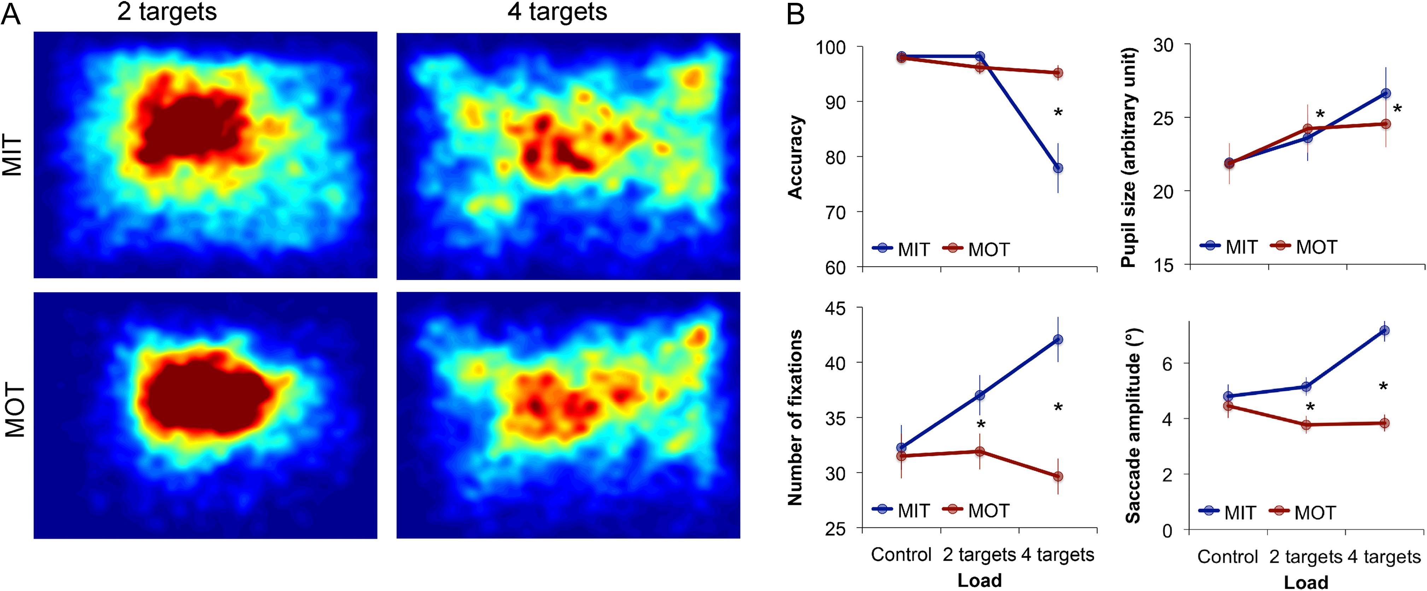
Figure 2. Tracking performance and eye movements in Experiment 1. Heatmaps (A) show that participants made more ...
Notes:
Figure 2. Tracking performance and eye movements in Experiment 1. Heatmaps (A) show that participants made more fixations in MIT than MOT and in the 4-target than the 2 target condition. This was accompanied with (B) a better performance in the 4-target MOT condition, increased cognitive load (indexed by pupil size) as a function of number of targets, and a greater number of fixations and longer saccades in MIT than MOT in the 2 versus 4-target condition.
Unless provided in the caption above, the following copyright applies to the content of this slide: © The Author 2016. Published by Oxford University Press. This is an Open Access article distributed under the terms of the Creative Commons Attribution Non-Commercial License (http://creativecommons.org/licenses/by-nc/4.0/), which permits non-commercial re-use, distribution, and reproduction in any medium, provided the original work is properly cited. For commercial re-use, please contact journals.permissions@oup.com

Slide 3
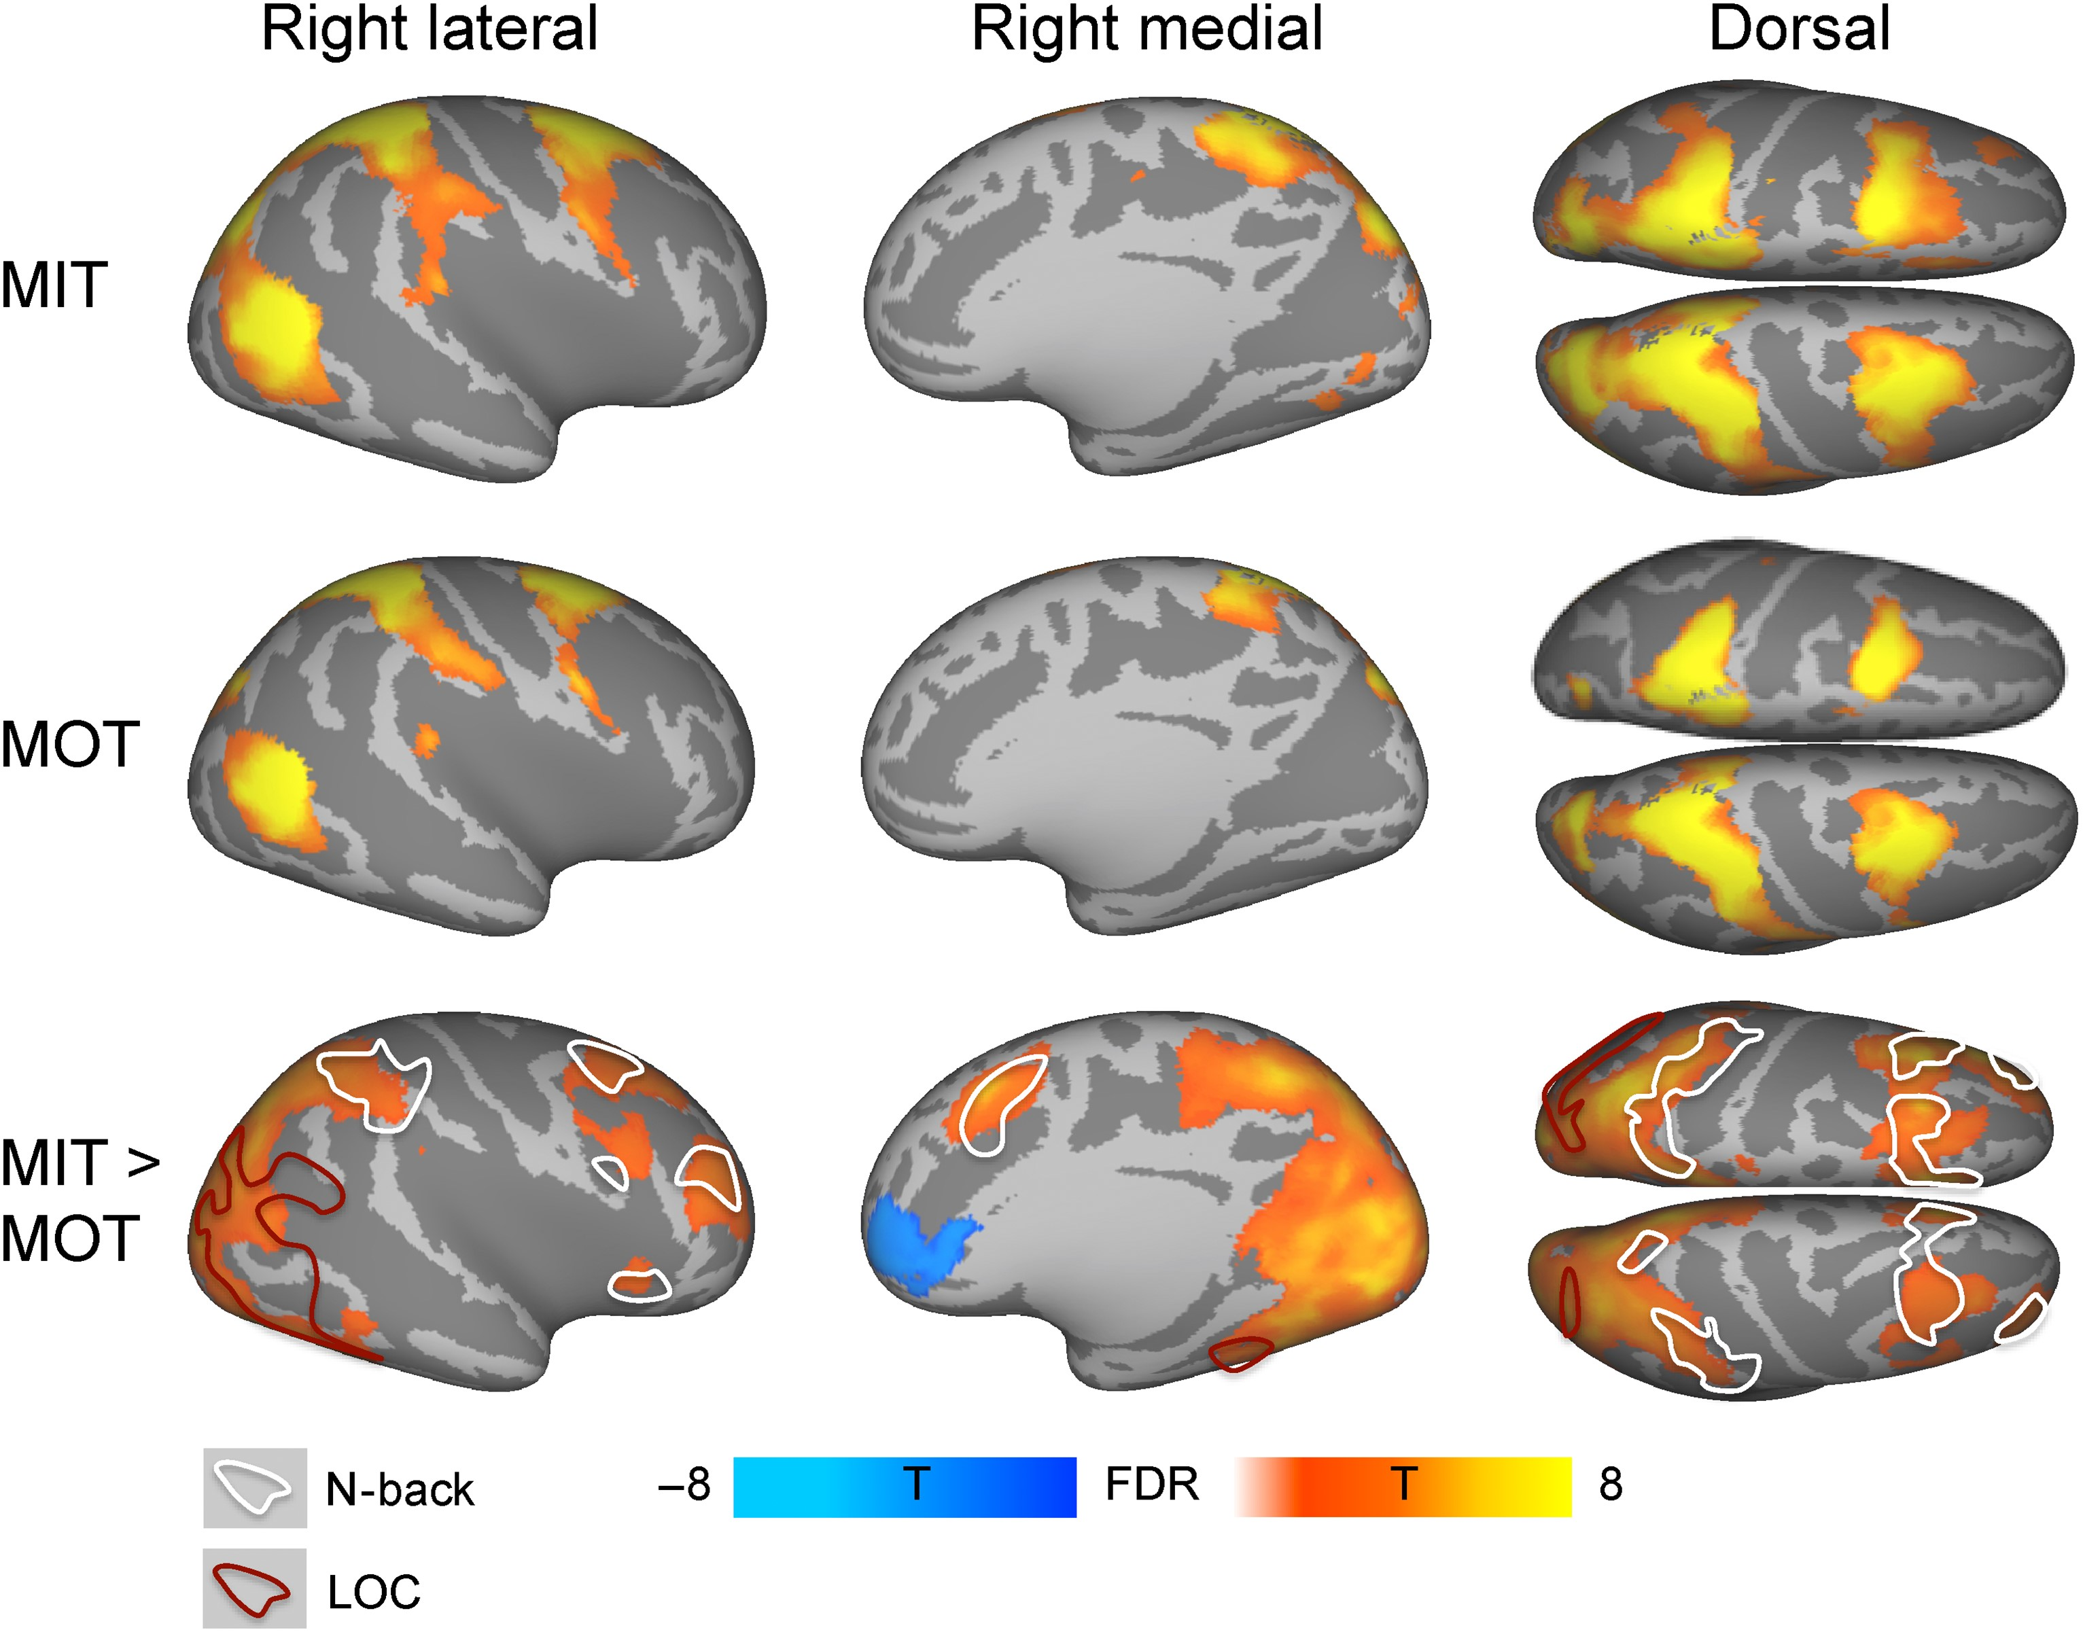
Figure 3. Brain regions whose activity increased as a function of the number of targets in MIT (top), MOT (middle), and ...
Notes:
Figure 3. Brain regions whose activity increased as a function of the number of targets in MIT (top), MOT (middle), and MIT versus MOT (bottom). Colorbar denotes the t-statistic range. The data are plotted at P < 0.01, FDR corrected at cluster level (except for MOT vs. MIT which is shown at 0.005, uncorrected). White outline shows areas activated in N-back working memory localizer and red outline areas activated in LOC localizer at P < 0.05 FWE corrected.
Unless provided in the caption above, the following copyright applies to the content of this slide: © The Author 2016. Published by Oxford University Press. This is an Open Access article distributed under the terms of the Creative Commons Attribution Non-Commercial License (http://creativecommons.org/licenses/by-nc/4.0/), which permits non-commercial re-use, distribution, and reproduction in any medium, provided the original work is properly cited. For commercial re-use, please contact journals.permissions@oup.com

Slide 4
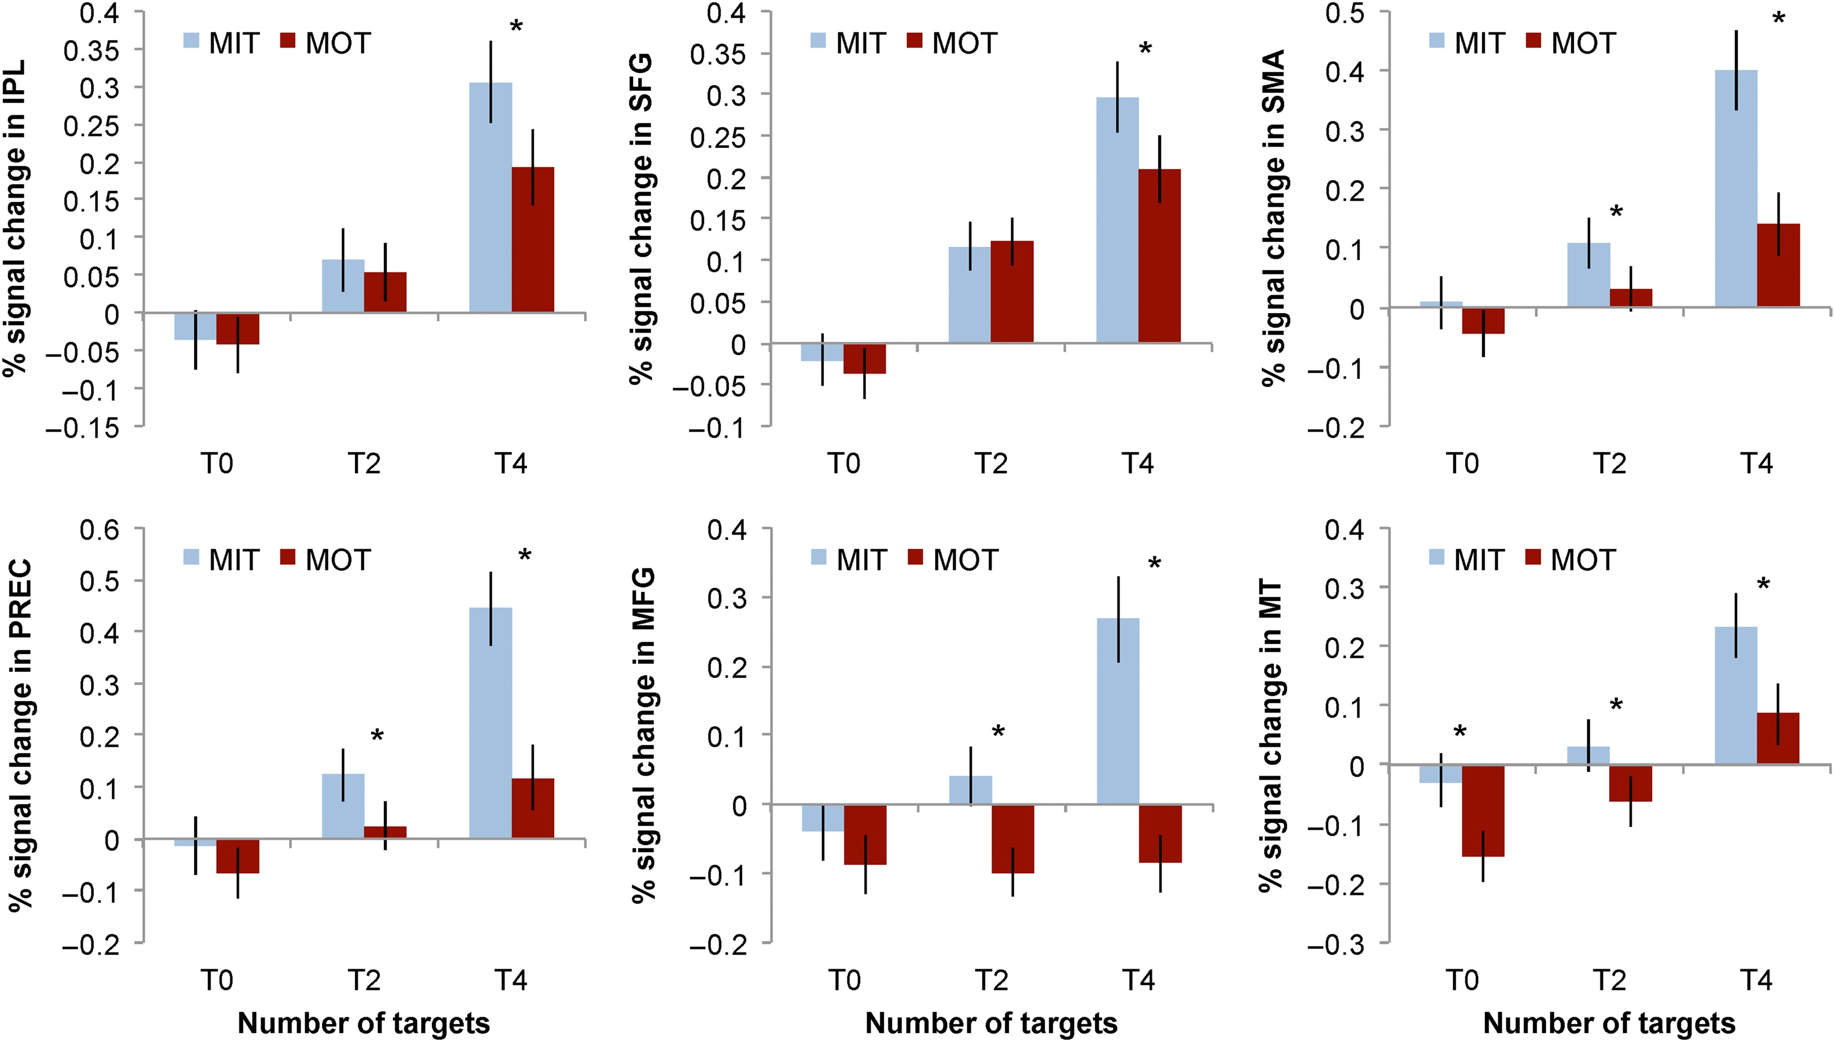
Figure 4. Mean (+SEM) signal changes for MIT and MOT in ROIs for n-back working memory (IPL, SFG, SMA, PREC, MFG) and ...
Notes:
Figure 4. Mean (+SEM) signal changes for MIT and MOT in ROIs for n-back working memory (IPL, SFG, SMA, PREC, MFG) and object localizer (MT) tasks. Statistically significant (P < 0.05, Bonferronni corrected) differences between the MIT and MOT conditions are denoted with asterisks. IPL, inferior parietal lobule; MFG, middle frontal gyrus; SFG, superior frontal gyrus, PREC, precentral gyrus; SMA, supplementary motor area; MT, middle temporal gyrus (area MT).
Unless provided in the caption above, the following copyright applies to the content of this slide: © The Author 2016. Published by Oxford University Press. This is an Open Access article distributed under the terms of the Creative Commons Attribution Non-Commercial License (http://creativecommons.org/licenses/by-nc/4.0/), which permits non-commercial re-use, distribution, and reproduction in any medium, provided the original work is properly cited. For commercial re-use, please contact journals.permissions@oup.com

Slide 5
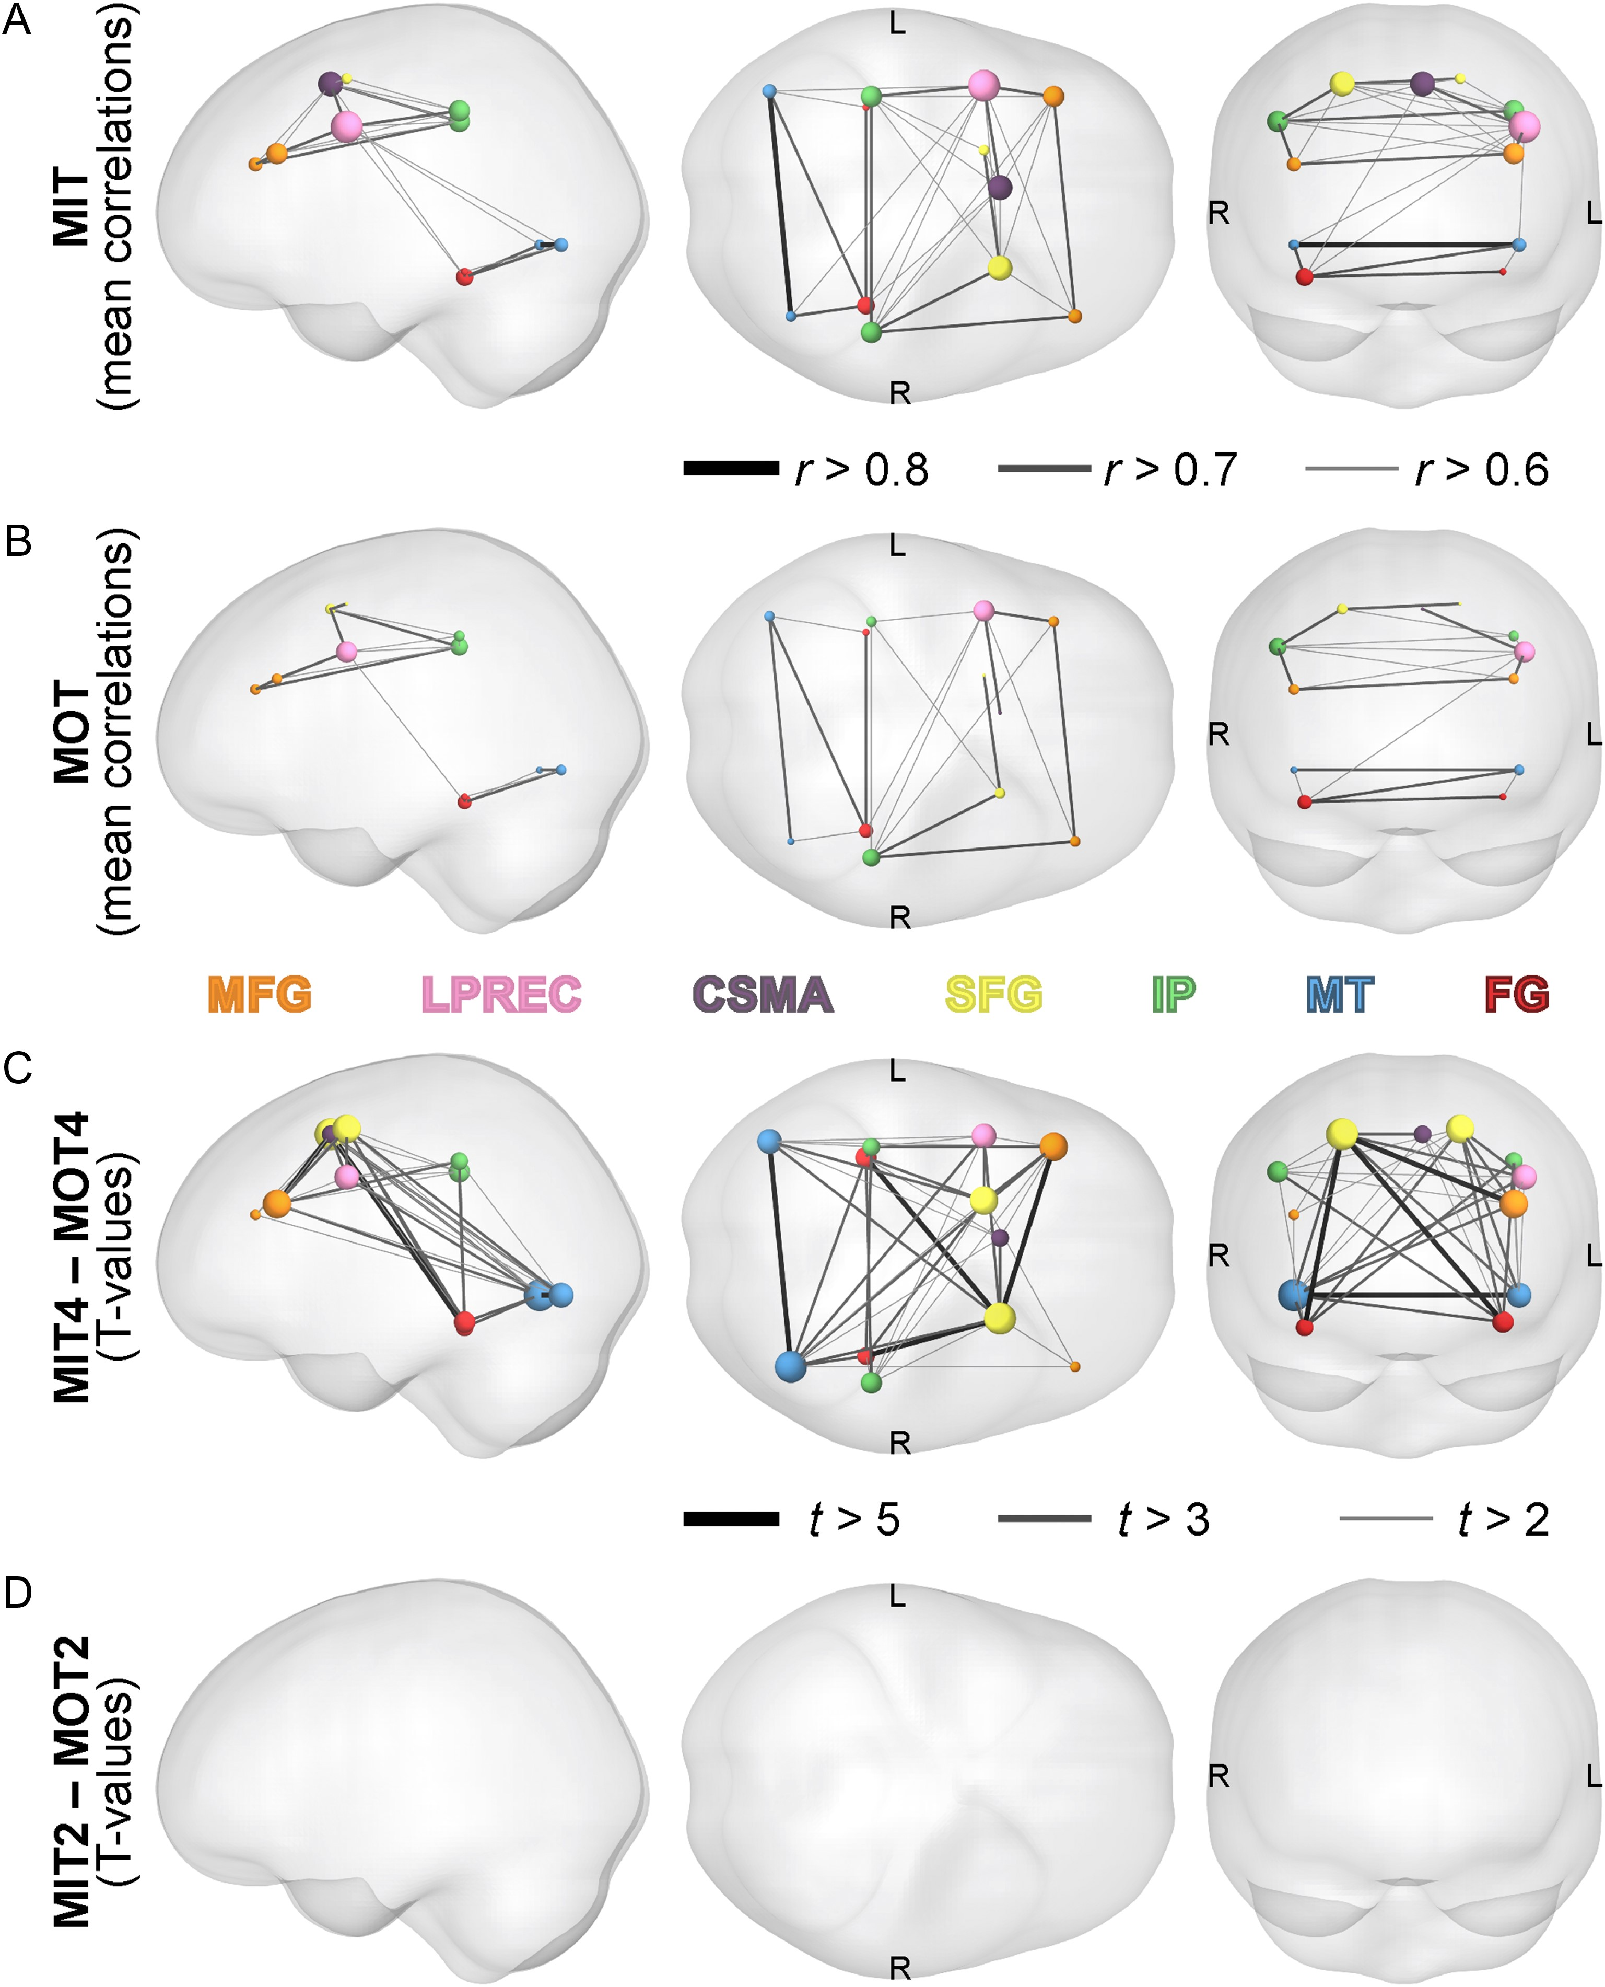
Figure 5. Functional connectivity. Mean functional connectivity values across all MIT and MOT trials (averaged over 2 ...
Notes:
Figure 5. Functional connectivity. Mean functional connectivity values across all MIT and MOT trials (averaged over 2 and 4 targets) are shown in panels A and B. For these plots, line thickness defines the link strength; node color shows the node region and node diameter is proportional to the significant links attached to each node. Panels C and D show the links whose strength was significantly stronger in MIT than MOT with 4 and 2 targets. For these plots, line thickness defines the T value for each link (i.e. link strength comparison between MIT and MOT). All data are thresholded at P < 0.05, FDR corrected. MFG, middle frontal gyrus; LPREC, left precentral gyrus; SMA, supplementary motor area; SFG, superior frontal gyrus, IPL, inferior parietal lobule; MT, area MT, FG, fusiform gyrus.
Unless provided in the caption above, the following copyright applies to the content of this slide: © The Author 2016. Published by Oxford University Press. This is an Open Access article distributed under the terms of the Creative Commons Attribution Non-Commercial License (http://creativecommons.org/licenses/by-nc/4.0/), which permits non-commercial re-use, distribution, and reproduction in any medium, provided the original work is properly cited. For commercial re-use, please contact journals.permissions@oup.com

Slide 6
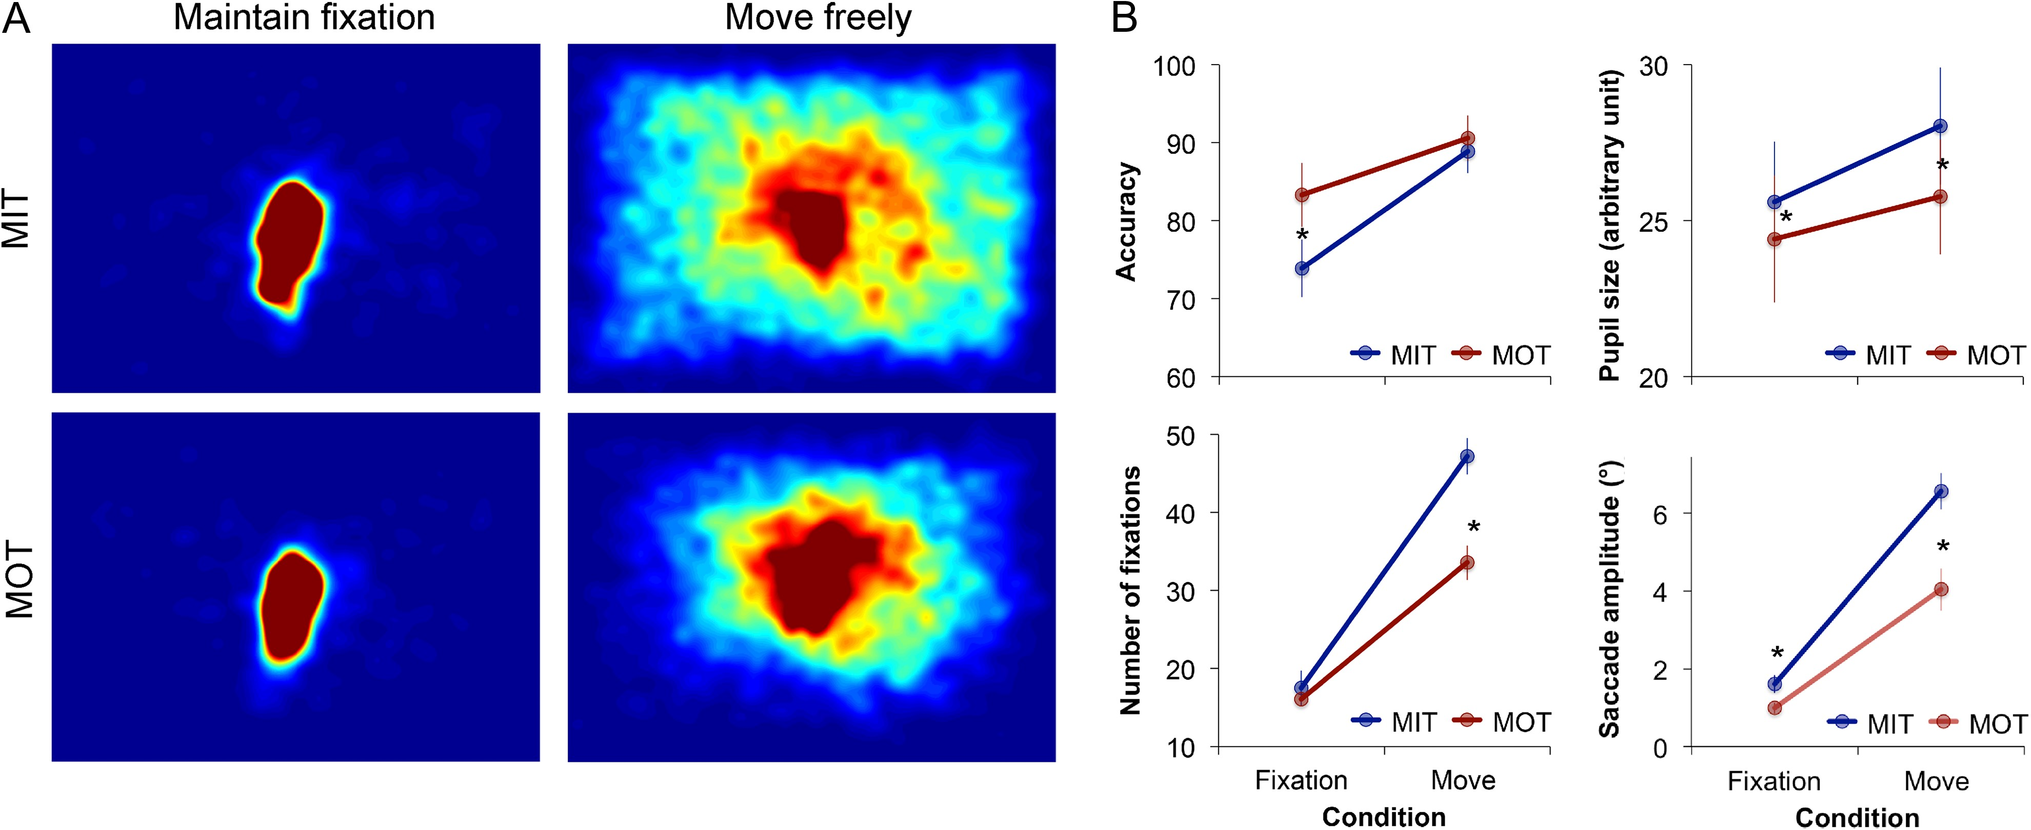
Figure 6. Tracking performance and eye movements in Experiment 2. Heatmaps (A) reveal that the fixation patterns during ...
Notes:
Figure 6. Tracking performance and eye movements in Experiment 2. Heatmaps (A) reveal that the fixation patterns during unconstrained viewing are more widely distributed in MIT than MOT. This effect is abolished when participants are instructed to maintain a fixation. Direct comparisons (B) revealed better performance in MOT than MIT, and increased cognitive load (indexed by pupil size), a greater number of fixations and longer saccades in MIT than MOT.
Unless provided in the caption above, the following copyright applies to the content of this slide: © The Author 2016. Published by Oxford University Press. This is an Open Access article distributed under the terms of the Creative Commons Attribution Non-Commercial License (http://creativecommons.org/licenses/by-nc/4.0/), which permits non-commercial re-use, distribution, and reproduction in any medium, provided the original work is properly cited. For commercial re-use, please contact journals.permissions@oup.com

Slide 7
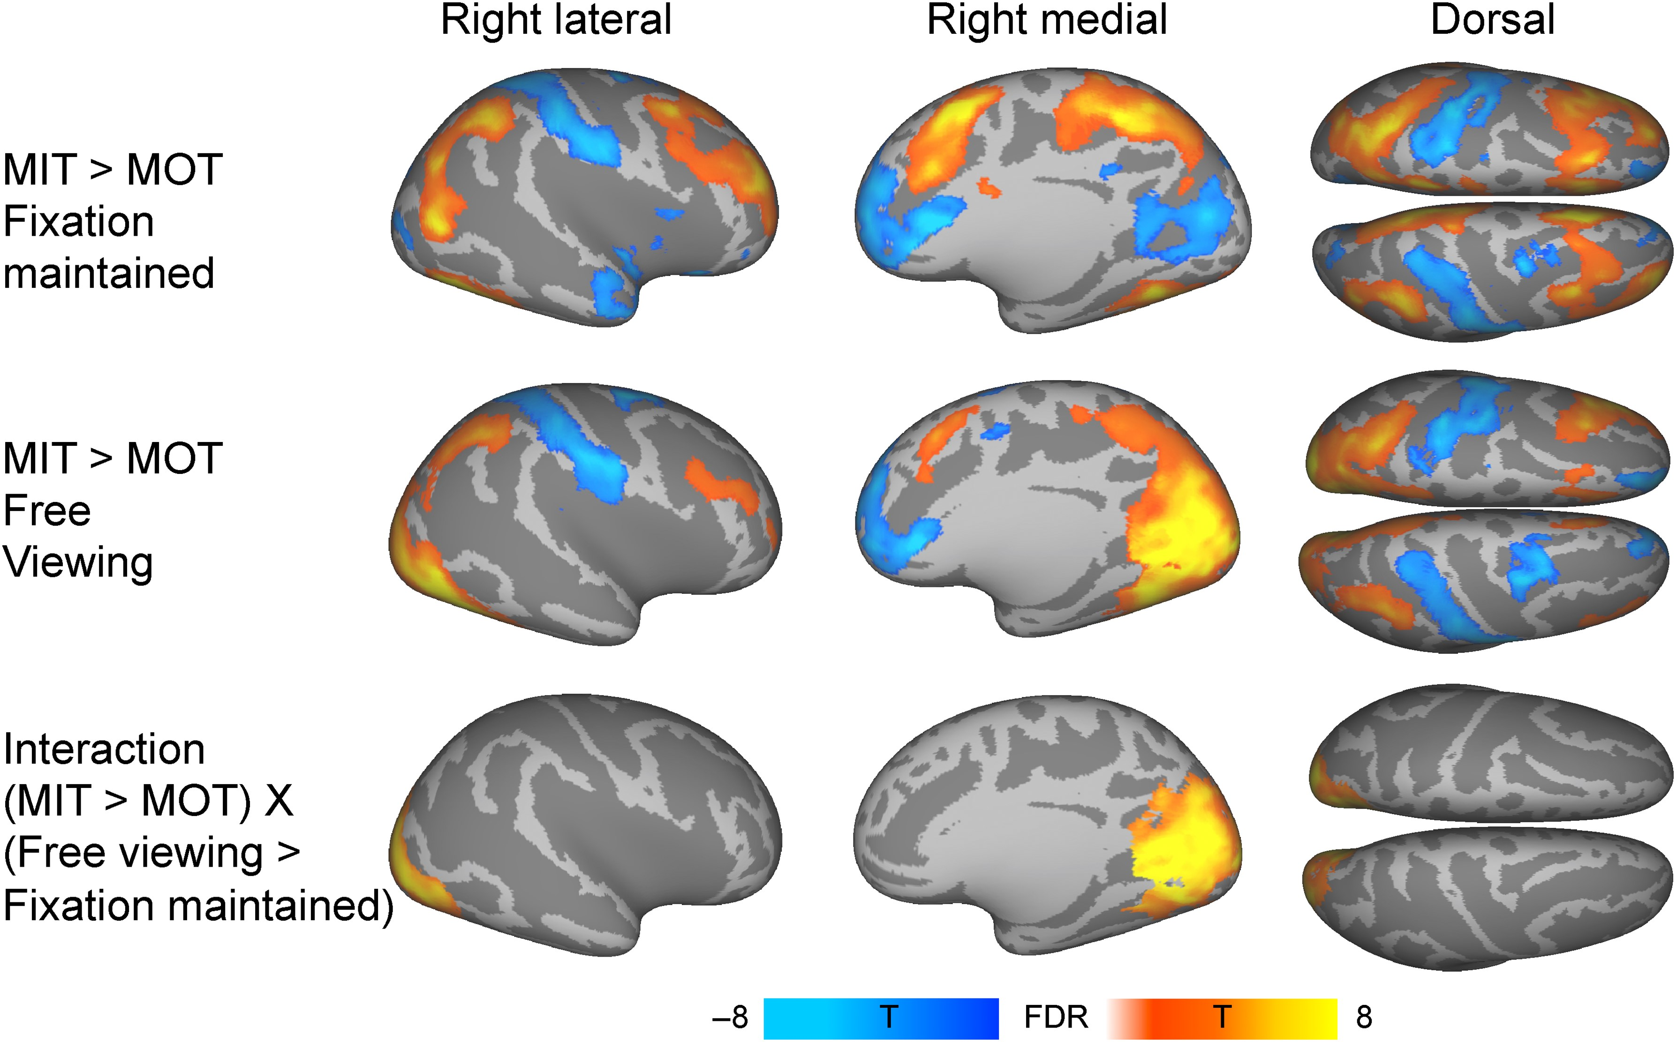
Figure 7. Brain regions showing larger response to MIT than MOT and vice versa while maintaining a fixation (top row) ...
Notes:
Figure 7. Brain regions showing larger response to MIT than MOT and vice versa while maintaining a fixation (top row) or moving eyes freely (middle row). Bottom row shows the regions whose increased activity in the MIT condition was contingent on eye movements. Colorbar denotes the t-statistic range. The data are plotted at P < 0.01, FDR corrected at cluster level.
Unless provided in the caption above, the following copyright applies to the content of this slide: © The Author 2016. Published by Oxford University Press. This is an Open Access article distributed under the terms of the Creative Commons Attribution Non-Commercial License (http://creativecommons.org/licenses/by-nc/4.0/), which permits non-commercial re-use, distribution, and reproduction in any medium, provided the original work is properly cited. For commercial re-use, please contact journals.permissions@oup.com

