Slide 1
Scheme 1 Overview of the proposed bioengineered pathway for the production of methanol from CO₂ utilizing a ...
Notes:
Scheme 1 Overview of the proposed bioengineered pathway for the production of methanol from CO2 utilizing a multi-step enzyme pathway.
Unless provided in the caption above, the following copyright applies to the content of this slide: © The Author 2017. Published by Oxford University Press. All rights reserved. For Permissions, please e-mail: journals.permissions@oup.com

Slide 2
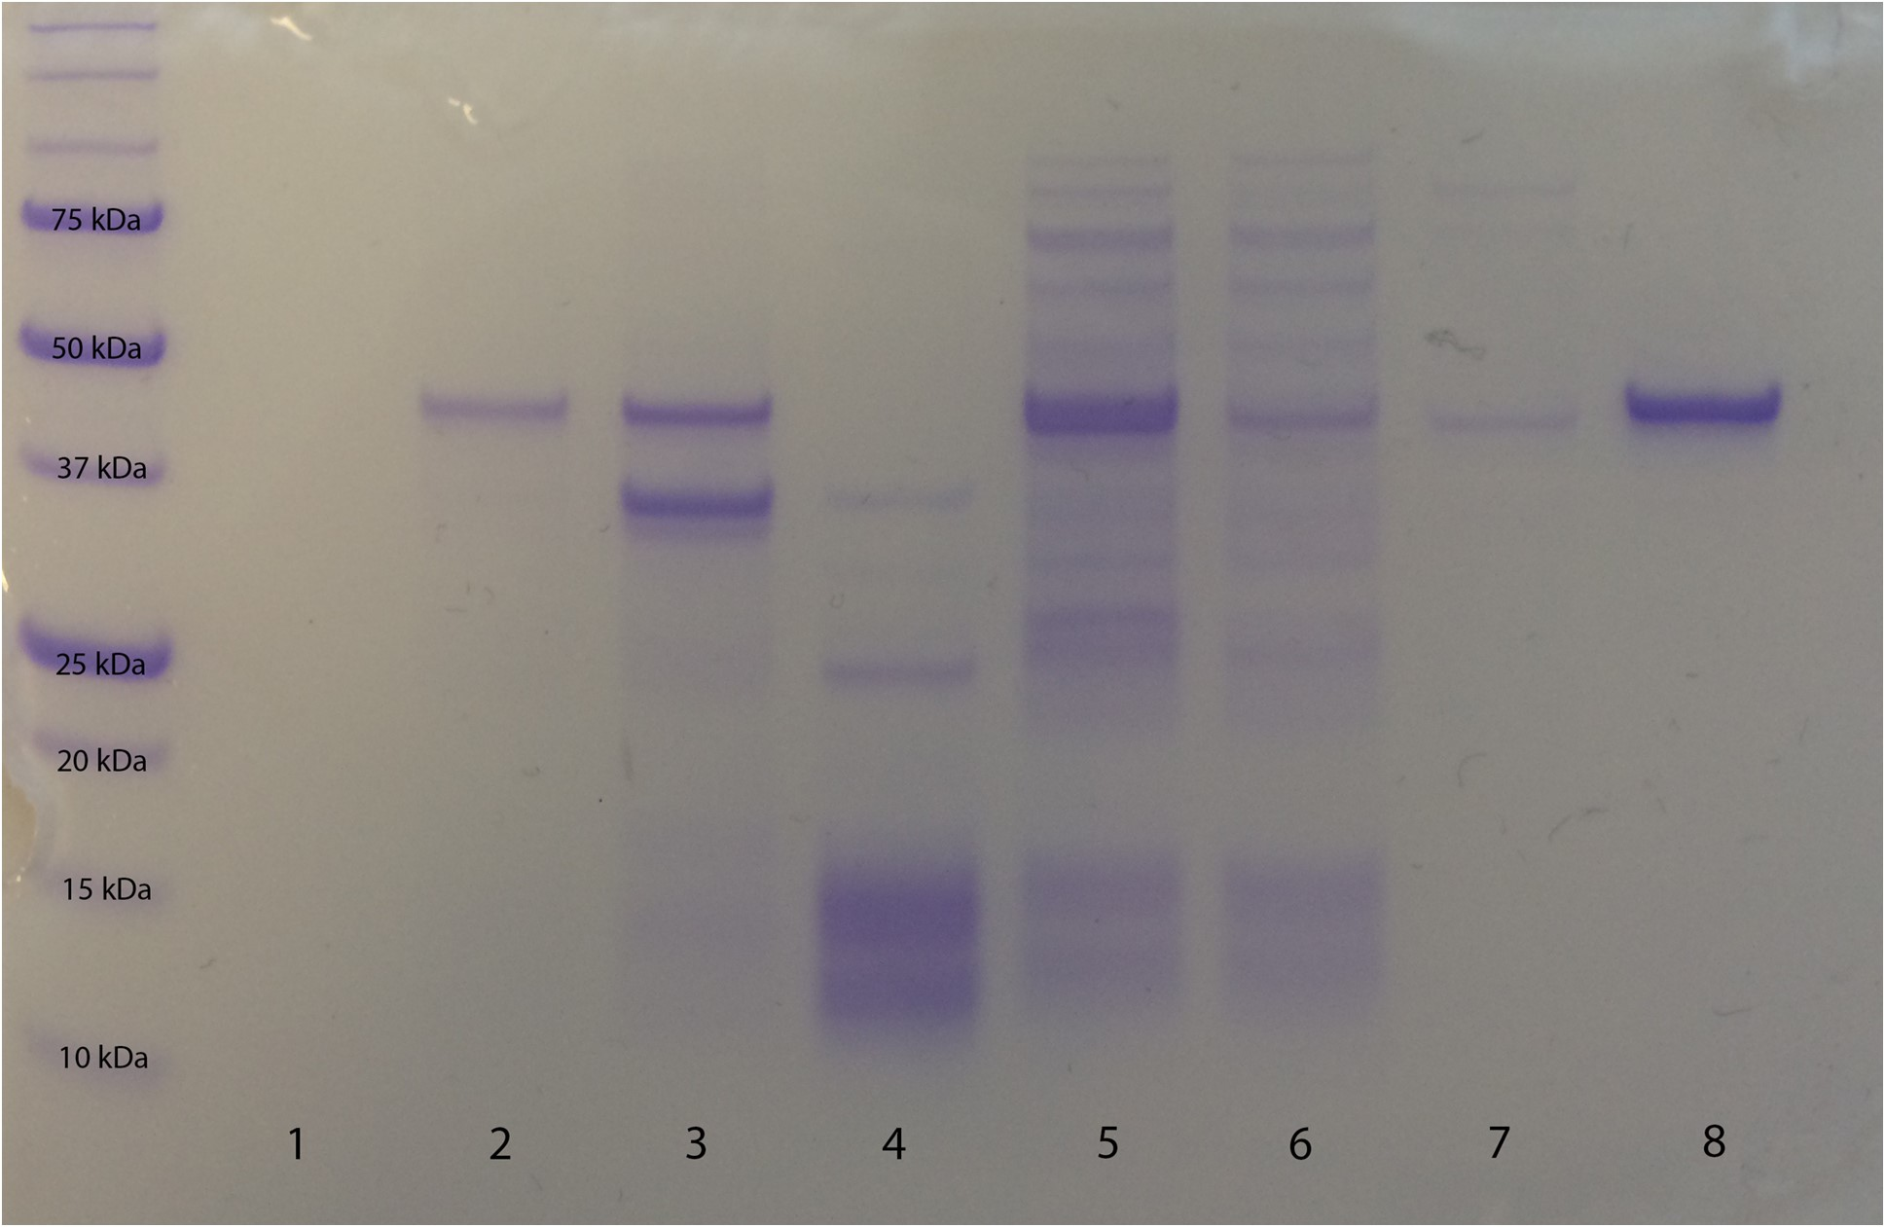
Fig. 1 SDS-PAGE analysis (10% acrylamide gel) of FDH-N at various stages of purification. FDH-N was expressed in E. ...
Notes:
Fig. 1 SDS-PAGE analysis (10% acrylamide gel) of FDH-N at various stages of purification. FDH-N was expressed in E. coli BL21(DE3). Lane 1− before IPTG induction; Lane 2− after IPTG induction; Lane 3− cell debris; Lane 4− after streptomycin sulfate precipitation; Lane 5− Ni-NTA column flow through; Lane 6− Ni-NTA column wash; Lane 7− before Q Sepharose column; Lane 8− after Q Sepharose column, final protein.
Unless provided in the caption above, the following copyright applies to the content of this slide: © The Author 2017. Published by Oxford University Press. All rights reserved. For Permissions, please e-mail: journals.permissions@oup.com

Slide 3
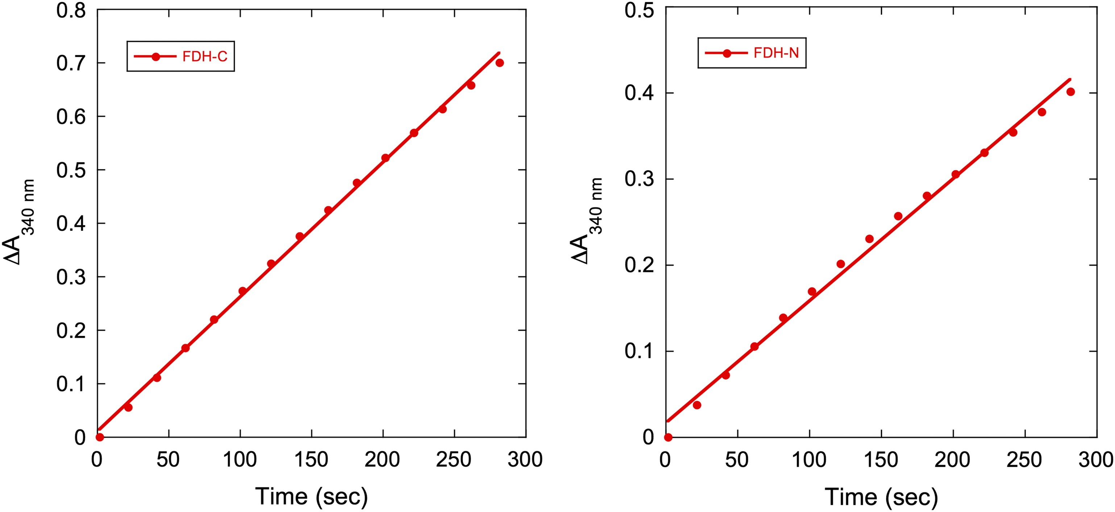
Fig. 2 The kinetic assay graph of FDH-C (0.5 μM, left) and FDH-N (0.1 μM, right) proteins measuring the conversion ...
Notes:
Fig. 2 The kinetic assay graph of FDH-C (0.5 μM, left) and FDH-N (0.1 μM, right) proteins measuring the conversion of NAD+ to NADH during the oxidation of sodium formate to carbon dioxide at pH 7. The specific activity of FDH-C is 1.1 U/mg and the specific activity of FDH-N is 2.7 U/mg.
Unless provided in the caption above, the following copyright applies to the content of this slide: © The Author 2017. Published by Oxford University Press. All rights reserved. For Permissions, please e-mail: journals.permissions@oup.com

Slide 4
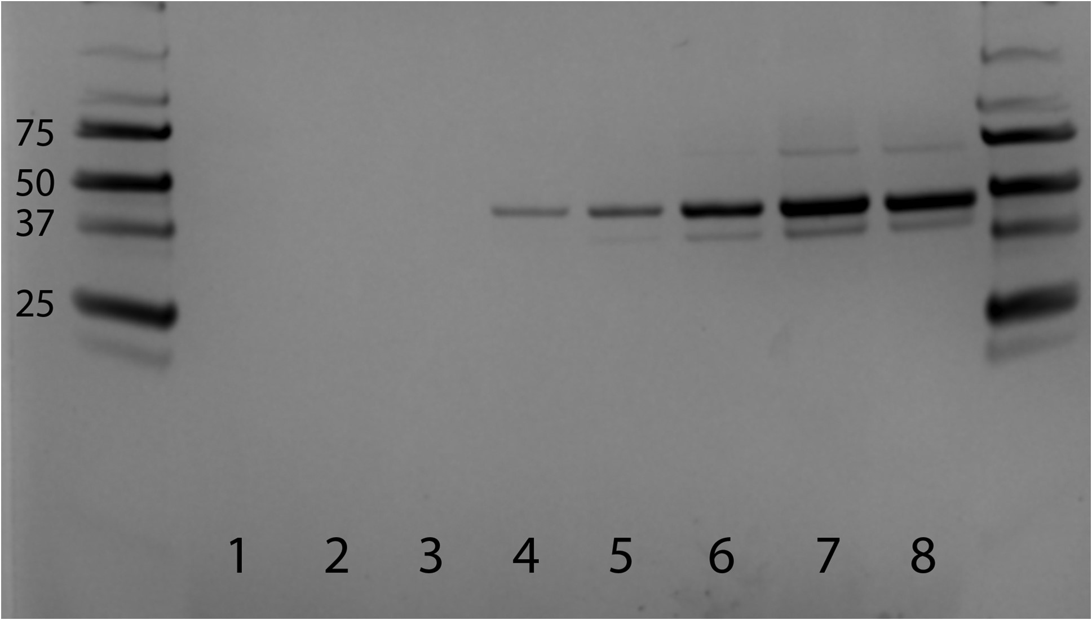
Fig. 3 SDS-PAGE (10% acrylamide) analysis of media after growing yeast with empty pPIC9 for 120 h (Lane 1); media ...
Notes:
Fig. 3 SDS-PAGE (10% acrylamide) analysis of media after growing yeast with empty pPIC9 for 120 h (Lane 1); media after growing yeast with FDH-C for 0 h (Lane 2), 8 h (Lane 3), 24 h (Lane 4), 48 h (Lane 5), 72 h (Lane 6), 96 h (Lane 7) and 120 h (Lane 8).
Unless provided in the caption above, the following copyright applies to the content of this slide: © The Author 2017. Published by Oxford University Press. All rights reserved. For Permissions, please e-mail: journals.permissions@oup.com

Slide 5
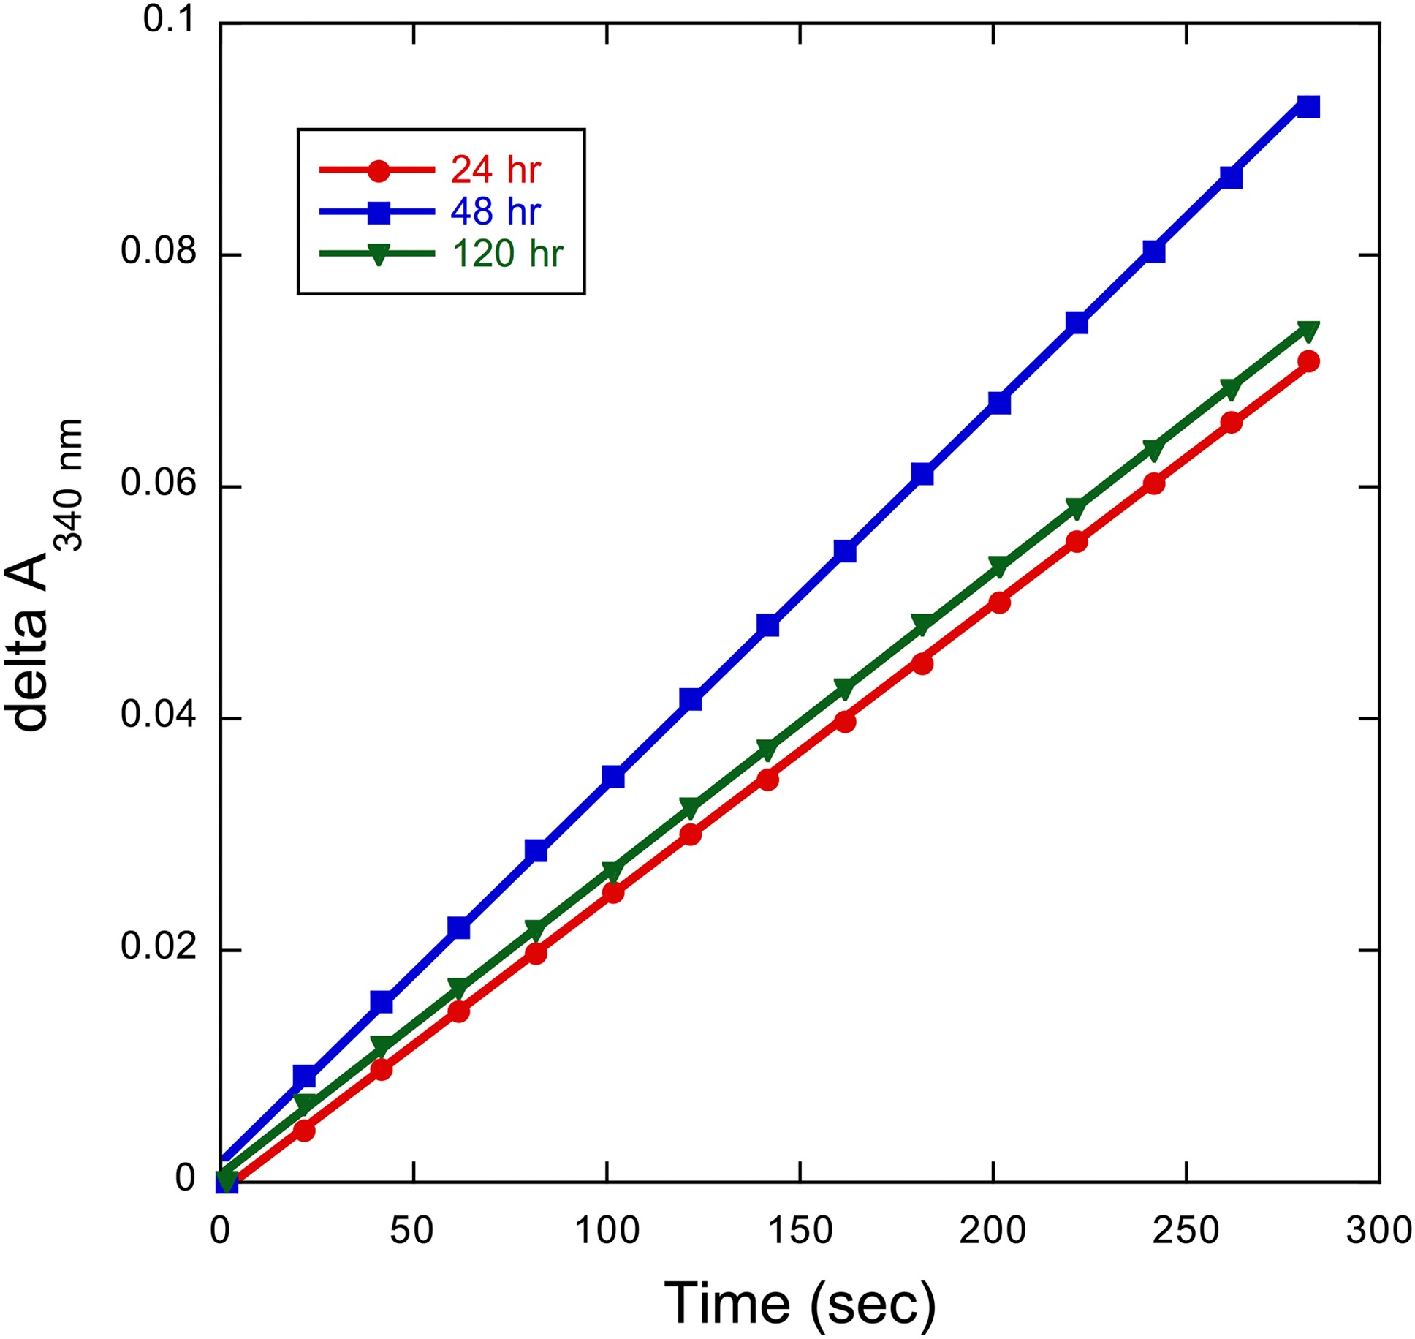
Fig. 4 The kinetic assay graphs measuring the conversion of NAD⁺ to NADH and the oxidation of sodium ...
Notes:
Fig. 4 The kinetic assay graphs measuring the conversion of NAD+ to NADH and the oxidation of sodium formate to carbon dioxide at pH 7 as catalyzed by secreted FDH-C protein (0.5 μM). The specific activity of FDH at 24 h is 0.11 U/mg, at 48 h is 0.13 U/mg and at 120 h is 0.10 U/mg.
Unless provided in the caption above, the following copyright applies to the content of this slide: © The Author 2017. Published by Oxford University Press. All rights reserved. For Permissions, please e-mail: journals.permissions@oup.com

Slide 6
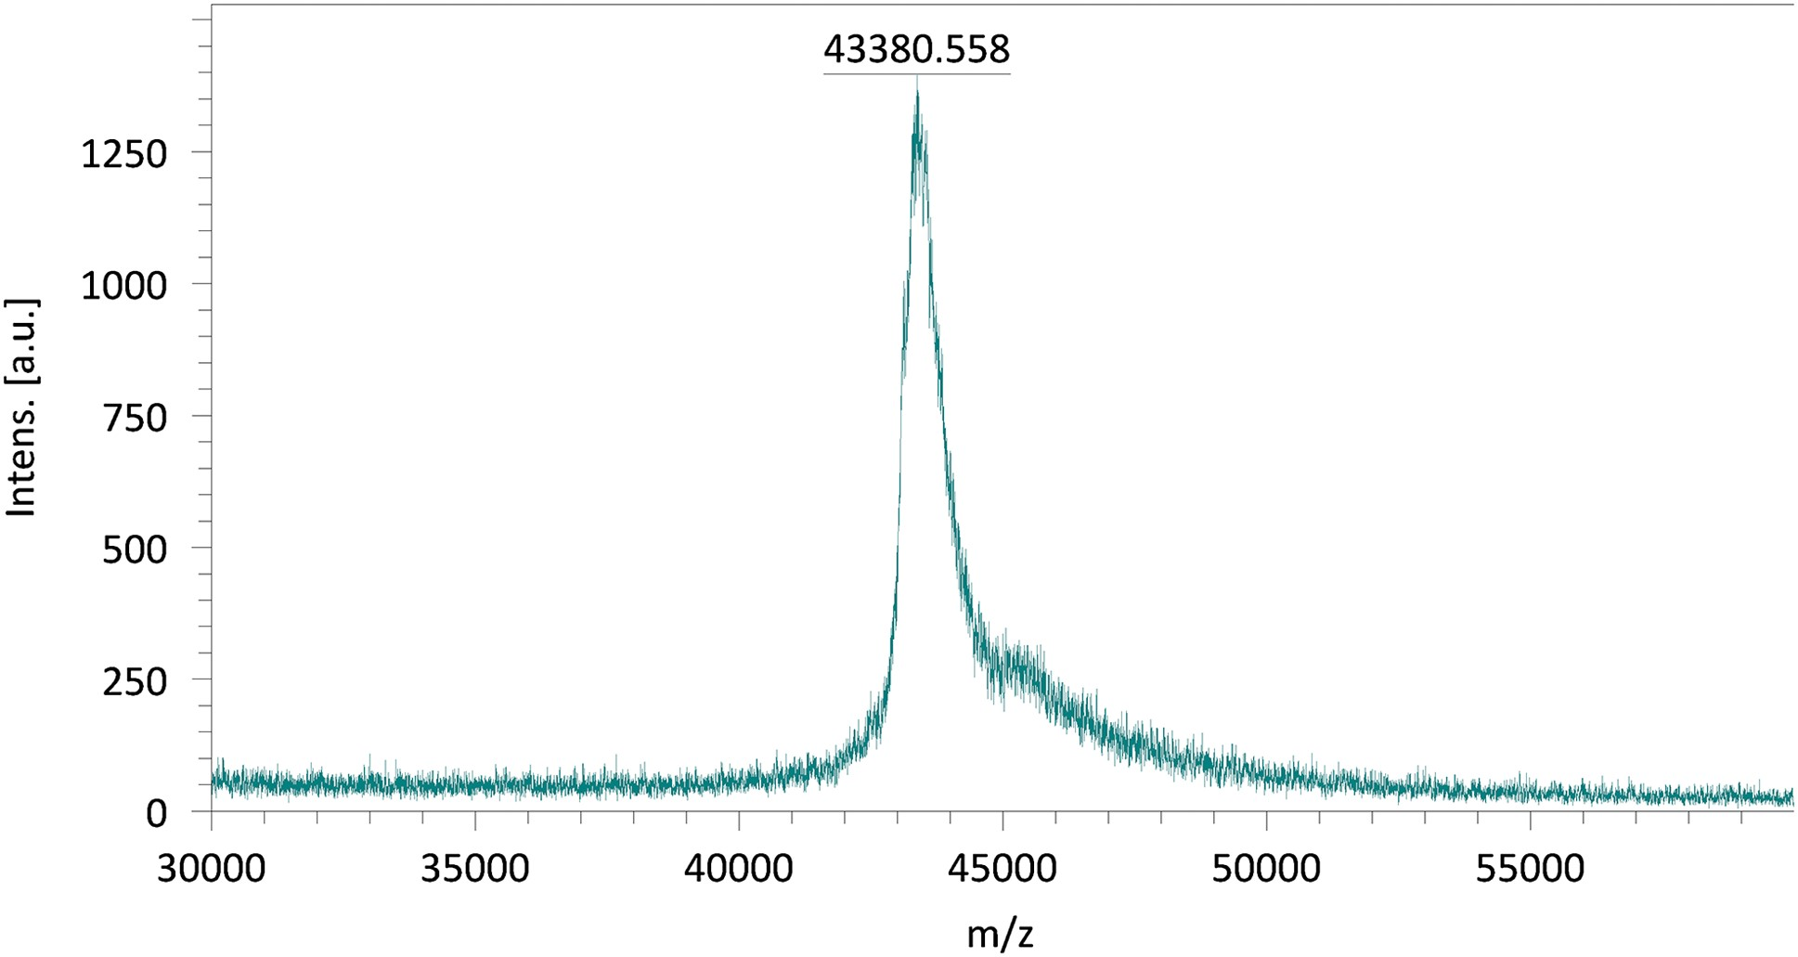
Fig. 5 MALDI-TOF spectrum of FDH-C secreted from P. pastoris. The calculated mass for the protein is 43.07 kDa.
Notes:
Fig. 5 MALDI-TOF spectrum of FDH-C secreted from P. pastoris. The calculated mass for the protein is 43.07 kDa.
Unless provided in the caption above, the following copyright applies to the content of this slide: © The Author 2017. Published by Oxford University Press. All rights reserved. For Permissions, please e-mail: journals.permissions@oup.com

Slide 7
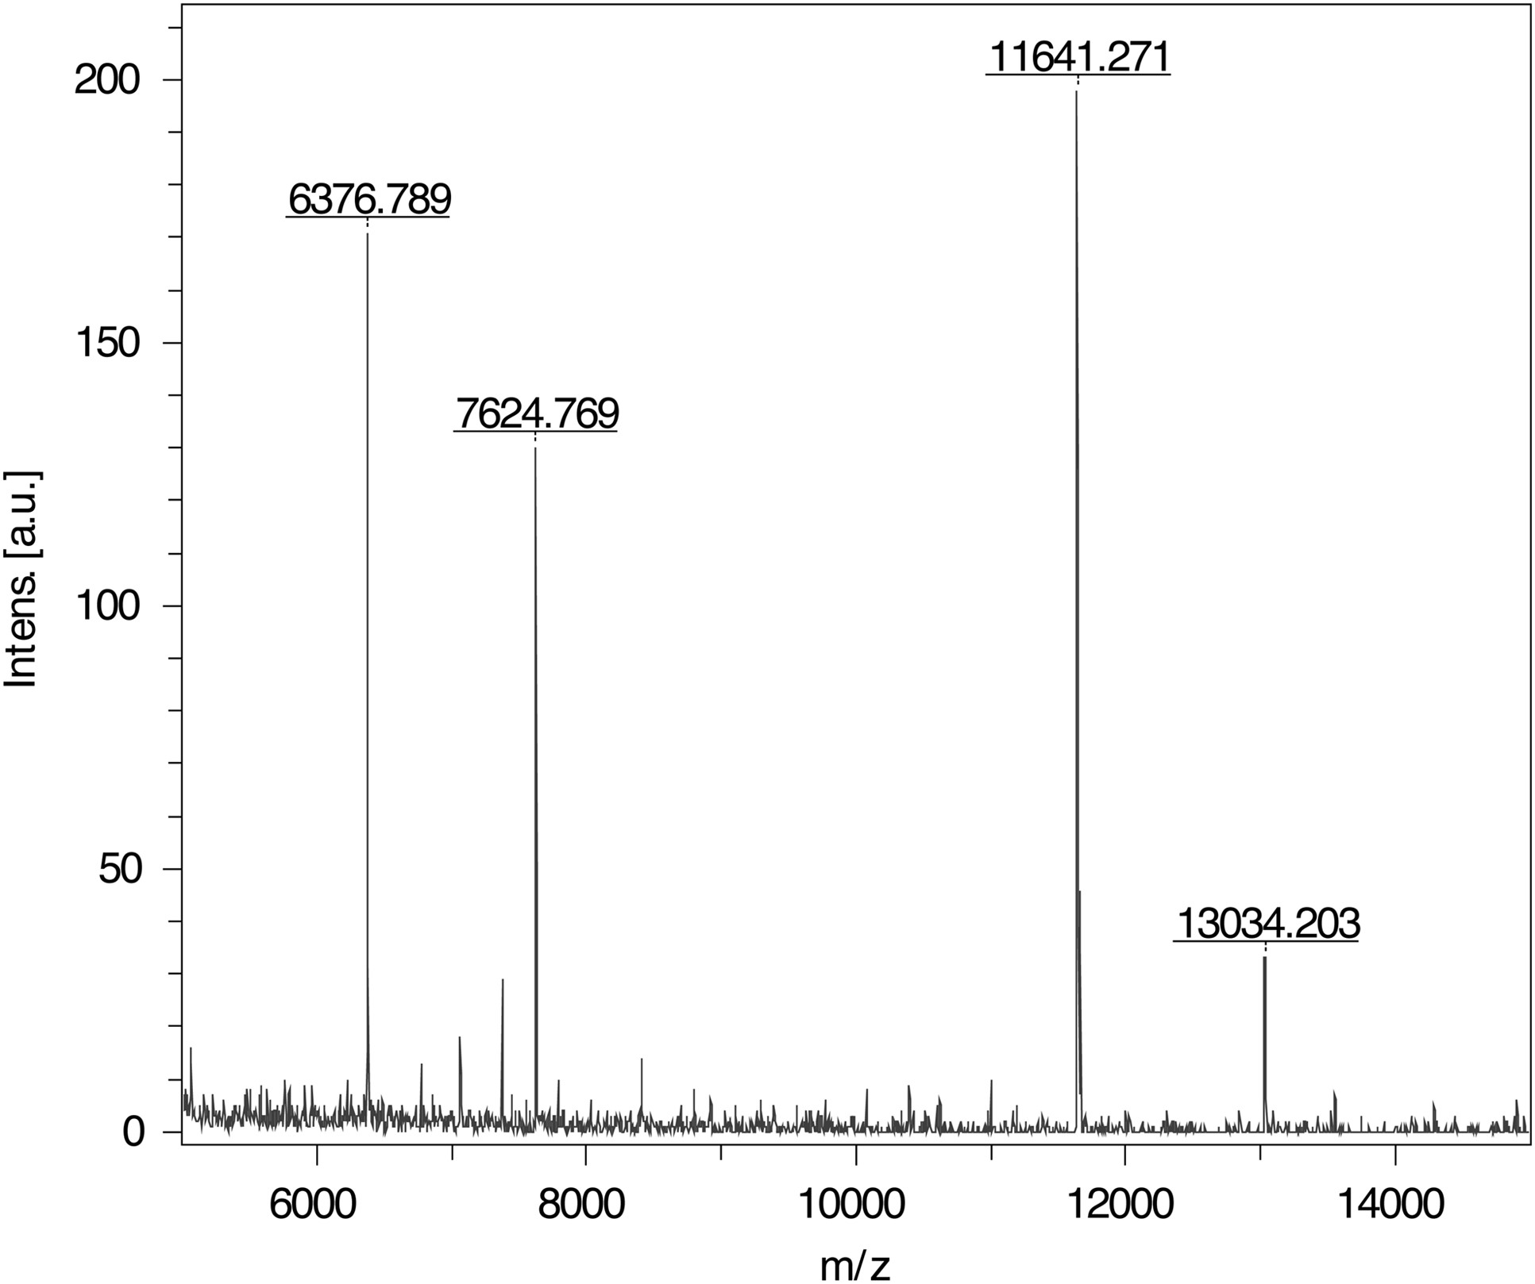
Fig. 6 MALDI-TOF spectrum of FDH-C secreted from P. pastoris after tryptic digestion. A peak at 7624 Da corresponds ...
Notes:
Fig. 6 MALDI-TOF spectrum of FDH-C secreted from P. pastoris after tryptic digestion. A peak at 7624 Da corresponds to a large fragment of α-factor.
Unless provided in the caption above, the following copyright applies to the content of this slide: © The Author 2017. Published by Oxford University Press. All rights reserved. For Permissions, please e-mail: journals.permissions@oup.com

