Slide 1
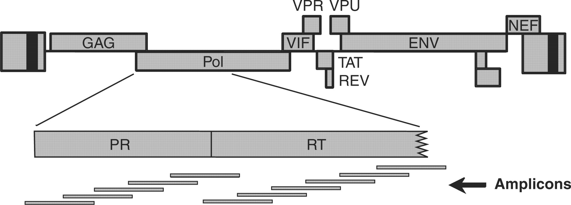
Figure 1. Amplicons querying positions of HIV drug resistance mutations in the PR and RT-coding regions. The HIV ...
Notes:
Figure 1. Amplicons querying positions of HIV drug resistance mutations in the PR and RT-coding regions. The HIV genetic map is shown at the top. Below is shown an expanded version of the segment of pol encoding PR and part of RT. At the bottom is shown the location of the amplicons used to interrogate positions of potential drug resistance mutations.
Unless provided in the caption above, the following copyright applies to the content of this slide: © 2007 The Author(s)This is an Open Access article distributed under the terms of the Creative Commons Attribution Non-Commercial License (http://creativecommons.org/licenses/by-nc/2.0/uk/) which permits unrestricted non-commercial use, distribution, and reproduction in any medium, provided the original work is properly cited.

Slide 2
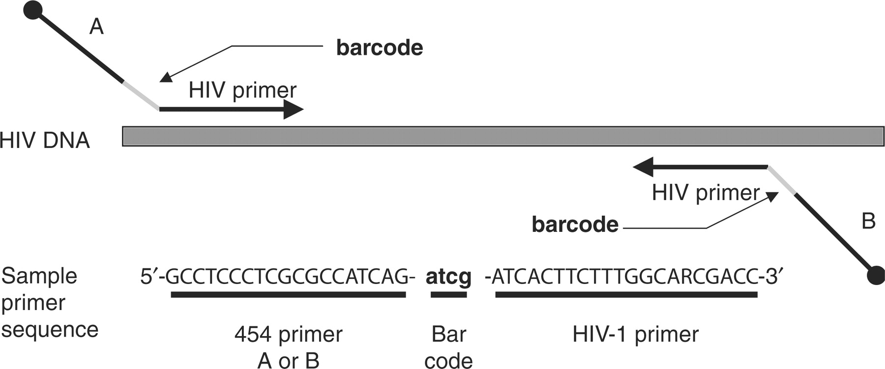
Figure 2. The DNA bar coding system. Primers are shown diagrammatically, illustrating the placement of the DNA bar code ...
Notes:
Figure 2. The DNA bar coding system. Primers are shown diagrammatically, illustrating the placement of the DNA bar code between the 454 primers (A and B) and the HIV-complementary sequences. An example of a primer sequence is shown at the bottom. DNA 5′ ends in the primers are shown as the black balls.
Unless provided in the caption above, the following copyright applies to the content of this slide: © 2007 The Author(s)This is an Open Access article distributed under the terms of the Creative Commons Attribution Non-Commercial License (http://creativecommons.org/licenses/by-nc/2.0/uk/) which permits unrestricted non-commercial use, distribution, and reproduction in any medium, provided the original work is properly cited.

Slide 3
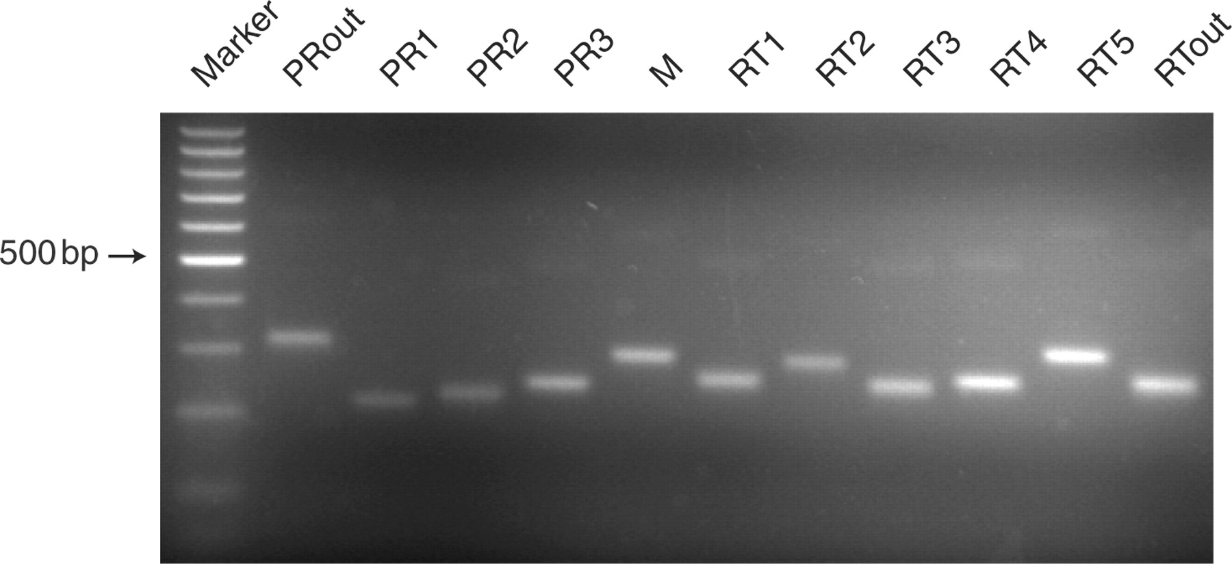
Figure 3. Amplification of HIV subtype C using the pan-HIV primer set. The figure shows products of RT-PCR reactions ...
Notes:
Figure 3. Amplification of HIV subtype C using the pan-HIV primer set. The figure shows products of RT-PCR reactions analyzed by agarose gel electrophoresis and ethidium bromide staining. The amplicons extend from the 5′ side of the PR-coding region (left) to an internal region of the RT-coding region (right), thereby covering all the known positions of drug resistance mutations in the PR and RT-coding regions (primer sequences are in Supplementary Table 1). The marker ladder has ‘steps’ of 100 bp. The position of the 500 bp fragment is marked.
Unless provided in the caption above, the following copyright applies to the content of this slide: © 2007 The Author(s)This is an Open Access article distributed under the terms of the Creative Commons Attribution Non-Commercial License (http://creativecommons.org/licenses/by-nc/2.0/uk/) which permits unrestricted non-commercial use, distribution, and reproduction in any medium, provided the original work is properly cited.

Slide 4
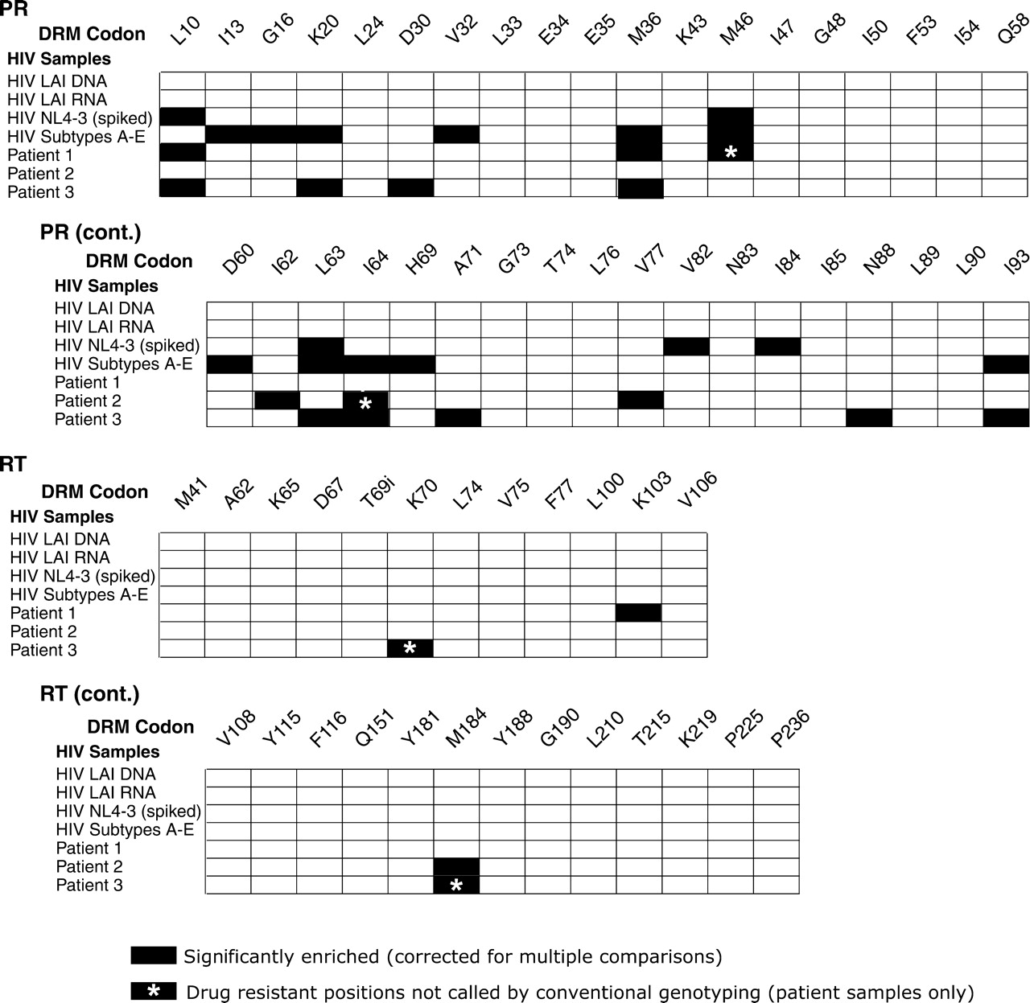
Figure 4. Summary of the drug resistance alleles detected. Results are shown for PR (top two grids) and RT (bottom two ...
Notes:
Figure 4. Summary of the drug resistance alleles detected. Results are shown for PR (top two grids) and RT (bottom two grids). The seven HIV samples studied are labeled to the left of each grid. The amino acid positions of drug-resistant mutations are marked at the top of the grid, labeled DRM for drug resistance mutation. Black tiles in the grid indicate positions that were significantly enriched for drug resistance mutations in the pyrosequencing data after correction for multiple comparisons. Raw counts are available in Supplementary Table 2. Black tiles with asterisks indicate positions that were enriched in drug resistance mutations in the pyrosequencing data that were not identified by a conventional genotyping method (Viroseq HIV Genotyping System v 2.0). The ‘i’ at RT position 69 denotes the insertions at this position that are known to confer drug resistance.
Unless provided in the caption above, the following copyright applies to the content of this slide: © 2007 The Author(s)This is an Open Access article distributed under the terms of the Creative Commons Attribution Non-Commercial License (http://creativecommons.org/licenses/by-nc/2.0/uk/) which permits unrestricted non-commercial use, distribution, and reproduction in any medium, provided the original work is properly cited.

